Slide 1
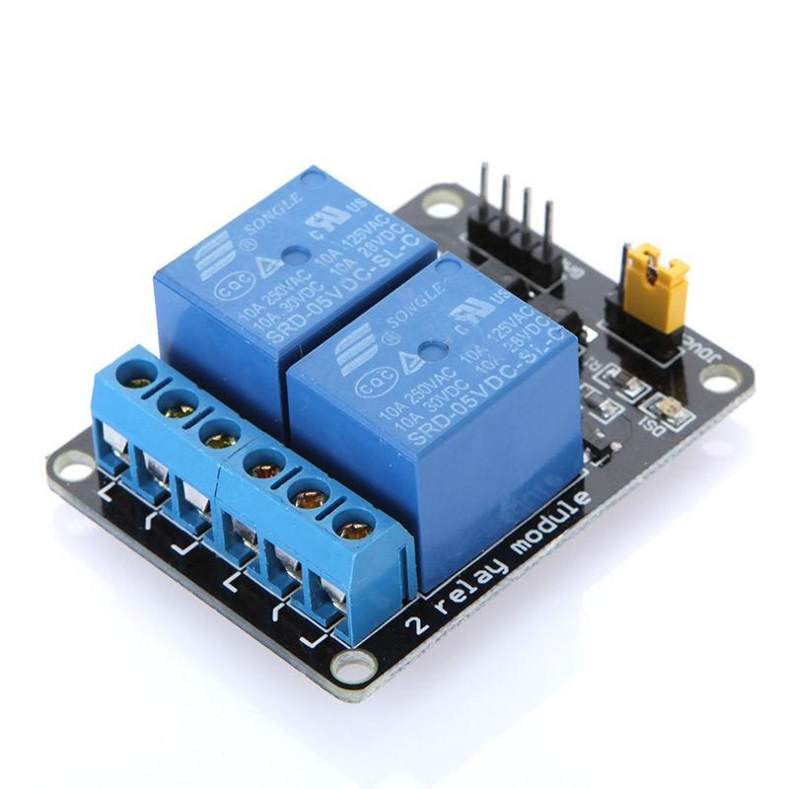
Interfacing of Two Channel Relay module
www.ablkart.com

Slide 2
Two Channel Relay
A Relay is defined as an electrically operated switch; their main use is controlling circuits by a low-power signal or when several circuits must be controlled by one signal. This module incorporates 2 relays.
www.ablkart.com

Slide 3
Working of Two Channel Relay
The relay has two outputs-normally open and normally closed (NO and NC). When the IN1 or IN2 pin is connected to ground, NO will be open and NC will be closed, and when IN1 or IN2 is not connected to ground the opposite occurs. Connecting a circuit or device between one of these two pins, the common pin on the relay output, and a power source will allow you to toggle power to a circuit or device.
Connect an LED and 220 ohm resistor in series between the NO pin (the right pin) on the terminal block on one of the relays and ground, then connect a 5V power source to the common pin (the left pin) on one of the relays. Nothing will happen (yet).
www.ablkart.com

Slide 4
Next connect a toggle switch or button between ground and one of the middle two pins on the header strip on the relay module. The middle-left one corresponds to the left relay, and the middle-right one corresponds to the right relay. Connect the rightmost pin to 5V and the leftmost pin to ground.
When the switch is flipped or the button is pressed, either IN1 or IN2 will become connected to ground. The relay should make a loud click and the LED should turn on. A microcontroller can also be used to control IN1 and/or IN2 and cause the relay to trip.
www.ablkart.com

Slide 5
Components Required:
Arduino Mega
Double channel relay module
LEDs
Resistor(220ohms)
USB Cable
Jumper wires
BreadBoard
www.ablkart.com

Slide 6
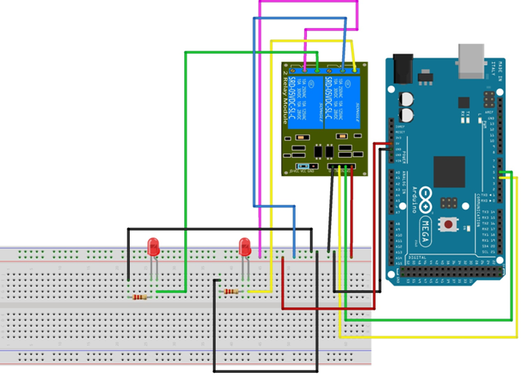
Connection Diagram
www.ablkart.com

Slide 7
Connections
Connect NO1 with LED’s positive pin through jumper wire.
Connect LED with resistor of 220ohm and connect LED’s negative pin with ground pin Arduino.
Connect COM1 pin with Vcc of Arduino.
Connect NO2 with another LED’s positive pin through jumper wire.
Connect LED with resistor of 220ohm and connect LED’s negative pin with ground pin Arduino.
Connect COM2 pin with Vcc of Arduino.
Connect GND pin of relay with GND pin of Arduino and Vcc pin with Vcc(+5V) of Arduino.
Now connect INT1 pin with 4 pin of Arduino.
Then connect INT2 pin with 5 pin of Arduino.
www.ablkart.com

Slide 8
Project Link : https://youtu.be/HTRnEjv5Ewo
www.ablkart.com

