Slide 1
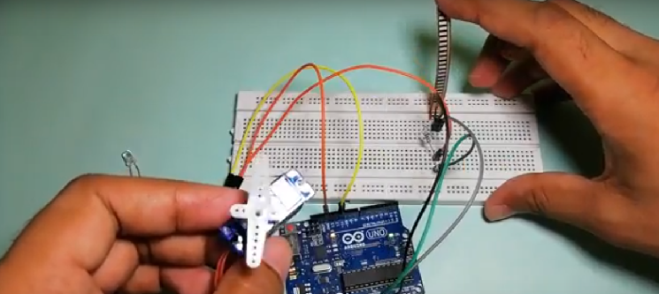
Automatic door lock system using Flex sensor
www.ableducation.com
www.ablkart.com

Slide 2
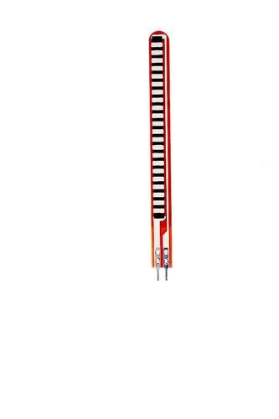
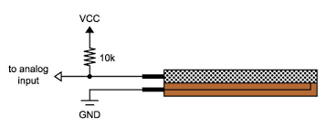
Flex sensor
A Flex sensor or Bend sensor is a sensor that measures the amount of deflection or bending . Usually, the sensor is stuck to the surface, and resistance of sensor element is varied by bending the surface. Since the resistance is directly proportional to the amount of bend it is used as goniometer, and often called flexible potentiometer.
www.ableducation.com
www.ablkart.com

Slide 3
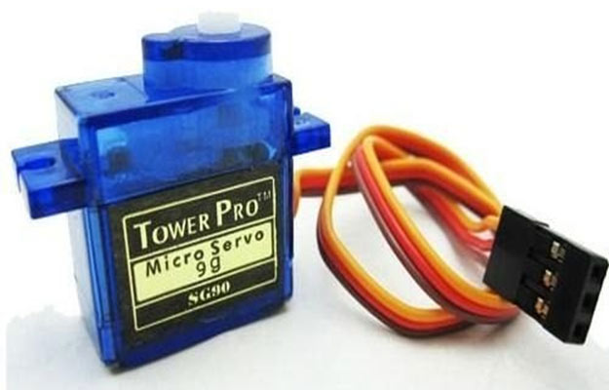
Servo Motor
A Servo motor is an electrical device which can push or rotate an object with great precision. If you want to rotate and object at some specific angles or distance, then you use servo motor. It is just made up of simple motor which run through servo mechanism.
It consists of three parts:
Controlled device
Output sensor
Feedback system
www.ableducation.com
www.ablkart.com

Slide 4

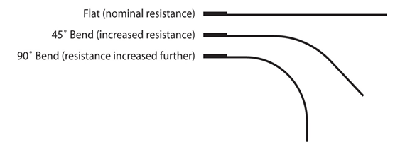
Working of project
In this project we have interfaced Flex sensor with Servo motor and Arduino Mega. Objective behind this project is to make automatic door lock attached with Servo motor which is automatically controlled by flex sensor. Flex sensor is bled at different angles according to which gate will open.
www.ableducation.com
www.ablkart.com

Slide 5
Components Required
Arduino Mega
Flex Sensor
Servo Motor
LED
BreadBoard
Resistor 10kohms
Jumper wires
www.ableducation.com
www.ablkart.com

Slide 6
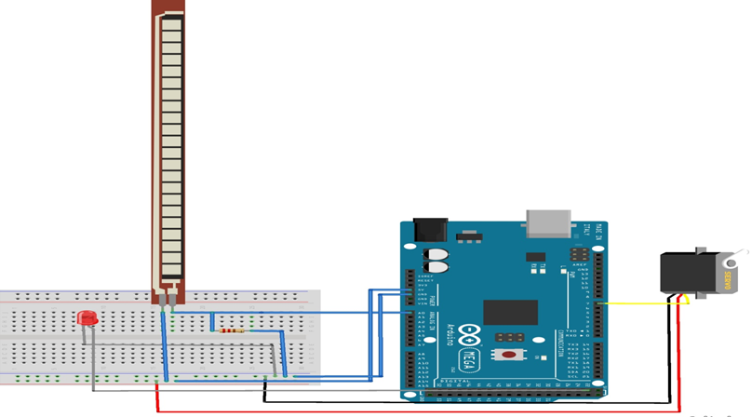
Connection Diagram
www.ableducation.com
www.ablkart.com

Slide 7
Connections
Connect first pin of flex sensor with A0 of Arduino.
Connect first pin again with resistor of 10k and then connect resistor with ground pin of Arduino.
Connect another pin of flex sensor with Vcc (+5V ) of Arduino.
Now connect positive of LED with 22 pin of Arduino.
Connect negative of LED with ground of Arduino.
Connect Red wire of servo with Vcc(+5V) of Arduino.
Connect Black wire of servo with GND of Arduino.
Connect orange wire of servo with 7 pin Arduino.
www.ableducation.com
www.ablkart.com

Slide 8
Project Link : https://youtu.be/IdkIHfCM2pw
www.ableducation.com
www.ablkart.com

