Slide 1
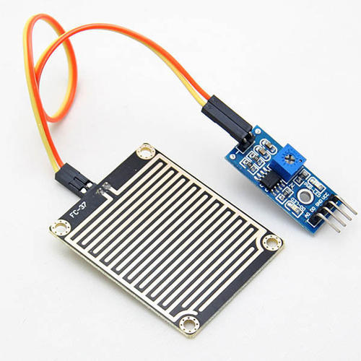
Interfacing of Raindrop Sensor
www.ablkart.com

Slide 2
Raindrop sensor
The Raindrop sensor module is used for rain detection. It is also for measuring rainfall intensity.
The module includes a rain board and a control board that are separate for more convenience. It has a power indicator LED and an adjustable sensitivity though a potentiometer.
www.ablkart.com

Slide 3
Concept of Raindrop Sensor
The module is based on the LM393 op amp. It includes a printed circuit board(control board) that “collects” the rain drops. As rain drops are collected on the circuit board, they create paths of parallel resistance that are measured via the op amp.
The lower the resistance (or the more water), the lower the voltage output. Conversely, the less water, the greater the output voltage on the analog pin. A completely dry board for example will cause the module to output five volts.
www.ablkart.com

Slide 4
Working of Raindrop Sensor
In this project basically raindrop sensor senses rain when comes, LED will blink.
A Rain sensor or Rain switch is a switching device activated by rainfall.
As rain drops are collected on the circuit board, they create paths of parallel resistance that are measured via the opamp.
www.ablkart.com

Slide 5
Components required
Arduino Mega
Raindrop sensor
LED
Breadboard
Jumper wires
www.ablkart.com

Slide 6
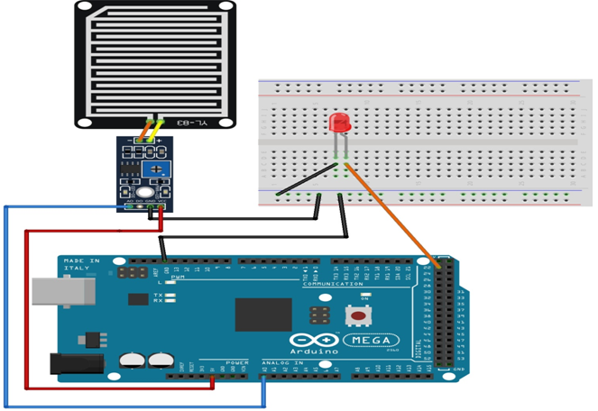
Connection Diagram
www.ablkart.com

Slide 7
Connections
Connect A0 pin of raindrop sensor with A0 pin of Arduino.
Connect Vcc of sensor with +5V of Arduino.
Connect GND of sensor with GND Arduino.
Connect LED’s positive with 22 pin of Arduino and negative pin with GND pin of Arduino.
www.ablkart.com

Slide 8
Project Link : https://youtu.be/tBHTN_bPIrM
www.ablkart.com

