Slide 1
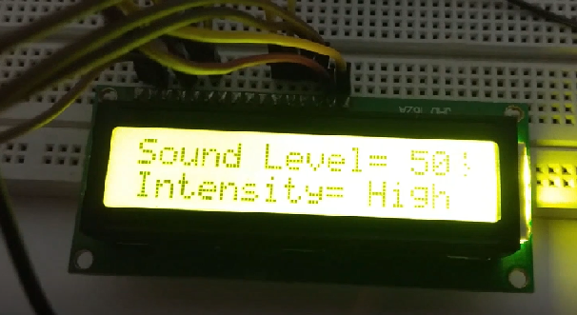
Sound Level and Intensity Measurement
www.ablkart.com

Slide 2
Sound sensor
The Sound sensor module provides an easy way to detect sound and is generally used for detecting sound intensity.
When the sensor detects a sound, it processes an output signal voltage which is sent to a microcontroller then performs necessary processing.
The Sound Detector is a small board that combines a microphone and some processing circuitry. It provides not only an audio output, but also a binary indication of the presence of sound, and an analog representation of it's amplitude.
www.ablkart.com

Slide 3
Working of project
It is using Sound Module & Arduino with LCD Display has been designed specifically for detecting the level of sound produced from any source and its intensity as well. The LCD panel directly displays the information about sound level in numbers. The sound is distinguished as low, medium and high level on the basis of intensity of LED glow.
www.ablkart.com

Slide 4
Components required
Arduino Mega
Sound sensor module
16x2 LCD display
Potentiometer
USB cable
Breadboard
Jumper wires(male to male)
www.ablkart.com

Slide 5
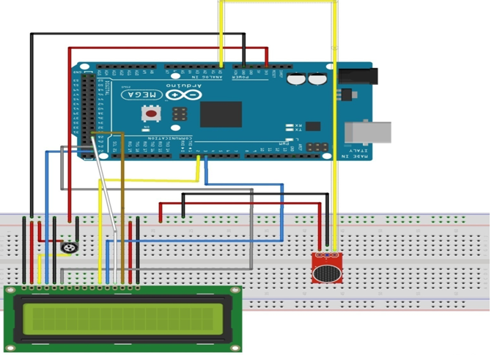
Connection Diagram
www.ablkart.com

Slide 6
Sound sensor connections :
Connect A0 pin of sound sensor with A0 pin of Arduino Mega.
Connect Vcc pin of sound sensor with Arduino +5V .
Connect GND pin of sound sensor with Arduino GND pin.
www.ablkart.com

Slide 7
Connections for LCD :
PIN1 or Vss to ground
PIN2 or Vdd or Vcc to +5V power
PIN3 or Vee to potentiometer (gives maximum contrast best for a beginner)
PIN4 or RS (Register Selection) to PIN22 of Arduino
PIN5 or RW (Read/Write) to ground
PIN6 or E (Enable) to PIN24 of Arduino
PIN11 or D4 to PIN2 of Arduino
PIN12 or D5 to PIN3 of Arduino
PIN13 or D6 to PIN28 of Arduino
PIN14 or D7 to PIN30 of Arduino
PIN15 or A to +5V of Arduino
PIN16 or K to GND of Arduino
www.ablkart.com

Slide 8
Project Link : https://youtu.be/nqSxk2alUuk
www.ablkart.com

