Slide 1
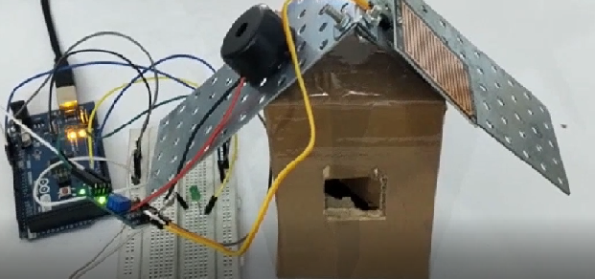
Automatic Rain Alarm Detector
www.ablkart.com

Slide 2
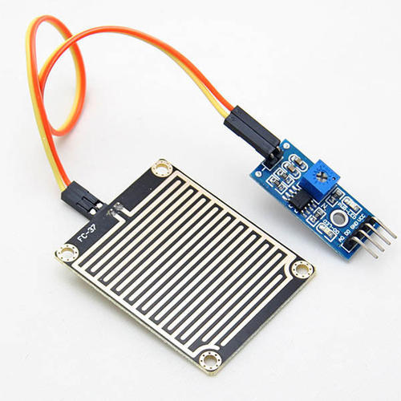
Raindrop sensor
The Raindrop sensor module is used for rain detection. It is also for measuring rainfall intensity.
The module includes a rain board and a control board that are separate for more convenience. It has a power indicator LED and an adjustable sensitivity though a potentiometer.
www.ablkart.com

Slide 3
Working of project
In this project basically raindrop sensor senses rain when comes ,buzzer will create alarm as rain alarm detector.
A Raindrop sensor or rain switch is a switching device activated by rainfall.
As rain drops are collected on the circuit board, they create paths of parallel resistance that are measured via the op amp.
www.ablkart.com

Slide 4
Components required
Arduino Mega
Raindrop sensor
Buzzer
LED
Breadboard
Jumper wires
www.ablkart.com

Slide 5
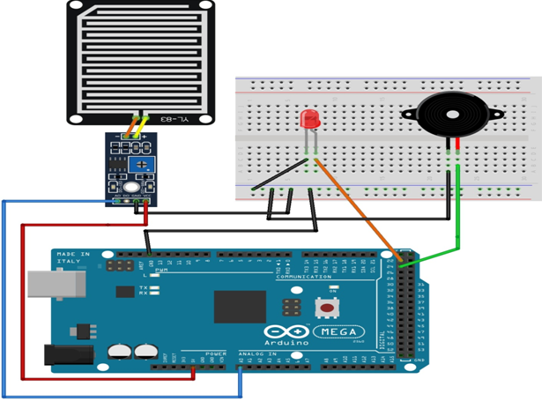
Connection Diagram
www.ablkart.com

Slide 6
Connections
Connect A0 pin of raindrop sensor with A0 pin of Arduino.
Connect Vcc of sensor with +5V of Arduino.
Connect GND of sensor with GND Arduino.
Connect buzzer’s positive pin with 24 pin of Arduino and negative pin with GND pin of Arduino.
Connect LED’s positive with 22 pin of Arduino and negative pin with GND pin of Arduino.
www.ablkart.com

Slide 7
Project Link : https://youtu.be/0BnZ33z5ZtI
www.ablkart.com

