Slide 1
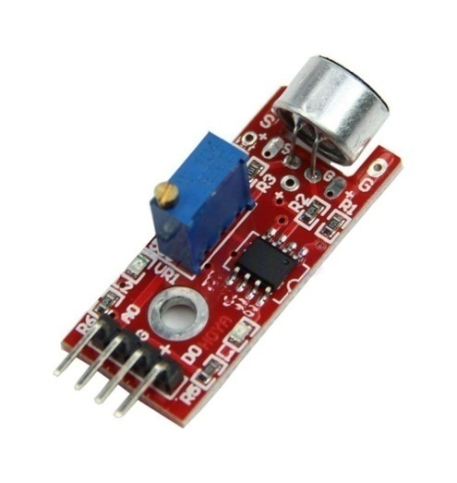
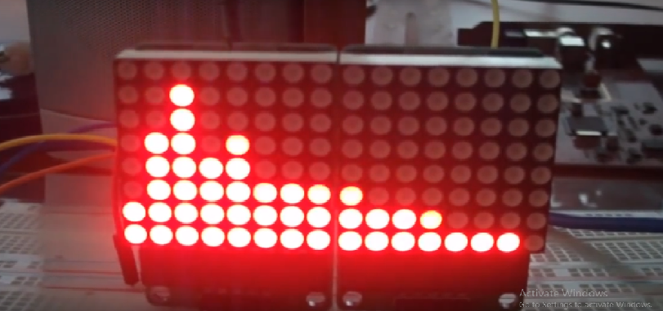
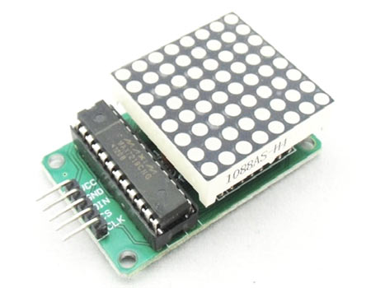
Spectrum Analyzer using LED matrix and Sound Sensor
www.ablkart.com

Slide 2
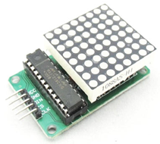
What is 8x8 LED matrix
An 8 x 8 LED matrix display is used in this project to display the information. LED matrices are available in different styles like single color, dual color, multi-color or RGB LED matrix.
They are also available in different dimensions like 5 x 7, 8 x 8, 16 x 16, 32 x 32 etc. Based on the arrangement of the LEDs in the matrix, an LED matrix can be either common row anode or common row cathode.
In case of common row anode type LED matrix, the current sources (high or positive voltage) are given to the rows A-D and the current sinks (low or negative voltage or ground) are given to the columns 1-4.
www.ablkart.com

Slide 3
In case of common row cathode type LED matrix, the current sources (high or positive voltage) are given to the columns 1-4 and the current sinks (low or negative voltage or ground) are given to the rows A-D.
IC MAX 7219
The LED matrix can be driven in two ways. They are parallel (where each row or column are sent with parallel data) and serial (where the data is sent serially and an IC is used to convert this serial data into parallel data).
MAX 7219 is a common cathode display driver with serial input and parallel output. It is used to interface microprocessors and microcontrollers with 64 individual LEDs (8 x 8 LED matrix for example has 64 LEDs), seven segment LED displays up to 8 digits or bar graph displays.
www.ablkart.com

Slide 4
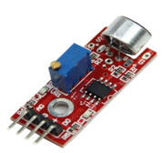
Sound sensor
The Sound sensor module provides an easy way to detect sound and is generally used for detecting sound intensity.
When the sensor detects a sound, it processes an output signal voltage which is sent to a microcontroller then performs necessary processing.
The Sound Detector is a small board that combines a microphone and some processing circuitry. It provides not only an audio output, but also a binary indication of the presence of sound, and an analog representation of it's amplitude.
www.ablkart.com

Slide 5
Working of project
A Spectrum Analyzer is determine by direct observation of the bandwidth of a digital or analog signal. Here analog signal is given by sound sensor and according to sensors’s signal, output will display on 8x8LED matrix.
www.ablkart.com

Slide 6
Components Required:
Arduino Mega
8x8 LED Matrix
Breadboard
USB Cable
Jumper wires
BreadBoard
www.ablkart.com

Slide 7
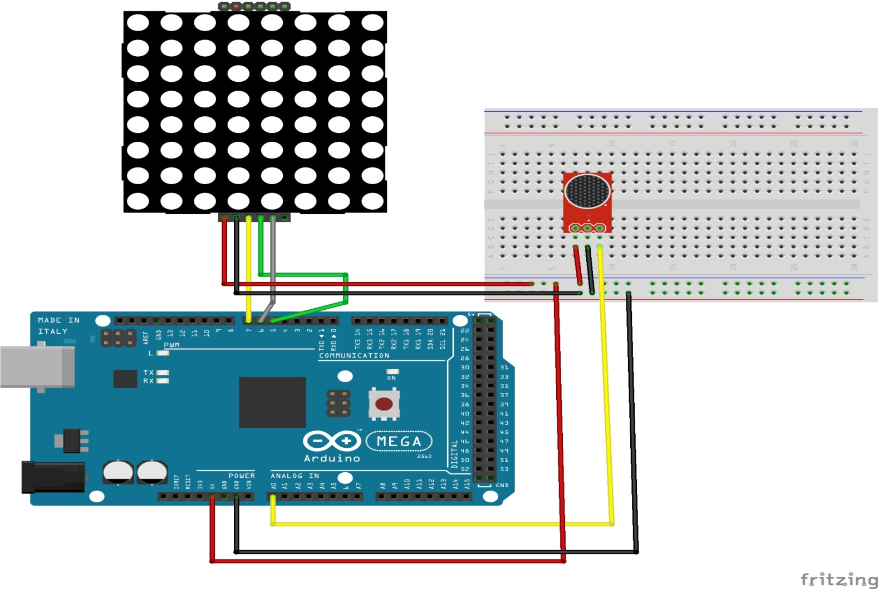
Connection Diagram
www.ablkart.com

Slide 8
Connections
Connect Vcc to +5V of Arduino.
Connect GND with GND pin of Arduino.
Connect DIN with 7 pin of Arduino.
Connect CLK with 6 pin of Arduino.
Connect CS with 5 pin of Arduino.
Connect A0 pin of sound sensor with A0 pin of Arduino Mega.
Connect Vcc and GND(ground) pin of sound sensor with Arduino 5V and GND respectively.
www.ablkart.com

Slide 9
Project Link : https://youtu.be/czl8uJI47bU
www.ablkart.com

