Slide 1








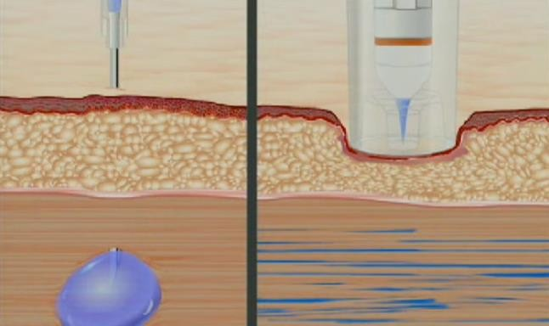
Medication reminders are needed to ensure that people take their medication as prescribed by their healthcare provider. This is important because taking medication at the right time and in the right dosage can help improve treatment outcomes and prevent potential complications.
Additionally, this band can be especially helpful for individuals who have difficulty remembering to take their medication, such as older adults or those with cognitive impairments.
A Band with a pressurized injection system that essentially injects medicine from a vial directly into the bloodstream (multiple times per day).
(don’t really know if this is viable since medicines need to go to specific places in our body and putting it in our veins sends it everywhere. might have side effects.)
basically, there is a 0.5ml container of medicine in the band and a highly pressurized nozzle system that should be able to do intramuscular and subcutaneous injections of medicines or vaccines without a needle by basically using pressurized medicine (liquid) to penetrate the skin.
since it is pressurized and released directly into the subcutaneous layer, it will take the path of least resistance, distributing evenly throughout the muscular tissue unlike what would happen if there was a normal injection (medicine would form a pool/blob thing).
(regular injection vs. pressurized injection)

Slide 2
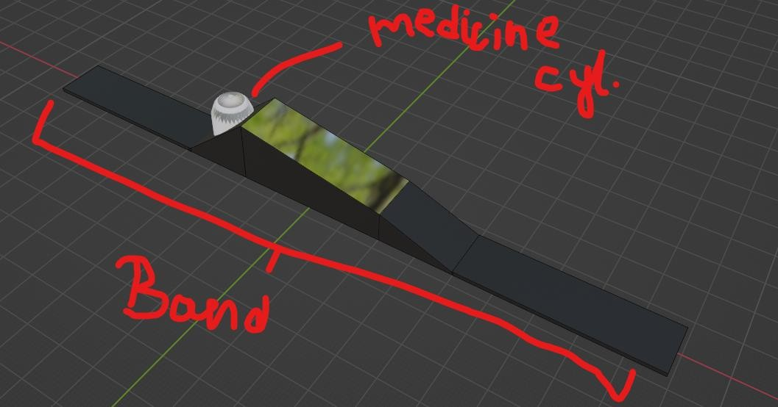



So instead of making a pressurizing system in the watch,
(too complicated, I don’t know how a compressor would fit in a band the width of like 3cm)
the container in which the medicine is contained will already have pressurized medicine. (similar to pressurized gas in cylinders).
The band will have a display that displays the things a SmartBand displays (time, SpO2 etc.), BUT it will have an additional “charge” level where-in it will show you when to replace the container of medicine and how much medicine is left.
(container volume can be tweaked later. there should be just enough volume so that it isn’t obstructive but can do a week’s worth of medicine so that it can be replaced on weekends by the elderly if they remember or their family members.)
Also, the watch should vibrate and display a message when its about to do an injection (like 10 min before) so that it doesn’t happen suddenly and shock the person and/or hamper what they are doing (imagine if they’re driving a car… very unsafe).

Slide 3









People get the correct dosage of medicine at the correct time.
Elderly people get medicated automatically (they don’t have to remember)
Children who require it may be happier/won’t cry because there is no “big and scary” needle.
If the “medication system” thing doesn’t work out you still get a cool watch.
Cheap to manufacture since all the “work” (pressurization) is already done.
Band needs to be charged weekly
What if the medication containers were not in stock???????
What if the person requires 2 kinds of medication?
Since the person will wear this as a watch, the left hand will be saturated with medical doses (might cause side effects)
This type of band won’t be really needed by a lot of people because most of the senior citizens in India have the care of their family and relatives and also have a memory good enough so that they remember to take their medication.
What if the chip inside the band malfunctions?
problem 1:- unfixable
problem 2:- Send an SOS to 112 and family members?
problem 3:- Could use 2 containers or a mixture of both medicines (probably won’t work)
problem 4:- no idea
problem 5:- sell it in places other than india
problem 6:- no good way to ensure that this does not happen.

