Slide 1
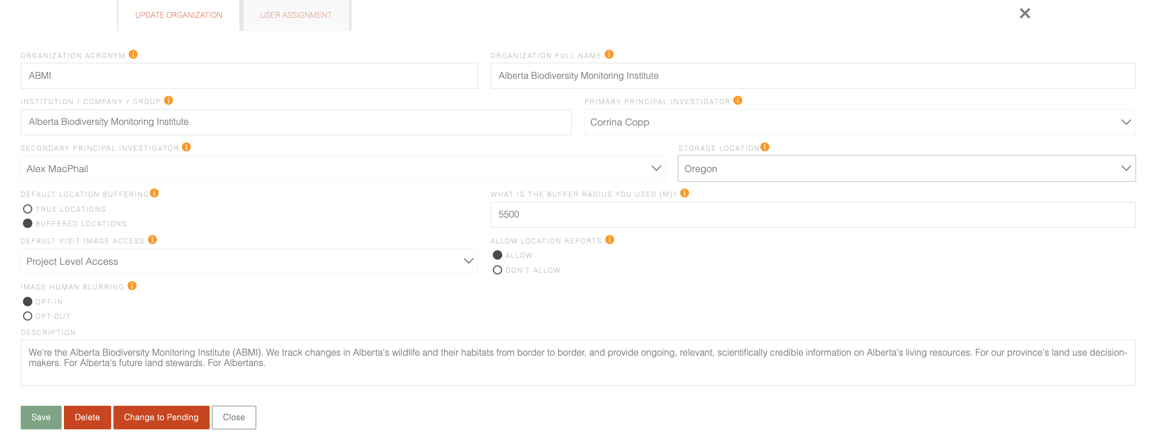

Slide 2
X
General
Users
Admin
Locations
Images
Organization acronym
Push to NextCloud
Organization name
Push to NatureCounts
Institution / Company
Description
Save
Delete
Change to Pending
Close

Slide 3
X
General
Users
Admin
Locations
Images
Primary Investigator
Secondary Investigator
User
Read
Admin
Showing 1 to 10 of 1,600 users
Users per page
10 ⌄

Slide 4
X
General
Users
Admin
Locations
Images
Storage Location
Total Images
1 TB
AWS – Montreal
AWS - Oregon
Edmonton - Cirrus
Total Recordings
4 TB
Total Volume
5 TB
$25.23 (Cirrus) x 5TB
$126.15
Next Billing Period
March 31, 2024

