Slide 1
Using JOGL and Eclipse RCP in fluid dynamics research
Wade Walker
Austin, Texas
SIGGRAPH 2012 BoF session

Slide 2
My research
Computational fluid dynamics
Computational elastodynamics
Soliton formation and interaction
Lots of coding (simulator is ~25KLOC)
Animated graphical display
Requires interaction with the graphics to help invent and refine the algorithms

Slide 3
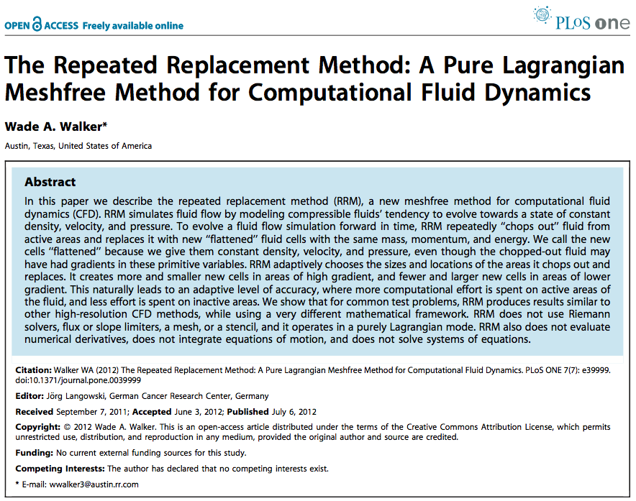
Just published in PLoS ONE

Slide 4
Research vs. production code
Exploratory code, not production code
Constantly changing and trying new things
Need flexibility and interactivity
Java provides garbage collection
Good for apps that are constantly being changed
Eclipse RCP provides app framework
Good for writing workbench-like GUI apps
But how to render interactive graphics?

Slide 5
Why JOGL?
Easy hardware-accelerated graphics in Java
Cross-platform (my simulator runs unaltered on Windows, Mac, and Linux)
Runs fast, gives good interactivity
Supported by great guys ☺

Slide 6
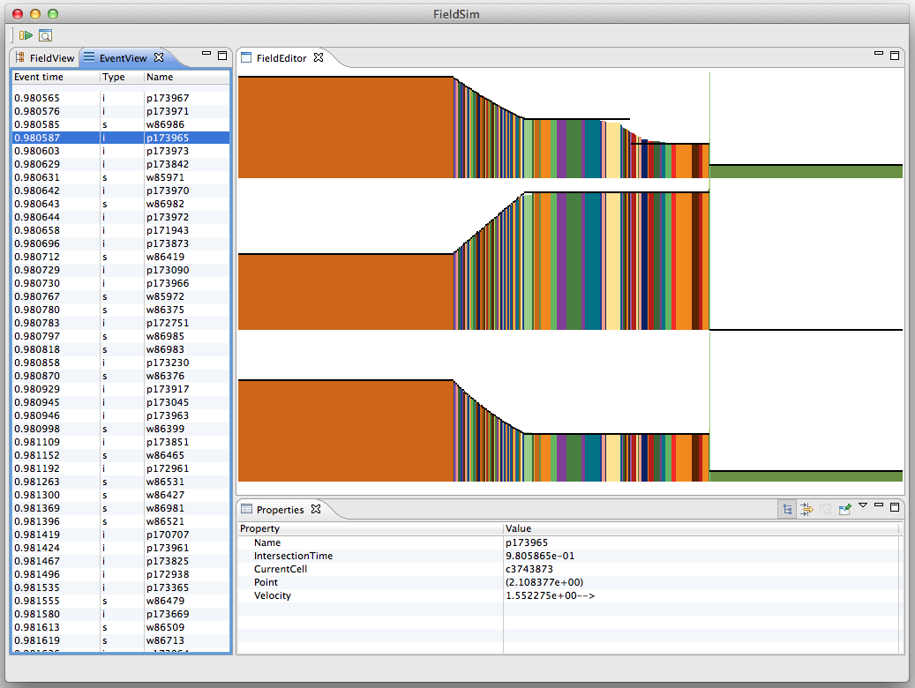
Demo simulator

Slide 7
Thanks!

