Slide 1
SFC CDR
VERSION: A0
DATE: 1/11/2017

Slide 2
Concept
The SFC converts the Ku band transmit frequency to the respective receive frequencies (2 RX Bands).
The Unit has single conversion with two options:
From : 13.75GHz- 14.5GHz to 10.95- 11.7GHz
From: 13.75GHz- 14.5GHz to 12.00- 12.75GHz

Slide 3
SRR NOTES
Attached Word

Slide 4
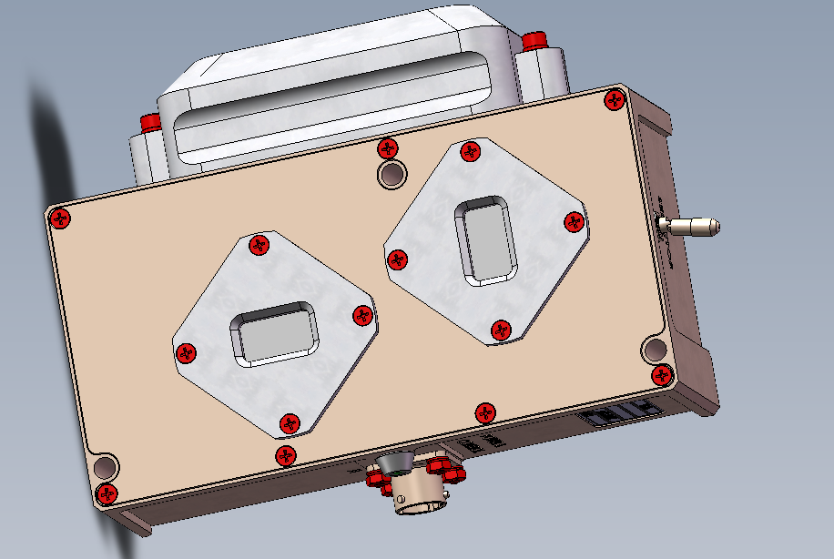
Mechanical Concept

Slide 5
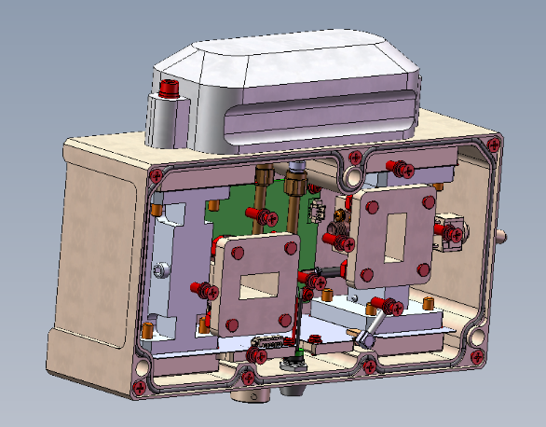
Mechanical concept

Slide 6
Spec
Notes | Spec | Parameter | Section
V | 13.75-14.5GHz | Input Freq | 1
3-7dBi full band | 5 +/-1dBi | Rx Antenna | 2
V ( not at the same time) | Band 1: 10.95- 11.7GHz Band 2: 12.00- 12.75GHz | Output frequency | 3
V | 2.8GHz / 1.75GHz | LO | 4
V | Ip65 2 pole | Band Switch | 5
+/-280Hz , V | +/-0.1ppm | Freq Stability | 6
V | -80dBc @1KHz -90dBc @ 10KHz -100dBc @ 100KHz | LO PHASE NOISE | 7
3-7dBi full band | 5 +/-1dBi | Tx Antenna | 8
~V | -18dB +/-1dB | Rx To Tx antenna gain | 9
~V | -25dB +/-1dB | Input to output gain | 10
V | +/-1.5dB for full band +/-0.75dB for 80MHz | Gain Flatness | 11
V | +/-10deg for any 5MHz | Phase linearity | 12

Slide 7
Spec cont
Notes | Spec | Parameter | Section
V | -40dBc | In band Spurs | 13
V | -40 dBm | Leakage Signals | 14
V | > 30dB | Image Rejection | 15
V | 0dBm | Input P1dB | 16
V | 5dBm | Damage power | 17
V ( problem to measure due to Network noise) | +/-0.5ns @ 40MHz | Group Delay | 18
Fixed after SRR to 90 deg | +/-10deg | 3dB Beam Width | 19
V see ICD | 7X 5.6 X 2.25 inch | Size | 20
V | 1A @ 12V DC | Power | 21
V ( three with Yellow) | 2 color LED | Visual indication | 22
V | Temp: -10 to +55 deg Rain : Drops Humidity : 10 – 95% | Environment | 23
Updated to another option according to letter from 30/7/2017 | Alodine | Coating | 24

Slide 8
Spec cont
Notes | Spec | Parameter | Section
V | PT02E10-6P | Power Supply connector | 25
At Risk currently at 1Kg | <0.6Kg | Weight | 26

Slide 9
Block Diagram

Slide 10
System Simulation

Slide 11
System Simulation

Slide 12
Input Filter

Slide 13
Mid Filter
Additional filter For 13.75-14.5GHz

Slide 14
Mixer
SIM-193H+
Need Passive mixer to allow for the specific operation Where:
Rf : 13.75GHz – 14.5GHz
IF : 10.9 -12.75GHz
LO: 1.75 – 2.8GHz
Use Mixer and switch IF and LO Connection

Slide 15
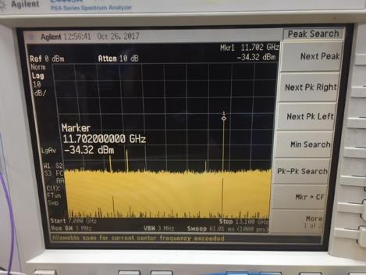
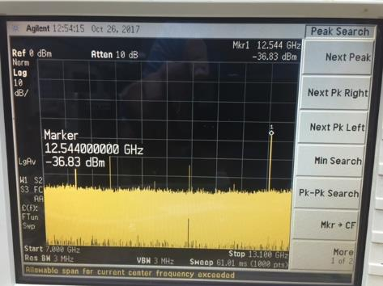
Mixer Preliminary tests
Expected Spurs
Multipliers of LO :
1.75GHZ → 6,7,8X == 10.5GHz, 12.25GHz, 14GHz
2.8GHz → 4,5X == 11.2GHz , 14GHz
All Should be below -40dBm
Function of LO input
Signal relative spurs are not expected

Slide 16
Output Selectable filters
Two Bands
Bank filters
Option of bypassing both filters

Slide 17
Output Filter

Slide 18
LO Stability OCXO
Tuning Option available

Slide 19
Lo Phase Noise
ADF4351
Phase Noise Table
Spec | Phase noise 1.75GHz | Phase noise 2.8GHz | Freq
 | -90dBc/Hz | -85dBc/Hz | 100 Hz
-80dBc/Hz | -95dBc/Hz | -95dBc/Hz | 1KHz
-90dBc/Hz | -99dBc/Hz | -96dBc/Hz | 10KHz
-100dBc/Hz | -106dBc/Hz | -106dBc/Hz | 100KHz
 | -130dBc/Hz | -130dBc/Hz | 1MHz

Slide 20
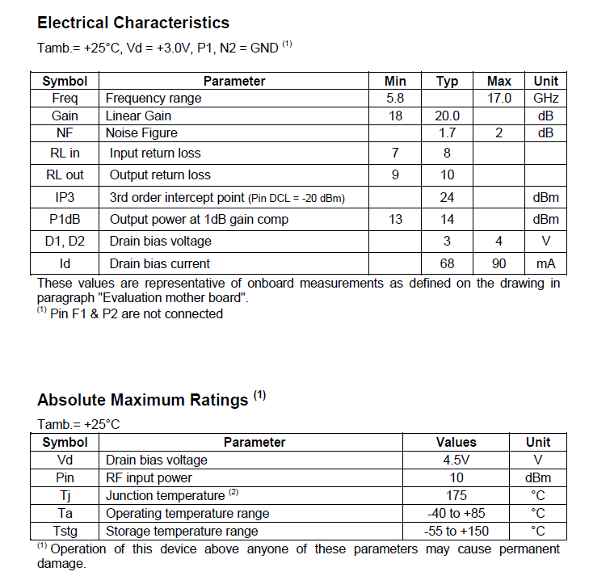
Amplifier – CHA-3656QAG
Optional Both on input and Output
Allows option of controlling the Spurs

Slide 21
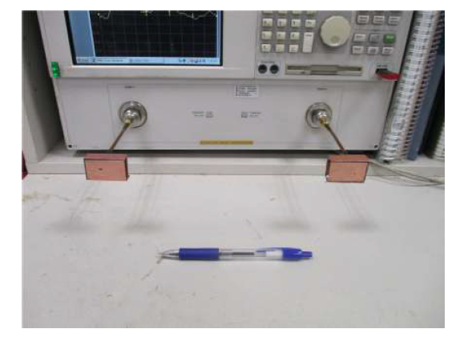
Antennas
Frequency : 10 -15GHz
Use Std Coax to Waveguide
Measured in Lab
Pr / Pt = Gr Gt λ² / (4π)² R²

Slide 22
Waveguide to MS

Slide 23
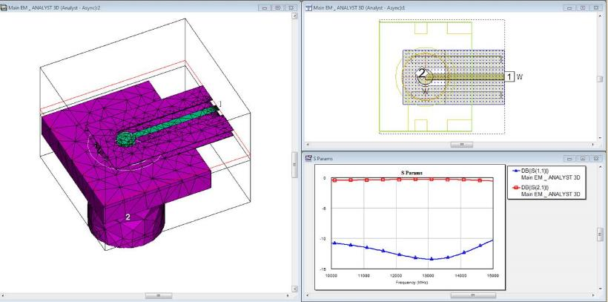
Waveguide to Coax
Built from waveguide to MS and Then MS to Coax

Slide 24
Power Consumption
NOTES | Current | Voltage | Unit
Startup only | 1A | 3.3 | OCXO
 | 0.2A | 3.3 | LO
 | 0.06A | 3.3 | LO Buffer
 | 0.12A | 3.3 | LNA/RF AMP
 | 1.4A From 3.3V | Total
From 12V to 3.8V
Ldo used down to 3.3V

Slide 25
Schematic
2 RF BOARDS
RF PATH
Filters + MIXER +AMP
DC /PIC/ OCXO SYNTH

Slide 26
RF SCHEMATIC

Slide 27
RF Schematic – input

Slide 28
RF SCHEMATIC - OUTPUT

Slide 29
RF PCB
RO4350B 0.254mm
No coating on Filters – only Copper

Slide 30
Main Control Board

Slide 31
DC/PIC

Slide 32
SYNTHSIZER TOP LEVEL

Slide 33
Synthesizer

Slide 34
PC BOARD
FR4 HIGH TG , 1.6 mm
4 Layers

Slide 35
SW
Using Pic PIC16LF1823-I/ML
SW SPI To control Freq
According to Sw state will control Switches and SPI
Control 2 pins for LED

Slide 36
Down Converting to LBAND Option
Changes :
Need to Replace AD4351 with ADF5355
Need to switch between input ports for the Mixer
Better Way to add additional mixer and switch LO

Slide 37
Mechanical

Slide 38
Mechanical Model
EDRAWING
Currently 1Kg

Slide 39
Connectors

Slide 40
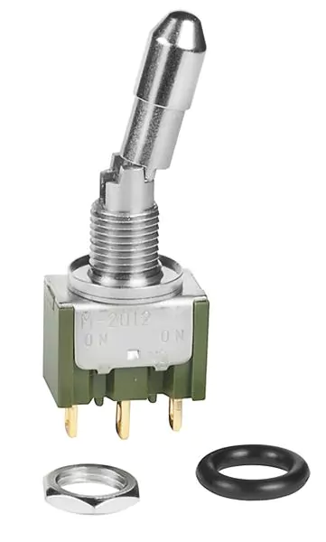
Switch/LED
M2012LL3G01

Slide 41
External Cable
Cable Types
Alpha Wires
PART NO. 78033
PART NO. 78043
AC/DC - LPF-16-12P

Slide 42
Schedule
NOTES | DATE | MILE STONE
 | 1/11/2017 | CDR
 | 15/11/2017 | Prototype blocks
 | 15/12/2017 | Final Mech,PCB order
 | 1/3/2018 | First unit ready
Might be sooner | 1/5/2018 | ENG UNIT

Slide 43
Risk

