Slide 1
KU FE Module ( Demo Project)
VERSION: A3
DATE: 11/11/2017

Slide 2
Concept
TDD Unit
Two Antenna System ( TX, RX)
Tx : From 950 – 2620 MHz to 10.95 – 11.7 GHz
Rx : From 13.75 – 14.5 GHz to 950 – 2620 MHz
Tx Output of 36dBm @ 5dB backoff
Time Critical !!

Slide 3
Block Diagram

Slide 4
SPEC-Tx
Comply | Notes | Spec | Parameter
V | 2570-2620MHz For this demo | 950-2620MHz | L-Band input Freq
 |  | -10 to -50dBm | Power Input
 |  | 10.95 – 11.7GHz | Ku band output
V | -30 to 55 deg cel | +/-0.5dB over temp range | Gain Stability
 |  | -50dBc/Hz@ 10Hz | Phase Noise
 |  | -66dBc/Hz @ 100Hz
 |  | -80dBc/Hz @ 1KHz
 |  | -90dBc/Hz @ 10KHz
 |  | -90dBc/Hz @ 100KHz
 |  | -104dBc/Hz @ 1MHz

Slide 5
SPEC-Tx
Comply | Notes | Spec | Parameter
V |  | 50dBc | Harmonics
V | Non carrier related | -60dBm in band | Spurious
V | Carrier related | -60dBc in band
V | 5dB backoff | 36dBm min | Output power
V |  | 12dB min | Gain Control
V | LTE Signal | 30dBc @36 dBm output | Spectral regrowth

Slide 6
SPEC-Rx
Comply | Notes | Spec | Parameter
V | 2570-2620MHz For this demo | 950-2620MHz | L-Band output Freq
 |  | 13.75 – 14.5GHz | Ku – band input
 |  | 4 dB max | NF
 |  | -15dBm min | IIP3
 |  | -25dBm min | Ip1dB
 |  | +5dBm min | Max in power for burn
 |  | 20dB +/-1dB | Total Gain
 |  | +/-0.5dB | Gain Stability
 |  | Same as TX | Phase noise
Only in IF low BW and not in full band |  | 50dBc min | Harmonics

Slide 7
SPEC-Rx
Comply | Notes | Spec | Parameter
V | Non carrier related | -60dBm in band | Spurious
V | Carrier related | -60dBc in band
 |  | 4.5 us | Switching Speed Tx/Rx

Slide 8
SPEC
Comply | Notes | Spec | Parameter
 |  | Tx Full VSWR Protection Rev voltage protection | Protection
 |  | Tx output power PLL Lock PA Temperature IF input power ( option) Tx Return power | Monitor
 |  | 18-36V | DC
 |  | 45W max at TX mode | DC Power
 |  | Mil-STD-704 , Mil-STD-461E | DC Protection
For OCXO Stability |  | 60 sec | Turn on time

Slide 9
Tx

Slide 10
Block Diagram

Slide 11
BA1478_UP
Used As is
The TGC2510-SM
Gain change of 18dB ( 0 V ) to 0dB ( 2V)
At High Gain OIP3 =~30dBm but at Low gain ~25dBm
Switch Vgate Levels at RX Mode.
MGA-53543
Always on
Requires no RF input while not in Tx mode .

Slide 12
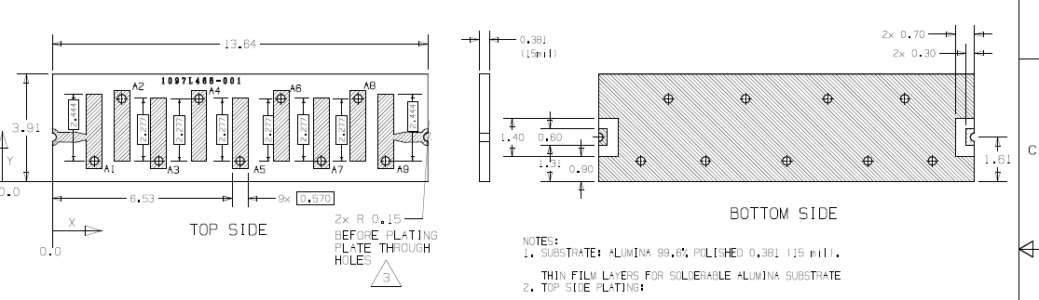
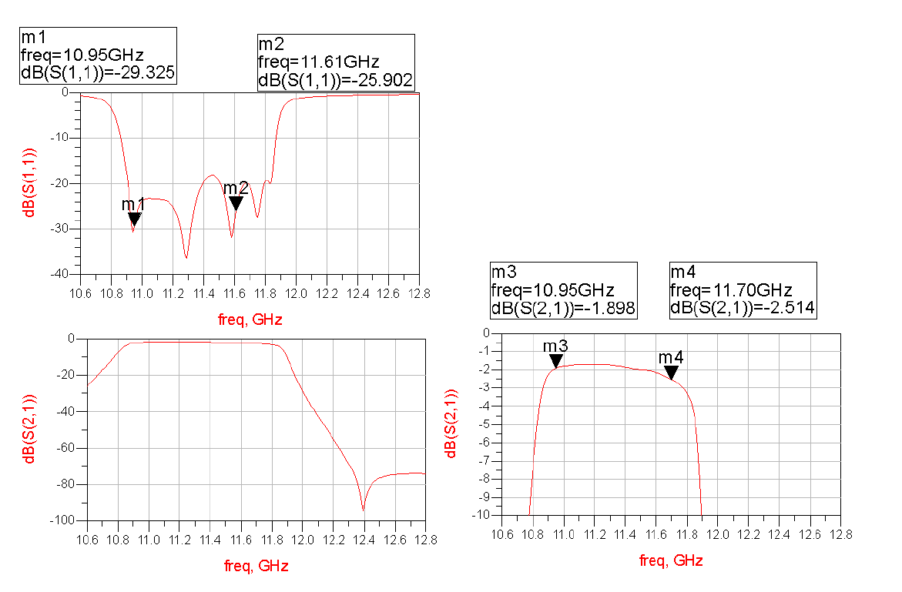
BPF
10.95-11.7GHz

Slide 13
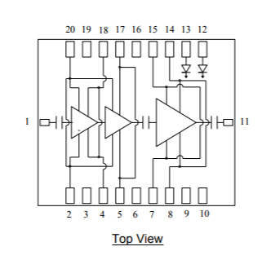
PA – 2X TGA2760-SM
Gaas with PA GAN
Combine 2 units for better matching , linearity , heat dissipation
Switch Gate Voltages to shut down
Requires turn on Sequence

Slide 14
LPF
Microstrip LPF
On RO4350B , 10 mil , 0.5 oz
No coating or plating of PCB copper

Slide 15
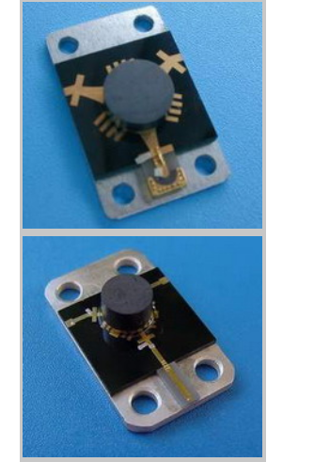
Circulator
Optional as Balanced operation should do the job
No Data on PA capability to withstand VSWR
Circulator will allow monitoring REV power.
This is not a must and will be an option

Slide 16
Monitoring TX
BA1478_UP
ADF5355 Lock Detect
Amplifier has internal Detector for FWD power
Read Rev power
Temperature sensor near PA
28V current and voltage monitor.

Slide 17
RX

Slide 18
Block Diagram

Slide 19
RX – Limiter (Optional)
Currently not planned to be placed
TGL2217-SM

Slide 20
BPF
1097L470-001
Can Add XLF-173+ LPF

Slide 21
LNA
Custom Design Not using Std Devices
Non STD Narrow Band 13.75-14.5GHz
Required Low NF
Risk Ip1dB , Input for burn not knowm
Based on CEL CE3521M4
Fall Back On CHA 2066-QAG
NF: 2.5-3 dB
Pin max = -3dBm

Slide 22
BA1478_DOWN
Only TGC2610 –SM on RF Path
+Synth
Eliminate Additional IF Amp
IF BPF is a PCB Fix .

Slide 23
SYNTH AND CLOCK

Slide 24
Synthesizer
ADF5355
Placed on BA1478 units
Controlled By MCU
What is the Synth Step ?
10,20MHZ ?
With 20MHz OCXO and 20MHz Steps

Slide 25
DC

Slide 26
Power Users
 | On mode | Current [mA] | Voltage [V] | Unit
 | All | 800 | 5.5 | BA1478_up
 | TX | 2200 | 7 | PA PRE
 | TX | 2000 | 28 | PA
 | ALL | 3 | -1 | PA VG 1
 | ALL | 3 | -3 | PA VG 3
 | ALL | 20 | 3.3 | LNA
 | ALL | 300 | 5.5 | BA1478_down
 | ALL | 200 | 3.3 | MCU
1000 @ startup | ALL | 300 | 3.3 | OCXO

Slide 27
Power Scheme

Slide 28
Power Supply units ( Non Isolated)
Operating | On mode | Current [mA] | Max Current [mA] | Voltage [V] | Unit
PA | DC/DC Buck Boost | 2000 | 2700 | 28 | MGDS-75-H-J /PI3749-00-LGIZ
PA | Dc/DC | 2500 | 3500 | 7 | TPS54340
ALL ( up/Down converter) | DC/DC | 3200 | 3500 | 5.5 | TPS54340
MCU | LDO | 200 | 250 | 3.3 | TPS73233DBVT
OCXO | LDO | 1000 | 1100 | 3.3 | LT1965EDD-3.3#PBF
LNA | LDO | 150 | 150 | 3.3 | ADP150AUJZ-3.3-R7
PA BIAS | INV LDO | 6 | 10 | -4 | MAX881REUB

Slide 29
Power Supply Pulses
Supporting pulses will require large capacitors
A turn on sequence will be set inside device
5.5v turns on before others
Only when negative voltage in +/-5% 28,7V go to the PA

Slide 30
MCU

Slide 31
Required Function and Pins
 | Description | # PINS | Function
 | SPI FOR ADF5355 | 4 | PLL UP
Can be only CE | SPI FOR ADF5355 | 4 ( 1) | PLL DOWN
For PA Bias | SPI for Dual DAC | 5 | AD5312
For UP Gain | SPI for Dual DAC | 5 | AD5312
 | Analog Inputs | 6 | Temp, FWD, REV, Voltage, Current
 | UART Com RS422 | 2 | UART IN/OUT
 | Discrete OUT | 2 | LED
 | Discrete OUT | 5 | Power ENABLE
 | Input to monitor TX/Rx ( interrupt) | 1 | TX/RX Monitor

Slide 32
Layout

Slide 33
Layout consideration
All RF On RO4350B 10 mil 0.5oz/oz
Filters and coupler with no plating
Built from Separated building blocks
POWER/COM/MCU will be on FR4 in Separated Board
ANTENNA SIZE?
ANTENNA CONNECTOR

Slide 34
First Placement

Slide 35
Mech

Slide 37
Schedule

Slide 38
Mile stones
 | Notes | Date | Mile Stone
 |  | 20/11 | CDR
 | BA1478 ready | 15/12 | PCB Ready for production
 |  | 15/12 | Mech ready for production
 | RF Connectors might be LLI | 15/12 | All Parts in B.A.
 |  | 27/12 | PCB Assembly
 |  | 1/1/2018 | Mech in B.A.
 |  | 15/1/2018 | Finish RF Design
 |  | 28/1/2018 | SW Control Integration
12 weeks from 31/10 ARO |  | 28/1/2018 | ENG UNIT
 |  | 25/3/2018 | SOF
 |  | 15/4/2018 | 4 PROTOTYPES

Slide 39
RISK

