Slide 1
UOG LMS
Group 2 :
ABDUL RAFAY 19014156-003
ABOBAKAR 19014156-022
Instructor:
Mr. Syed Nakshab

Slide 2
DATA Structures Used
Linked List (Singly)
Stack
Array
File Handling (store data)

Slide 3
Functionality of Project
LOG IN SYSTEM (everyone have unique ID)
UOG LMS MANEGMENT SYSTEM
TEACHER MANEGMENT SYSTEM
STUDENT MANEGMENT SYSTEM
MAIL MANEGMENT SYSTEM
TIME TABLE MANEGMENT SYSTEM

Slide 4
Users
Admin
Teacher
Student

Slide 5
Admin
Admin can enter Teacher Student and Time Table data. Admin can edit remove or update data. When Admin Enter new teacher or Student data Teacher or Student ID auto-generated by program. Admin can send Mail to everyone.
Like :
Admin ID= admin-001
Teacher ID= teacher-001
Student ID= 19014156-001

Slide 6
Admin Function
admin_data* head, * tail, * temp, * t;
int admin_managment();
void admin_insert_data();
void admin_search_data();
void admin_update_data();
void admin_full_Display_data(admin_data* t1);
void write_admin_data(admin_data* t2);
void read_admin_data();
void check_login(char id[12], char pwsd[12]);
int uni_manegment_systam(admin_data* t3);

Slide 7
Teacher
Teacher can enter Assignment Quiz presentation mid and final Marks of student.
Teacher Can see Time Table.
Teacher can send Mail everyone.

Slide 8
Teacher Function
void teacher_insert_data();
void teacher_search_data();
void teacher_update_data();
void teacher_delete_data();
void teacher_full_Display_data(teacher_data* t1);
void write_teacher_data(teacher_data* t2);
void read_teacher_data();
void edit_student_data();
int teacher_management();
int t_check_login(char id[12], char pwsd[12]);

Slide 9
Student
Student can see Marks
Student can see Time table
Student can see GPA
Student can send Mail

Slide 10
Student Function
void student_insert_data();
void student_search_data();
void student_update_data();
void student_delete_data();
void student_full_Display_data(student_data *s1);
void write_student_data(student_data* s2);
void read_student_data();
void course_data(int N, student_data* s3);
void U_GPA(student_data* s4);
void show_GPA(student_data* s5);
int edit_student_subject_data(int s);
student();
int student_management();
int student_login(char id[20], char pwsd[20]);

Slide 11
Time Table Function
void insert_time_table_data();
void edit_time_table();
void show_time_table();
void write_time_table_data();
int time_table_managment();
void read_time_table_data();

Slide 12
Mail System
void write_mail_data(mail_data* d);
void send_mail(char* id);
void inbox_mail(char* id);
void SEND_MAIL_TO_AN_OTHER(char* sid);
void show_mail(mail_data* p);
void stack();
int uog_mail_system(char* sid);

Slide 13
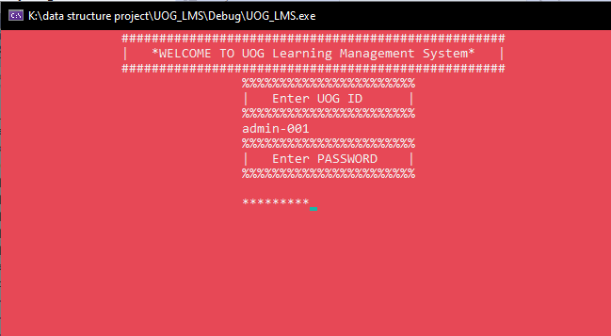
Log in System

Slide 14
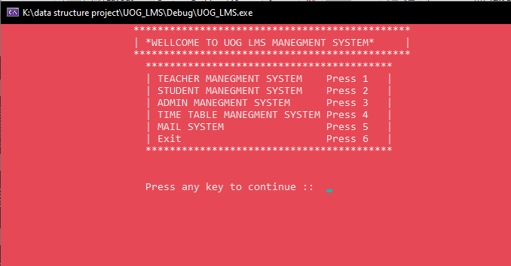
Admin(log in) UOG Management System

Slide 15
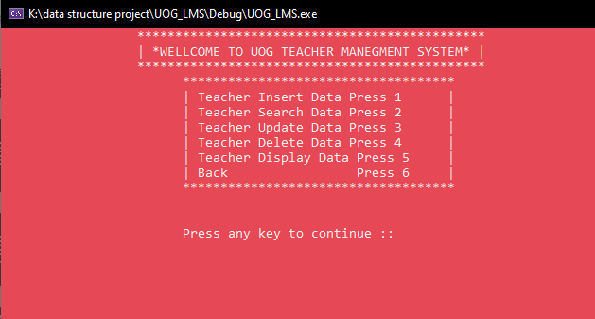
Teacher Management System

Slide 16
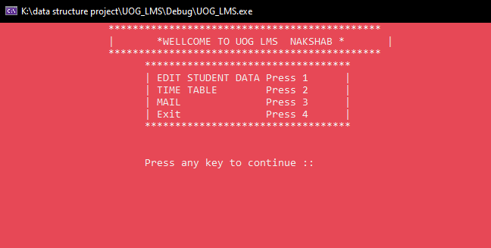
Teacher (log in)

Slide 17
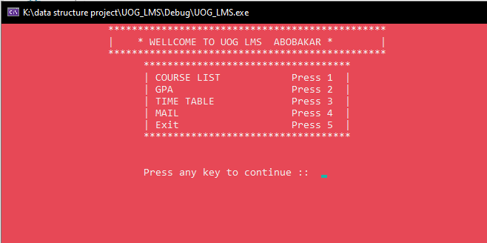
Student (log in)

Slide 18
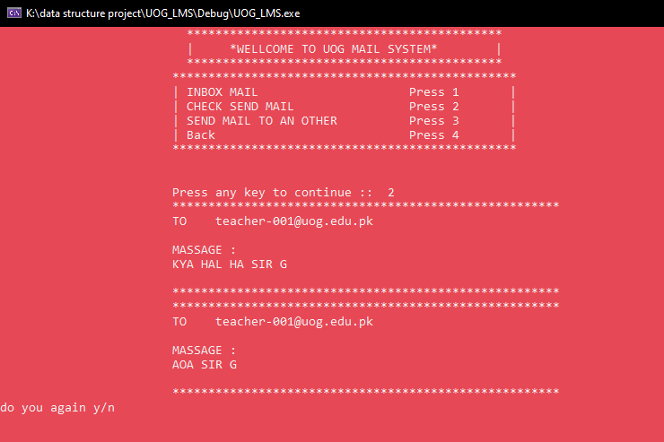
Mail System(check send Mail)

Slide 19
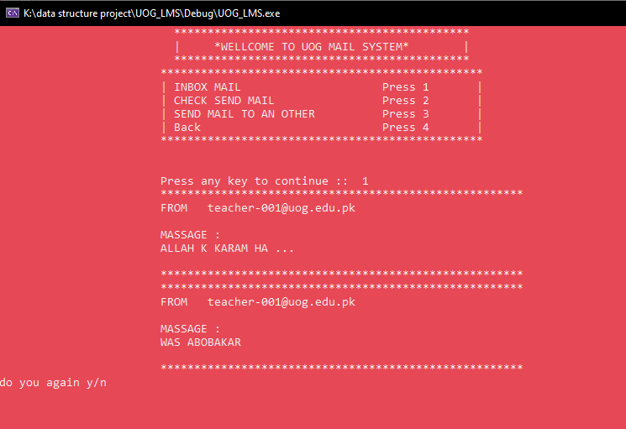
Mail System(check Inbox Mail)

Slide 20
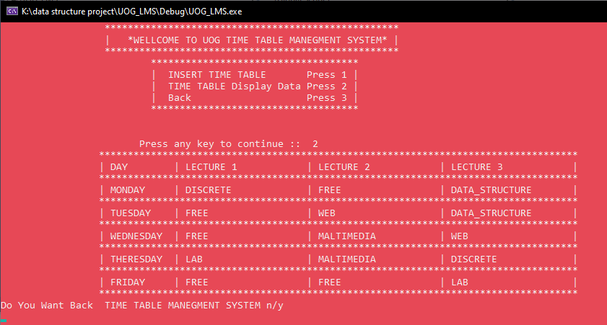
Time table

