Slide 1
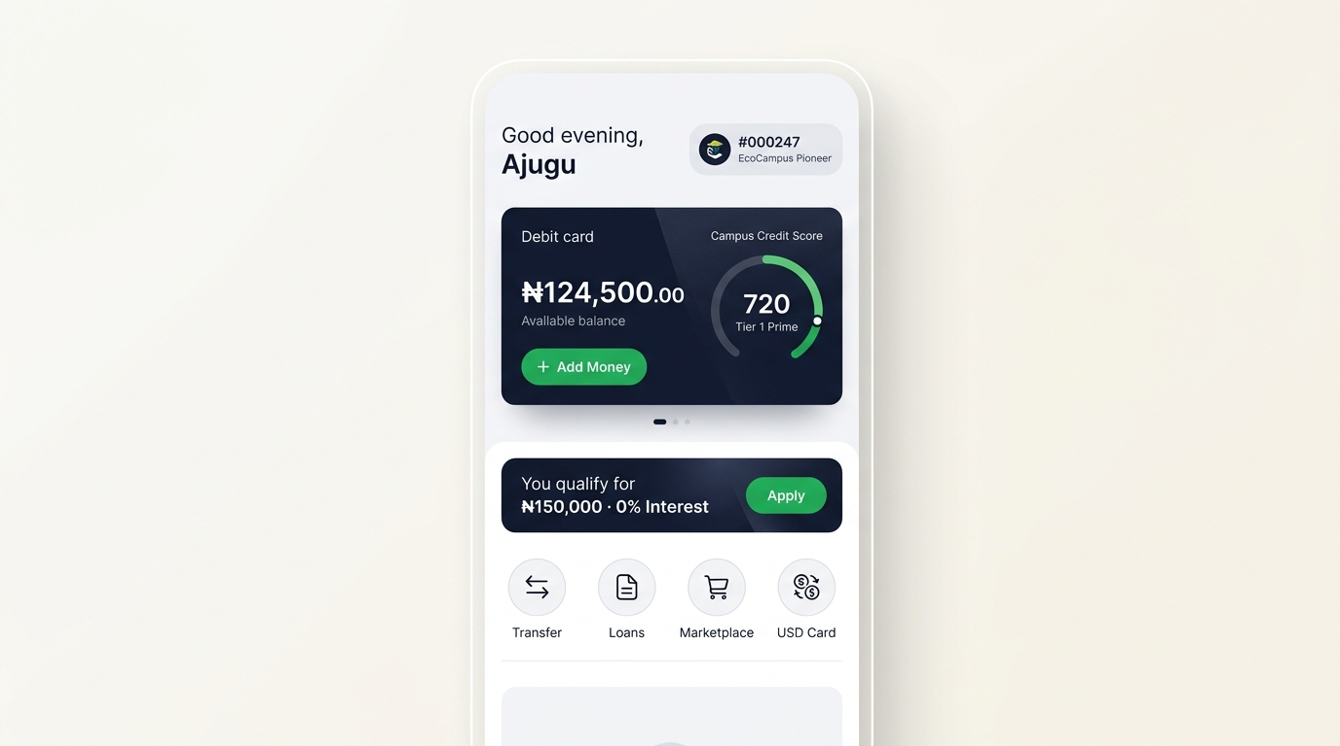
FLAGSHIP ECOBANK HACKATHON INITIATIVE
EcoCampus: The Youth Financial Operating System
Transforming Ecobank Blaze from a basic youth debit card into an indispensable daily ecosystem where 2.5 million Nigerian undergraduates and 350,000 corps members live, trade, upskill, and launch their careers.
Zero-Interest Tuition & NYSC Financing: 24-48hr bursary disbursement via CBN GSI multi-account recourse.
EcoMarketplace with Smart Escrow: Ecobank vault locks funds until 4-digit physical inspection OTP release.
Opportunity Hub & Talent Retention: Direct corporate hiring pipeline with Ecobank, Paystack, and top fintechs.
Official Motto: LEARN. GROW. ACHIEVE. | Prepared for: Adebanke Oladejo, Victor Yalokwu & Babawale John

Slide 2
SLIDE 2 OF 7 | THE MACRO CRISIS
ECOBANK HACKATHON 2026 · REIMAGINING POSSIBILITIES
Structural Failure in Tertiary Education Financing & Youth Banking
Nigerian undergraduates face systemic friction: bureaucratic delays, predatory loan apps, and career drop-off.
BUREAUCRATIC DELAYS
NELFUND 3 to 6 Month Bottleneck
THE COMMERCIAL BANKING GAP
Federal student loans suffer from prolonged administrative processing, single-purpose tuition restrictions, and paper verification that arrives months after university portal registration has closed.
Why Traditional Retail Banks Fail Nigerian Students:
PREDATORY CAPITAL
Loan Sharks Charging 25% - 35% Monthly Interest
01
Banks treat students as zero-revenue account holders, issuing inert plastic cards with no utility.
Desperate students turn to unregulated digital loan apps. Unmanageable debt traps lead to aggressive contact list shaming, institutional stigma, and academic abandonment.
02
No salary slip or fixed collateral means traditional credit scoring marks students as un-bankable.
UNPROTECTED COMMERCE
Campus P2P Fraud on WhatsApp & Social Feeds
Textbook exchanges, refurbished laptop sales, and hostel essentials carry severe transaction risk: fake bank alerts, delivery ghosting, and zero buyer or seller recourse.
03
Customer Acquisition Cost (CAC) exceeds ₦12,000 per user when trying to recruit graduates post-NYSC.
THE NYSC CLIFF
04
Zero integration with campus bursaries leaves tuition liquidity completely unserved.
Post-Graduation Drop-off on ₦77,000 Allowance
350,000 annual corps members face high urban relocation costs with zero equipment financing to acquire laptops or tools needed for remote technology employment.

Slide 3
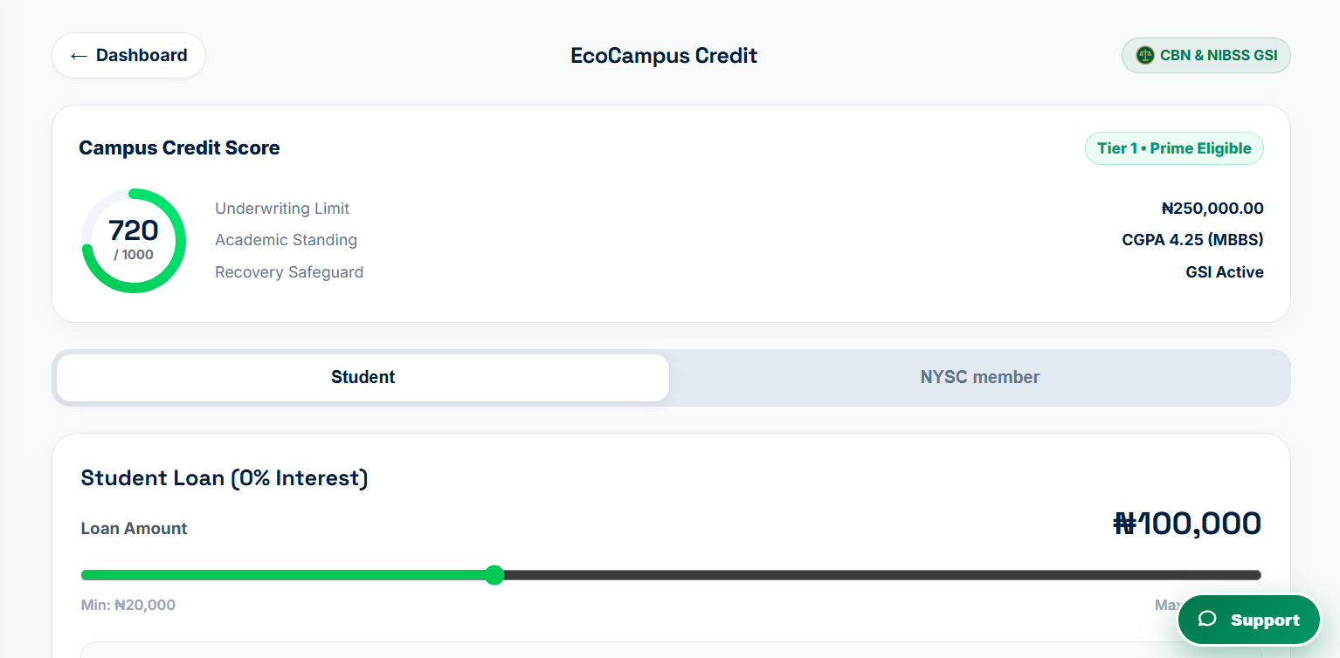
SLIDE 3 OF 7 | THE SOLUTION & CORE PRODUCT
ECOBANK HACKATHON 2026 · REIMAGINING POSSIBILITIES
Not Just a Loan Platform: An Integrated Campus Financial Ecosystem
Combining zero-interest underwriting with CBN-compliant GSI multi-account recourse and escrow protection.
0% INTEREST FINANCING ENGINE
Undergrad (200L+) & NYSC Advances
Disbursements from ₦20,000 to ₦250,000 in 24 to 48 hours at 0.0% APR.
Tuition paid straight to school bursary, eliminating fund diversion.
NYSC equipment loans up to ₦500,000 automated via monthly stipend deduction.
LEGAL RISK MITIGATION
CBN Global Standing Instruction (GSI) via NIBSS
Mandate executed under CBN Circular BSD/DIR/GEN/LAB/13/053.
Legally enforceable automated recourse across all 30+ Nigerian banks via BVN.
Brings institutional default risk near zero without requiring traditional collateral.
ECOBANK SMART ESCROW
Zero-Fraud Peer-to-Peer Campus Commerce
Funds held safely in Ecobank Escrow Vault during P2P marketplace trades.
Payment released only upon in-person inspection and 4-digit OTP validation.
Each completed trade builds student's proprietary Campus Score (0-1000).

Slide 4
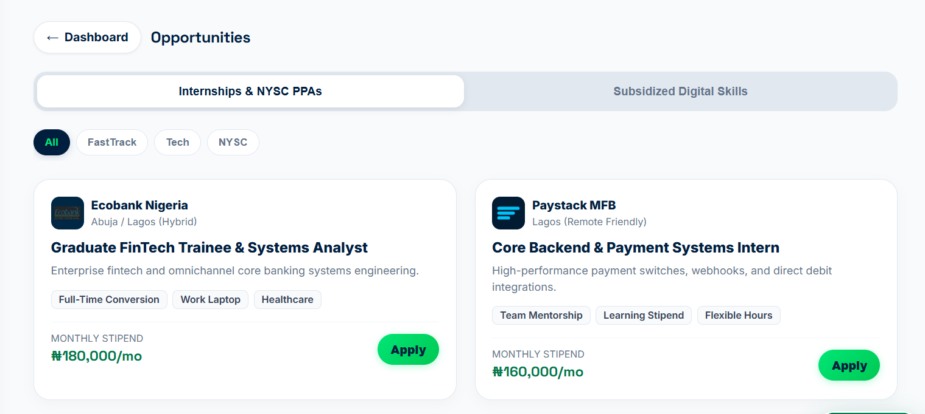
SLIDE 4 OF 7 | THE TALENT BRIDGE
ECOBANK HACKATHON 2026 · REIMAGINING POSSIBILITIES
Mitigating African 'Brain Drain' Through Corporate Network Matching
Pairing educational financing with structured post-graduate career pipelines across Ecobank's Pan-African network.
THE PROBLEM: FINANCING WITHOUT CAREER PLACEMENT
Tuition loans alone do not solve the youth crisis if graduating scholars face 40% youth underemployment and are forced into the 'Japa' brain-drain wave.
THE ECOSYSTEM BRIDGE: OPPORTUNITY HUB
Direct Ecobank FastTrack & Tech Internships:
Top academic performers (CGPA 3.5+) matched directly with graduate trainee programs at Ecobank Nigeria, Paystack MFB, and multinational corporate partners.
Subsidized Digital Skills ('Learn & Earn'):
Sponsored industry certifications (Next.js, Python for Finance, SQL) subsidized through Ecobank CSR that boost loan limits while building practical workforce capacity.
NYSC High-Allowance PPA Matcher:
Corpers connected to technology PPAs offering monthly agency top-up stipends (₦160,000 - ₦180,000/mo) to guarantee loan liquidation and high savings accumulation.

Slide 5
SLIDE 5 OF 7 | COMMERCIAL ARCHITECTURE
ECOBANK HACKATHON 2026 · REIMAGINING POSSIBILITIES
Why Ecobank Wins: Compounding SROI & Commercial Balance Sheet Offsets
While zero-interest student lending operates at zero direct profit, the commercial offsets create an unbeatable institutional moat.
₦0 CAC
Lifetime Customer Acquisition (LTV)
100%
Post-Graduate Salary Domiciliation
ORGANIC VIRALITY
Retail banking CAC in Nigeria exceeds ₦12,000 per user. EcoCampus acquires students at near-zero organic CAC through campus word-of-mouth. Beneficiaries enter deep generational loyalty with 30+ year customer retention.
REVENUE RETENTION
Graduates who received tuition liquidity and corporate internships naturally maintain their primary professional salary accounts with Ecobank, yielding mortgage, credit card, and auto-loan cross-sell opportunities.
₦500M+
Campus Escrow Float Mobilization
3.5%
NYSC Equipment Advance Facility Margin
NON-INTEREST DEPOSIT
Tens of thousands of active marketplace trades generate substantial, non-interest-bearing operational liquidity. Buyer funds locked in Ecobank Escrow Vault provide zero-cost deposit float.
SUSTAINABLE MARGIN
Corper equipment financing carries a single-digit 3.5% facility fee. Automated monthly allowance split via NIBSS ensures zero collection overhead and zero recovery friction.

Slide 6
SLIDE 6 OF 7 | STRATEGIC POSITIONING
ECOBANK HACKATHON 2026 · REIMAGINING POSSIBILITIES
The Pan-African Blueprint: Public-Private Partnership (PPP) Engine
Positioning Ecobank as the premier financial execution partner for NELFUND and the African Union's Educational Initiatives.
PUBLIC-PRIVATE PARTNERSHIP (PPP) ALIGNMENT
CONTINENTAL SCALE & ESG IMPACT
The Ideal Implementation Partner for NELFUND:
Ecobank: Reimagining Possibilities Across Africa
Overcoming Federal Distribution Lag: NELFUND holds sovereign capital but lacks low-latency digital rails. EcoCampus provides the turnkey student KYC, academic authentication, and instant bursary disbursement engine.
33 AFRICAN MARKETS
Ecobank RapidTransfer Integration
Enables seamless cross-border tuition settlement, regional scholarship distribution, and intra-African academic mobility without foreign currency friction.
GSI Default Safeguard Infrastructure: Protects public loan capital through automated NIBSS Global Standing Instruction mandates across all commercial banking assets, ensuring federal repayment compliance.
UN SDG 4 & 8 COMPLIANT
Quality Education & Decent Work
Provides verified ESG reporting metrics, positioning Ecobank for international green/social concessional funding and development finance institution (DFI) partnerships.
Pan-African Scalability across 33 Nations: EcoCampus leverages Ecobank's unmatched footprint across 33 African countries to support the African Union Educational Initiative with cross-border tuition settlement.
2.5M NIGERIAN UNDERGRADS
TAM Onboarding Potential
Capturing 10% market share yields 250,000 active retail accounts, ₦12.5B in loan underwriting, and a foundational pipeline of future African business leaders.

Slide 7
SLIDE 7 OF 7 | EXECUTION & THE ASK
ECOBANK HACKATHON 2026 · REIMAGINING POSSIBILITIES
Implementation Roadmap: From Hackathon Demo to National Pilot
EcoCampus is fully functional and tested today. We present a clear, 3-phase execution roadmap.
PHASE 1 (MONTHS 1 - 6)
PHASE 2 (MONTHS 7 - 12)
PHASE 3 (YEAR 2+)
5-University Flagship Pilot
National NYSC Camp Rollout
Pan-African Continental Scale
Deploy at UniAbuja, UNILAG, UI, OAU, and ABU Zaria.
Target: 100,000 verified accounts, ₦500M escrow GMV.
Direct integration with university bursary accounts.
Partnership with 37 NYSC orientation camps nationwide.
Issue co-branded Ecobank Blaze cards with equipment advances.
Automated monthly allowance splits via NIBSS Direct Debit.
Replicate model in Ghana, Kenya, Côte d'Ivoire & Senegal.
Launch Ecobank RapidTransfer student remittance rails.
Formalize continental execution partnership with African Union.
THE ASK TO ECOBANK EXECUTIVE LEADERSHIP
Partnering with Adebanke Oladejo, Victor Yalokwu & Babawale John to Power Africa's Youth:
1
Core Banking Sandbox
2
Campus Pilot Approval
3
Talent Pipeline Matching
API credentials for live testing with Ecobank OmniCore & NIBSS GSI Switch.
Authorization to pilot with 5,000 University of Abuja students under Ecobank Blaze sponsorship.
Official onboarding of Opportunity Hub into Ecobank Group's HR graduate recruitment network.

