Slide 1


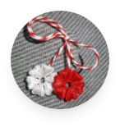
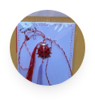

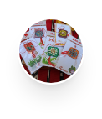
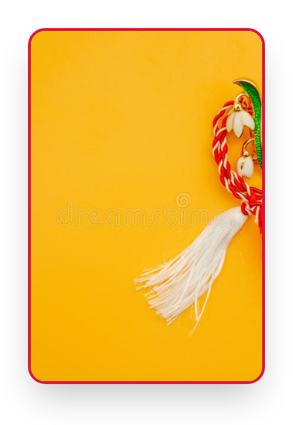
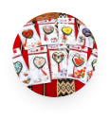
Friendship
Thread
The Thread of Friendship: Bilingual Mărțișor
Activity: "The Thread of Friendship: Bilingual Mărțișor"
Language: English

Slide 2













Salutul
Elevii din ambele țări se vor saluta și își vor prezenta școala.
Žáci z obou zemí se pozdraví a představí svou školu.
România
Cehia
1
Bună ziua!
1
Dobrý den!
2
Hello!
2
Hello!
3
Prezentarea școlii și a clasei
3
Představení školy a třídy
Împreună prin prietenie • Společně skrze přátelství

Slide 3




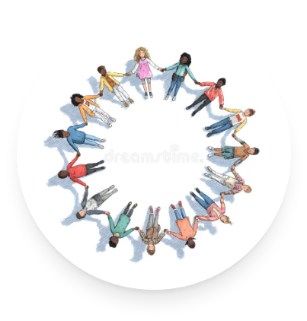



Welcome to Our Project!
1
Stop Bullying Together
Our goal isn't just to learn about what bullying is, but to actively prevent and stop it. We have the power to make our school a safe and happy place!
2
We Are All Equal
Every child in the world is equal. No matter how we look or where we come from, we are all children first, deserving of love and respect.
3
The Power of Friendship
Friendship is the same for everyone! It brings the exact same warm, happy feelings to all of our hearts, connecting us like a beautiful thread.
The Thread of Friendship
02

Slide 4

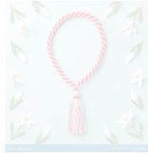
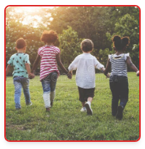
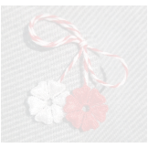
01
Why friendship matters (anti-bullying)
CONTENTS
02
What Mărțișor means (legend + colors)
Catalog
03
Step-by-step activity plan
04
Creative workshop: making the bilingual Mărțișor
05
Anti-bullying message & digital finale
06
Bilingual vocabulary (RO–CZ)
The Thread of Friendship: Bilingual Mărțișor
03

Slide 5

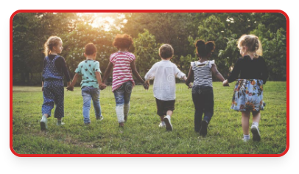












Friendship and Anti-Bullying
Build friendship to create a community without bullying.
Friendship focus
Anti-bullying focus
Tradition as a guide
•
"The Thread of Friendship" as a symbol of connection between students
•
"Together against bullying!" as a shared class message
•
Mărțișor symbolizes rebirth → "we are reborn" as a kinder community
The Thread of Friendship: Bilingual Mărțișor
04

Slide 6


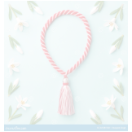






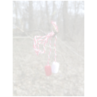

Mărțișor: Meaning Through Colors
Moldovan contribution
Czech contribution
Present the Mărtișor legend (Spring vs Winter)
White = purity / peace
Red = courage / blood spilled for freedom
Connection point
White–red thread as a shared symbol students can understand together
The Thread of Friendship: Bilingual Mărțișor
05

Slide 7


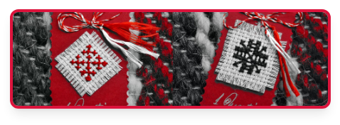


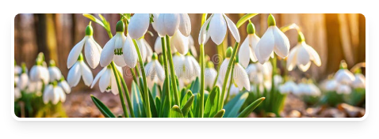




The Legend of Mărțișor
1) March 1st: Spring goes to the forest edge and sees a small snowdrop under the snow.
2) Winter gets angry and sends a strong blizzard to destroy the flower.
3) Spring protects the snowdrop, hurts her finger; a warm drop of blood falls and saves the flower.
5) We wear the red-white thread as a symbol of good over evil and friendship.
4) Meaning of the colors:
•
White = purity of the snowdrop
•
Red = love and sacrifice of Spring
The Thread of Friendship: Bilingual Mărțișor
06

Slide 8



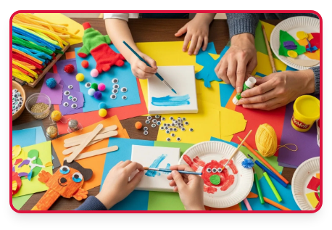





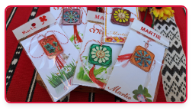
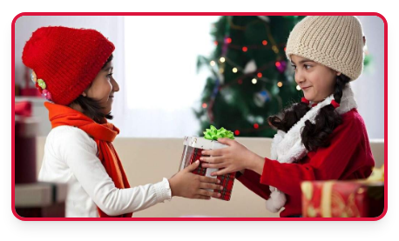




Creative Workshop
(30 min)
Materials
1
Cut a cardboard circle
•
White-red cord
•
White cardboard
Side A (Romanian): write a beautiful word (example: PRIETENIE)
2
•
Markers
Side B (Czech): write the translation (example: PŘÁTELSTVÍ)
3
4
Attach the red-white cord to the bilingual circle
The Thread of Friendship: Bilingual Mărțișor
07

Slide 9



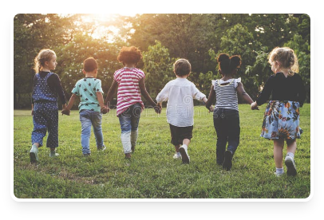

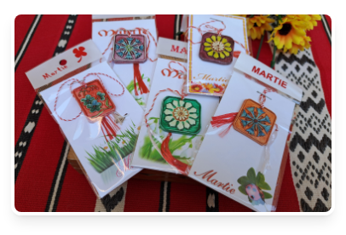





From Symbol to Action
Anti-bullying message
Mărțișor = rebirth → we 'rebirth' as a community without bullying
Digital wrap-up: 'Virtual Spring Board' (Padlet/Jamboard)
1
2
3
Take a photo with the created mărțișor
Upload it to the board
Write the message: 'Společně proti šikaně!' (Together against bullying!)
The Thread of Friendship: Bilingual Mărțișor
08

Slide 10





Words of
Friendship
(Bilingual)
Romanian
Czech
Pronunciation
BUNĂTATE
LASKAVOST
(Las-ka-vost)
PACE
MÍR
(Mir)
RESPECT
ÚCTA
(U-țta)
ZÂMBET
ÚSMĚV
(U-smiev)
AJUTOR
POMOC
(Po-moț)
The Thread of Friendship: Bilingual Mărțișor
09

Slide 11

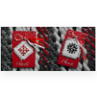
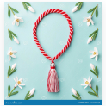




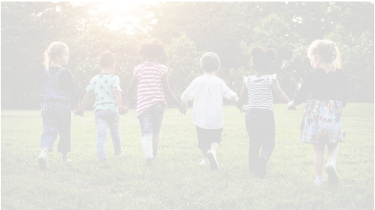
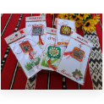
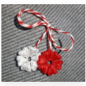
Thank You
Together against bullying!
Společně proti šikaně!
❤️
❤️
❤️

