Slide 1
Automated Dispenser for Harmful Chemicals
An Arduino-based Embedded System Project

Slide 2
Group Members
Year Div Name Enrollment Number
SYBCA A [Member 1 Name] [Number]
SYBCA B [Member 2 Name] [Number]
SYBCA C [Member 3 Name] [Number]

Slide 3
Abstract
This project focuses on developing an automated, touchless dispensing system designed for harmful chemicals or liquids that are unsafe for direct human contact. The system uses an Arduino Uno with ultrasonic sensors to detect the presence of an object such as a container, bottle, or hand (in the case of sanitizers or handwash). Upon detection, the system activates a servo motor or pump to release a fixed quantity of liquid without requiring any physical touch.
The project ensures safety, hygiene, and automation in chemical handling processes, reducing risks of burns, contamination, and accidents.

Slide 4
Objective
• Design a touchless chemical dispensing system.
• Ensure safety by preventing direct contact with harmful chemicals.
• Automate dispensing using sensors and microcontroller.
• Provide a low-cost, scalable, and easy-to-use solution.
• Promote hygiene and safety in workplaces.

Slide 5
Components
Hardware Components:
• Arduino Uno
• Ultrasonic Sensor (HC-SR04)
• Servo Motor / Peristaltic Pump
• Relay Module
• Liquid Container
• Tubes and Nozzles
• Power Supply
Software Components:
• Arduino IDE
• Embedded C/C++ Code

Slide 6
Components Functionality
Hardware Functionality:
• Ultrasonic Sensor: Detects object presence.
• Arduino Uno: Processes sensor data.
• Servo Motor / Pump: Dispenses liquid.
• Relay Module: Controls high-power devices.
• Power Supply: Provides voltage.
Software Functionality:
• Arduino IDE: Code writing and uploading.
• Embedded C/C++: Logic for sensing and control.

Slide 7
Working of System
The ultrasonic sensor monitors the distance in front of the dispenser. If an object is detected within the threshold distance, Arduino activates the motor or pump to dispense the liquid for a set time, then stops. This ensures safe, contactless operation.

Slide 8
Functionality of System
• Touchless detection and dispensing.
• Adjustable detection range and dispensing time.
• Safe for handling harmful chemicals and sanitizers.
• Low-cost and easy to maintain.
• Suitable for industrial, lab, and sanitation use.

Slide 9
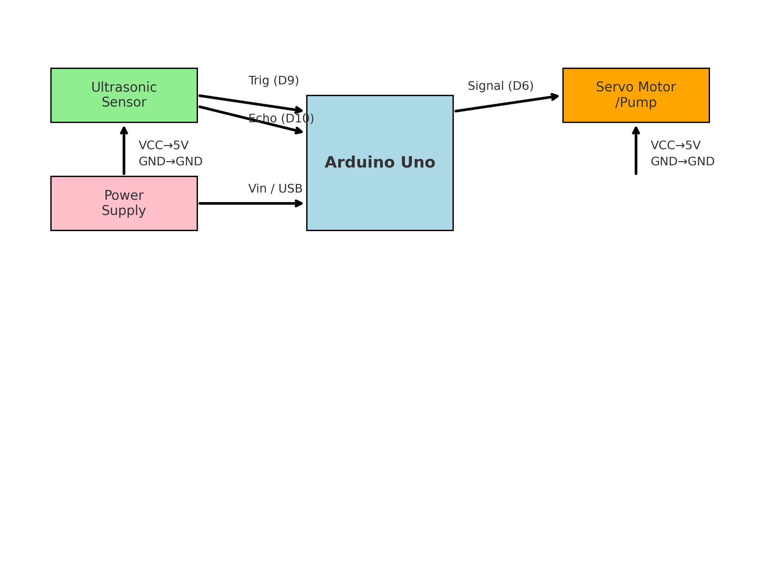
Circuit Diagram

