Slide 1
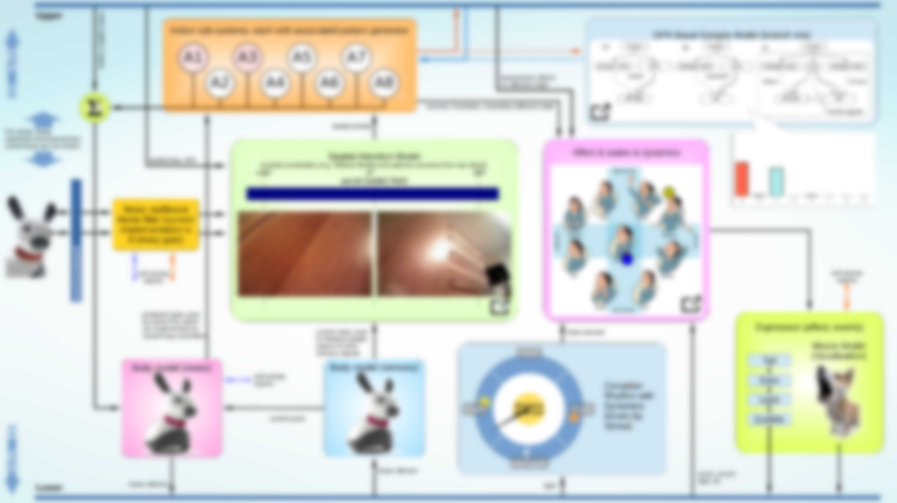
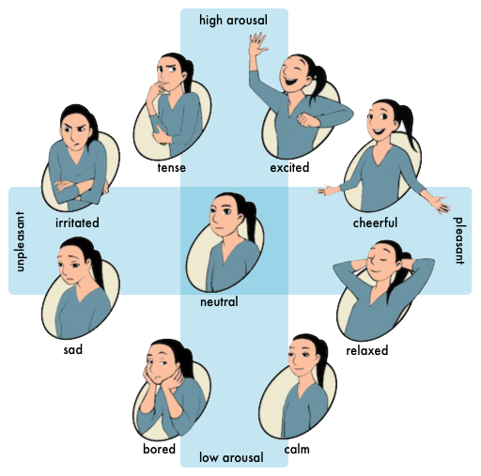
Affect & States & Dynamics
Emotion and Mood
Sleep pressure/wakefulness
Expression
(affect, events)
Downstream effects
on affective state
Success, frustration
Base arousal
touch, sound, light, tilt

