Slide 1
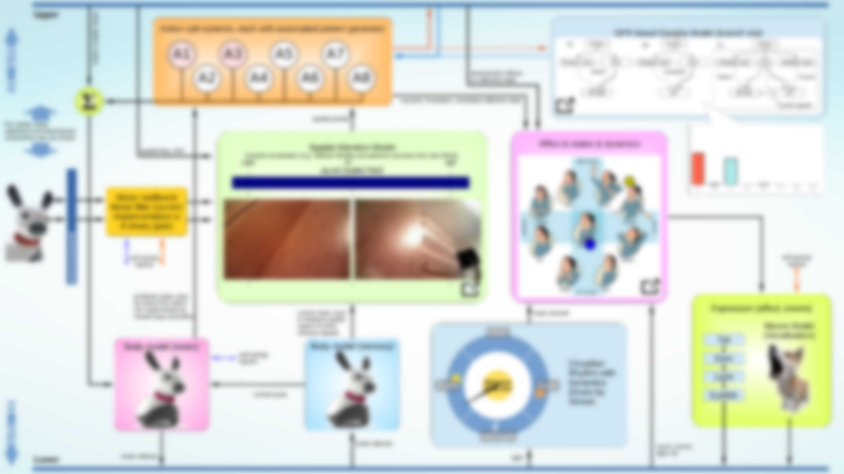
GPR Basal Ganglia Model (branch s/w)
Priority
(a)
Cortex
(b)
Cortex
(c)
Cortex
Striatum (D1)
STN
Striatum (D2)
STN
Striatum (D1)
STN
Striatum (D2)
Select
Function?
Select
Control
EP/SNr
GP
EP/SNr
GP
Control signals
Disinhibition

