Slide 1
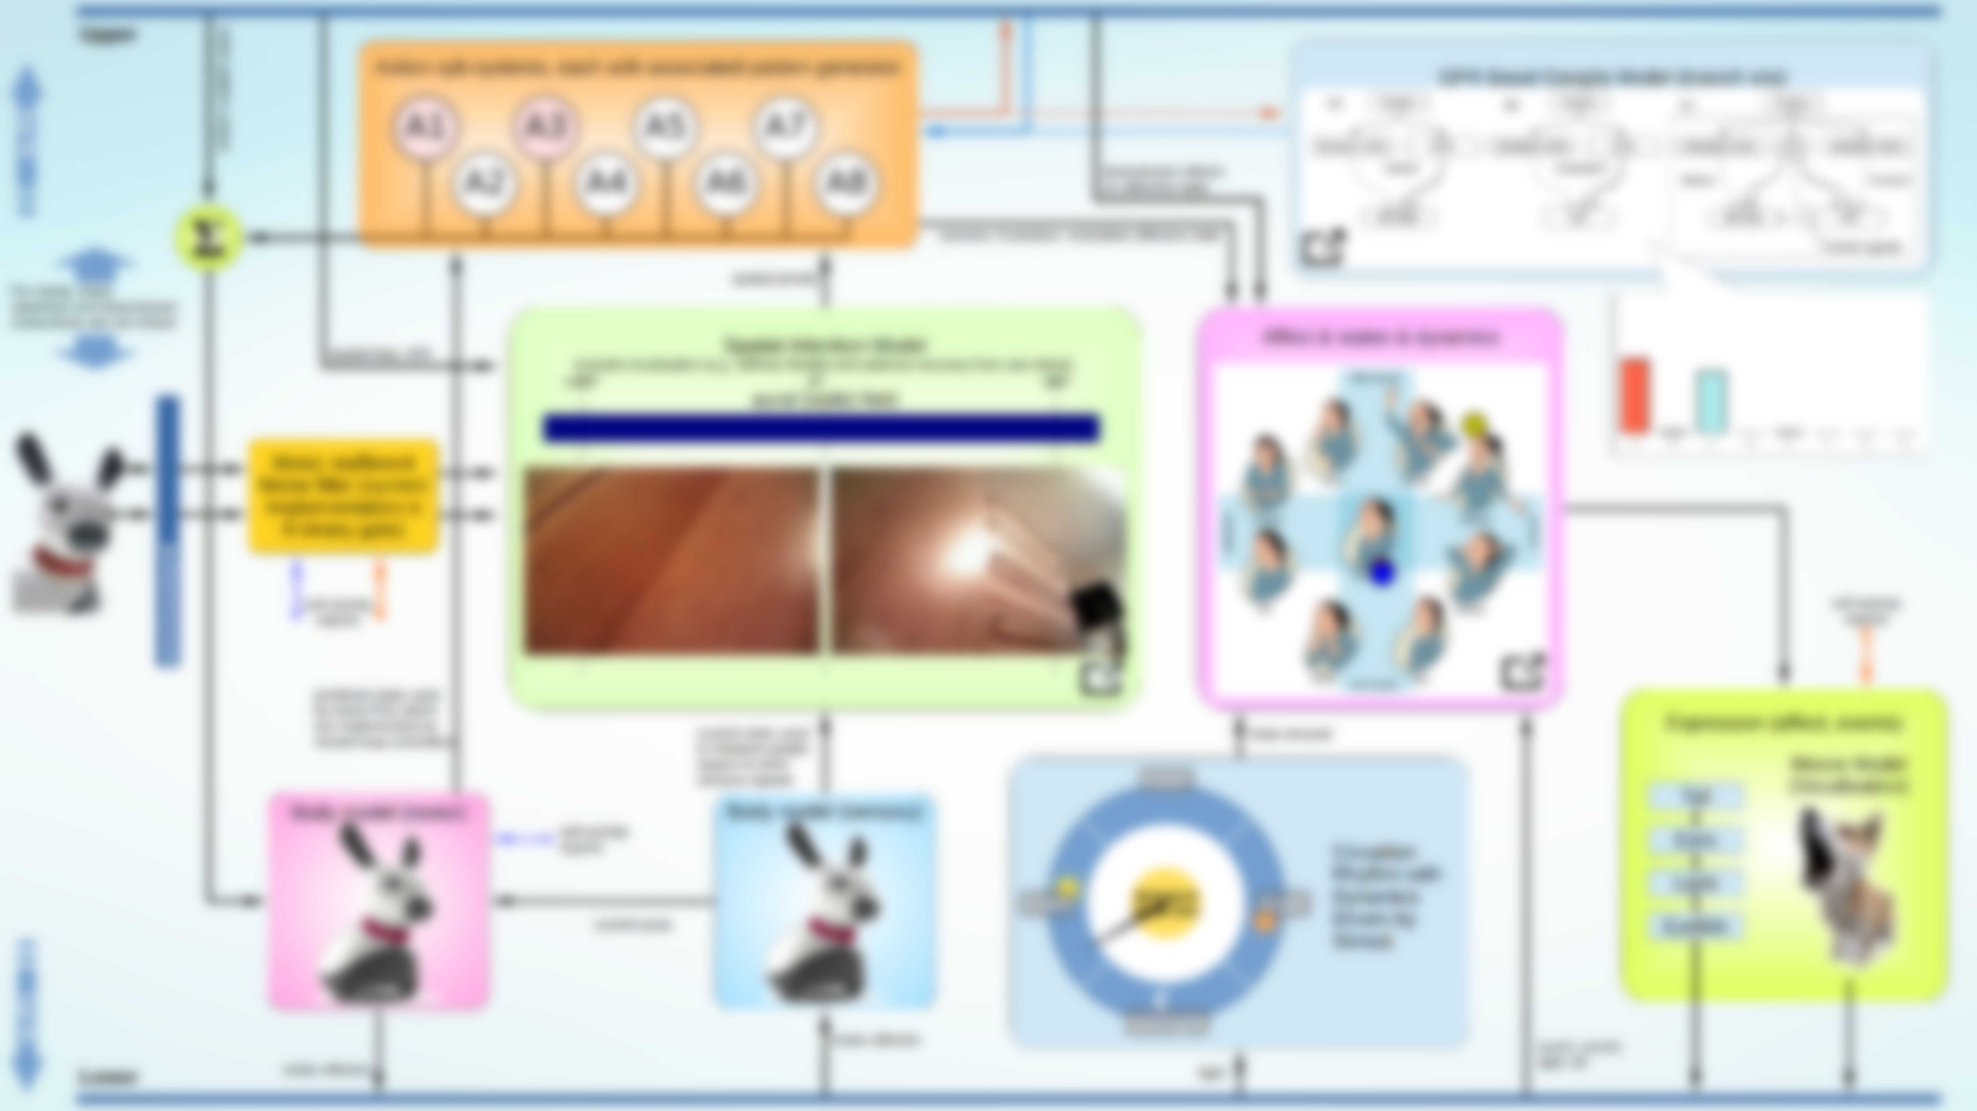
Spatial Attention Model
Includes localisation (e.g. Jeffress Model) and salience recovery from raw stimuli.
+90° 0° -90°
Spatial Priority
Spatial bias, IOR
aural (wide) field
Motor reafferent
Noise filter (current
Implementation is
A binary gate)
Current state used to interpret spatial aspect of other sensory signals
self-activity
reports

