Slide 1
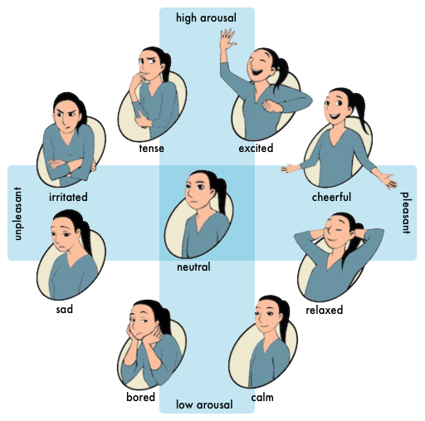
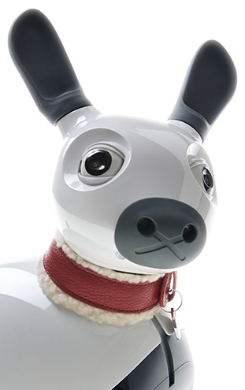
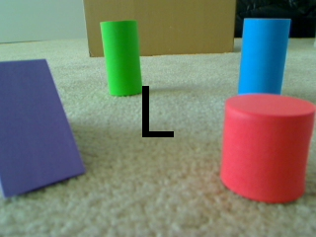
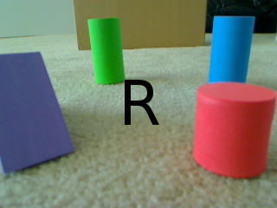
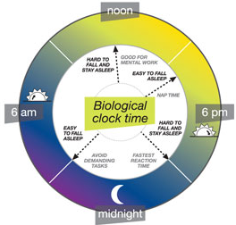
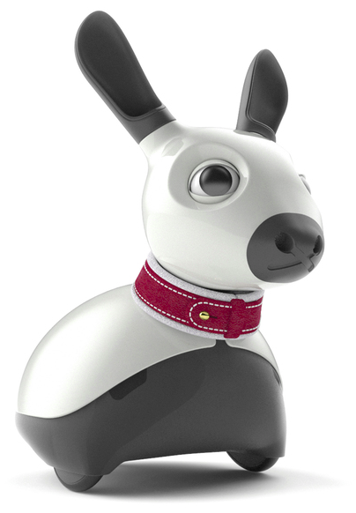

Upper
Action syb-systems, each with associated pattern generator
GPR Basal Ganglia Model (branch s/w)
to P3
motor pattern output
A1
A3
A5
A7
(a)
Cortex
(b)
Cortex
(c)
Cortex
A2
A4
A6
A8
Striatum (D1)
Select
STN
Striatum (D2)
Function?
STN
Striatum (D1)
STN
Striatum (D2)
downstream effects
on affective state
Select
Control
Σ
success, frustration, modulates affective state
EP/SNr
GP
EP/SNr
GP
Control signals
For clarity, many
Upstream and downstream connections are not shown
spatial priority
Spatial Attention Model
Includes localisation (e.g. Jeffress Model) and salience recovery from raw stimuli.
+90° 0° -90°
Affect & states & dynamics
spatial bias, IOR
aural (wide) field
Motor reafferent
Noise filter (current
Implementation is
A binary gate)
environment
self-activity
reports
self-activity
reports
predicted state used
by some PGs which
are implemented as
closed-loop controllers
Expression (affect, events)
current state used
to interpret spatial
aspect of other
sensory signals
base arousal
noon
Moore Model
(Vocalisation)
Body model (motor)
Body model (sensory)
Tail
self-activity
reports
Circadian
Rhythm with
Dynamics
Driven by
Stimuli.
Ears
Biological
Clock time
Light
6 am
6 pm
Eyelids
current pose
to P1
midnight
motor afferent
touch, sound,
light, tilt
motor efferent
light
Lower

