Slide 1

Towards a two-process model of antisaccades in PD WP3
Jen Lewis

Slide 2
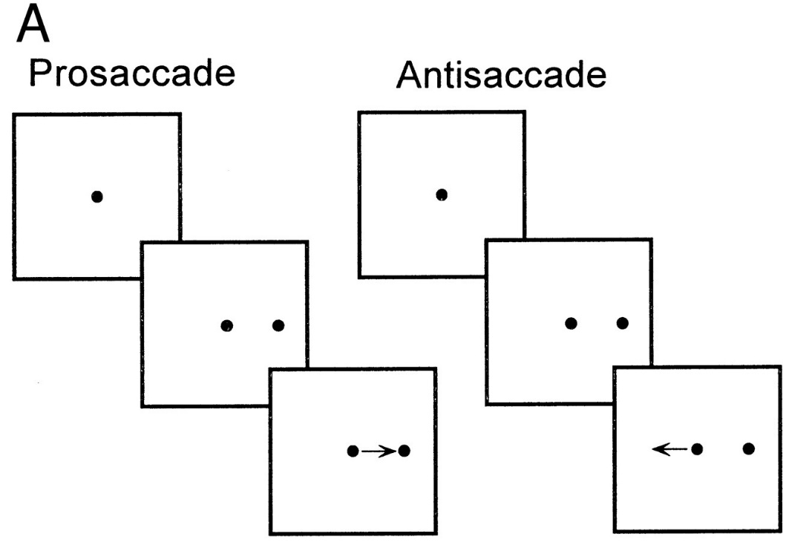
Towards a 2-process model of antisaccades in PD
Introduction
The antisaccade task + PD
From Bell et al., 2000
Existing studies of antisaccades in PD patients inconsistent and contradictory (though usually some impairment)

Slide 3
Towards a 2-process model of antisaccades in PD
Introduction
Particularly confusing is that studies suggest impairments result from cognitive deficits, rather than motor ones
Computational models can help elucidate mechanisms
– currently no models of antisaccade performance in PD
New data from Oxford ‘Discovery’ study to constrain novel model
Proposal for new model of antisaccades in PD, based on existing GPR oculomotor model
Model to include cognitive processes that depend on BG connectivity with frontal and parietal regions

Slide 4
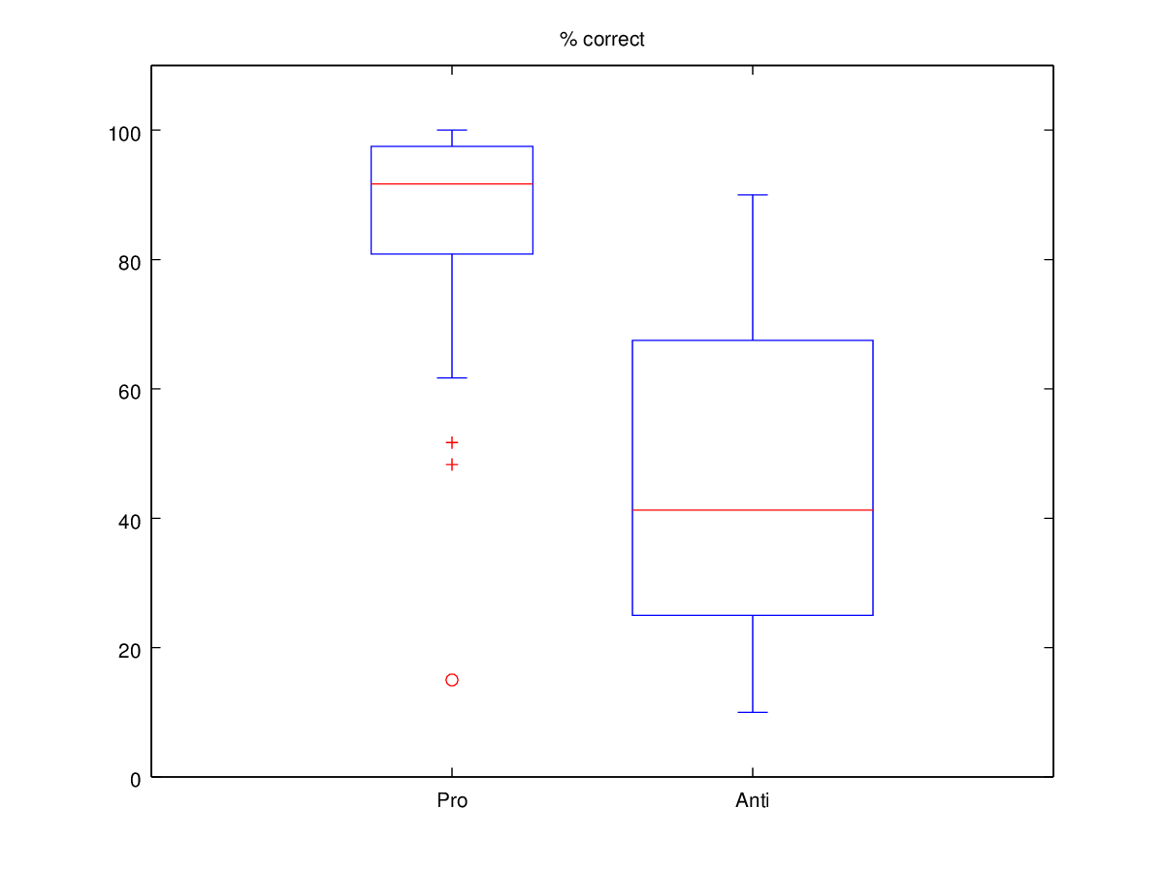
Towards a 2-process model of antisaccades in PD
New data from the Oxford ‘Discovery’ study – PD patients
% Correct
20 PD patients
Standardised antisaccade protocol
Step trials
5 blocks:
60 Pro trials
40 Anti trials
40 Anti trials
40 Anti trials
60 Pro trials
High error rate on AS
High variability on AS – consistent with literature
100
80
60
40
20
PS trials
AS trials

Slide 5
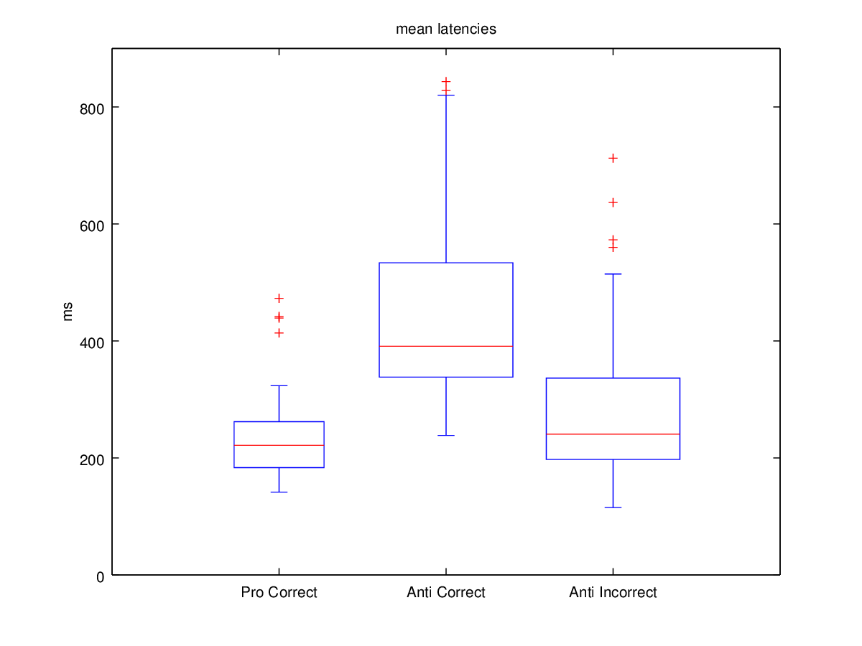
Towards a 2-process model of antisaccades in PD
New data from the Oxford ‘Discovery’ study – PD patients
Mean saccadic latency
800
Shortest RTs and least variability on PS trials
Longest RTs and greatest variability on correct AS trials
Largely consistent with literature
600
ms
400
200
0
Correct
PS trials
Correct
AS trials
Incorrect
AS trials

Slide 6
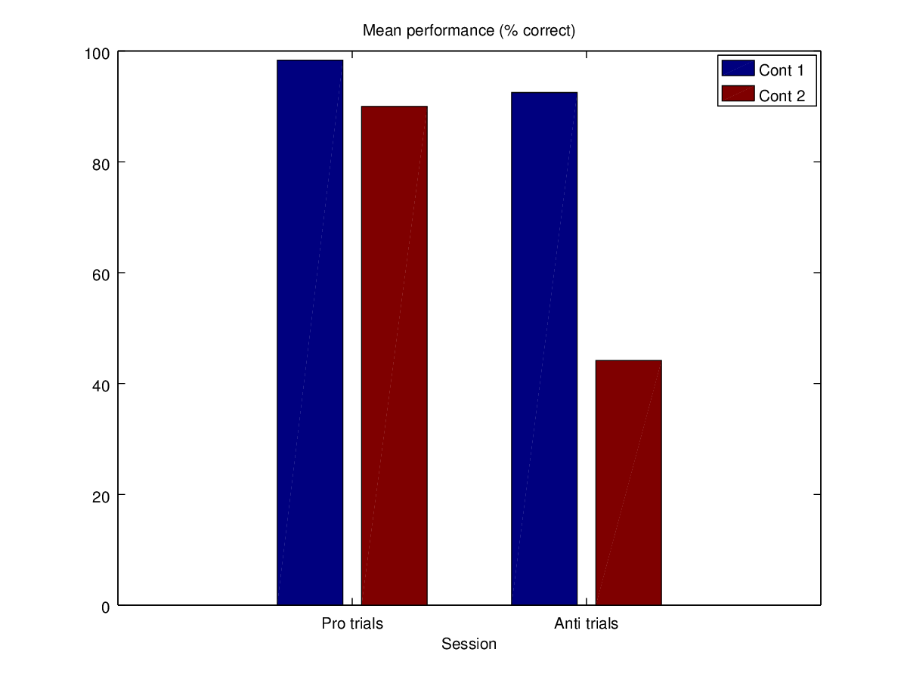
Towards a 2-process model of antisaccades in PD
New data from the Oxford ‘Discovery’ study – Controls (prelim)
% Correct
100
Con 1
Con 2
Early control data hints at interesting variability on AS?
‘Patient-like’ profile for control ppt 2?
Known that healthy controls can perform badly on AS – especially with increasing age
(Pa et al., 2014)
80
60
40
20
PS trials
AS trials

Slide 7
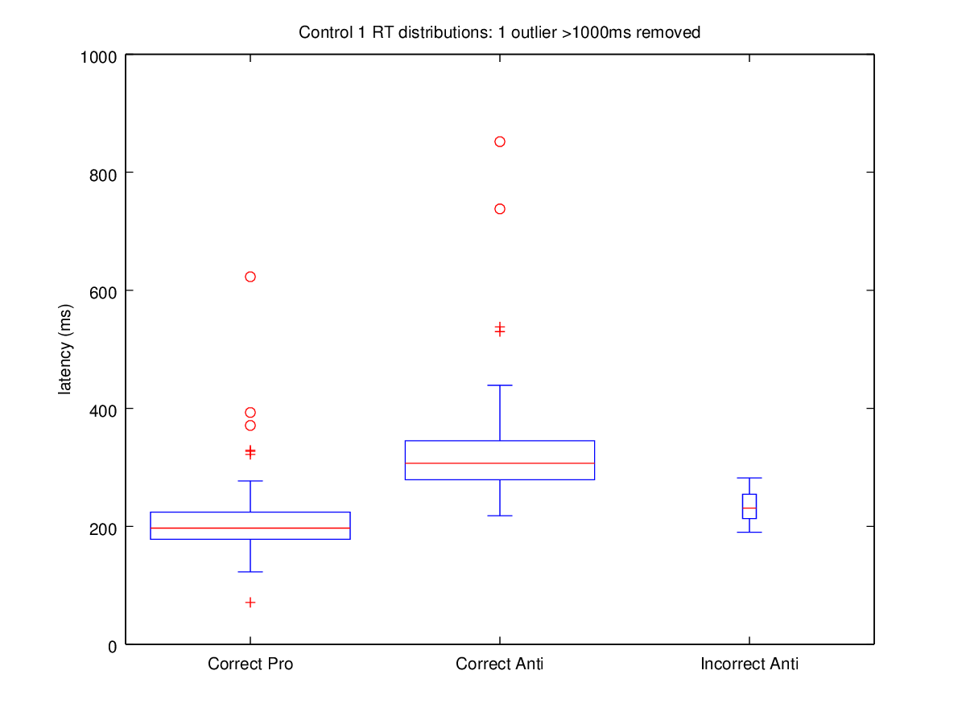
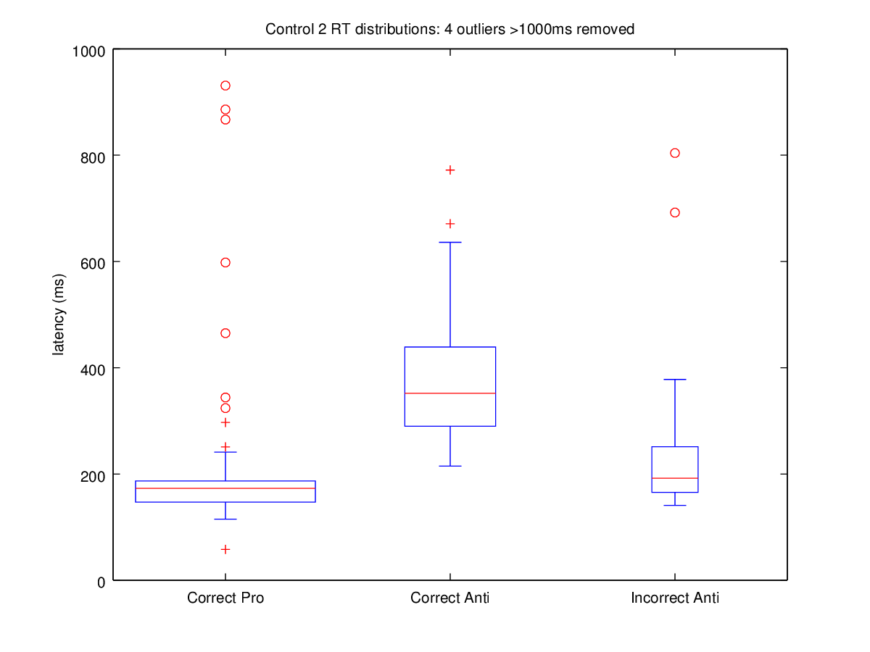
Towards a 2-process model of antisaccades in PD
New data from the Oxford ‘Discovery’ study – Controls (prelim)
Saccadic latency – Control 1 1 outlier > 1000ms removed
Saccadic latency – Control 2
4 outliers > 1000ms removed
1000
800
600
ms
400
200
0
Correct
PS trials
Correct
AS trials
Incorrect
AS trials
Correct
PS trials
Correct
AS trials
Incorrect
AS trials

Slide 8
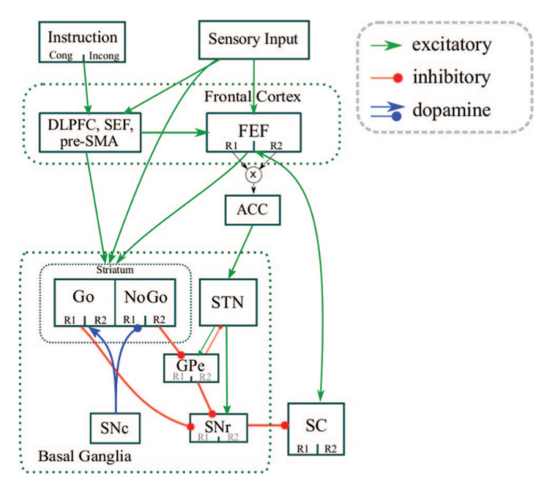
Towards a 2-process model of antisaccades in PD
Existing approaches to modelling antisaccades with BG
Wiecki & Frank, 2015
3 mechanisms for antisaccade performance:
‘Hold your horses’ signal in hyperdirect pathway – raises selection threshold
Excitation of stimulus location response in ‘No-go’ pathway
Excitation of opposite location response in ‘Go’ pathway

Slide 9
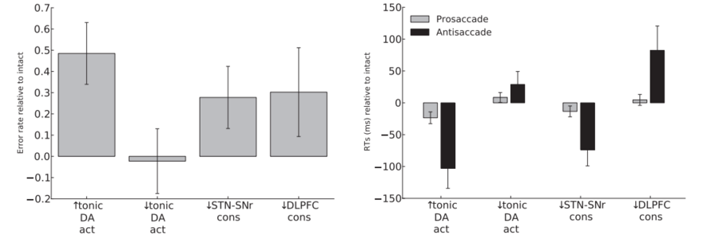
Towards a 2-process model of antisaccades in PD
Modelling depleted DA in motor BG:
Change in AS error rate
Change in saccadic latency
Model cannot account for PD antisaccade data by depleting tonic DA in motor regions of BG

Slide 10
Towards a 2-process model of antisaccades in PD
Why doesn’t depleted DA in motor loops result in PD-like performance?
PD performance on AS task correlates with measures of executive function rather than motor ability, especially switching ability (Antoniades et al., 2015; Cameron et al., 2012)
fMRI shows abnormal activation in prefrontal and parietal cortices in PD patients performing AS, as well as FEF (Cameron et al., 2012; Georges et al., 2015)
Especially during saccade preparation, rather than execution
Suggestive of an impairment in cognitive processes
Due to dysfunction in different regions of basal ganglia-thalamocortical system – not fully incorporated in Wiecki & Frank model.

Slide 11
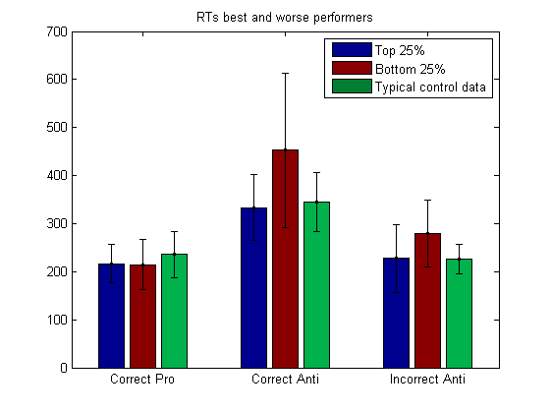
Towards a 2-process model of antisaccades in PD
What can we learn from comparisons of best and worst performers?
Mean saccadic latency
Best performers hardly impaired?
Worst performers slowest to perform correct AS
Possibly slower on incorrect antisaccades?
Worst performers no more impulsive
600
400
ms
200
0
Correct
PS trials
Correct
AS trials
Incorrect
AS trials

Slide 12
Towards a 2-process model of antisaccades in PD
What can we learn from comparisons of best and worst performers?
Mean saccadic latency
Slower errors suggest no more difficulty inhibiting prepotent response in worst performers
Instead, worst performers have more difficulty generating correct saccade?
Two processes may be differentially affected
(van Stockum et al., 2012)
600
400
ms
200
0
Correct
PS trials
Correct
AS trials
Incorrect
AS trials

Slide 13
Towards a 2-process model of antisaccades in PD
Reflexive response inhibition: two different mechanisms?
Thalamus
Associative BG
Notes:
Response inhibition is working through two mechanisms
They’re both accounted for in Frank’s model
But disruption in DA signalling in motor BG does not affect it’s functioning

Slide 14
Towards a 2-process model of antisaccades in PD
Voluntary response generation – multiple processes?
Selecting and maintaining a representation of the task
Parietal cortex (LIP)
Contributions to saccade programming & cognitive-motor
transformations
Contributions to spatial attention and saccade specification

Slide 15
Towards a 2-process model of antisaccades in PD
All regions sit in basal ganglia-thalamocortical loop system:
DLPFC
SEF
FEF
LIP
Overlapping corticostriatal projections
Basal ganglia
Dorsomedial
Dorsolateral
All these cortical regions show abnormal activation in PD antisaccades

Slide 16
Towards a 2-process model of antisaccades in PD
Are different loops more or less affected in individual patients?
DLPFC
SEF
FEF
LIP
May account for inconsistent findings including:
Some patients more affected by impulsive responding
Some patients more affected by slow responding
Differences in hypometria
Increasing severity of only some features in more severe PD

Slide 17
Towards a 2-process model of antisaccades in PD
Modelling approach:
DLPFC – BG loop
SEF – BG loop
FEF – BG
loop
LIP – BG
loop
Disrupt DA: deficits in inhibition & WM?
Disrupt DA: deficits in specifying saccades
Disrupt DA: slowed responses
Disrupt DA: deficits in attending to location for saccade
Model (some!) sub-processes in response inhibition and voluntary saccade generation independently
(May also begin to account for poorer performance in older controls and frontal lesion patients)

