Slide 1




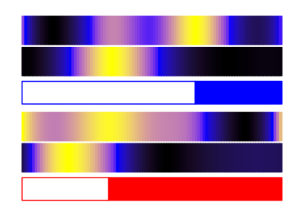
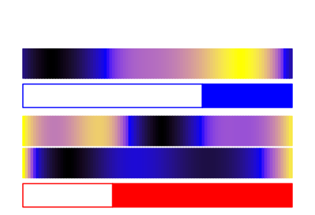
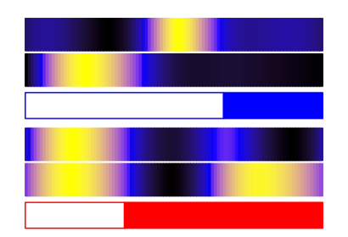
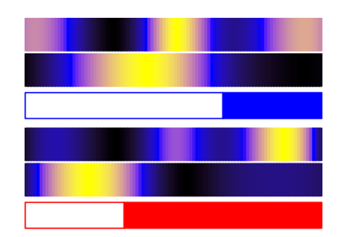
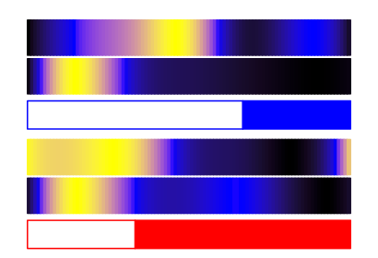
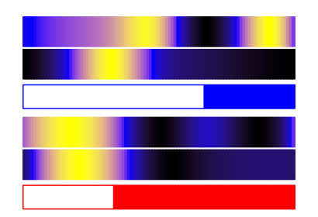
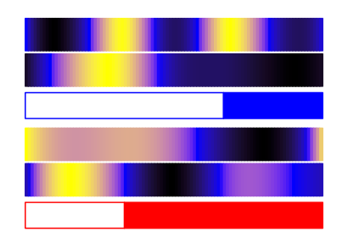
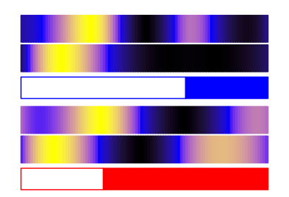
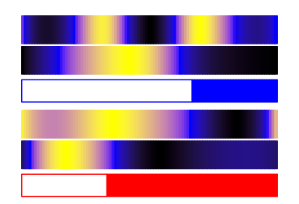
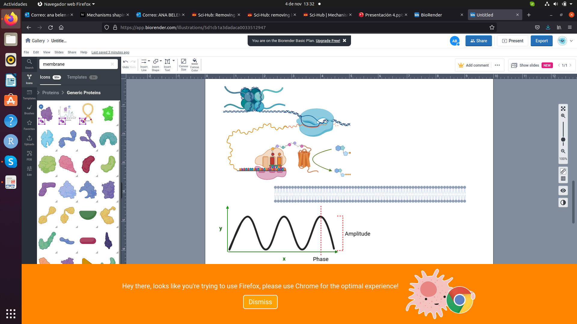
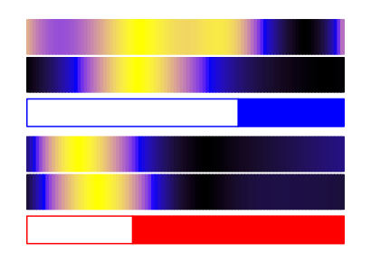
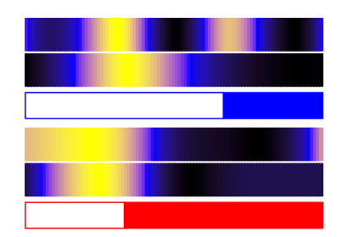
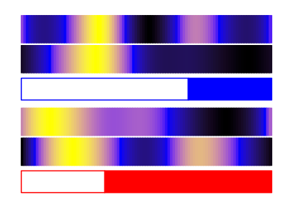
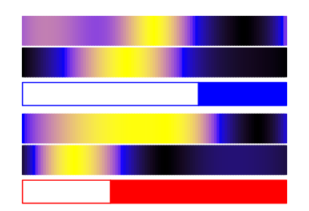
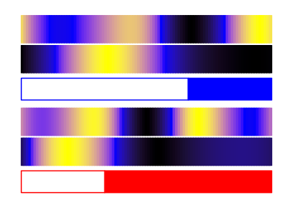
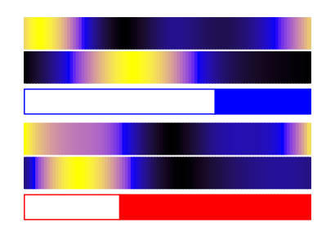
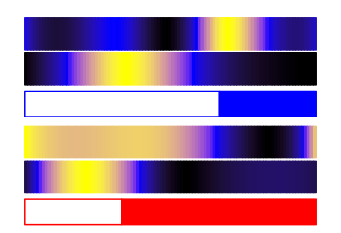
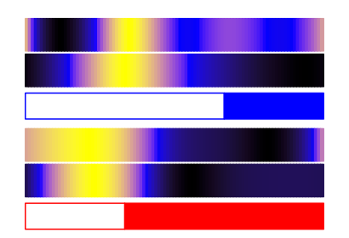
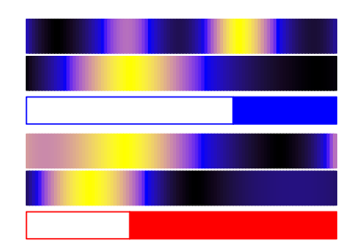
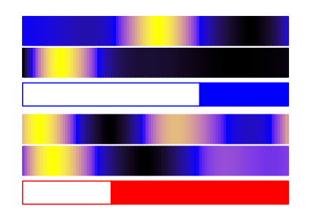
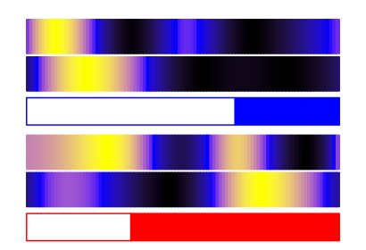
SOD
O₂ ⁻ + H⁺
H₂O₂
Ascorbate
NADPH
Stroma
NADPH
NADP⁺ + H⁺
APX
MDAR
H₂O
MDA
NADP⁺ + H⁺
FNR
H⁺
Fd
ADP + Pi
ATPD
ADP + Pi
LHCB5
H⁺
PsaD
O₂
H₂O
PsaE
ATPG
e⁻
PTOX
Psb27B
PQ
PetE
PetF
PsaG
ATPC
PsaL
LHCSR
PetC
PsaH
2H₂O
PsbO
PsbP
PsbQ
2O₂ + 4H⁺
Pc
PsaN
H⁺
H⁺
PsaF
PSII
Cyt b6f
PSI
ATPase
Lumen
PsbO - ostta14g00150
PsbP - ostta14g02630
PsbQ - ostta16g01620
LHCB5 - ostta14g00065
LHCB5 - ostta14g00065
Psb27B - ostta12g01970
LHCSR - ostta05g01780
PetC - ostta01g06610
PetE - ostta09g04240
PetF - ostta17g00310
PsaD - ostta15g02670
PsaE - ostta02g03860
PsaG - ostta05g00800
PsaL - ostta02g00580
PPH1 - ostta02g02330
PsaH - ostta15g00990
PsaN - ostta06g00250
PsaF - ostta04g01790
Fd - ostta17g00310
FNR - ostta18g01250
ATPC - ostta01g03770
ATPD - ostta07g01350
ATPG - ostta09g01080

Slide 2

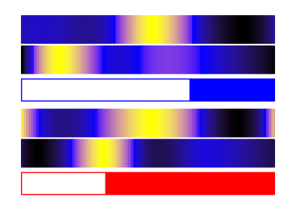

SOD
O₂ ⁻ + H⁺
H₂O₂
Ascorbate
NADPH
NADPH
NADP⁺ + H⁺
APX
MDAR
Flv
H₂O
MDA
NADP⁺ + H⁺
O₂
H₂O
FNR
Stroma
FNR
H⁺
PSII
Cyt b6f
Fd
PSI
ADP + Pi
ATPD
ADP + Pi
^{P}
LHCB5
H⁺
PsaD
PPH1
O₂
H₂O
PGR5
PsaE
^{P}
ATPG
e⁻
PTOX
STN7-8
Psb27B
PQ
PetE
PetF
PGRL1
PsaG
ATPC
PsaL
LHCSR
PetC
PsaH
2H₂O
PsbO
PsbP
PsbQ
2O₂ + 4H⁺
Pc
PsaN
H⁺
H⁺
PsaF
Lumen
PsbO - ostta14g00150
PsbP - ostta14g02630
PsbQ - ostta16g01620
LHCB5 - ostta14g00065
LHCB5 - ostta14g00065
Psb27B - ostta12g01970
LHCSR - ostta05g01780
PetC - ostta01g06610
PetE - ostta09g04240
PetF - ostta17g00310
PsaD - ostta15g02670
PsaE - ostta02g03860
PsaG - ostta05g00800
PsaL - ostta02g00580
PPH1 - ostta02g02330
PsaH - ostta15g00990
PsaN - ostta06g00250
PsaF - ostta04g01790
Fd - ostta17g00310
FNR - ostta18g01250
ATPC - ostta01g03770
ATPD - ostta07g01350
ATPG - ostta09g01080

Slide 3
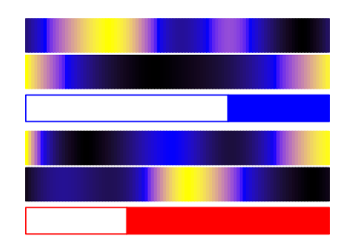

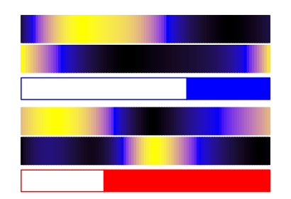
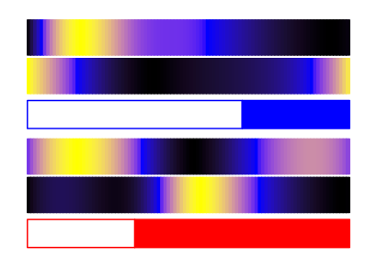

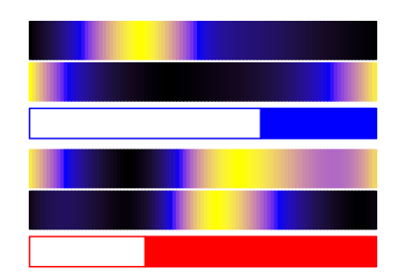
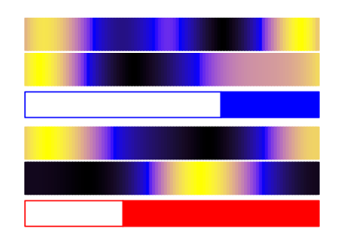
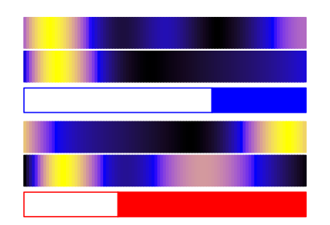
Protein LD
Transcript LD
Protein SD
Transcript SD
Nitrate
NRT3
Nitrate
NR
Nitrite
Nitrite
NIR
Ammonia
low
high
NRT2
GS
Glutamine
GOGAT
Glutamate
Cytoplasm
Chloroplast
NRT2 - ostta10g00950
NRT3 - ostta10g00940
NR - ostta10g00920
NIR - ostta10g00930
GS - ostta01g05020
GOGAT - ostta14g01900

Slide 4



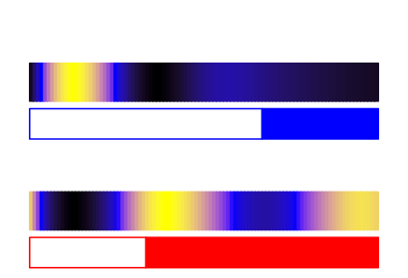


















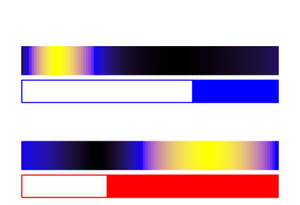





Pyruvate
Protein LD
low
high
(A)
GAP
Transcript LD
Protein SD
DXS
Transcript SD
Neoxanthin
DPX
Uriolide
NXS
DXR
MEP
Violaxanthin
CMS
Micromonal
VDE
ZEP
CDP-ME
CMK
CDP-MEP
Dihydrolutein
Prasinoxanthin
Antheraxanthin
MCS
VDE
ZEP
MEcPP
HDS
HMB-PP
Lutein
Zeaxanthin
HDR
εCH
βCH
IPP
DMAPP
βCH
GPPS
GPPS
α-carotene
β-carotene
GPP
LCYε/β
GGPPS
GGPP
PSY
Phytoene
PDS
ζ-carotene
ZDS
Lycopene
(B)
Transcript LD
Transcript SD
Protein LD
Protein SD
(C)
DXS - ostta02g01730
α-carotene
DXR - ostta04g03270
dihydrolutein
CMS - ostta07g03570
α branch
lutein
MEP
Pathway
CMK - ostta16g01910
prasinoxanthin
MCS - ostta11g00050
micromonal
HDS - ostta09g00960
uriolide
HDS - ostta09g00960
β-carotene
HDR - ostta08g01180
GPPS - ostta04g03170
β branch
zeaxanthin
GGPPS - ostta12g01280
antheraxanthin
PSY - ostta05g03530
violaxanthin
PDS - ostta10g02860
neoxanthin
Carotenogenesis Pathway
ZDS - ostta16g00590
LCYε/β - ostta14g00700
βCH - ostta13g02440
ZEP - ostta16g00670
VDE - ostta16g00660
NXS - ostta03g05610
εCH - ostta09g02540
α branch

Slide 5
















(A)
G1 Phase
S Phase
G2 Phase
% of Cells
% of Cells
% of Cells
G1
S
G2|M
G1
S
G2|M
G1
S
G1
S
G2|M
G1
S
G2|M
G1
S
G1
S
G2|M
G1
S
G2|M
G1
S
G1
S
G2|M
G1
S
G2|M
G1
S
G2|M
G1
S
G2|M
G1
S
G2|M
G1
S
G2|M
G1
S
G2|M
G1
S
G2|M
G1
S
G2|M
(B)
LD G1 Phase
LD G2 Phase
G1 Phase
Cells
G2 Phase
Cells
(G)
G1 Phase
Proteins
G2 Phase
Proteins
G1 Phase
Genes
G2 Phase
Genes
G2|M
G1
S
G2|M
G1
S
SD G1 Phase
SD G2 Phase
G1 Phase
Cells
G2 Phase
Cells
G1 Phase
Proteins
G2 Phase
Proteins
G1 Phase
Genes
G2 Phase
Genes
G1
S
G2|M
G1
S
G2|M
(C)
(D)
(E)
cycA
cycB
cycD
cdkA
CDKA
cdkB
CDKB
Gene Expression (FPKM)
Scaled Gene Expression
Protein Abundance
Scaled Gene Expression
Protein Abundance
G2|M
G1
S
G2|M
G1
S
G2|M
G1
S
cycA
cycB
cycD
cdkA
CDKA
cdkB
CDKB
Gene Expression (FPKM)
Scaled Gene Expression
Protein Abundance
Scaled Gene Expression
Protein Abundance
G1
S
G2|M
G1
S
G2|M
G1
S
G2|M
(F)
ftsz
FTSZ
ftsz
FTSZ
Scaled Gene Expression
Protein Abundance
Scaled Gene Expression
Protein Abundance
G2|M
G1
S
G1
S
G2|M

