Slide 1
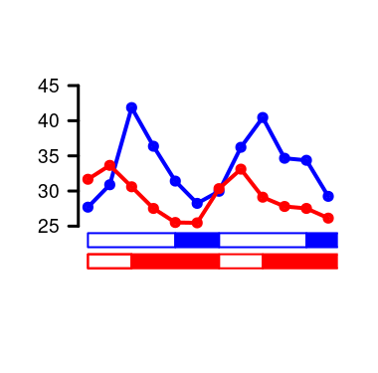
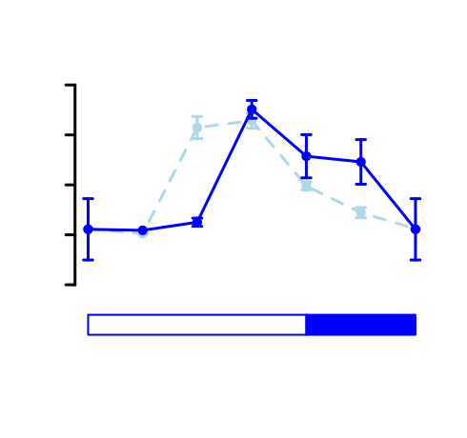
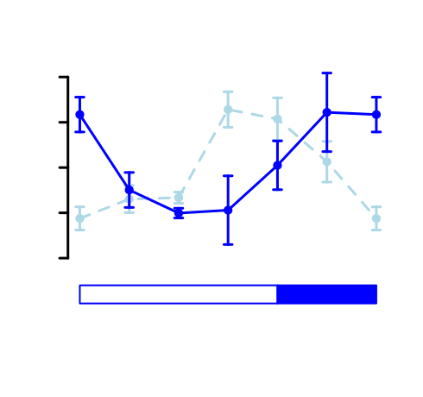

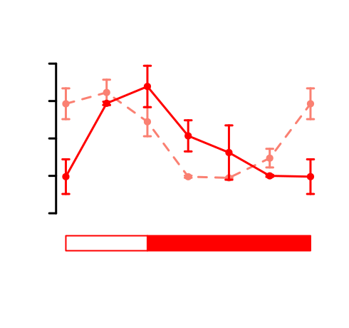
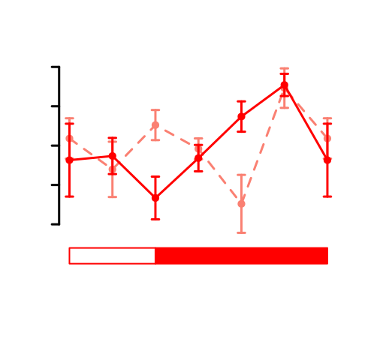

(A)
(B)
APL - ostta07g03440
AMY - ostta10g00260
Scaled Gene Expression
Protein Abundance
Scaled Gene Expression
Protein Abundance
Starch Content (%DW)
Starch
Starch
APL - ostta07g03440
AMY - ostta10g00260
Scaled Gene Expression
Protein Abundance
Scaled Gene Expression
Protein Abundance
Starch
Starch

