Slide 1




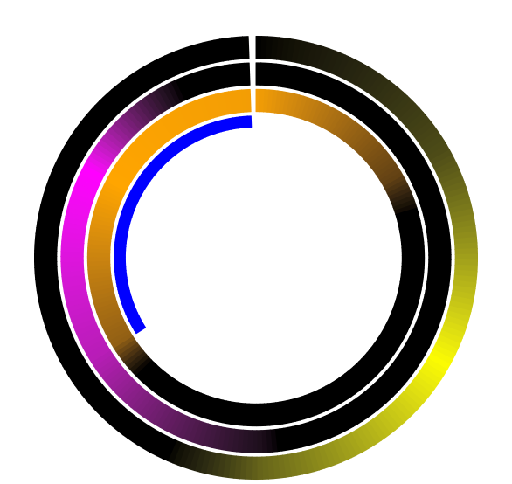
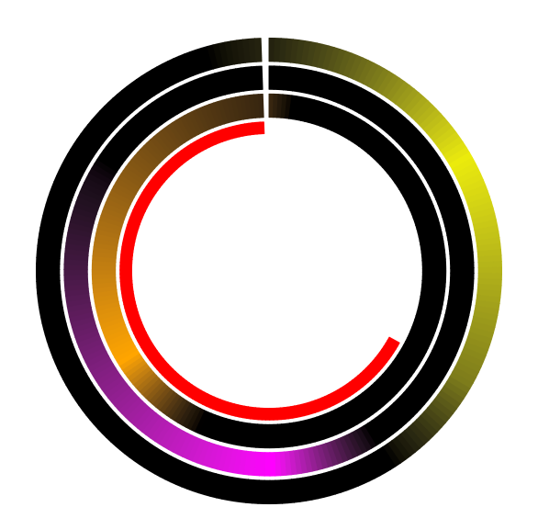
(A)
(B)
(C)
G1 Phase
S Phase
G2 Phase
% of Cells
% of Cells
% of Cells
G1
S
G2|M
G1
S
G2|M
G1
S
G1
S
G2|M
G1
S
G2|M
G1
S
G1
S
G2|M
G1
S
G2|M
G1
S
G1
S
G2|M
G1
S
G2|M
G1
S
G2|M
G1
S
G2|M
G1
S
G2|M
G1
S
G2|M
G1
S
G2|M
G1
S
G2|M
G1
S
G2|M
(A)
(A)
(B)
Number of cells
(C)
ZT0
Low High
ZT0
ZT20
ZT4
ZT20
ZT4
ZT16
ZT8
ZT16
ZT8
ZT12
ZT12

