Slide 1


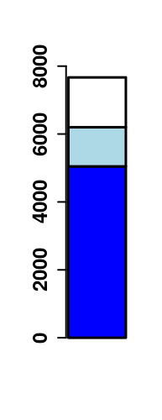
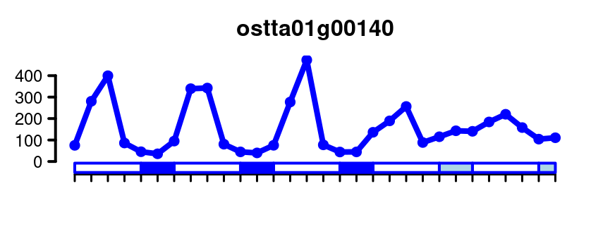
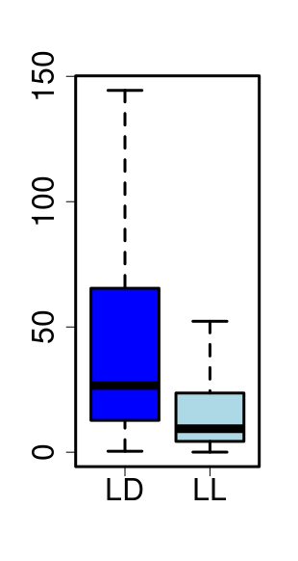
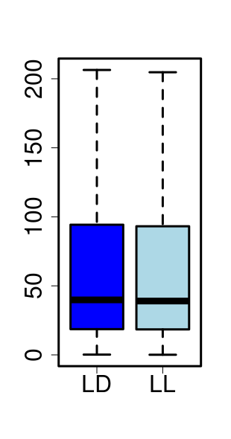
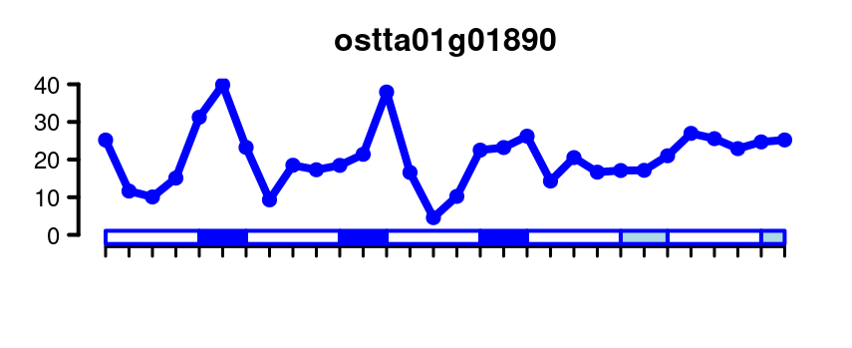
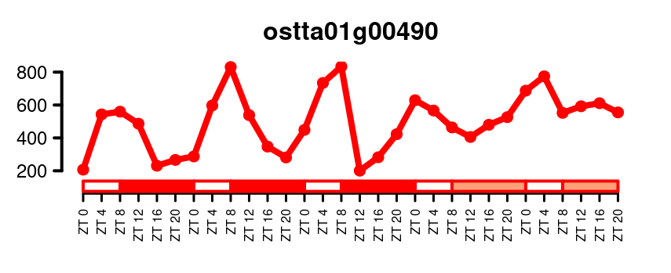
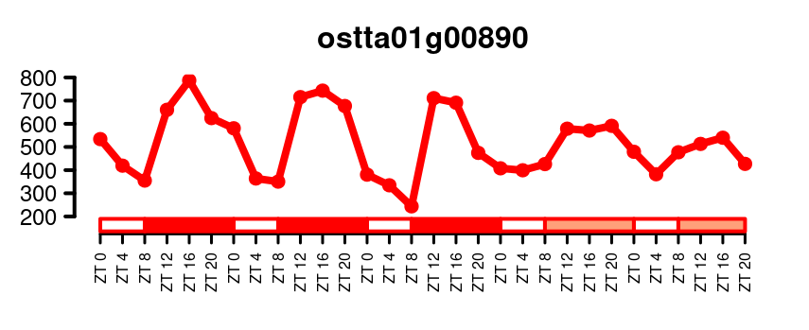
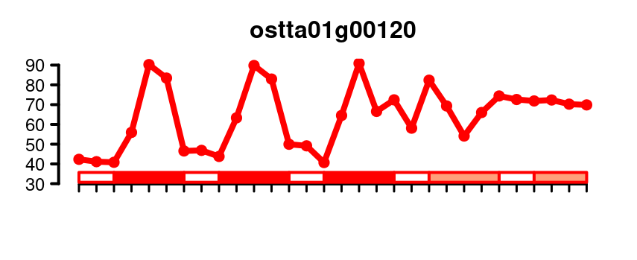
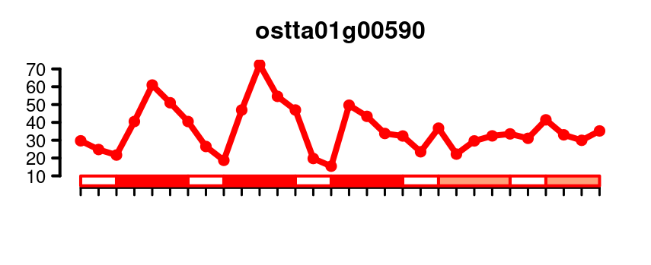
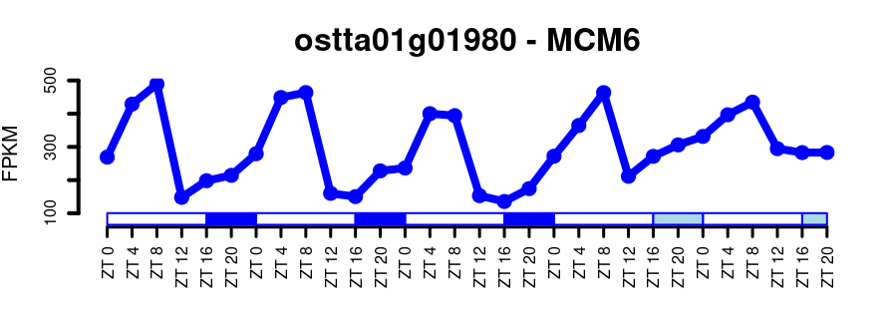
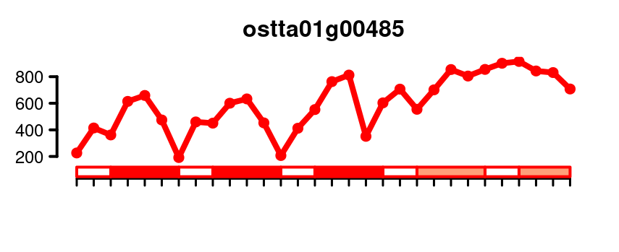
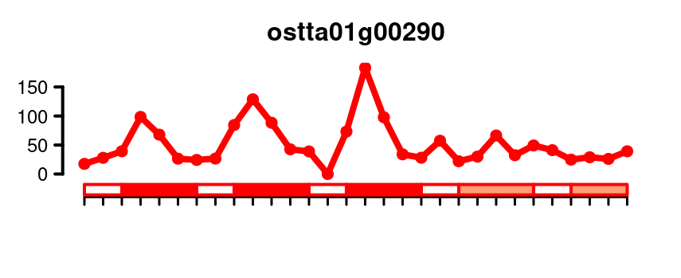
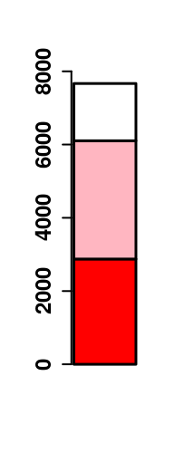
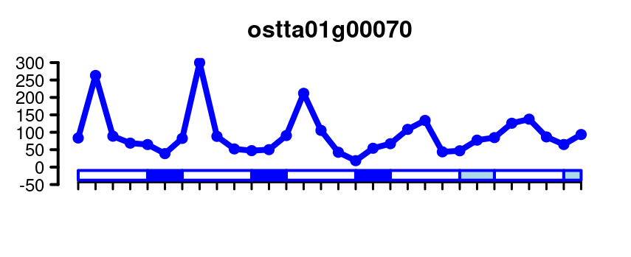
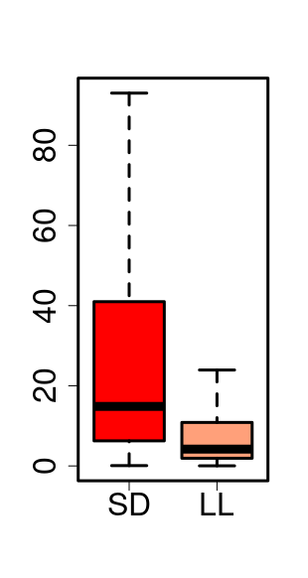
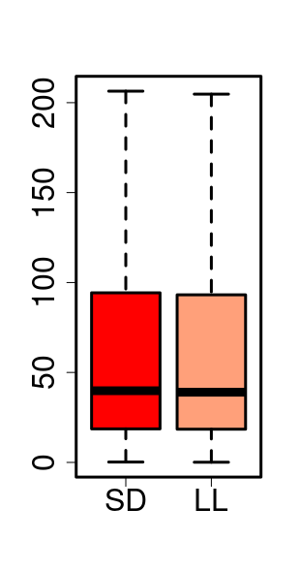
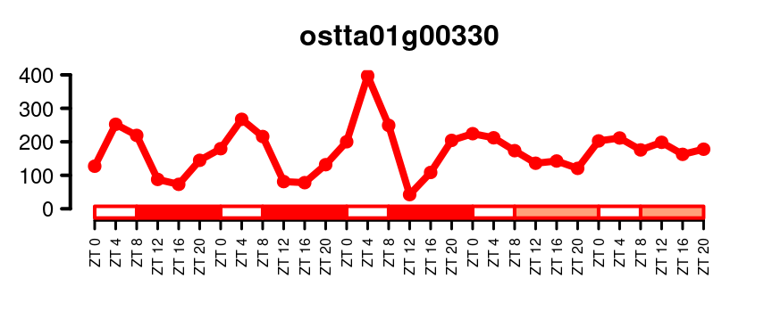
SD
Non rhythmic
212
Rhythmic
Number of Genes
620
Non rhythmic
Single peak rhythmic
Two peaks rhythmic
Max Expression (FPKM)
4589
683
176
ND
432
LD
753
Number of Genes
Mesor (FPKM)
Amplitude (FPKM)
Number of Genes

Slide 2
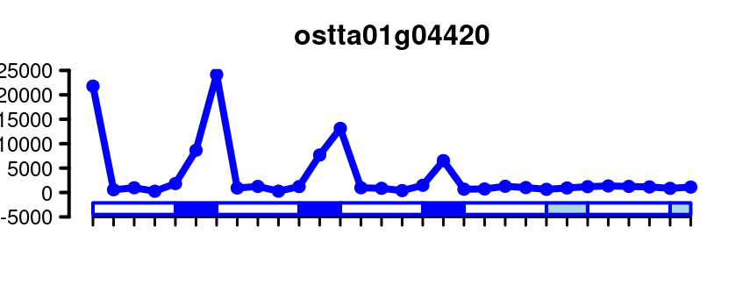
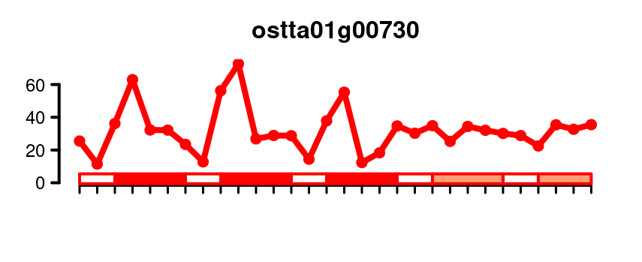
(A)
(B)
SD
(C)
Non rhythmic
212
Rhythmic
Number of Genes
620
Non rhythmic
Single peak rhythmic
Two peaks rhythmic
683
Max Expression (FPKM)
4589
176
ND
432
LD
753
(D)
(E)
(F)
Non rhythmic
Number of Genes
Rhythmic LD
Mesor (FPKM)
Rhythmic LD/LL
Amplitude (FPKM)
(G)
(H)
(I)
Non rhythmic
Mesor (FPKM)
Number of Genes
Rhythmic SD
Rhythmic SD/LL
Amplitude (FPKM)

Slide 3
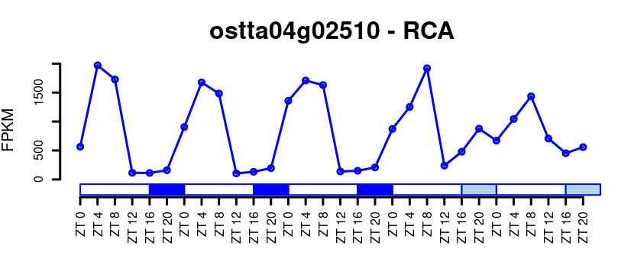
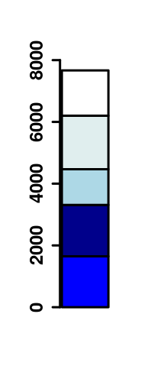
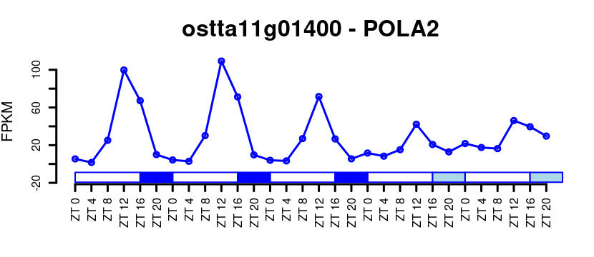
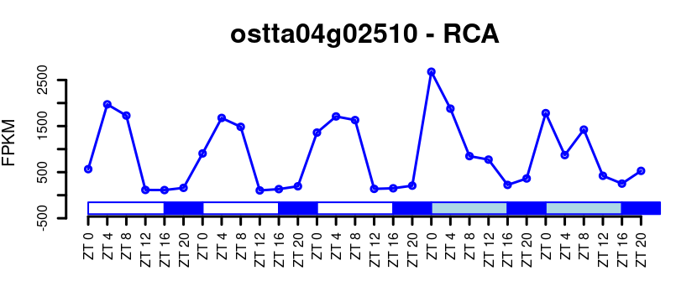
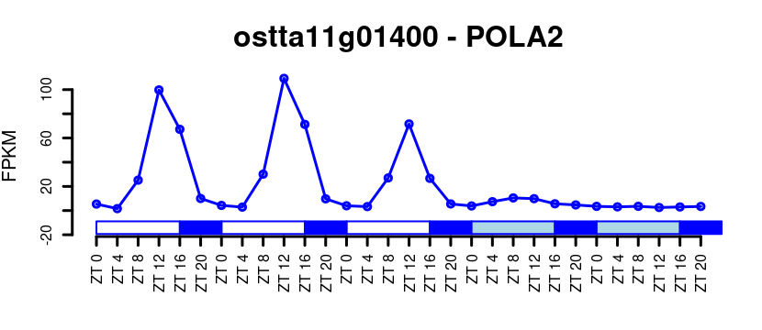
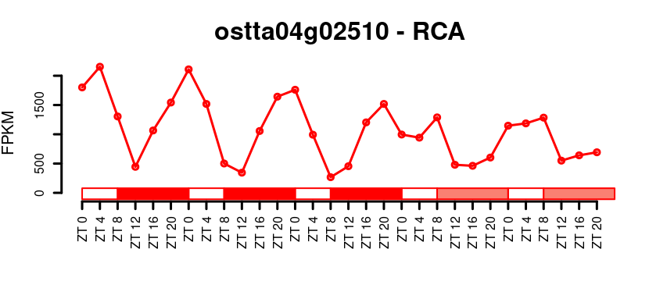
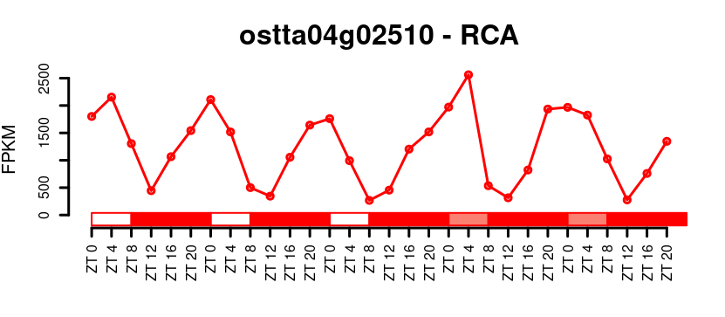
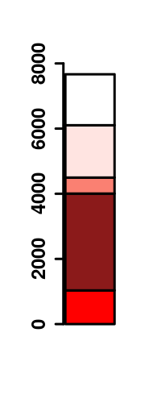
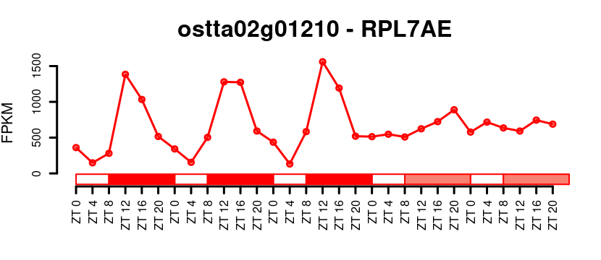
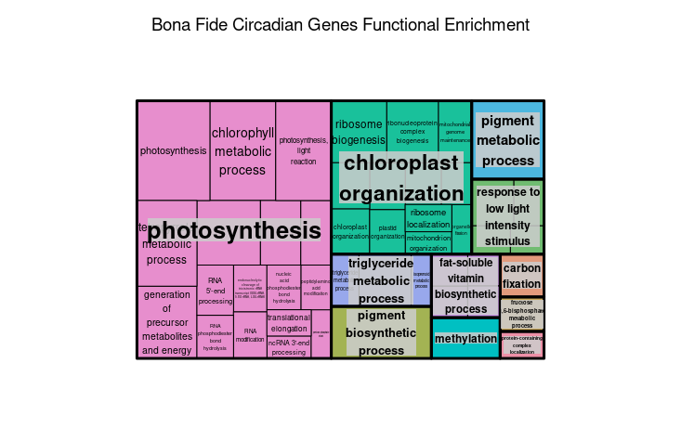
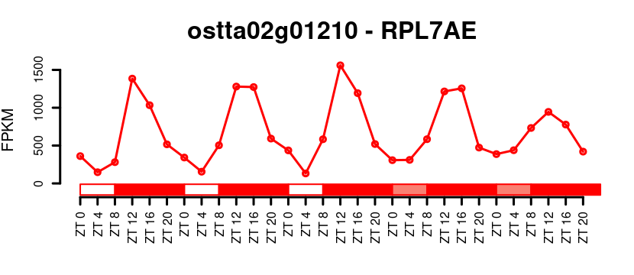
(A)
(B)
(C)
Rhythmic
Non rhythmic
929
Max Expression (FPKM)
5272
832
(H)
(D)
(E)
Non Rhythmic LD
Rhythmic only LD
Rhythmic LD/LL
Rhythmic LD/DD
Rhythmic LD/LL/DD
(F)
(G)
Non Rhythmic SD
Rhythmic only SD
(I)
Rhythmic SD/LL
Rhythmic SD/DD
Rhythmic SD/LL/DD

Slide 4
(A)
(B)
(G)
Rhythmic
Non rhythmic
Max Expression (FPKM)
1297
350
684
929
5272
832
(H)
(C)
(D)
Non Rhythmic LD
Rhythmic only LD
Rhythmic LD/LL
Rhythmic LD/DD
(I)
Rhythmic LD/LL/DD
(E)
(F)
Non Rhythmic SD
Rhythmic only SD
Rhythmic SD/LL
Rhythmic SD/DD
Rhythmic SD/LL/DD

Slide 5
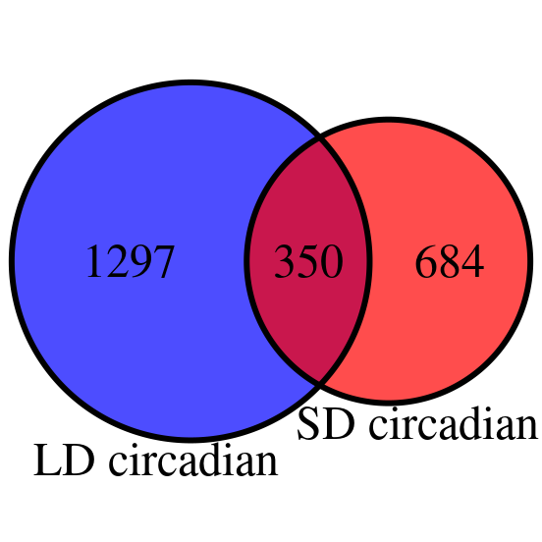

Slide 6
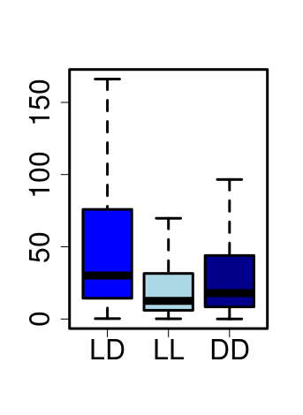
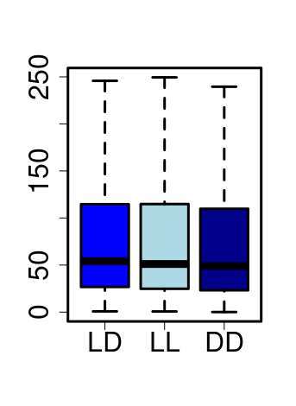
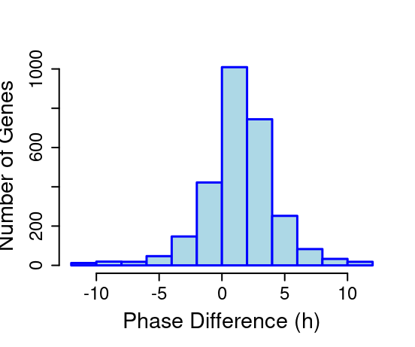
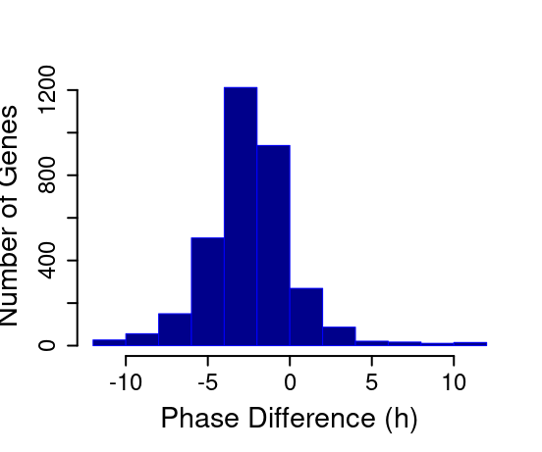
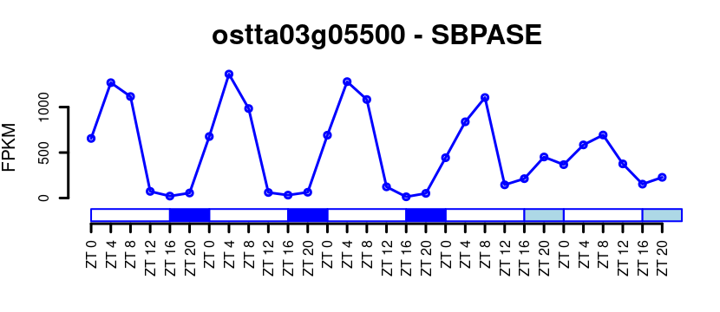
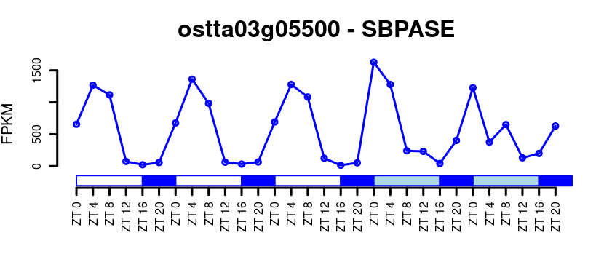
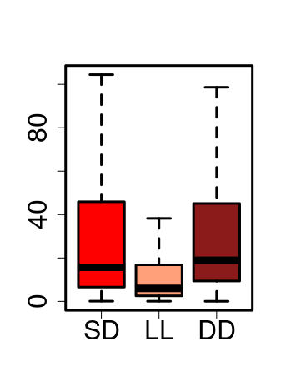
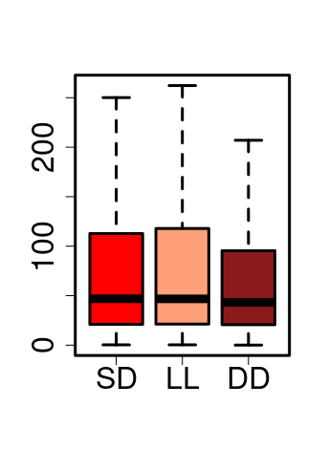
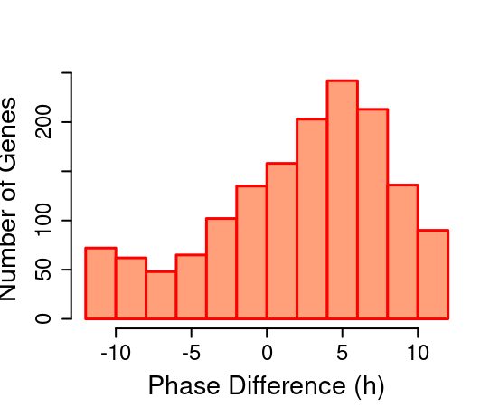
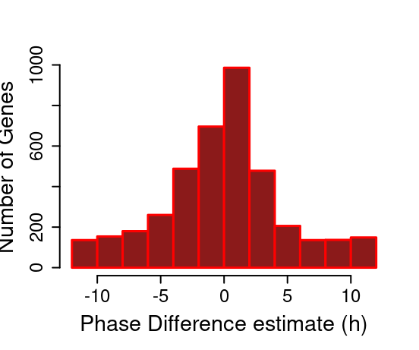
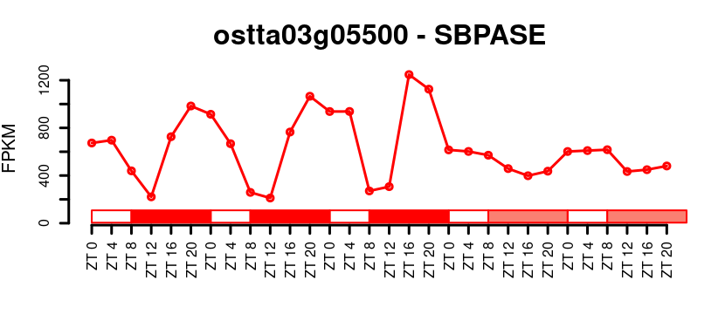
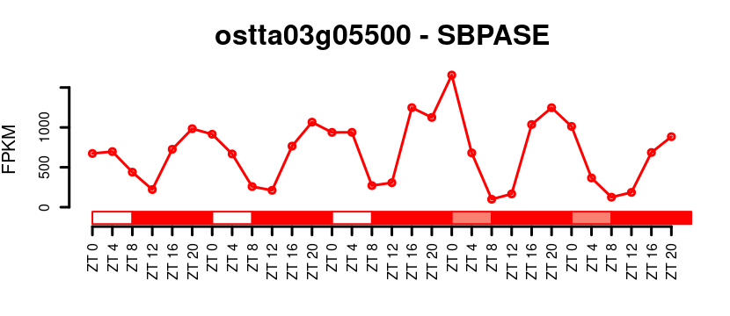
(A)
(B)
Mesor (FPKM)
1200
800
Amplitude (FPKM)
800
Number of genes
Number of genes
400
400
0
0
-10
-5
0
5
10
-10
-5
0
5
10
(C)
Phase Difference (h)
Phase Difference (h)
ostta03g05500 - SBPase
ostta03g05500 - SBPase
1000
1000
FPKM
FPKM
0
0
(D)
(E)
Amplitude (FPKM)
Mesor (FPKM)
200
800
Number of genes
Number of genes
100
400
0
0
-10
-5
0
5
10
-10
-5
0
5
10
(F)
Phase Difference (h)
Phase Difference (h)
ostta03g05500 - SBPase
ostta03g05500 - SBPase
1200
1500
FPKM
FPKM
600
750
0
0

Slide 7
(A)
(B)
1200
800
Amplitude (FPKM)
800
Number of genes
Number of genes
400
400
0
0
-10
-5
0
5
10
-10
-5
0
5
10
(C)
Phase Difference (h)
Phase Difference (h)
ostta03g05500 - SBPase
ostta03g05500 - SBPase
1000
1000
FPKM
FPKM
0
0
(D)
(E)
Amplitude (FPKM)
200
800
Number of genes
Number of genes
100
400
0
0
-10
-5
0
5
10
-10
-5
0
5
10
(F)
Phase Difference (h)
Phase Difference (h)
ostta03g05500 - SBPase
ostta03g05500 - SBPase
1200
1500
FPKM
FPKM
600
750
0
0

Slide 8
(A)
(B)
1200
800
Amplitude (FPKM)
800
Number of genes
Number of genes
400
400
0
0
-10
-5
0
5
10
-10
-5
0
5
10
(C)
Phase Difference (h)
Phase Difference (h)
ostta03g05500 - SBPase
ostta03g05500 - SBPase
1000
1000
FPKM
FPKM
0
0
(D)
(E)
Amplitude (FPKM)
200
800
Number of genes
Number of genes
100
400
0
0
-10
-5
0
5
10
-10
-5
0
5
10
(F)
Phase Difference (h)
Phase Difference (h)
ostta03g05500 - SBPase
ostta03g05500 - SBPase
1200
1500
FPKM
FPKM
600
750
0
0

