Slide 1


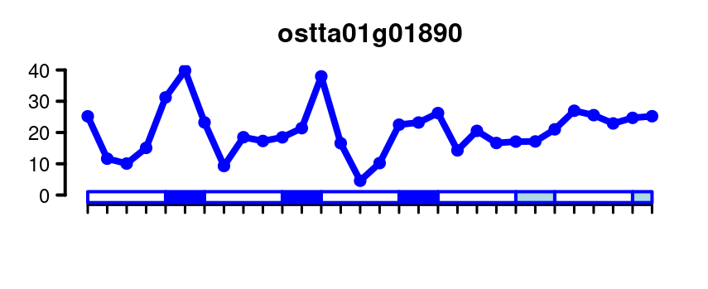
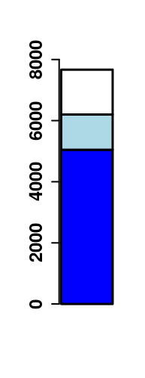
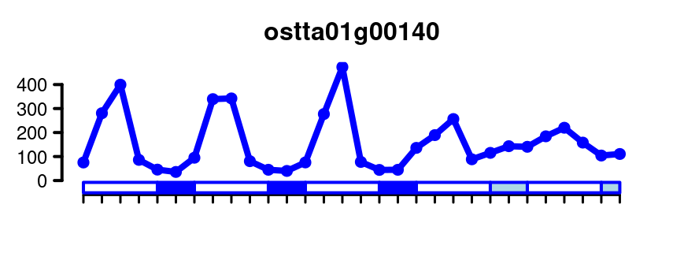
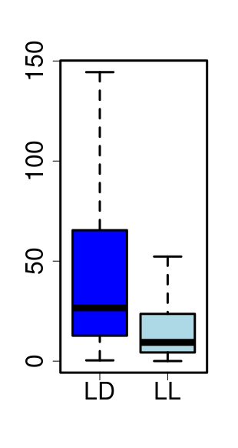
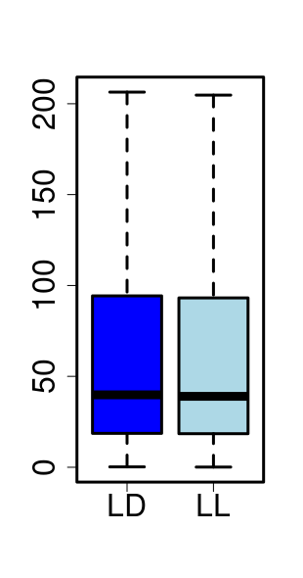
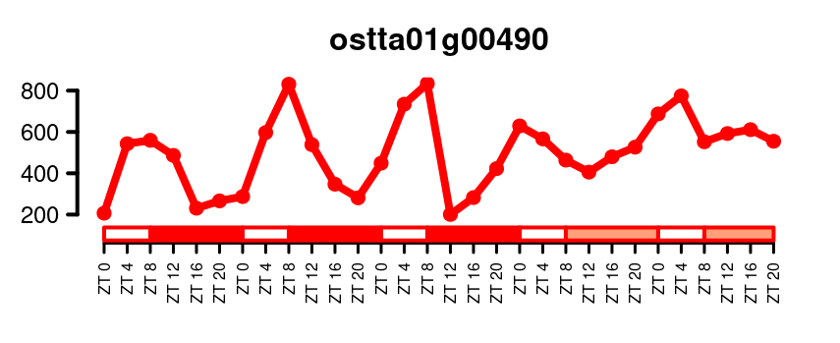
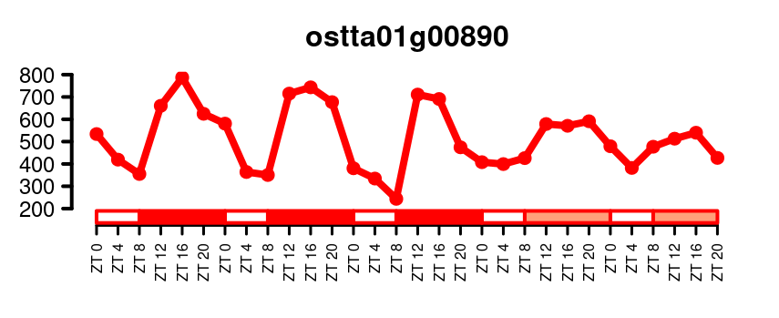
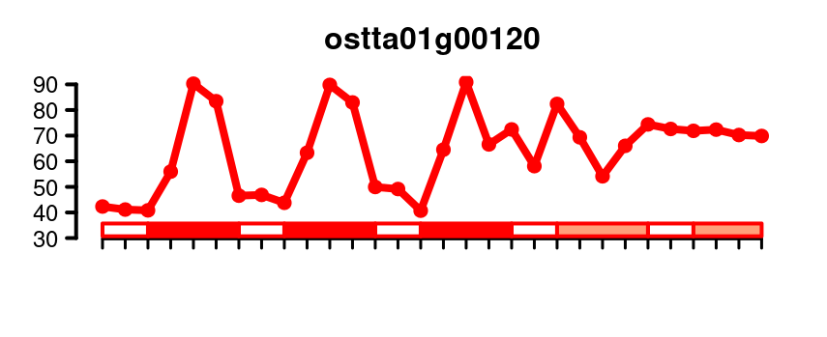
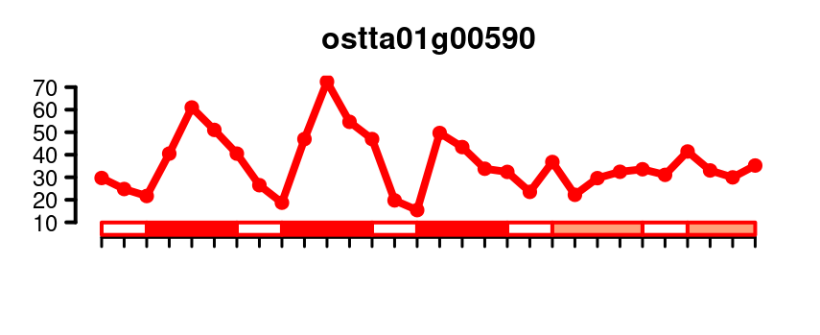
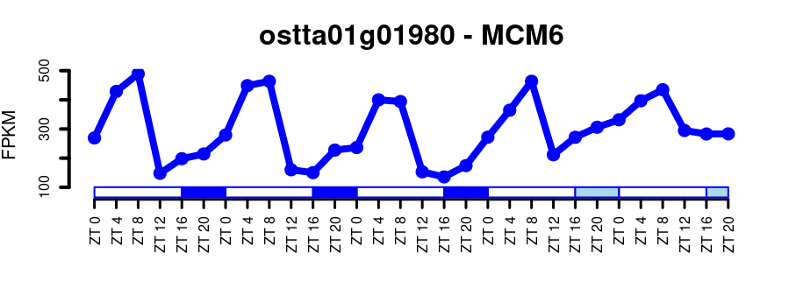
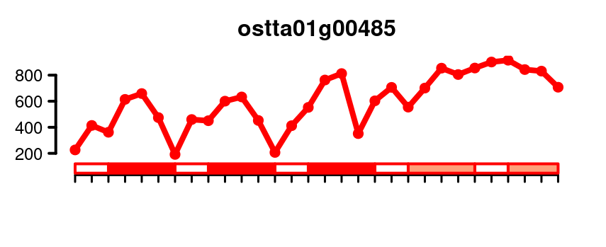
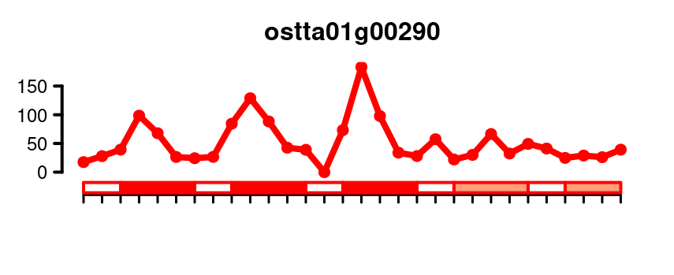
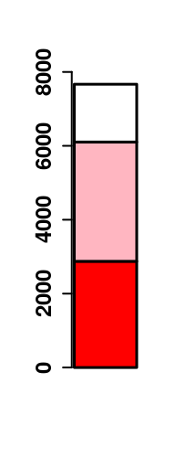
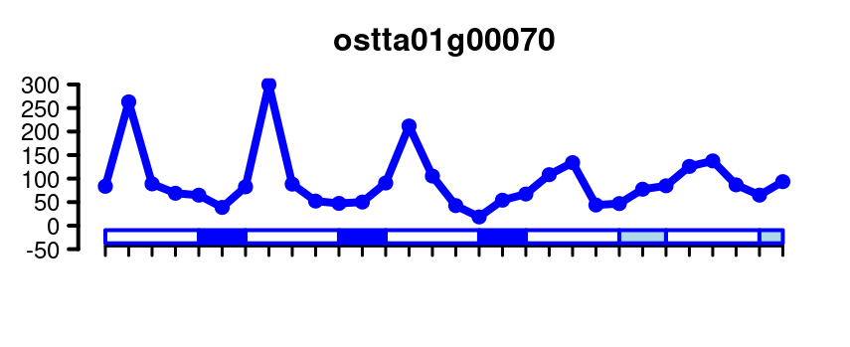
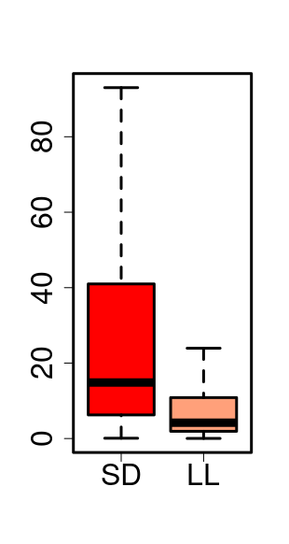
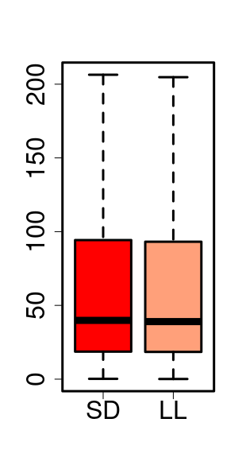
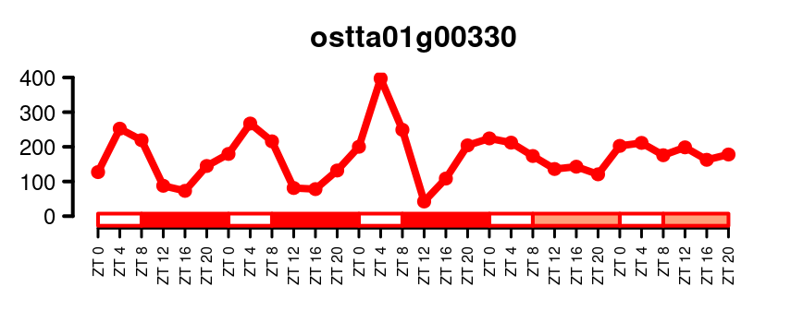
SD
Non rhythmic
620
212
Rhythmic
Number of Genes
Single peak rhythmic
Non rhythmic
Two peaks rhythmic
4589
683
Max Expression (FPKM)
ND
176
432
753
LD
Number of Genes
Amplitude (FPKM)
Mesor (FPKM)
Number of Genes

Slide 2
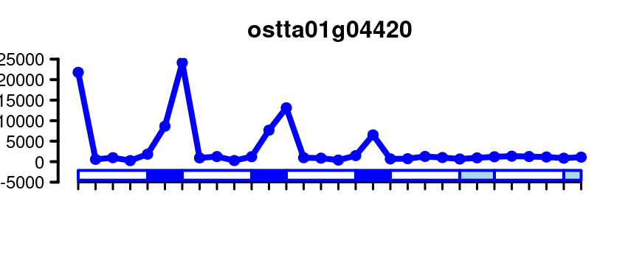
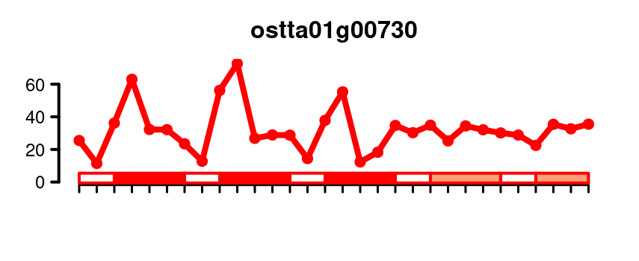
(A)
(B)
SD
(C)
Non rhythmic
620
212
Rhythmic
Number of Genes
Single peak rhythmic
Non rhythmic
Two peaks rhythmic
4589
683
Max Expression (FPKM)
ND
176
432
753
LD
(D)
(E)
(F)
Non rhythmic
Mesor (FPKM)
Number of Genes
Rhythmic LD
Amplitude (FPKM)
Rhythmic LD/LL
(G)
(H)
(I)
Number of Genes
Non rhythmic
Mesor (FPKM)
Rhythmic SD
Amplitude (FPKM)
Rhythmic SD/LL

Slide 3

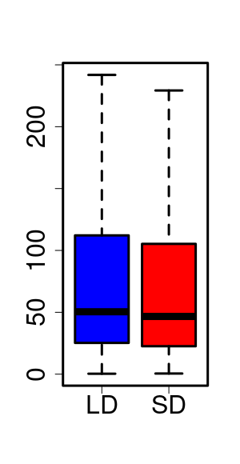









(A)
(B)
FPKM
Number of Genes
(C)
ZT0
ZT8
ZT16
ZT4
ZT12
ZT20
ZT24
Mesor (FPKM)
Amplitude (FPKM)
FPKM
Number of Genes
ZT0
ZT8
ZT16
ZT4
ZT12
ZT20
ZT24
(D)
FPKM
Number of Genes
Non rhythmic
Single peak
Two peaks
(F)
ZT0
(G)
ZT0
ZT20
ZT4
ZT20
ZT4
ZT16
ZT8
ZT16
ZT8
ZT12
ZT12

Slide 4
(A)
(B)
FPKM
Number of Genes
(C)
ZT0
ZT8
ZT16
ZT4
ZT12
ZT20
ZT24
Amplitude (FPKM)
FPKM
Number of Genes
ZT0
ZT8
ZT16
ZT4
ZT12
ZT20
ZT24
(D)
(E)
(F)
FPKM
Number of Genes
Non rhythmic
Single peak
Two peaks
(G)
ZT0
(H)
ZT0
ZT20
ZT4
ZT20
ZT4
ZT16
ZT8
ZT16
ZT8
ZT12
ZT12

Slide 5
(A)
(B)
FPKM
Number of Genes
(C)
ZT0
ZT8
ZT16
ZT4
ZT12
ZT20
ZT24
Amplitude (FPKM)
FPKM
Number of Genes
ZT0
ZT8
ZT16
ZT4
ZT12
ZT20
ZT24
(D)
(E)
(F)
FPKM
Number of Genes
Non rhythmic
Single peak
Two peaks
(G)
(H)
Ribosome
Biogenesis
Catabolic
Process
ZT0
ZT0
Amino Acid
Metabolism
Translation
Carbohydrate
Metabolism
Photosynthesis
ZT20
ZT4
ZT20
ZT4
ZT16
ZT8
Translation
ZT16
ZT8
Intracellular
Transport
Photosynthesis
Amino Acid
Metabolism
DNA
Replication
Carbohydrate
Metabolism
ZT12
ZT12
DNA
Replication
Ribosome
Biogenesis

Slide 6
(A)
(B)
FPKM
Number of Genes
(C)
ZT0
ZT8
ZT16
ZT4
ZT12
ZT20
ZT24
Amplitude (FPKM)
FPKM
Number of Genes
ZT0
ZT8
ZT16
ZT4
ZT12
ZT20
ZT24
(D)
(E)
(F)
FPKM
Number of Genes
Non rhythmic
Single peak
Two peaks
(G)
(H)
Ribosome
Biogenesis
Catabolic
Process
ZT0
ZT0
Amino Acid
Metabolism
Translation
Carbohydrate
Metabolism
Photosynthesis
ZT20
ZT4
ZT20
ZT4
ZT16
ZT8
Translation
ZT16
ZT8
Intracellular
Transport
Photosynthesis
Amino Acid
Metabolism
DNA
Replication
Carbohydrate
Metabolism
ZT12
ZT12
DNA
Replication
Ribosome
Biogenesis

Slide 7
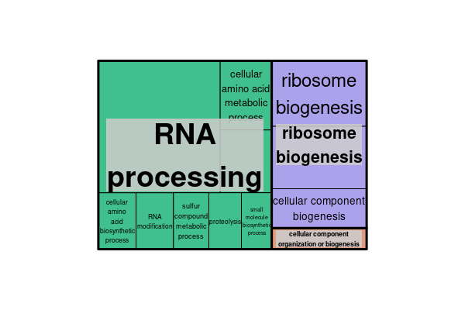
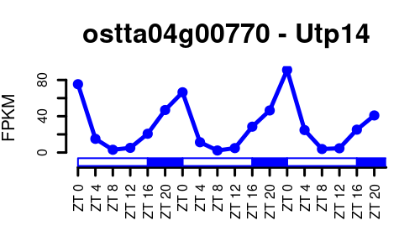
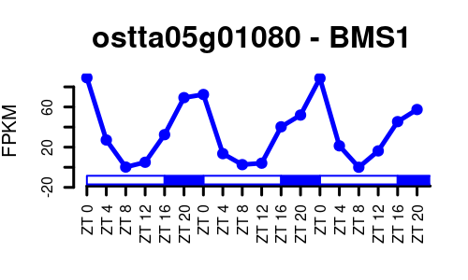
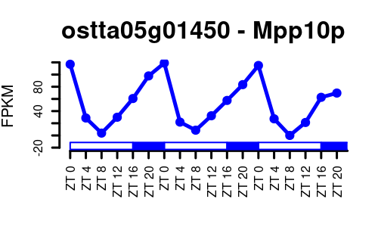
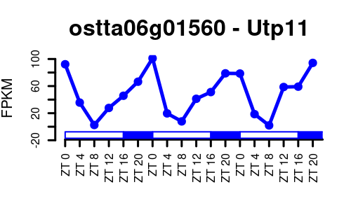
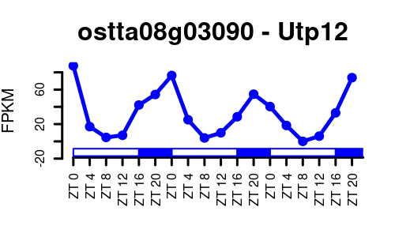
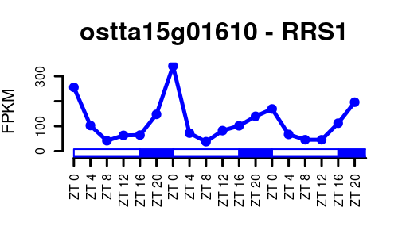
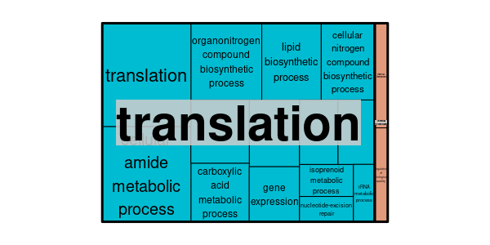
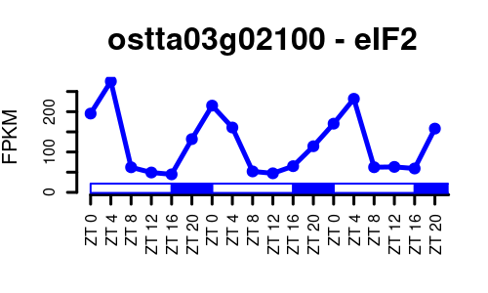
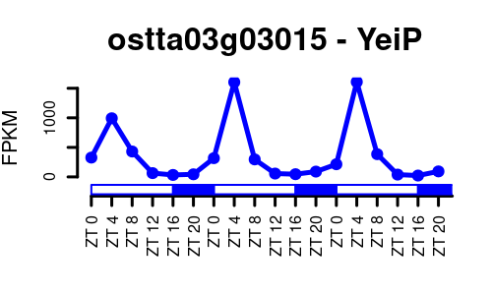
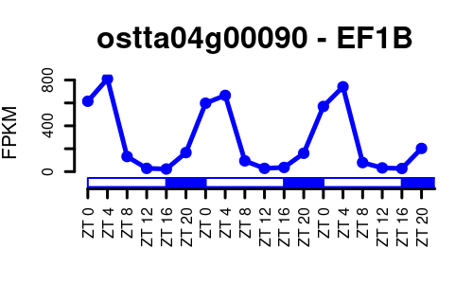
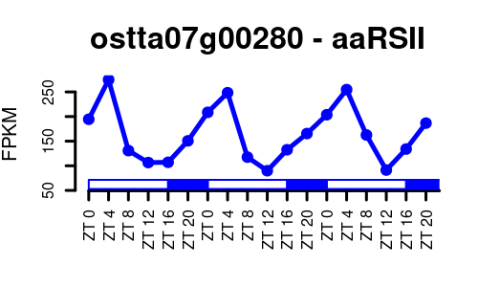
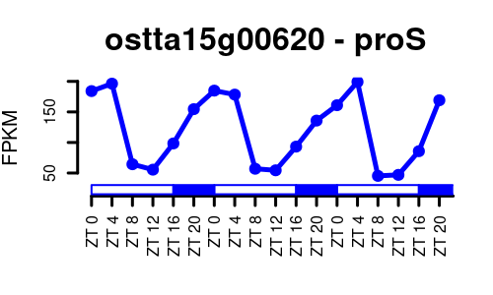
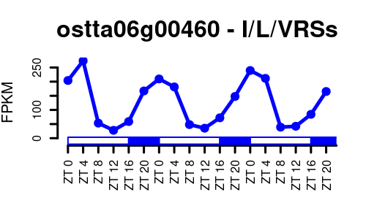
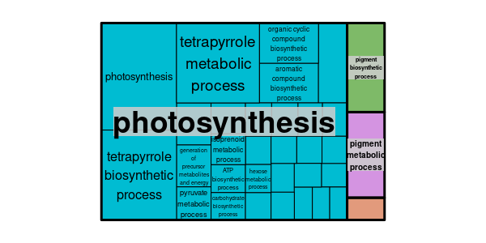
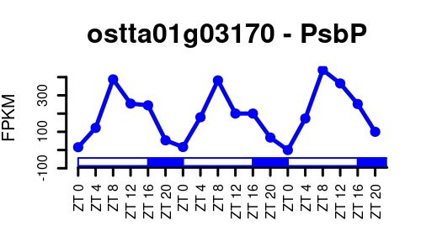
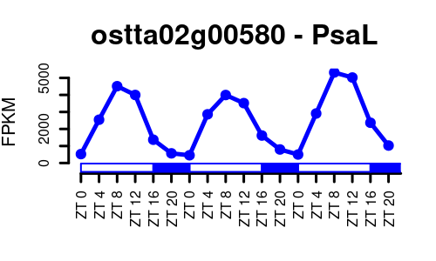
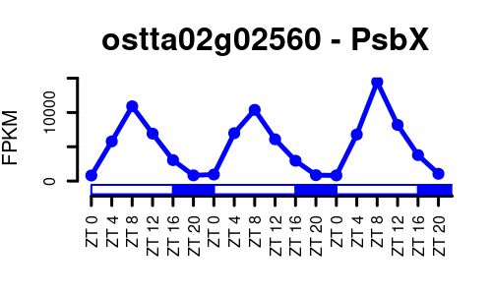
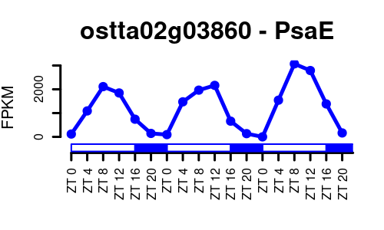
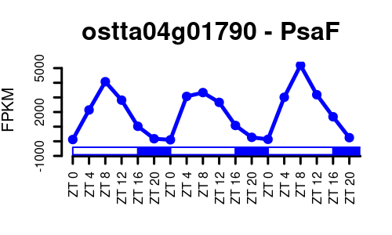
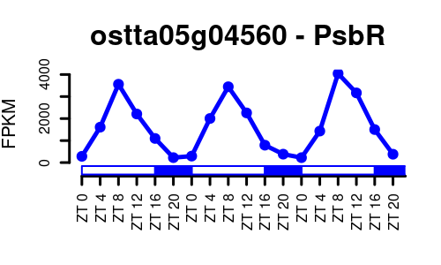
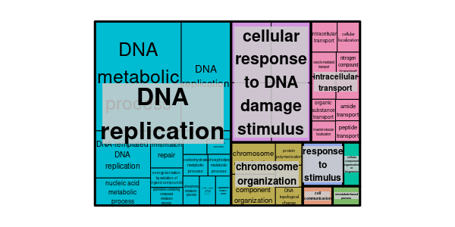
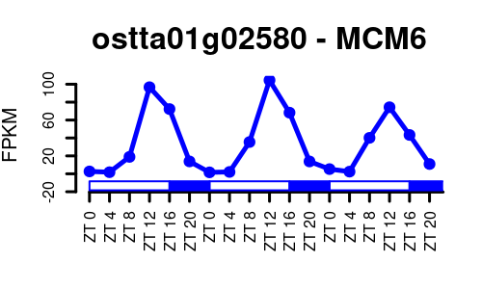
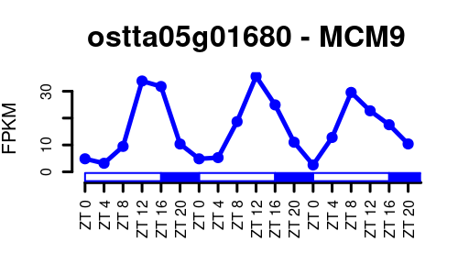
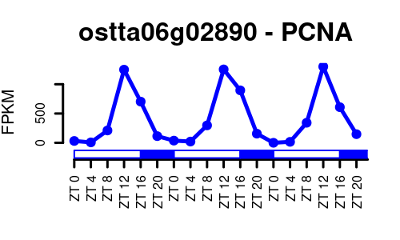
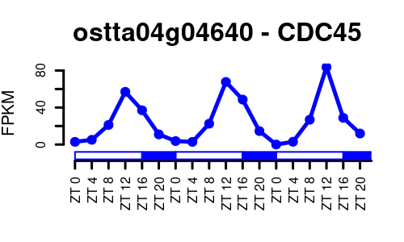
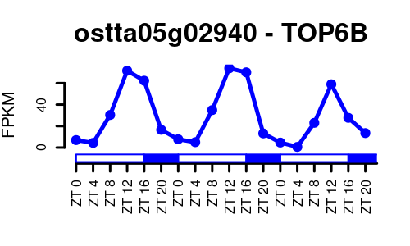
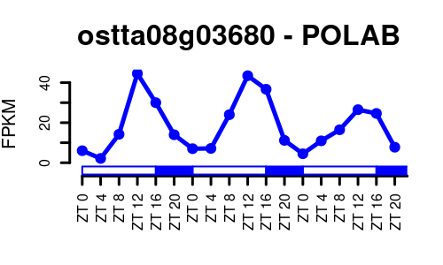
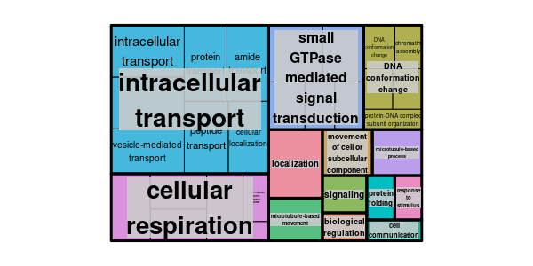
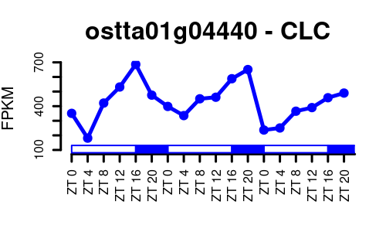












ZT0
ZT4
ZT8
ZT12
ZT16
ZT20

Slide 8










































ZT0
ZT4
ZT8
ZT12
ZT16
ZT20

Slide 9


















Slide 10


















