Slide 1
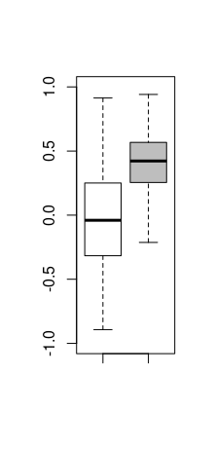
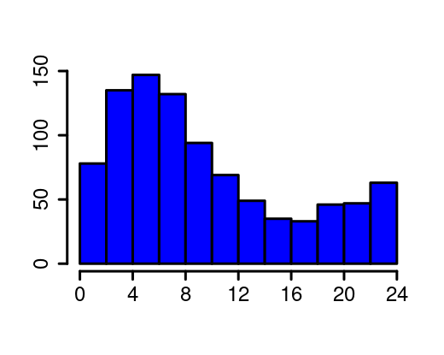
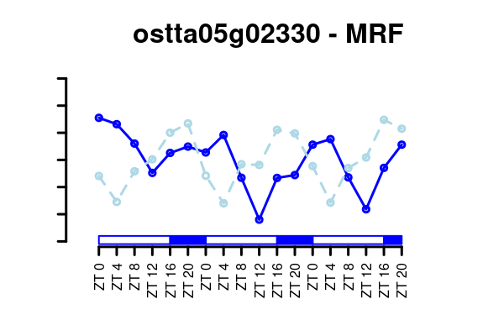
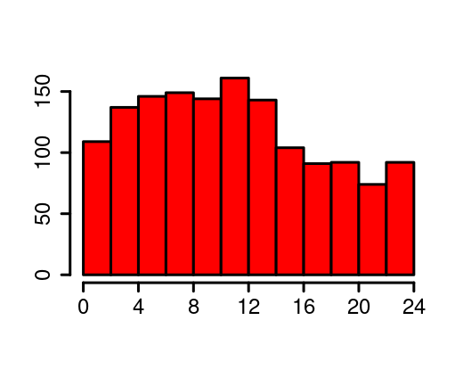
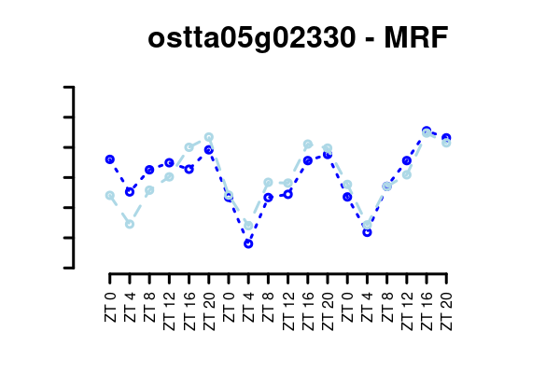
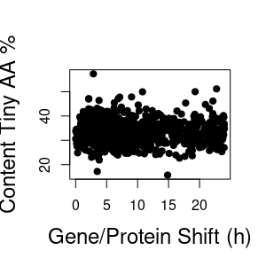
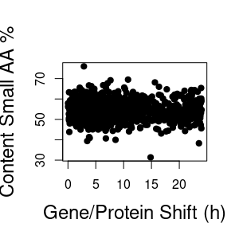
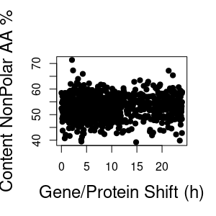
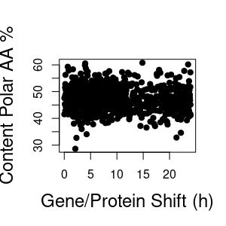
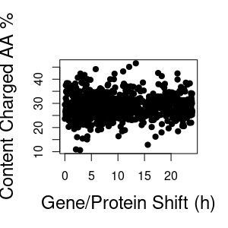
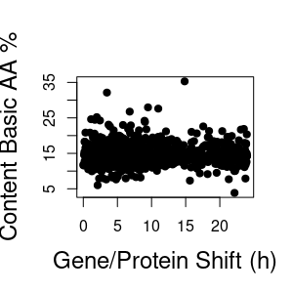
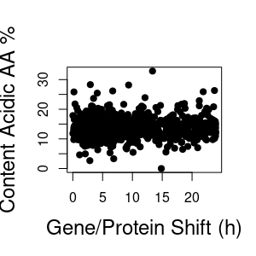
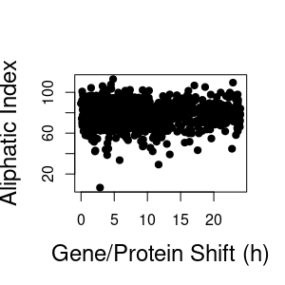
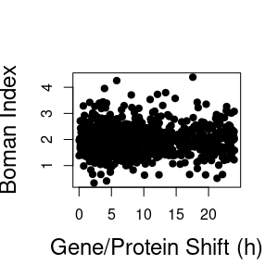
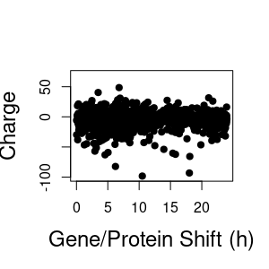
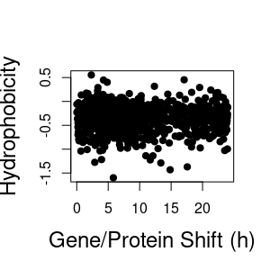
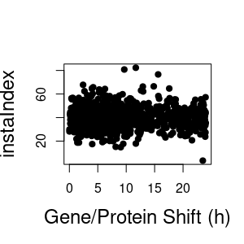
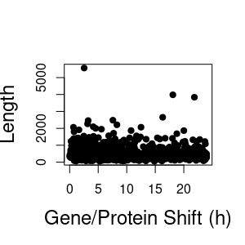
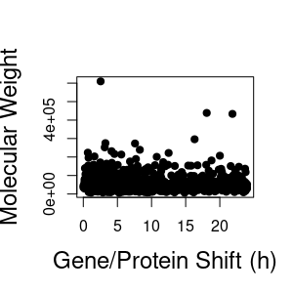
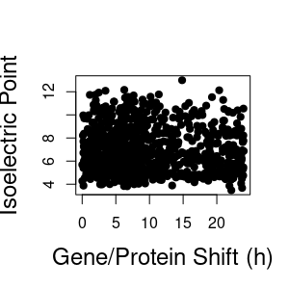
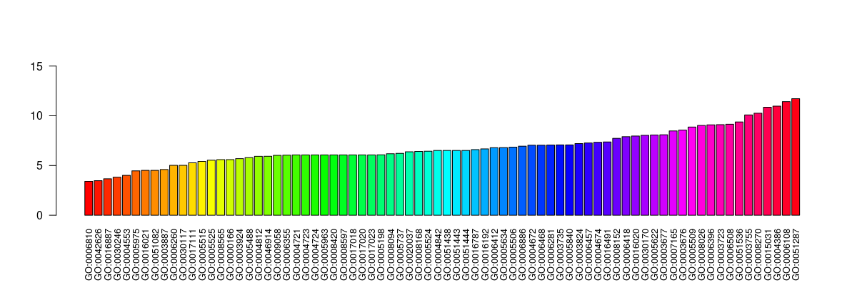
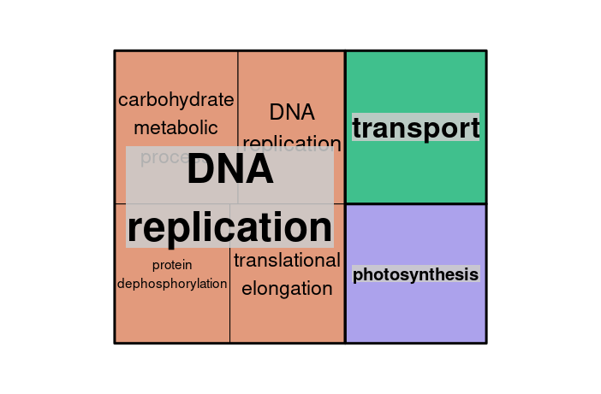
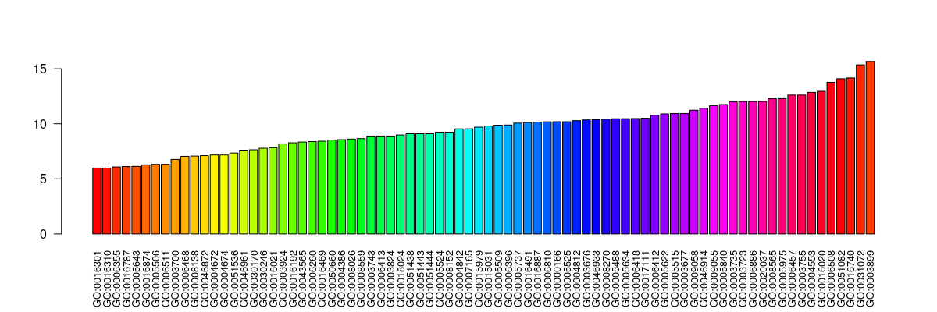
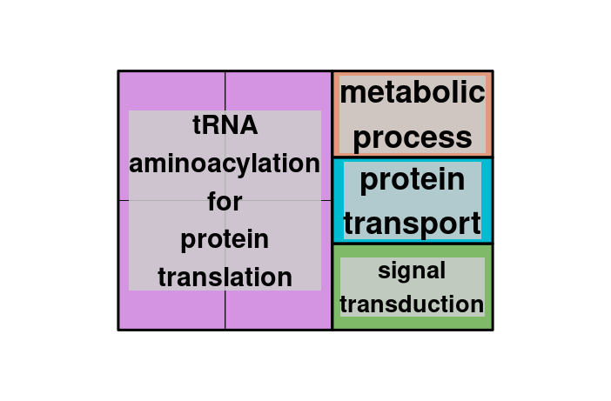
(A)
(B)
(C)
Number of Proteins
Scaled Gene Expression
Protein Abundance
Gene/Protein Profiles Correlation
Protein/Gene Offset (h)
Number of Proteins
Original Out of
Phase Profiles
Scaled Gene Expression
Protein Abundance
Shifted Phase Aligned Profiles
Protein/Gene Offset (h)
(D)
Protein/Gene Offset (h)
Protein/Gene Offset (h)
Protein/Gene Offset (h)
Protein/Gene Offset (h)
Protein/Gene Offset (h)
Protein/Gene Offset (h)
Protein/Gene Offset (h)
Protein/Gene Offset (h)
Protein/Gene Offset (h)
Protein/Gene Offset (h)
Protein/Gene Offset (h)
Protein/Gene Offset (h)
Protein/Gene Offset (h)
Protein/Gene Offset (h)
Protein/Gene Offset (h)
(E)
(F)
Protein/Gene Offset
Median (h)
Gene Ontology Term
Protein/Gene Offset
Median (h)
Gene Ontology Term

Slide 2
(A)
(B)
(C)
Number of Proteins
Protein/Gene Profiles Correlation
Correlation -0.34
Protein/Gene Offset (h)
Number of Proteins
Original Out of
Phase Profiles
Shifted Phase Aligned Profiles
0.8368383
Protein/Gene Offset (h)
(D)
Protein/Gene Offset (h)
Protein/Gene Offset (h)
Protein/Gene Offset (h)
Protein/Gene Offset (h)
Protein/Gene Offset (h)
Protein/Gene Offset (h)
Protein/Gene Offset (h)
Protein/Gene Offset (h)
Protein/Gene Offset (h)
Protein/Gene Offset (h)
Protein/Gene Offset (h)
Protein/Gene Offset (h)
Protein/Gene Offset (h)
Protein/Gene Offset (h)
Protein/Gene Offset (h)
(E)
(F)
Protein/Gene Offset
Median (h)
Gene Ontology Term
Protein/Gene Offset
Median (h)
Gene Ontology Term

Slide 3
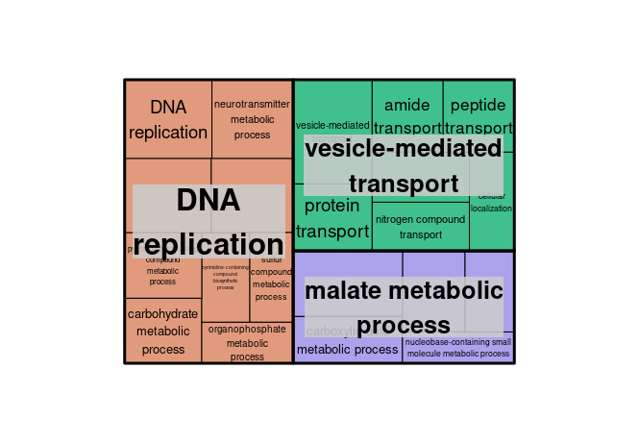
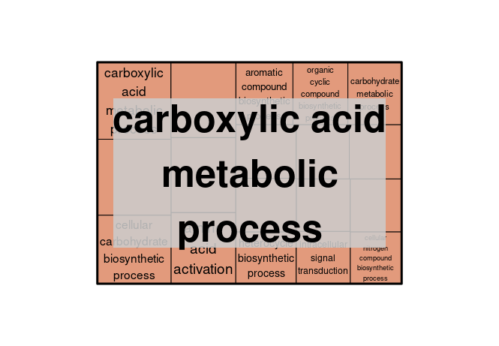
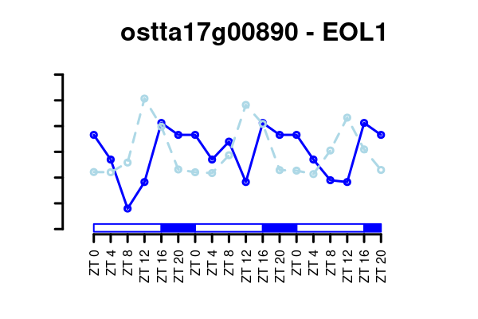
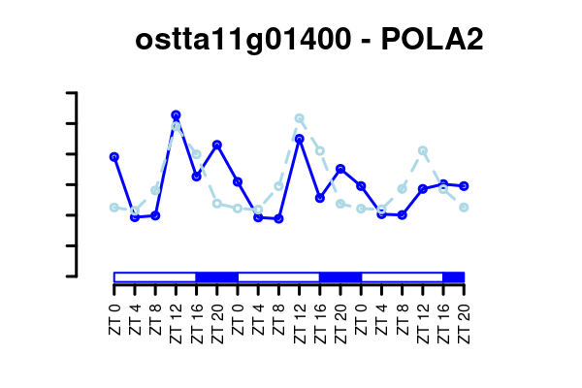
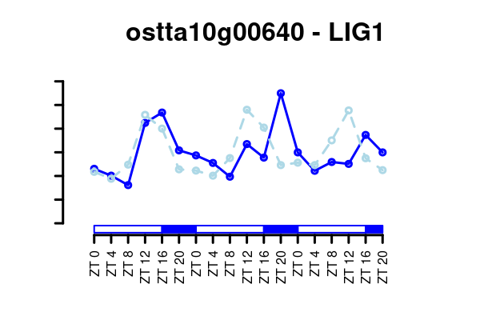
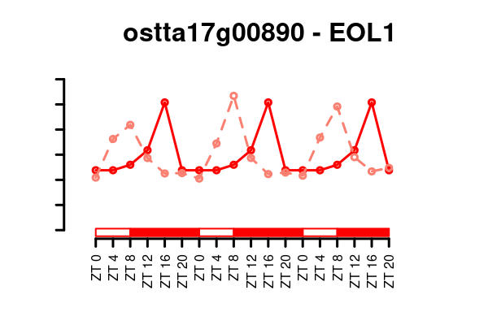
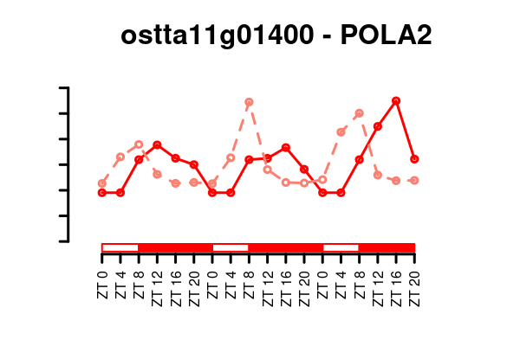
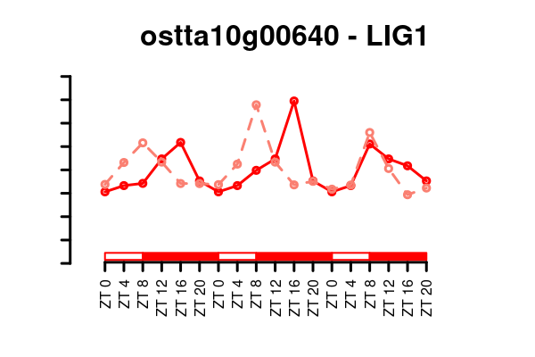
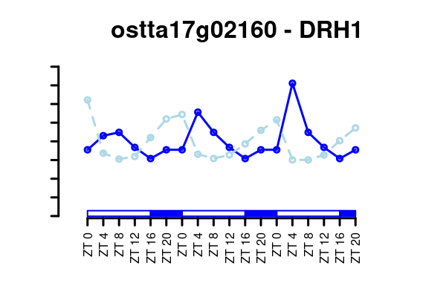
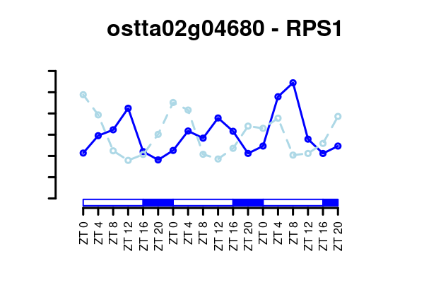
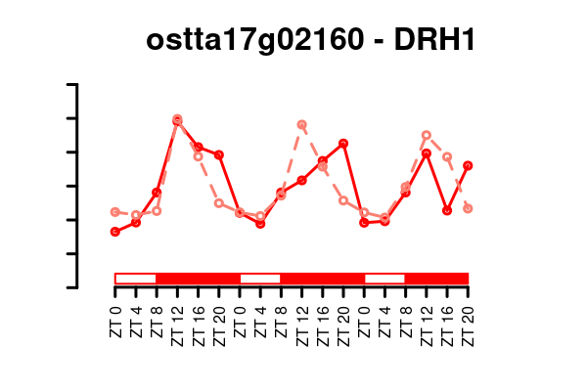
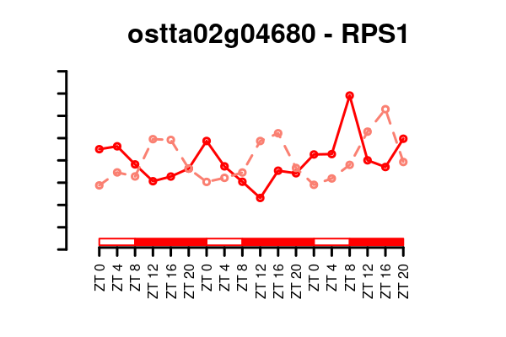

Slide 4
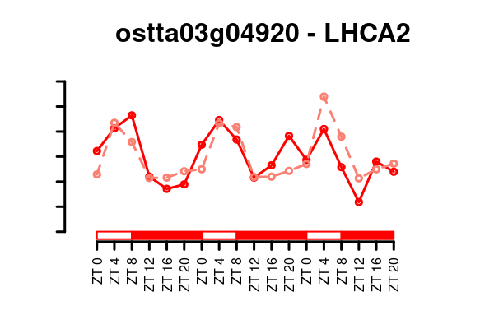
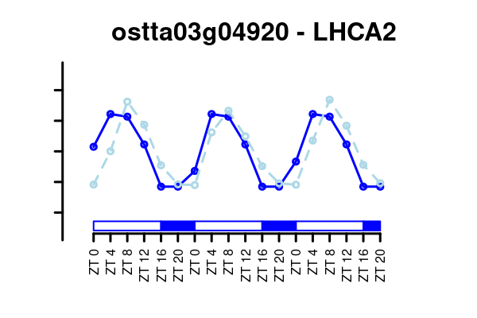
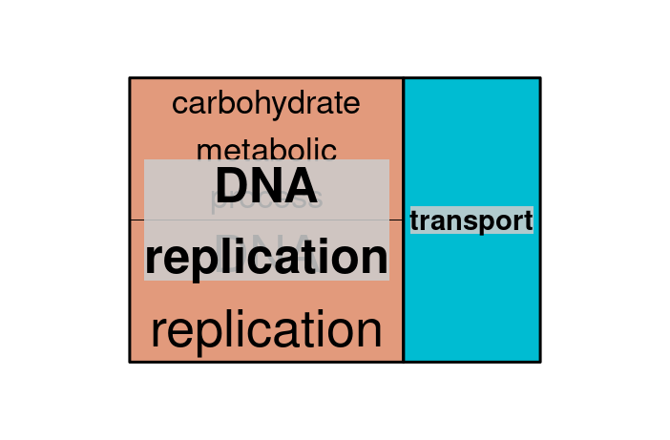

Slide 5
Protein/Gene Offset (h)
Protein/Gene Offset (h)
Protein/Gene Offset (h)
Protein/Gene Offset (h)
Protein/Gene Offset (h)
Protein/Gene Offset (h)
Protein/Gene Offset (h)
Protein/Gene Offset (h)
Protein/Gene Offset (h)
Protein/Gene Offset (h)
Protein/Gene Offset (h)
Protein/Gene Offset (h)
Protein/Gene Offset (h)
Protein/Gene Offset (h)
Protein/Gene Offset (h)
*
*
*
*

