Slide 1
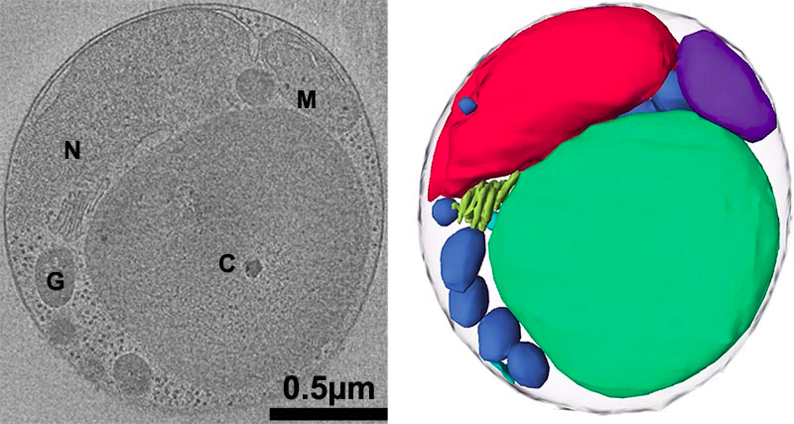
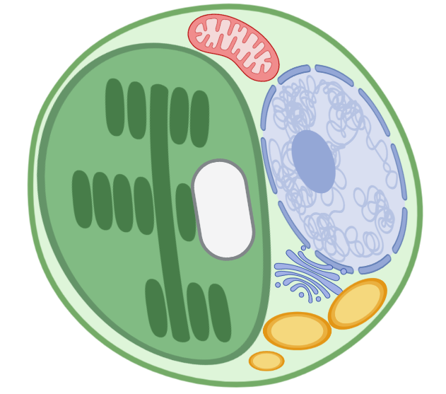
(A)
(B)
M
C
N
G
SG
R
G
GR

