Slide 1
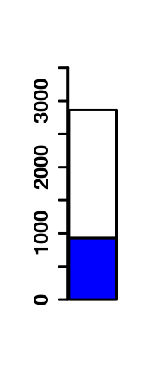
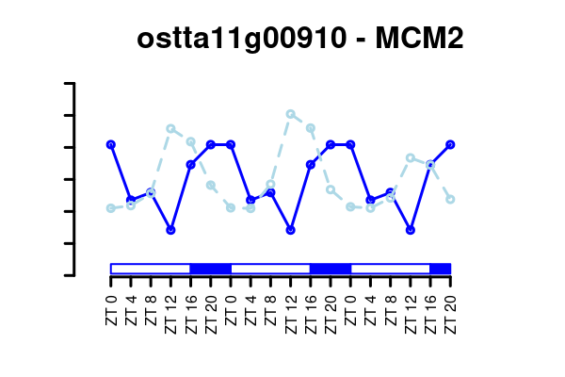
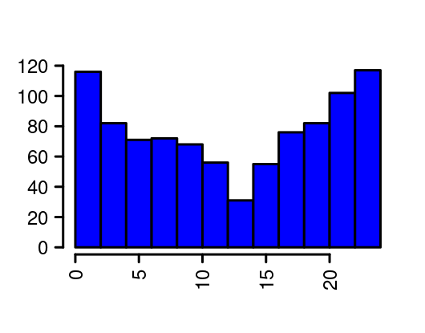
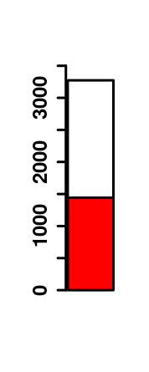
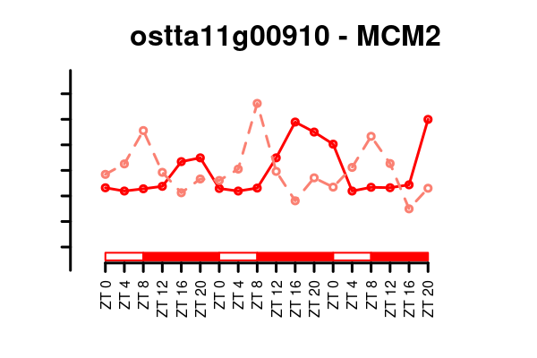
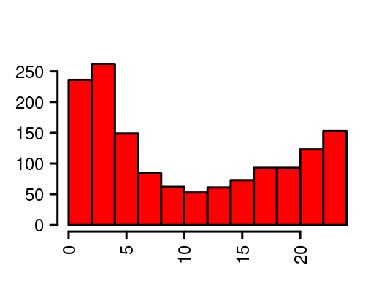
(A)
(C)
(E)
Non rhythmic
Number of Proteins
Rhythmic LD
Number of Proteins
Scaled Gene Expression
Protein Abundance
Number of Proteins
ZT0
ZT4
ZT8
ZT12
ZT16
ZT20
ZT24
(B)
(D)
(F)
Non rhythmic
Rhythmic SD
Number of Proteins
Number of Proteins
Scaled Gene Expression
Protein Abundance
Number of Proteins
ZT0
ZT4
ZT8
ZT12
ZT16
ZT20
ZT24

Slide 2
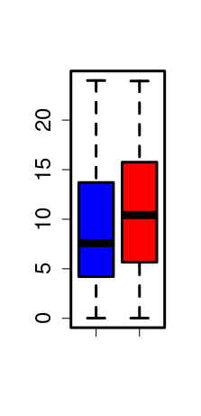
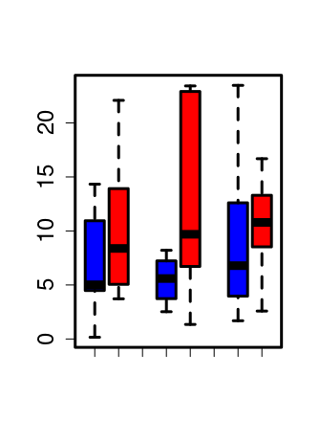
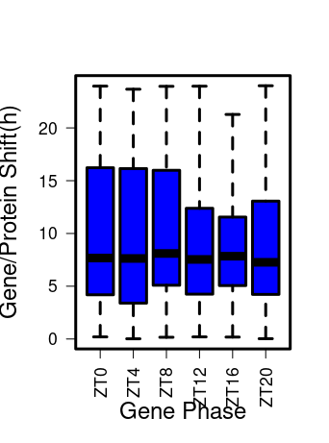
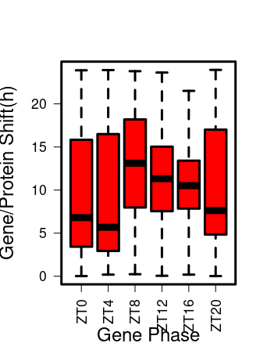
(A)
(B)
Protein/Gene Offset (h)
Protein/Gene Offset (h)
SD
SD
SD
LD
LD
LD
Photosynthesis
(GO:0009521)
DNA replication
(GO:0006260)
Translation
(GO:0006412)
LD
SD
(C)
(D)
20
20
15
15
Protein/Gene Offset (h)
Protein/Gene Offset (h)
10
10
5
5
0
0
ZT12
ZT16
ZT20
ZT12
ZT16
ZT0
ZT4
ZT8
ZT0
ZT4
ZT8
ZT20
Gene Phase
Gene Phase

Slide 3
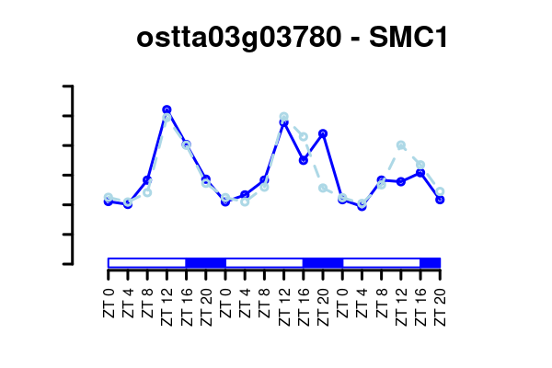
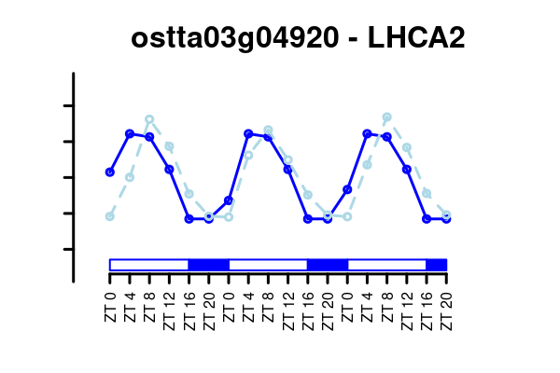
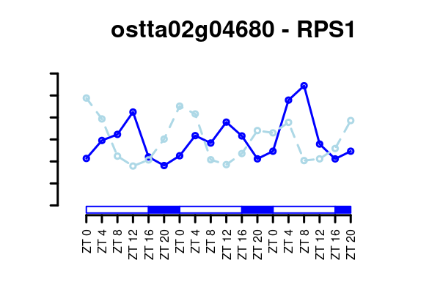
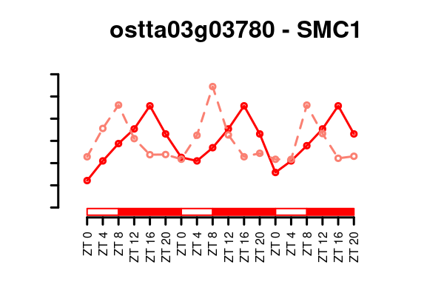
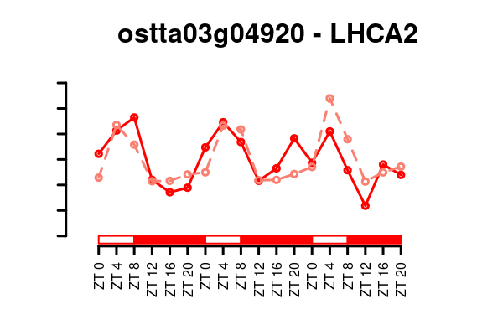
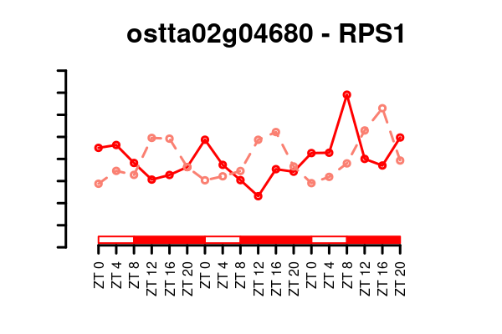
(D)
(F)
(E)
20
20
Protein/Gene Offset (h)
15
15
Protein/Gene Offset (h)
Protein/Gene Offset (h)
10
10
5
5
LD
SD
LD
SD
LD
SD
0
0
ZT12
ZT16
ZT12
ZT20
ZT16
LD
SD
ZT0
ZT4
ZT8
ZT0
ZT4
ZT8
ZT20
DNA replication
(GO:0006260)
Gene Phase
Gene Phase
photosynthesis(GO:0009521)
translation
(GO:0006412)
(G)
Scaled Gene Expression
Protein Abundance
Scaled Gene Expression
Protein Abundance
Scaled Gene Expression
Protein Abundance
Scaled Gene Expression
Protein Abundance
Scaled Gene Expression
Protein Abundance
Scaled Gene Expression
Protein Abundance

