Slide 1

Airline reservation system
Presented BY:
Akansha gaikawad
Akash satpute
Manisha Shinde
Prajwal Dhagude
Rani Mandage
Guided BY : PROFESSOR SMITA KANDEKAR

Slide 2
INTRODUCTION
Customer Details Entry:
Customers can easily put in their name, age, address, gender, and phone number . This helps keep their information organized and ready for booking flights.
Flight Registration : Customers can see all the available flights to different places like Dubai, Canada, and more . They can choose their flight, see when it leaves, and how much it costs, all in one place.
Ticket Generation : After booking, the system makes a ticket with all the important details . Customers can print their ticket from the system whenever they need it.
Benefits Booking is Quick: No more filling out lots of forms, making it faster to book a flight.
Organized Information: Keeps customer details and flight info neat and easy to manage.
Better Experience: Customers get their tickets fast and without mistakes, making them happy and satisfied.

Slide 3
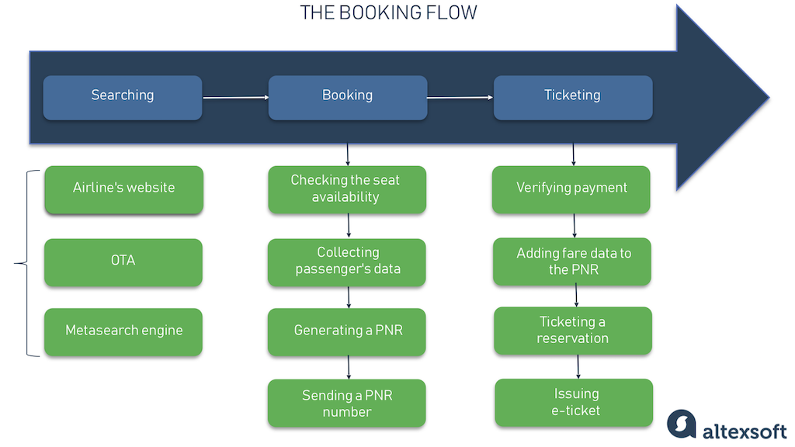

Slide 4
Overview Customer Details
Management Customers enter their details (name, age, gender, contact) for booking . Handled by the Details class in the code.
Flight Registration System Customers browse flights, select destinations, and book tickets . Managed by the registration class in the code.
Ticket Generation and Billing System generates tickets with customer info, flight details, and charges . Billing information is also included . Implemented by the ticket class in the code.
Main Menu Function : Central hub for navigation and interaction with the system.
Offers options for customer details entry, flight registration, ticket generation, and system exit . Facilitates a user-friendly experience and smooth system operate

Slide 5
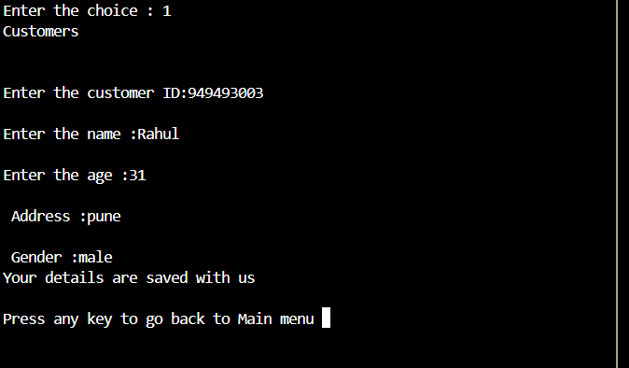
Customer Details Management
Entering Details Customers fill in essential details:
Name ,Gender , Age , Address , Phone Number , Input Form Sample
Customers input accurate information for successful bookings.
Importance of Accuracy Accurate details are vital because they : Ensure correct ticket issuance . Enable effective communication and updates.
Facilitate smooth check-in and boarding . Maintain a reliable customer database

Slide 6
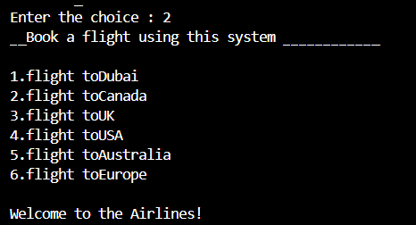
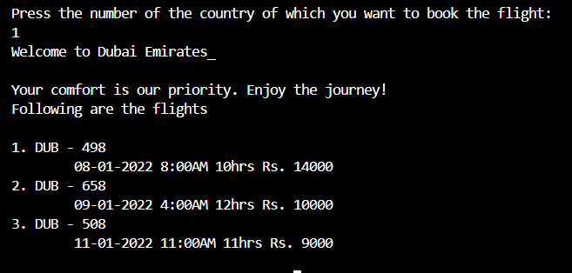
Flight Registration System
Selecting Flights Customers choose flights by : Viewing available options Picking destination, date, and time Sample Flight List
Flights to Dubai, Canada, UK, USA, Australia, Europe Shows date, time, and cost

Slide 7
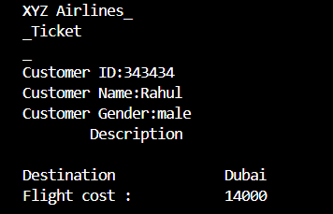
Ticket Generation
Ticket Generation Process :
After booking, the system automatically creates tickets with:
Customer name, gender Flight details (destination, date, time)Total charges Sample Ticket Format Shows customer and flight info, along with charges.
Saving Tickets are saved in a file for easy access and printing.

Slide 8

Slide title 29
Thank you for choosing our airline. Wishing you a safe flight and a journey filled with delightful moments!"

Slide 9


