Slide 1

Credit Approval Prediction Using ML Classifiers Mini Project KCS 752/ 7th Sem
STUDENT NAME :
Aryan Tyagi
[2000320120050]

Slide 2
Outline
Dataset selection
Importing Libraries and Datasets
Data Pre-processing
Data Visualization
Splitting Dataset
Model Training and Evaluation
Visualization of Results
Future outcomes

Slide 3
Introduction
LOANS are the major requirement of the modern world. By this only, Banks get a major part of the total profit. It is beneficial for students to manage their education and living expenses, and for people to buy any kind of luxury like houses, cars, etc.
But when it comes to deciding whether the applicant’s profile is relevant to be granted with loan or not. Banks have to look after many aspects.
So, here we will be using Machine Learning with Python to ease their work and predict whether the candidate’s profile is relevant or not using key features like Marital Status, Education, Applicant Income, Credit History, etc.

Slide 4
Proposed System
1. Data Collection and Storage:
Selection of dataset by analyzing parameters.
Create a secure and organized data repository.
2. Data Analysis and Visualization:
Use statistical software for analysis and visualization.
Calculate statistics, correlations, and, if applicable, perform hypothesis testing and inferential analysis.
Create clear data visualizations to illustrate findings.
3. Project Report and Documentation:
Prepare a structured project report with sections covering introduction, methodology, findings, discussion, and conclusion.
Maintain documentation for transparency and reproducibility.
4. Ethical and Security Considerations:
Adhere to ethical guidelines for data collection and analysis, particularly when working with sensitive student data.
Implement data security measures to protect sensitive information

Slide 5
Objectives
Prediction of loan approval using independent variables like Credit History, Education, Age, Loan Amount etc.
Predict whether the candidate’s profile is relevant or not using key features/parameters using Machine Learning.

Slide 6
Tools and Technologies Used
Python
Matplotlib, Pandas and Seaborn (Python)
Excel
SQL
GitHub
Jupyter Notebooks
Visual Studio Code
Additional Libraries

Slide 7
Methodology Used
As this is a classification problem so we will be using these models :
K Neighbor Classifiers
Random Forest Classifiers
Support Vector Classifiers
Logistic Regressions
To predict the accuracy we will use the accuracy score function from scikit-learn library.

Slide 8
Regression and Classification algorithms are Supervised Learning algorithms. Both the algorithms are used for prediction in Machine learning and work with the labeled datasets. The main difference between Regression and Classification algorithms that Regression algorithms are used to predict the continuous values such as price, salary, age, etc. and Classification algorithms are used to predict/Classify the discrete values such as Male or Female, True or False, Spam or Not Spam, etc.

Slide 9
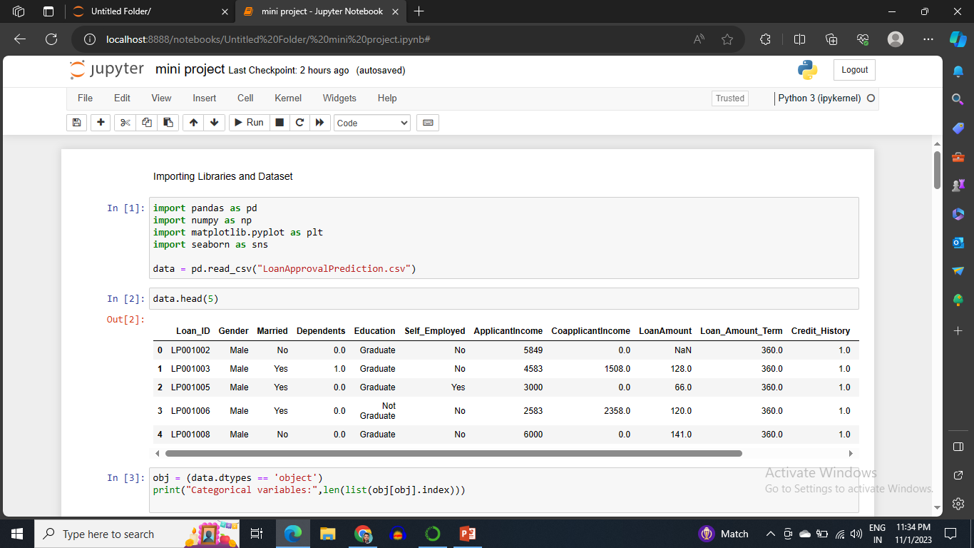
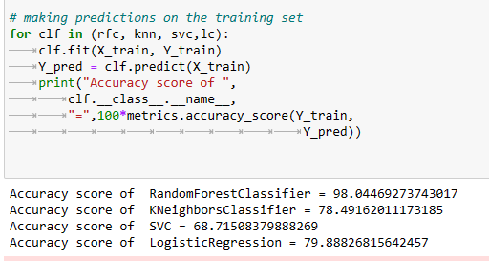
Implementation

Slide 10
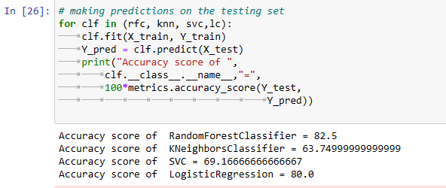
Results
Result after testing the algorithm on testing dataset.

Slide 11
Limitations &Future Enhancements
Limitations: This project's limitations include single dataset which can be treated by increasing number of data fields in the dataset taken.
Future Enhancements: To improve the project, we can also consider increasing the number of dataset and combining these data sets into one by various mathematical operations. We can also consider to choose different classification algorithms for better accuracy.

Slide 12
Conclusion
Random Forest Classifier is giving the best accuracy with an accuracy score of 82% for the testing dataset. And to get much better results ensemble learning techniques like Bagging and Boosting can also be used.

Slide 13
References
Johnston, L. D., O'Malley, P. M., Bachman, J. G., Schulenberg, J. E., & Miech, R. A. (2020). "Monitoring the Future national survey results on drug use, 1975-2019: Volume II, College students and adults ages 19-60." Institute for Social Research, The University of Michigan.
National Institute of reserach and Alcoholism (NIAAA). (2015). "College drinking.
Read, J. P., Merrill, J. E., Kahler, C. W., & Strong, D. R. (2007). "Predicting functional outcomes among college drinkers: Reliability and predictive validity of the Young Adult Alcohol Consequences Questionnaire." Addictive Behaviors, 32(11), 2597-2610.

Slide 14
THANK YOU

