Slide 1
2D Truss Analysis using Finite Element Method (FEM) in Python
TERM PROJECT
COMPUTING TOOLS
Submitted By-
Medari Vikas (2024210010)
Abhishek Tiwari (2024210012)
Guided by:
Prof. K. Sriranjani

Slide 2
Introduction
Structural analysis of 2D truss using Python
Reads geometry, loads, and material properties from Excel
Computes stiffness matrices
Solves for nodal displacements
Determines member forces and stresses
Visualization and data export included

Slide 3
WORKFLOW
START
READ TRUSS DATA
Geometry and Loads from Excel using Pandas
STIFFNESS MATRIX
Assemble Global Stiffness Matrix using NumPy
APPLY BOUNDARY CONDITIONS
SOLUTIONS
Solve System of Equations [K]{u} = {F} for Nodal Displacements
COMPUTE MEMBERS FORCES AND STRESSES
OPTIMIZATION
Within Allowable stress limits
VISUALISATION
Initial Truss Plot, Force Distribution, Displacement Plot
STORING RESULTS
Displacements, Member forces, Stresses

Slide 4
Python Libraries Used
NumPy: matrix computation
Pandas: Excel data handling
Matplotlib: plotting
Openpyxl: Excel read/write operations

Slide 5
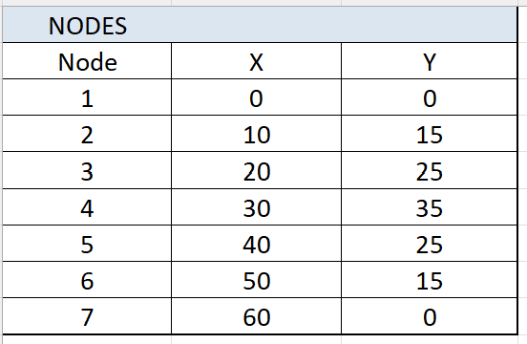
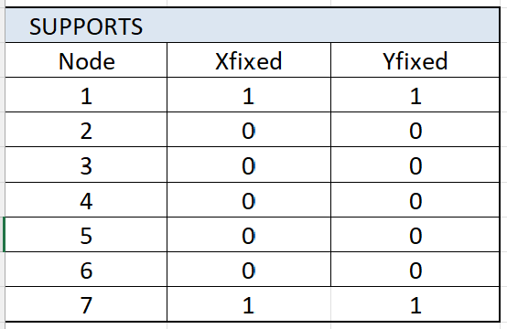
Methodology – Data Extraction
Imported using pandas
Dataset for structural details
Includes nodes, elements, supports, loads
Properties: Area, E-modulus, node coords, connectivity

Slide 6
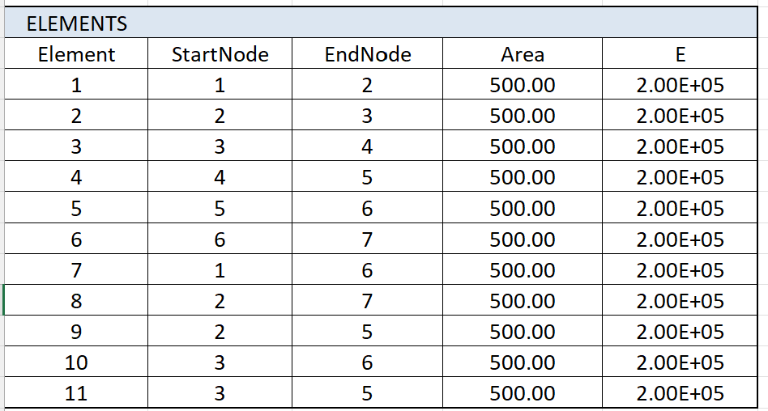
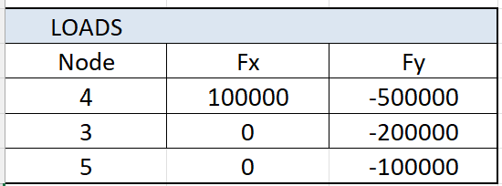
Methodology – Data Extraction

Slide 7
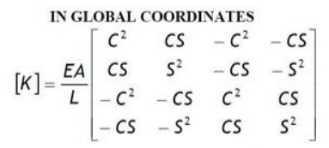
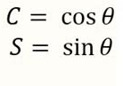
Methodology – Stiffness Matrix
4×4 local stiffness matrix per member
Direction cosines used for global transformation
Assembled into global matrix using NumPy

Slide 8
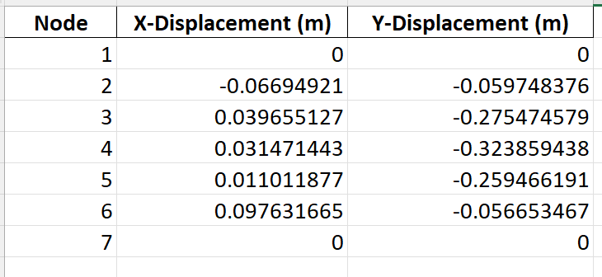
Displacement Calculation
System: [K]{U} = {F}
Solved with numpy.linalg.solve()
Boundary conditions applied before solution

Slide 9
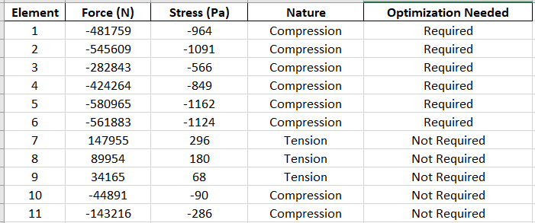
Forces & Stresses
Axial force: F = (EA/L) * delta
Stress: σ = F/A
Compared to allowable stress for optimization

Slide 10
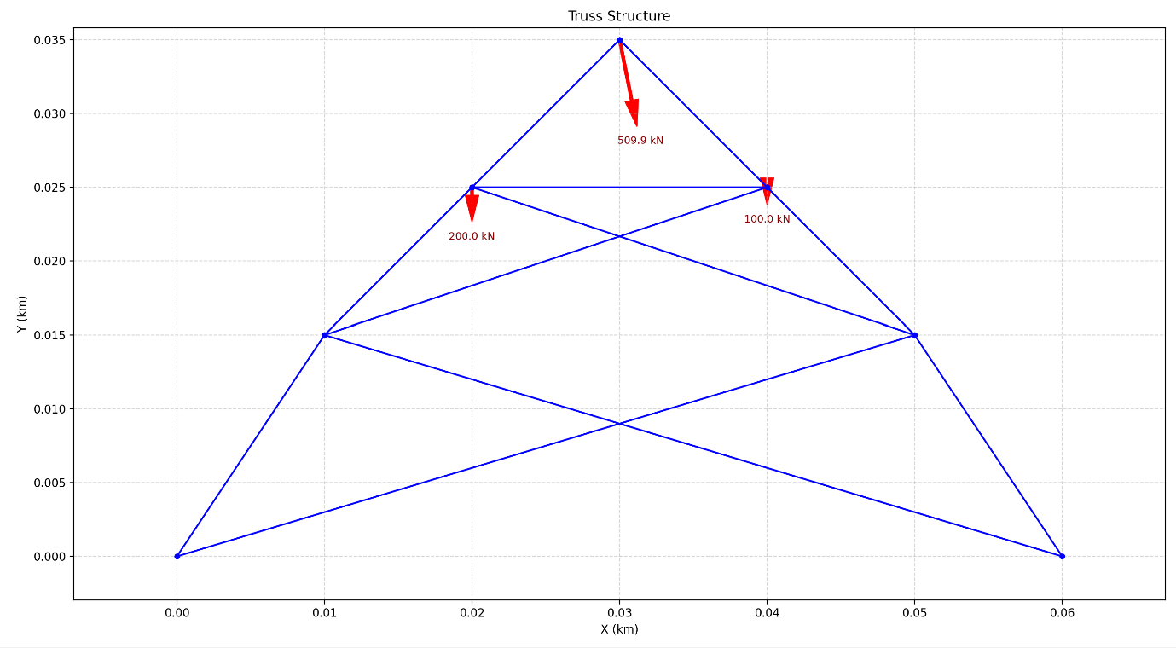
Visualization
Truss geometry and loads

Slide 11
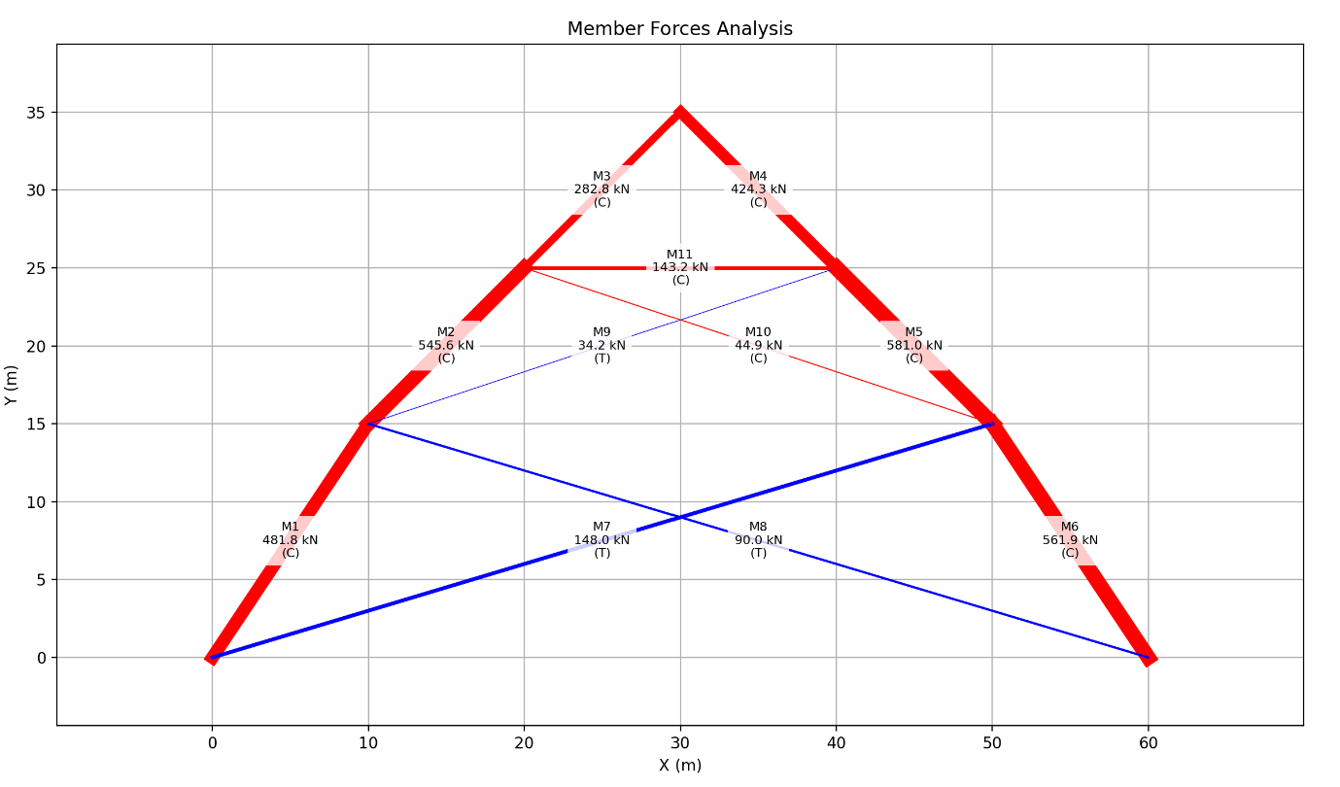
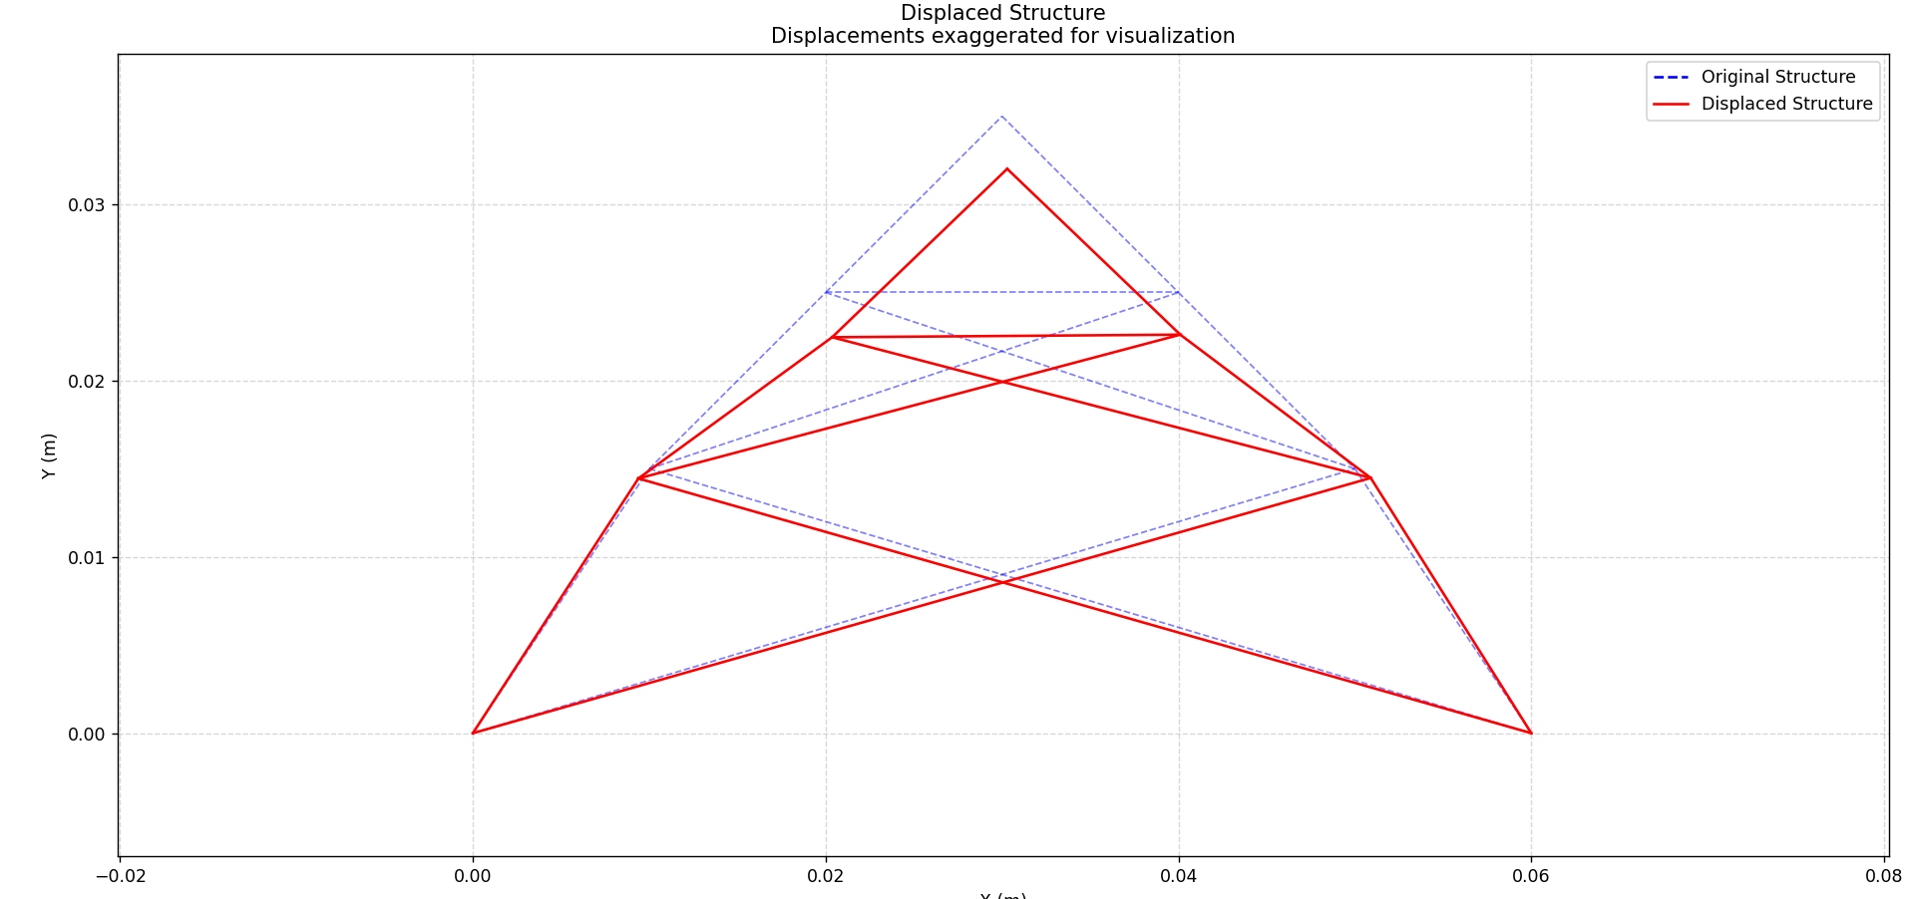
Member forces: tension (blue), compression (red)
Deformation plot (exaggerated)

Slide 12
Results
Max displacement: Node 4 → Ux = 0.0314, Uy = -0.324
Force distribution visualized
Critical members identified

Slide 13
Conclusion
Successfully automated 2D truss analysis
Results include displacements, forces, stresses
Optimization needed if σ > σ_{allowable}

