Slide 1
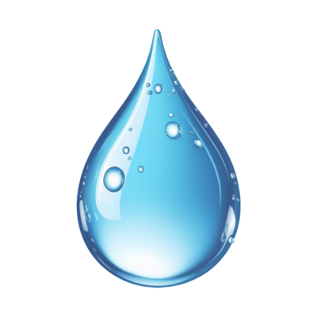
LATEST TECHNOLOGY DESCRIPTION

Slide 2
Harvested rainwater can provide a source of alternative water to federal facilities. Alternative waters are sustainable sources of water, not supplied from fresh surface water or groundwater, that offset the demand for freshwater. Rainwater harvesting captures, diverts, and stores rainwater from rooftops for later use. Typical uses of rainwater include landscape irrigation, wash applications, ornamental pond and fountain filling, cooling tower make-up water, and toilet and urinal flushing. With additional filtration and disinfection, harvested rainwater can also be treated to potable standards to supplement municipal potable water supplies to facilities.

Slide 3
SYSTEM COMPONENTS
❖ Collection system: Roof surface and gutters to capture the rainwater and send it to the storage system
❖ Inlet filter: Screen filter to catch large debris
❖ First flush diverter: Diverter that removes debris not captured by the inlet filter from the initial stream of rainwater
❖ Storage tank: Storage tanks composed of food-grade polyester resin material approved by the U.S. Food and Drug Administration (FDA), which is green in color and helps to reduce bacterial growth

Slide 4
❖ Overflow: Drainage spout that allows for overflow if the storage tank gets full  Controls: Control system that monitors water level and filtration system  Treatment system: Filtration and disinfection system that treats the water to non-potable or potable standards  Pump: Pump to move water through the system to where it will be used  Backflow prevention: Backflow preventer to ensure that under negative pressure water cannot flow backwards through the system into the make-up water system  Flow meter: Flow meter (with data logger) to measure water production  Power supply: Systems may use either conventional power sources or, to improve off-grid capabilities, alternative sources such as stand-alone or grid-tied solar systems

