Slide 1
FORM ONE ENGLISH
ADJECTIVES
Notes:
PRESENTNED BY WANEROBA WATUHA D. ON 29TH JULY,2013 AT MIVUMONI SECONDARY SCHOOL KWALE CUONTY.

Slide 2
Adjectives
We have already learnt that a noun is a naming word.
Now we are going to learn about adjectives
Activity 1
List all the items or people in the following
picture.(i.e. the nouns in the picture)

Slide 3
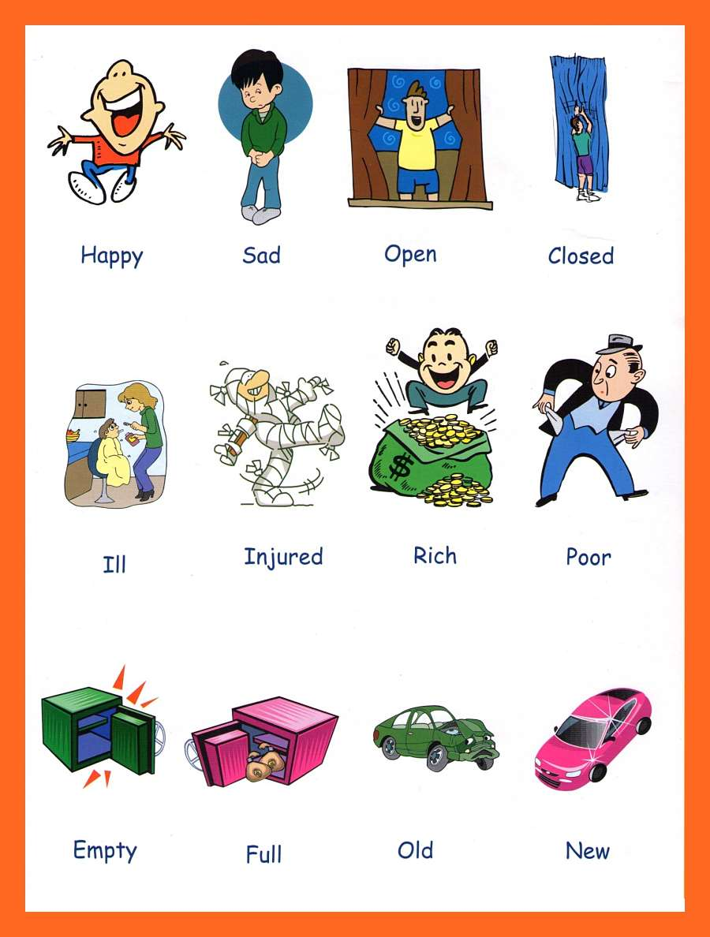
Look at the following pictures!

Slide 4
‘’
Activity 1(b)
Now write down words that describe each of the items or people in the picture.

Slide 5
Cont’d
You can give more information about the things,
items or people you have named by answering
the question which?
For example from the nouns: woman, man, car
we can ask the questions:
Which woman? Ill woman
Which man? Rich man
Which car? New car

Slide 6
‘’
Adjectives help to make our thoughts and
information as clear and specific as possible
For example:
The shy girl has joined our group.
Now for you to get the adjective you can ask the question:
Which girl has joined our group?
Activity 2
Identify the adjectives in each of the following pictures :

Slide 7
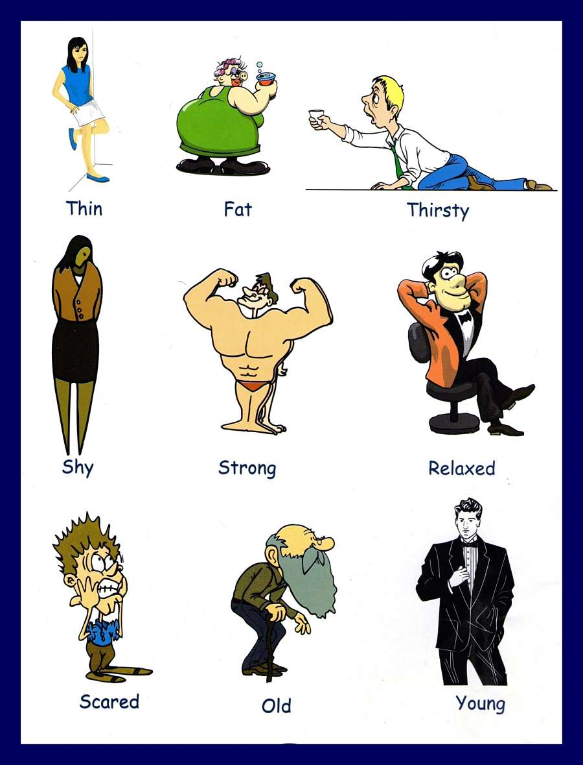
Which type of people are in this picture?

Slide 8
‘’
EXERCISE
Identify the adjectives in the following sentences.
The thin girl is my sister.
The fat woman refused to eat more snacks.
My grandfather is an old man now.
My uncle is always a relaxed man.
Jill is always a scared boy.
I admire a strong man.
We met a thirsty man at the bore hole.
Peter is a young man

Slide 9
‘’
Activity 3
Make six different sentences using adjectives from the following pictures.

Slide 10
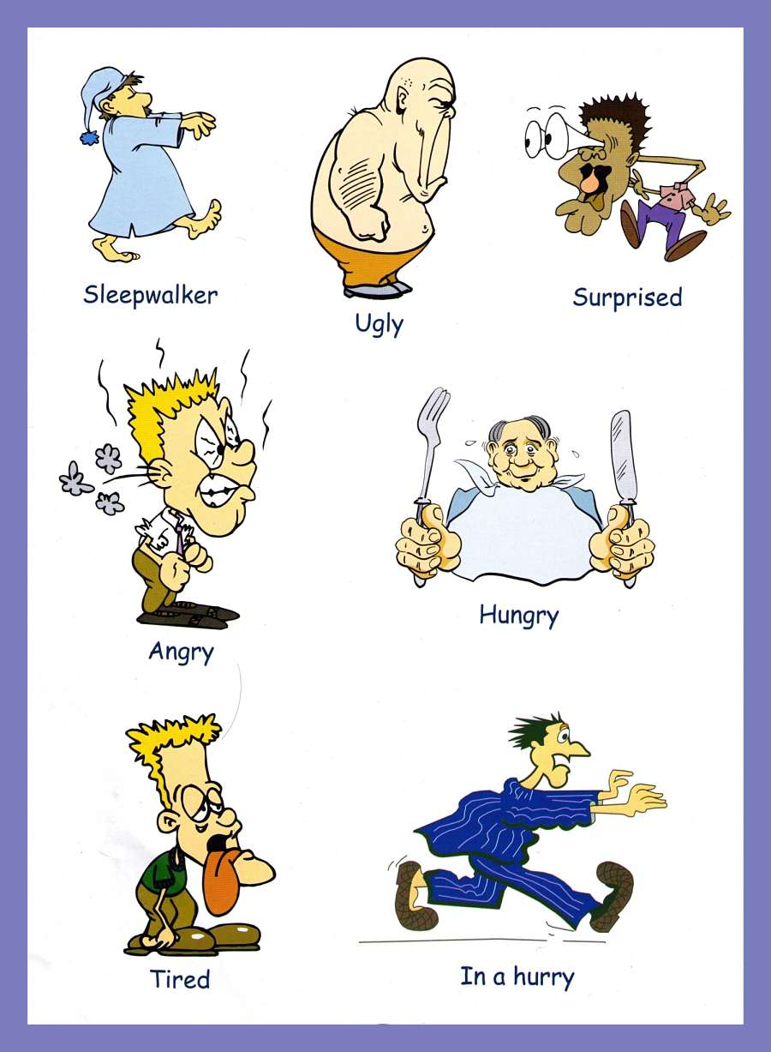
‘’

Slide 11
‘’
Note that adjectives can be placed in front of nouns i.e. before the nouns
For example:
Jill is always a scared boy
Adjectives can also be placed after the verb
For example:
The man at the borehole is thirsty.
The adjective thirsty comes after the verb is

Slide 12
Assignment
QUESTIONS
Identify the adjectives in each of the following sentences
1.The day was windy and chilly
.
2.My father bought a blue car yesterday
3.A hungry man is an angry man
4.The old woman wore a thick woollen jacket
5.The athletes were tired and frustrated.

Slide 13
THANK YOU

