Slide 1

Dr. MD. ZILLUR RAHMAN
Associate Professor

Slide 2
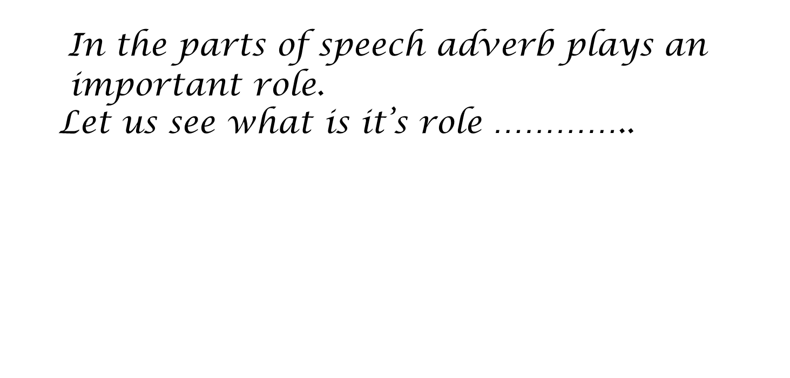

Slide 3
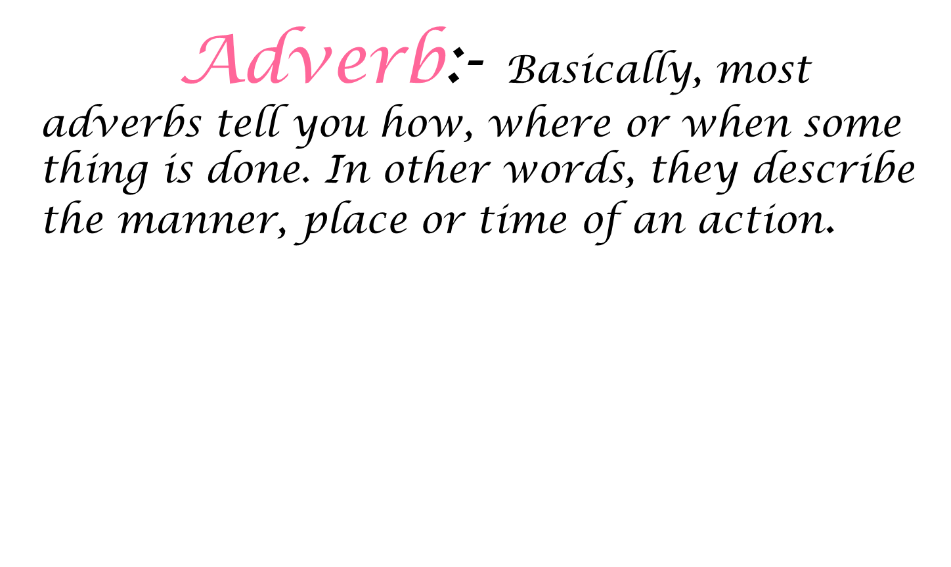

Slide 4
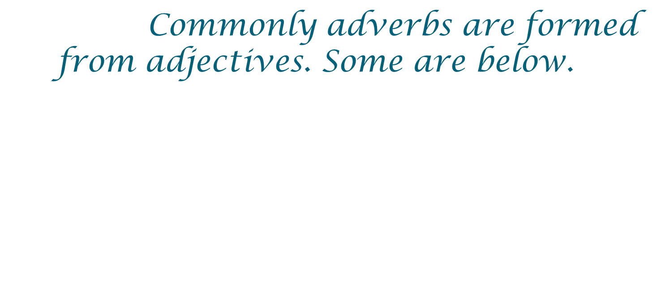
Adjectives | Adverbs
Kind | Kindly
Happy | Happily
Wonderful | Wonderfully
Loud | Loudly
Sad | Sadly
Beautiful | Beautifully
Sweet | Sweetly

Slide 5
Many adverbs end with ly. You make these adverbs by adding ly to adjectives.
Note:
Some words that end in ly are not adverbs. Some adjectives end in ly too. For Example:-
1.Sam was feeling very lonely.
2.She was wearing a lovely dress.
3.It was a very lively party

Slide 6
Kinds of Adverbs
Manner
Place
Time
Frequency
Purpose/Reason
It describes in which manner an action is done.
It describes where an action is done.
It describes when an action is done.
It shows how many times an action is done.
It describes the purpose or reason for the action.

Slide 7
Kinds of Adverbs
Quantity/Degree
Affirmation /Negation
It shows how much or in what degree or to what extent.
Which says yes if it is yes and no if it is no

Slide 8
Adverbs of Place:
Some adverbs and adverb phrases answer the question “where?”.
They are called adverbs of place.
Examples :
The boys are playing upstairs.
The dog is in the garden.
We’re going to NewYork City on our school trip.
It’s very sunny but cold outside.

Slide 9
Adverb of places
I’ve lived here for about two years.
English and German are closely related.
Is mark still in bed
His children go everywhere with him.

Slide 10
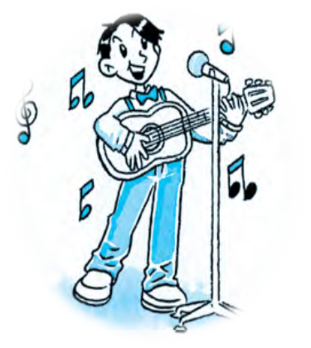

Adverbs of Manner:
Some adverbs and adverb phrases describe the way people do things.
Examples:
The girls answered all the questions correctly.
He was driving carelessly.
The plane landed safely.
Ramu plays guitar skillfully.

Slide 11
Adverb of manner
They watched Carefully.
The flower was beautifully made up
She seemed faintly.
The team played wonderfully.

Slide 12
Adverbs of Frequency
Some adverbs and adverb phrases answer the question “how often an action is done”
They are called adverbs of frequency.
Examples :
The children always go to school on the bus.
I’ll never make that mistake again .
I clean my bedroom every day.
Dad polishes his shoes twice a week.

Slide 13
Adverbs of Time:
Some adverbs and adverb phrases answer the question “when?”.
They are called adverbs of time.
Examples :
The train has already left.
We moved into our new house last week.
Our favorite T.V. program starts at 6’o clock.
I’m going to my new school tomorrow.

Slide 14
Adverbs Of Time
We shall now begin to work.
He called here a few minutes ago.
I have spoken to him yesterday.
He comes here daily.
Mr. Guptha formerly lived here.

Slide 15

Adverbs of quantity or degree
It shows how much, or in what degree or to what extent.
He was too careless.
The sea is very stormy.
I am rather busy.
I am fully prepared.
These mangos are almost ripe.

Slide 16

Adverbs of reason
The adverb which tells about a reason is called adverb of reason.
He is hence unable to refute the charge.
He therefore left school.

Slide 17
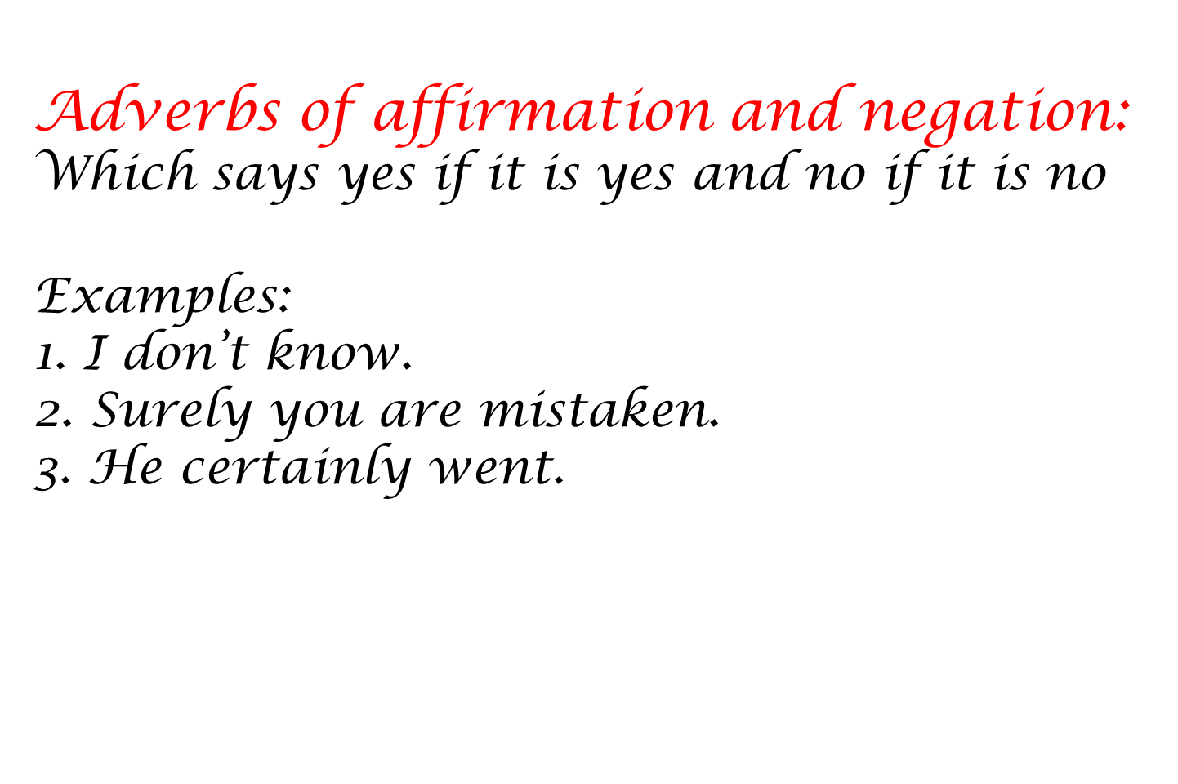

Slide 18
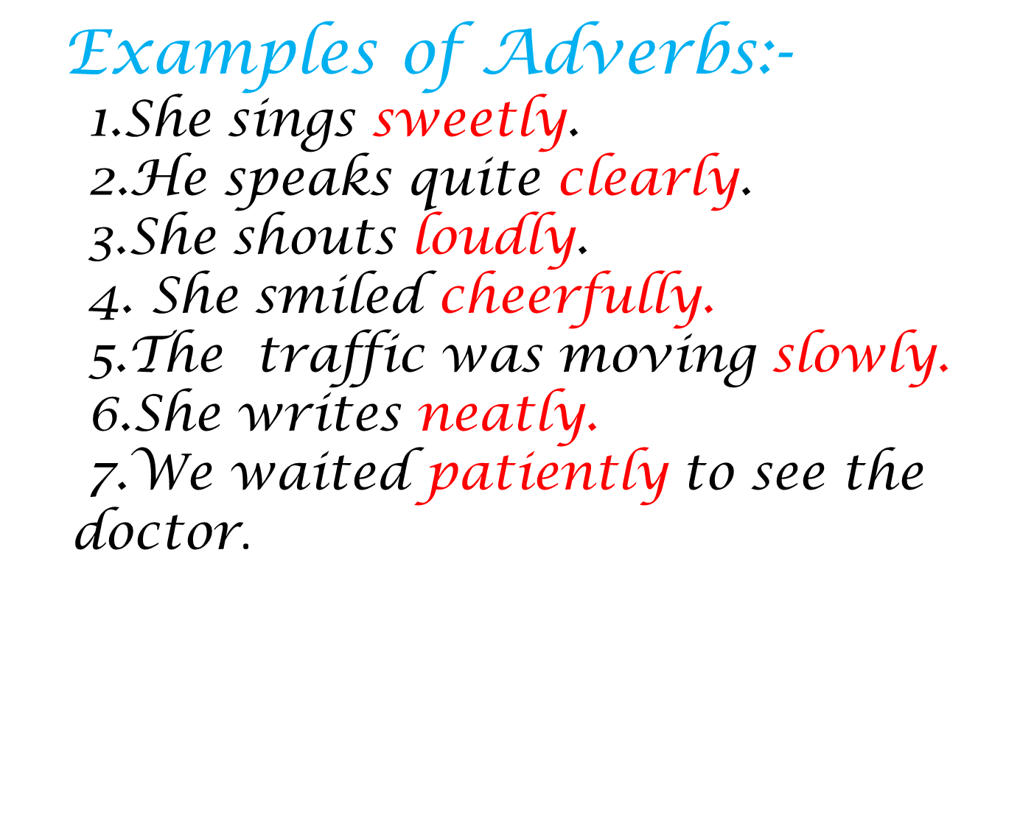

Slide 19
Some examples of adverbs of different kinds:
Tortoise walks slowly (Manner).
We will have our Semester exams on April 1st week(Time).
The accident happened near the Highway(Place).
At least twice a week I used to go for Temple(Frequency).
We all go for a picnic just for enjoyment(Purpose).
The sea is very stormy(Degree /Quantity).
Surely you are mistaken(Affirmation/Negation).

Slide 20
Try this exercise :
in old clothes
His face was dirty and he was dressed ----------------------.(manner)
2. Have you---------------- ---------------------- been in a plane? (frequency)
3. She was so ill that she missed school -------------------------. (duration)
4. I did some homework last night and finished it--------------------.(time)
5. We went--------------------------------- to play. (place)
6. Dad takes the dog for a walk ------------------------------. (frequency)
7. Sally left her pencil case--------------------------------- . (place)
8. Speak -----------------------------so everyone can hear you. (manner)
9. It was a fine day and the children played in the garden ------.(duration)
10. “Go and do your homework.” “I’ve------------------------done it.” (time)
ever
for a week
this morning
outside
everyday
on the bus
clearly
all day
already
(outside this morning ever on the bus clearly
all day in old clothes for a week already every day)

Slide 21
THANK YOU!

