Slide 1
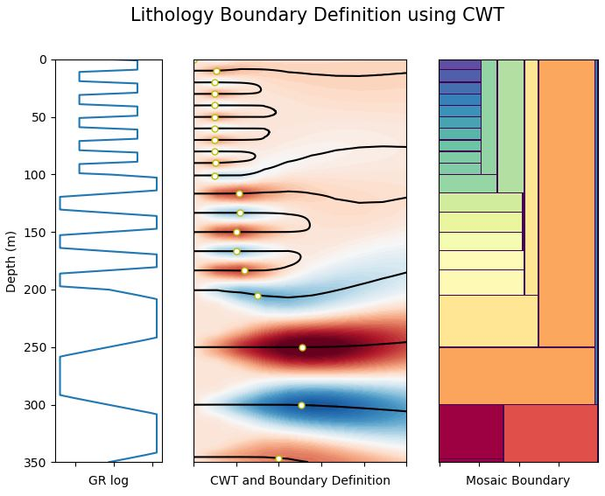
Notes:
Welcome
Hi everybody at Transform2020, welcome to the closing talk for our hackathon project!
Our project was about encoding Continuous Wavelet Transforms to estimate coal lithology boundaries from downhole geophysical logs, using only python.
The image here is only based on a the synthetic log to the left
I have to tell you, generating a mosaic plot was a lot harder than we thought! So when you see the mosaic plot later on, you have to clap!
Move slide (2)

Slide 2
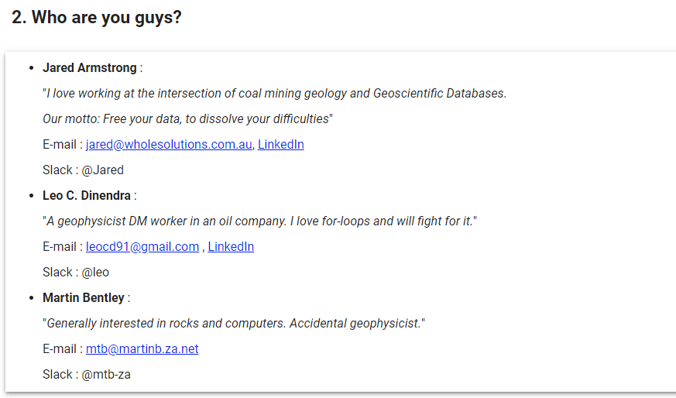
Notes:
My name is Jared Armstrong, and our team includes myself, Leo Dinendra and Martin Bentley!
You can read a bit about us here while I am talking.
A bit of background to the project ..
A couple of days before this conference I Read Evelyn Jun Hill's paper. I though wow! Imagine if you could successfully do this in coal sediments by just pressing a button!
You can find references to some of her papers in the project slack channel.
Anyway during Filippo’s welcoming address for the Hackathon, he encouraged us all to still enter a project if we had an idea, so I decided to have a crack and the project got launched!
Move to third slide (synth log)

Slide 3
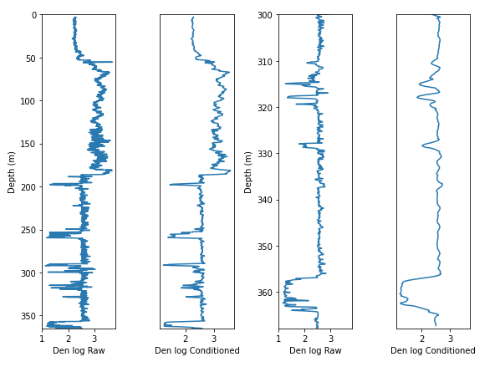
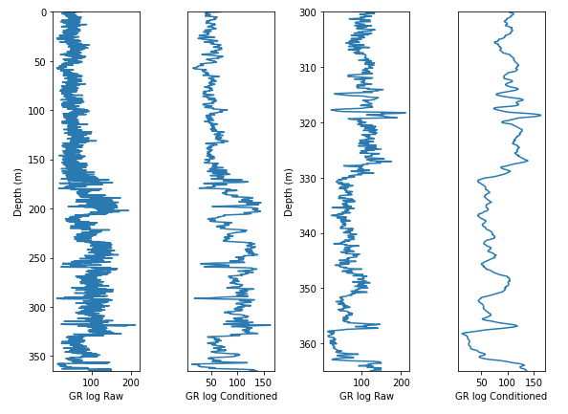
Libraries in used ..
Numpy
Pandas
Matplotlib
Scipy
Pywt (for the CWT)
Notes:
This is the gamma log. The first 2 plots are the full hole. The last two plots are the bottom 150m. You can see the difference between the raw and conditioned logs
I want to talk a bit about the process
Firstly, we realized the raw log was visually too busy. After playing around a bit, we log conditioned using the savgol filter. (click next twice) then Later we switched from gamma to density log.
Some of the libraries we ended up using are on the screen ..
Move to next slide (5)

Slide 4
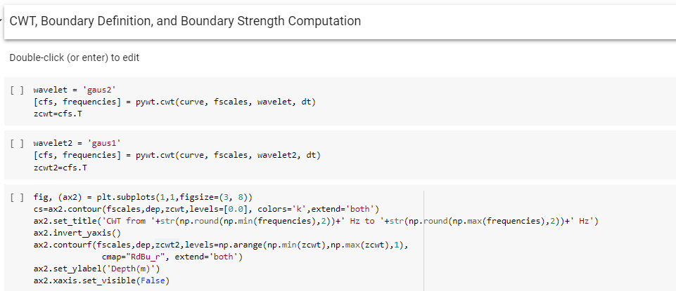
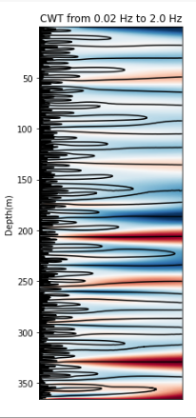
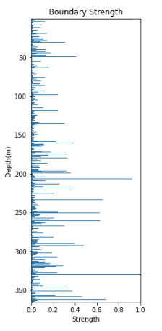
Notes:
Secondly, We (or Leo) successfully generating the CWT plot on the left and the boundary strength plot on the right..
This is the only bit of code you will see so savor it while you can!
Move to next slide (6)

Slide 5
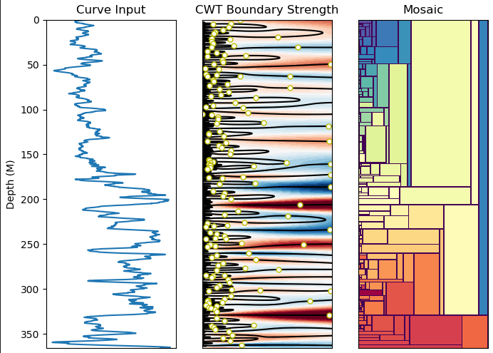
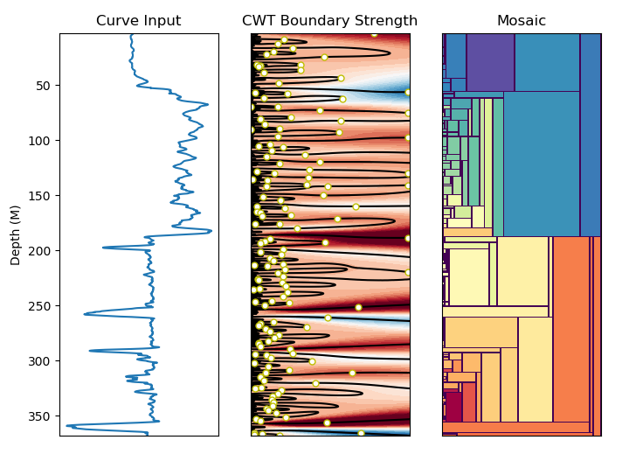
Notes:
Finally! the mosaic plot!. Yay! You can clap right about now!!
Click to add black arrows showing coal seams
First is gamma, second is density ( or RHOB). Black arrows point to the coal seams.
Unfortunately we found the visual correlation between the gamma and lithological boundaries to be fairly average,
Correlation seemed to improved with density, but ultimately, we need to try a multiscale correlation meaning combine both logs and try again.
Change slide (to 7)

Slide 6
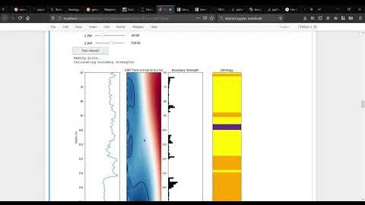
Notes:
Martin built on Leo’s excellent work and added some interactive slider widgets which I will now show.

Slide 7
Final wrap up ..
Notes:
In terms of Future work
There is much more that can be done here to further mold these initial concepts and code into more usable features ..
So in Conclusion ..
We think tessellations could rapidly and reproducibly resolve subtle or subjective detail in coal rocks and other other geological domains. Obviously, it still needs a bit of work.
We think this technique should therefore be considered an important addition to the mining and exploration geoscientists toolkit. Especially where lithological data is mostly derived from 1m composite intervals of rock chips or chip /RAB holes.
So, on behalf of the team, a MASSIVE thankyou to all that have been involved through the week. Thankyou to the organizers of the T2020 conference! Thankyou to Philippo for his guidance, also the energy for this project generated by folks like DougMc, thanks to Brendon for some of his technical resources and to all of you that contributed in some way to the project, thankyou!
Finally, to the Software Underground community, we bequeath to you, the code, the ideas, and the gorgeous mosaic plots generated by our team.
That’s it!
Goodnight.

