Slide 1


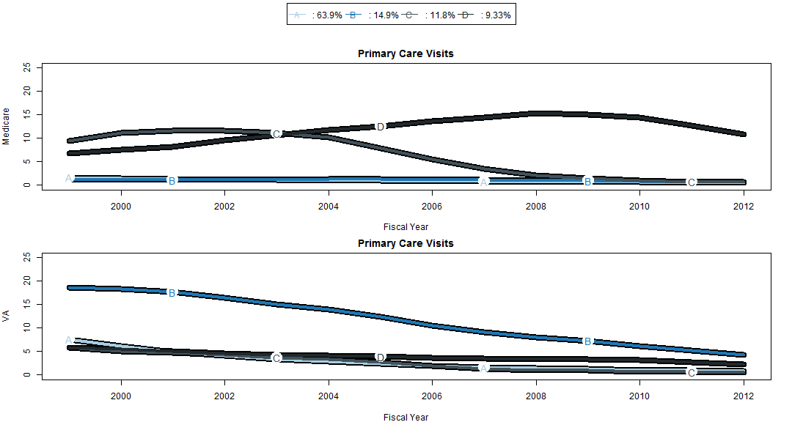
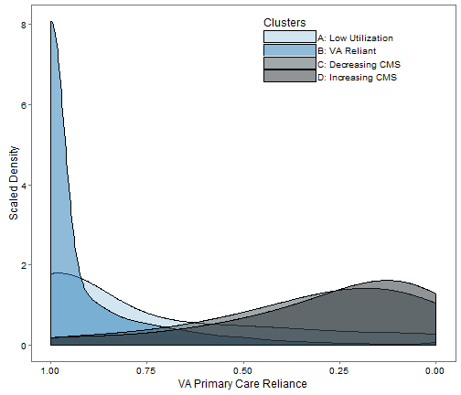
Health and Social Risk Characteristics of Veterans Who Choose to Rely on the VA for Primary Care
Adam J Batten BA¹, Paul L. Hebert PhD^{1,2} , Edwin S. Wong PhD^{1,2}, Steve Zeliadt^{1,2}, Emily Neely¹, Christine Sulc¹, Fen Liu^{1,2}
¹Seattle Center of Innovation for Veteran-Centered and Value-Driven Care, VA Puget Sound Health Care System; ²Department of Health Services, University of Washington;
BACKGROUND
RESULTS
CONCLUSION
Ongoing debate over whether the Veterans Affairs healthcare system (VA) should exist in its present form as a provider of comprehensive care, or a smaller organization that coordinates care provided largely by non-VA providers.
This debate is informed by choices of primary care use .
Figure 1: Identification of 4 joint group trajectories in primary care utilization for Medicare and VA
Group A (64%) consists of low intensity users of both VA and Medicare
Group B (15%) are the heavy VA and light Medicare users
Groups C & D (12% and 9%) are the heavy Medicare and light VA users
Figure 3: Combining the two heavy Medicare groups (Groups C and D) into one revealed substantial differences in demographics, health risks, and health behaviors between heavy VA and Medicare users.
Veterans who were eligible for Medicare in 1999 and became heavy VA users were more likely to be a minority race, have greater health risks, poorer health behaviors, and higher levels of social risks compared to veterans who became heavy Medicare users.
KML3D procedure can differentiate heavy and light VA users among veterans with a high ratio of VA/(VA+Medicare) use.
OBJECTIVES
Classified veterans based on their long-term trends in primary care use among veterans aged into Medicare from 2000 to 2012.
Examined whether patient demographics, comorbid conditions, and social risk factors were associated with the VA reliance group that veterans were classified to.
IMPLICATIONS
Heavy VA users who choose VA care over Medicare are our most at-risk Veterans.
Heavy VA users are most affected by efforts to shift care to non-VA providers, such as through the Veterans Choice Act or transforming the VA into an insurance provider rather than providers of comprehensive care.
POPULATION STUDIED
11,618 respondents of the 1999 Long form Health Survey of Enrolled Veterans (LHSEV) CORE questions.
Age 65-69
With Medicare part B, but not enrolled in an HMO
METHODS
Figure 2: The traditional method of measuring reliance as ratio of VA/(VA+ Medicare) would identify two groups of veterans. However, within each group, there are two distinct subgroups: heavy and light users of care.
Limitations
Figure 4: Heavy VA users were more likely to report having no emotional social support compared to heavy Medicare users
The KML3D method is a complete cases method that does not handle truncation. In this analysis we allowed the algorithm to impute up to 2 missing values and set all post mortality counts to 0.
Our sample is small (for VA) and is selected from a voluntary response survey.
Study Design: Retrospective cohort study using LHSEV surveys, VA administrative data, and Medicare claims
Outcomes: annual primary care visits in VA and Medicare, respectively, from 2000 to 2012
Independent variables: patient demographics, comorbid conditions, and social risk factors in 1999
Analysis
Modeled primary care visits as a joint longitudinal process with the nonparametric KML3D method of Genolini et al (2013) to classify groups based on primary care use trends over time.
Used the Calinski-Harabatz statistics to determine the optimal number of groups.
Compared the baseline characteristics of Veterans who would become heavy VA users over time with those who would become heavy Medicare users.
Acknowledgement
This work was undertaken as part of a VA HSR&D funded grant (IIR-10-150). Dr. Wong was supported by VA Career Development Award 13-024. The views expressed are those of the authors and do not necessarily reflect the position and or policy of the Department of Veterans Affairs or the U.S. Government, University of Washington.
REFERENCES
Christophe Genolini, Xavier Alacoque, Marianne Sentenac, Catherine Arnaud (2015). kml and kml3d: R Packages to Cluster Longitudinal Data. Journal of Statistical Software, 65(4), 1-34.
Ben Kesling (May 12, 2016). Donald Trump Adviser Signals Plan to Change Veterans’ Health Care; Wall Street Journal

