Slide 1

Transition (Core29 Challenge)
ABZ Digital Group

Slide 2

The challenge
You at Core29 have asked us to develop a way to track CO2 emissions and encourage more people to travel in a more environmentally friendly and productive way

Slide 3
Our solution
We as a team have built a web app that maps out travel routes, tracks CO2 emissions, and encourages users to travel in a more sustainable way through a gamified system.

Slide 4
Key Features
Route planning showing all available transport methods
Smart recommendations based on weather conditions
Gamification of sustainable transport choices
Achievements and personal stats

Slide 5

The web app live demo!

Slide 6
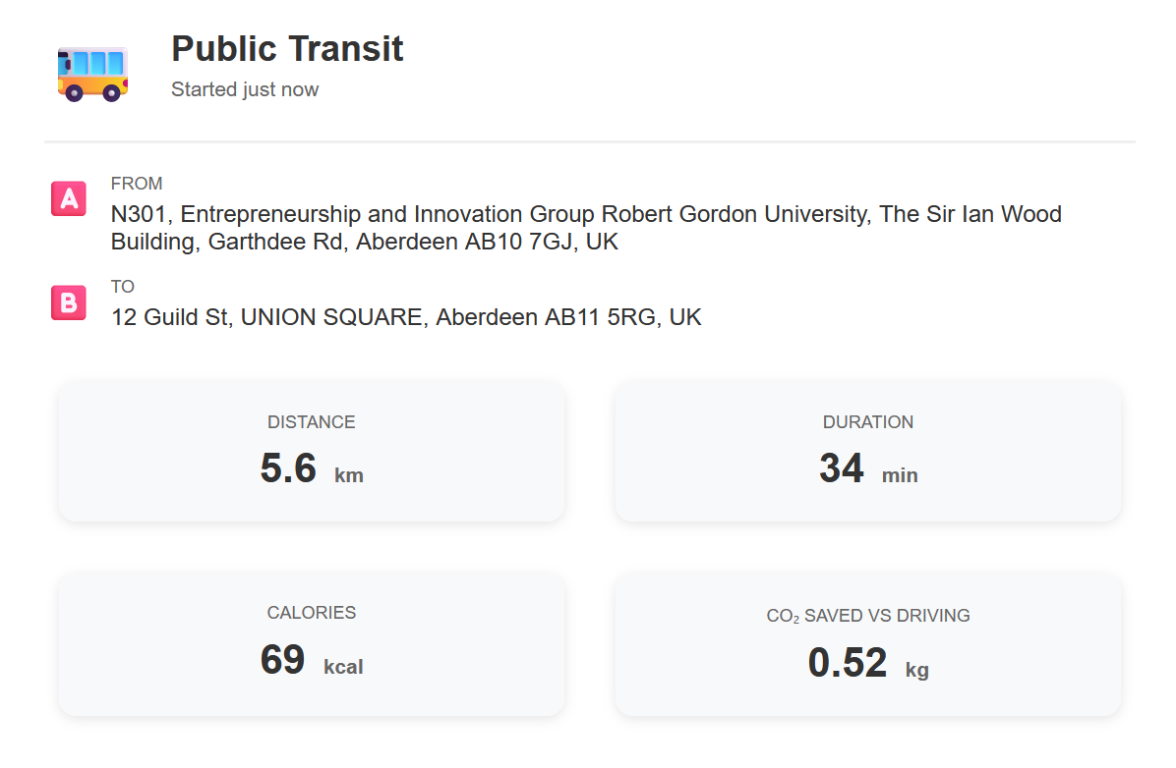
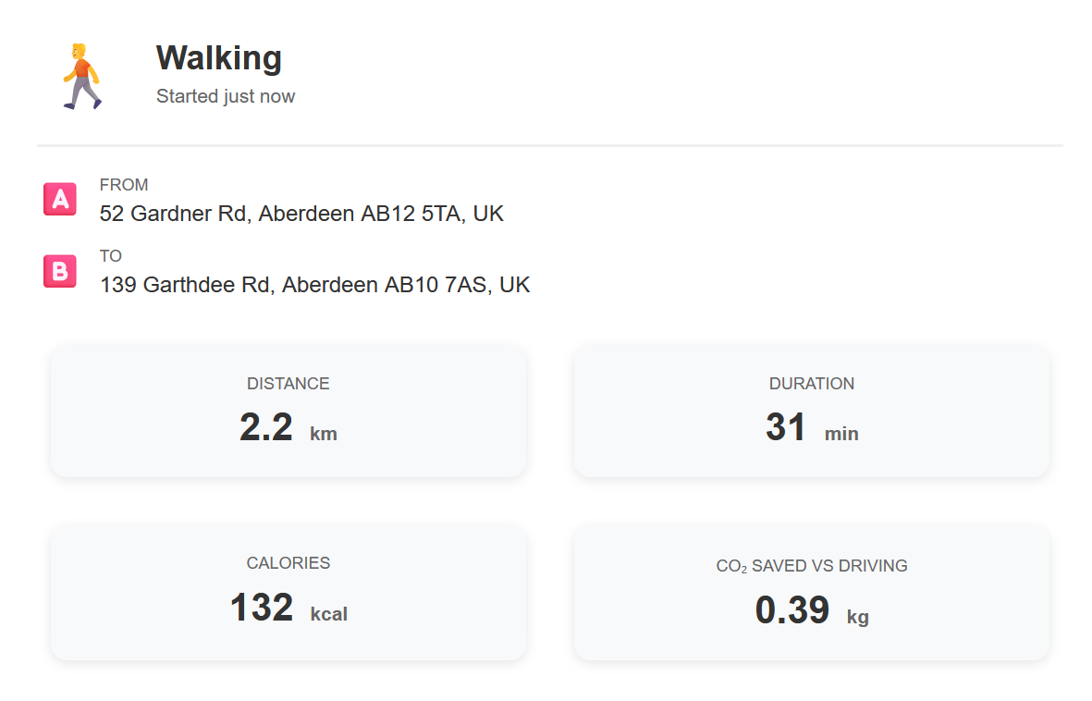
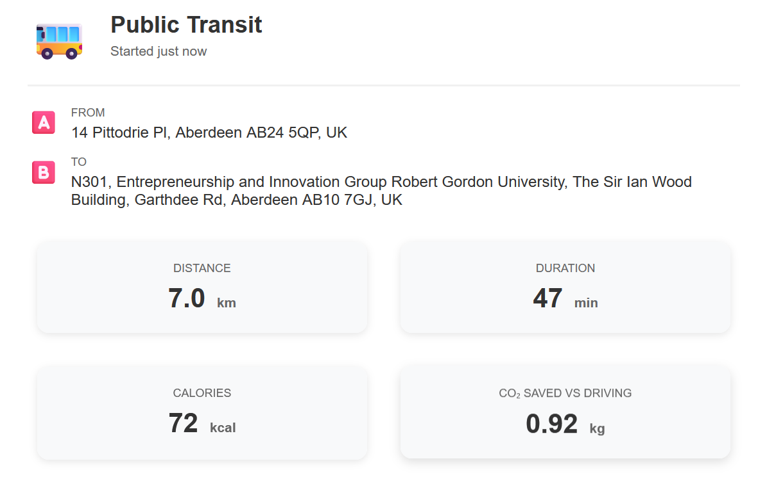
As a group we can see we saved
Approximately 1.8kg of carbon in emissions from our morning commute to RGU by using alternative transport instead of cars!
Thank you for your time

