Slide 1
Introduction to the CUDA Platform

Slide 2
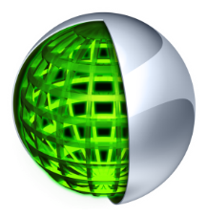

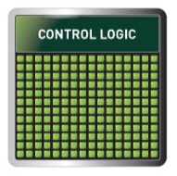
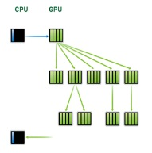
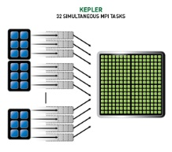
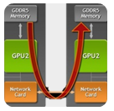
CUDA Parallel Computing Platform
www.nvidia.com/getcuda
Programming Approaches
Libraries
OpenACC Directives
Programming Languages
“Drop-in” Acceleration
Easily Accelerate Apps
Maximum Flexibility
Development
Environment
Nsight IDE
Linux, Mac and Windows
GPU Debugging and Profiling
CUDA-GDB debugger
NVIDIA Visual Profiler
Open Compiler
Tool Chain
Enables compiling new languages to CUDA platform, and CUDA languages to other architectures
Hardware Capabilities
SMX
Dynamic Parallelism
HyperQ
GPUDirect

Slide 3
3 Ways to Accelerate Applications
Applications
Libraries
OpenACC Directives
Programming Languages
“Drop-in” Acceleration
Easily Accelerate Applications
Maximum Flexibility
Notes:
There are 3 basic approaches to adding GPU acceleration to your applications.
But first, many applications are already GPU-accelerated. So first, find out if the
application you are interested in already uses GPUs.
If you are developing your own application, you can add GPU acceleration by:
1. Dropping in pre-optimized GPU-accelerated libraries as an alternative to MKL, IPP, FFTW and other widely used libraries
2. Adding some directives (or compiler “hints”) in your source code to automatically parallelize loops
3. Using the programming languages you already know to implement your own parallel algorithms
For each performance-critical area in your application, these approaches can be used independently or together.
For example you can use a GPU-accelerated library to perform some initial calculations on your data and then write your own code to perform custom calculations not (yet) available in a library.
The CUDA parallel computing platform and programming model supports all of these approaches.
So, let’s take a closer look at each approach.

Slide 4
3 Ways to Accelerate Applications
Applications
Libraries
OpenACC Directives
Programming Languages
“Drop-in” Acceleration
Easily Accelerate
Applications
Maximum Flexibility
Notes:
Many professional applications have already been ported to GPUs. If you are a developer interested in accelerating
your own application, you have 3 main options for adding GPU acceleration: In order of increasing effort, they are,
1. Drop in pre-optimized GPU-accelerated libraries as an alternative to MKL, IPP, FFTW and other widely used libraries
2. Use OpenACC directives (or compiler “hints”) in your source code to automatically parallelize compute-intensive loops
3. Use the programming languages you already know to implement your own parallel algorithms
For each performance-critical area in your application, these approaches can be used independently
or together.
For example, you might use a GPU-accelerated library to perform some initial calculations on your data and then use OpenACC to accelerate your own code to perform custom computations that are not (yet) available in a library.
CUDA is a parallel computing platform that supports all of these approaches. Here we present libraries and what it takes to get drop-in acceleration.

Slide 5

Libraries: Easy, High-Quality Acceleration
Ease of use: Using libraries enables GPU acceleration without in-depth knowledge of GPU programming
“Drop-in”: Many GPU-accelerated libraries follow standard APIs, thus enabling acceleration with minimal code changes
Quality: Libraries offer high-quality implementations of functions encountered in a broad range of applications
Performance: NVIDIA libraries are tuned by experts
Notes:
Developing applications around libraries offers a range of benefits:
- Being callable from your host application, the CUDA accelerated libraries can hide a lot of the architectural details of the GPUs and therefore significantly shorten your application development
cycle.
CUDA-accelerated libraries often use APIs similar to well established libraries widely used
in scientific applications, thus enabling a drop-in acceleration experience. In some cases, the
libraries will offer exactly the same interface for both the GPU accelerated Version and the CPU
only version, resulting in code portable between the worlds. In other cases, some with a minimal
amount of code changes will be necessary to accommodate both CPU and GPU support.
Designing an application around libraries is also good software engineering practice, as it
reuses well tested code and therefore enhancing the overall quality of your application.
- Finally, CUDA accelerated libraries developed by NVIDIA engineers are highly tuned for
Performance, delivering excellent performance on every generation of GPUs, while maintaining generality.

Slide 6

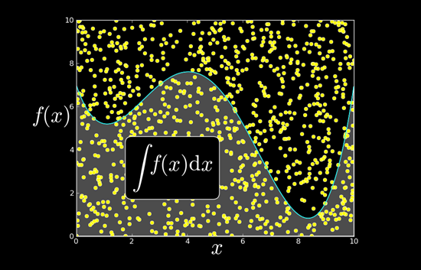
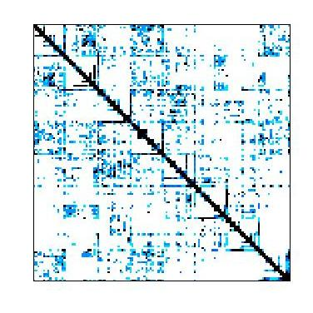


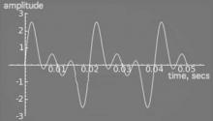







Some GPU-accelerated Libraries
NVIDIA cuBLAS
NVIDIA cuRAND
NVIDIA cuSPARSE
NVIDIA NPP
Vector Signal Image Processing
GPU Accelerated
Linear Algebra
Matrix Algebra on GPU and Multicore
NVIDIA cuFFT
Building-block Algorithms for CUDA
Sparse Linear Algebra
C++ STL Features for CUDA
IMSL Library
ArrayFire Matrix Computations
Notes:
- Green glow represents libraries developed by NVIDIA
- OSI symbol represents open-source libraries
Points to make:
There are libraries for a wide range of domains
There are 3rd party commercial libraries available (often with free and “freemium” versions)
There are many open source libraries, even from NVIDIA
NVIDIA produces and supports a large set of high-performance libraries

Slide 7
3 Steps to CUDA-accelerated application
Step 1: Substitute library calls with equivalent CUDA library calls
saxpy ( … ) cublasSaxpy ( … )
Step 2: Manage data locality
- with CUDA: cudaMalloc(), cudaMemcpy(), etc. - with CUBLAS: cublasAlloc(), cublasSetVector(), etc.
Step 3: Rebuild and link the CUDA-accelerated library
nvcc myobj.o –l cublas
Notes:
Three steps are necessary to use GPU accelerated libraries:
The function names may need to be changed
Data locality must be managed: Data needs to be moved to/from the GPU
In some libraries, this step is done by the library itself, entirely transparent
to the application developer
- Code needs to be linked against the accelerated library

Slide 8
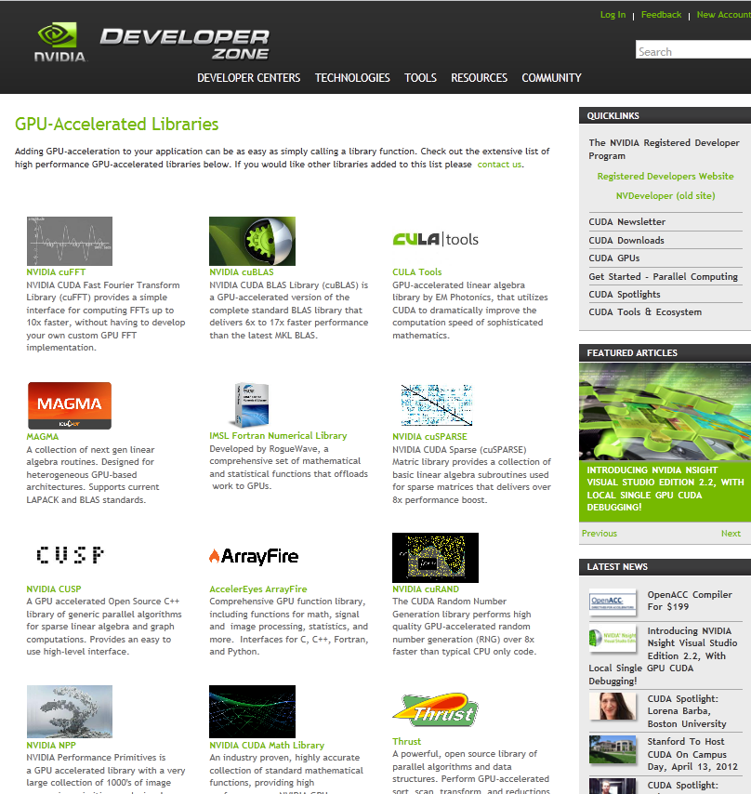
Explore the CUDA (Libraries) Ecosystem
CUDA Tools and Ecosystem described in detail on NVIDIA Developer Zone:
developer.nvidia.com/cuda-tools-ecosystem
Notes:
The next steps are now to explore the CUDA libraries ecosystem, accessible at
Developer.nvidia.com/cuda-tools-ecosystem. There you will find descriptions
and links of libraries you can start using today.

Slide 9
3 Ways to Accelerate Applications
Applications
Libraries
OpenACC Directives
Programming Languages
“Drop-in” Acceleration
Easily Accelerate
Applications
Maximum Flexibility
Notes:
Many professional applications have already been ported to GPUs. If you are a developer interested in accelerating
your own application, you have 3 main options for adding GPU acceleration: In order of increasing effort, they are,
1. Drop in pre-optimized GPU-accelerated libraries as an alternative to MKL, IPP, FFTW and other widely used libraries
2. Use OpenACC directives (or compiler “hints”) in your source code to automatically parallelize compute-intensive loops
3. Use the programming languages you already know to implement your own parallel algorithms
For each performance-critical area in your application, these approaches can be used independently
or together.
For example, you might use a GPU-accelerated library to perform some initial calculations on your data and then use OpenACC to accelerate your own code to perform custom computations that are not (yet) available in a library.
CUDA is a parallel computing platform that supports all of these approaches. Here we present libraries and what it takes to get drop-in acceleration.

Slide 10

OpenACC Directives
CPU
GPU
Simple Compiler hints
Compiler Parallelizes code
Works on many-core GPUs & multicore CPUs
Program myscience
... serial code ...
!$acc kernels
do k = 1,n1
do i = 1,n2
... parallel code ...
enddo
enddo !$acc end kernels
... End Program myscience
OpenACC
compiler
Hint
Your original
Fortran or C code
Notes:
OpenACC is an open programming standard for parallel computing on accelerators such as GPUs, using compiler directives.
OpenACC compiler directives are simple “hints” to the compiler that identify parallel regions of the code to accelerate. The compiler automatically accelerates these regions without requiring changes to the underlying code.
Directives expose parallelism to the compiler so that it can do the detailed work of mapping the computation onto parallel accelerators such as GPUs.
Additional directive options can be used to provide additional information to the compiler, for example about loop dependencies and data sharing.
Compilers without support for OpenACC will ignore the directives as if they were code comments, ensuring that the code remains portable across many-core GPUs and multi-core CPUs.

Slide 11

OpenACC The Standard for GPU Directives
Easy: Directives are the easy path to accelerate compute intensive applications
Open: OpenACC is an open GPU directives standard, making GPU programming straightforward and portable across parallel and multi-core processors
Powerful: GPU Directives allow complete access to the massive parallel power of a GPU
Notes:
OpenACC is easy, open and powerful. Directives provide access to the high performance of parallel accelerators without having to learn a parallel programming language or rewrite large
Portions of existing code. OpenACC is an open standard supported by multiple vendors, enabling straightforward development of portable accelerated code. OpenACC directives allow
Complete access to the parallel power of GPUs, in many cases achieving nearly the performance of direct programming of parallel kernels in languages such as CUDA C and CUDA Fortran.

Slide 12
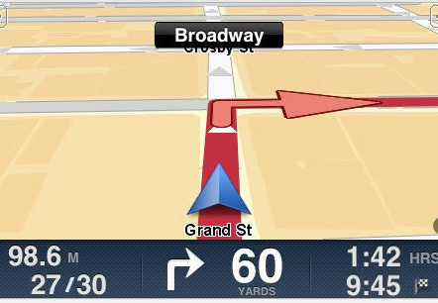

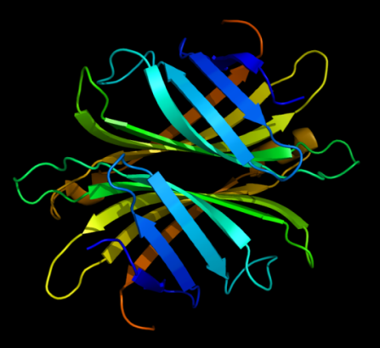
Directives: Easy & Powerful
Real-Time Object Detection
Global Manufacturer of Navigation Systems
Valuation of Stock Portfolios using Monte Carlo
Global Technology Consulting Company
Interaction of Solvents and Biomolecules
University of Texas at San Antonio
5x in 40 Hours
2x in 4 Hours
5x in 8 Hours
“
Optimizing code with directives is quite easy, especially compared to CPU threads or writing CUDA kernels. The most important thing is avoiding restructuring of existing code for production applications.
”
-- Developer at the Global Manufacturer of Navigation Systems
Notes:
In initial trials of OpenACC, users have achieved significant speedups of existing code in just hours with only minor modifications. Parallel computations such as object detection in image sequences, monte carlo stock portfolio valuations, and molecular dynamics simulations are good examples of the types of computations that have the potential for good speedups with OpenACC. In all three of these examples, most of the time was spent in exploring the existing code to find hot spots with loops that can be parallelized. The developers of all three examples were experts in their domain, with a good understanding of their application’s performance and data, but with little or no experience programming GPUs. Even without GPU experience, they were able to get significant acceleration with relatively little effort.
In some cases, it is necessary to make small changes to applications to expose sufficient parallelism, for example changing the layout of data in memory so that memory can be accessed in parallel by many threads without cache conflicts. We find that changes like this are valuable in general because they often benefit performance on the CPU even before OpenACC directives are added, and since the same code can be compiled with and without the directives, all platforms benefit.
Additional Information:
Global Manufacturer of Navigation Systems:
Object detection algorithm:
My application is involved in scene object detection in image sequence using also point clouds from laser scans (scans with low density). The computational intensive part is to calculate several features for each window, such as mean color, median, distance variance, etc.
Global Technology Consulting Company:
Doing a couple of things.
One is finding valuation of stock portfolio using monte carlo sim and the other is finding option prices portfolio of stocks using Black Scholes. It’s compute intensive in that for a large basket of instruments, each stock/option is calculated in a loop. Just by adding one line “#pragma acc for” into the code, he got 2x immediately.
University of Texas at San Antonio
He is in the beginning stages of developing algorithms to describe protein & solvent interactions. He just finished modeling his work using Matlab and Fortran and needs to develop real code. His goal is to develop algorithms and solutions that are much faster than existing ones today and he believes his work will have big impact in computational study of organic and bio molecules.

Slide 13
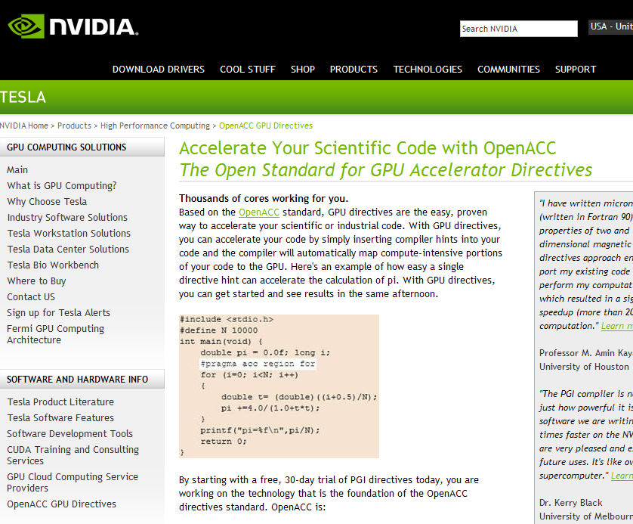
Start Now with OpenACC Directives
Sign up for a free trial of the directives compiler now!
Free trial license to PGI Accelerator
Tools for quick ramp
www.nvidia.com/gpudirectives
Notes:
NVIDIA has partnered with PGI to offer a free trial compiler license so that you can try OpenACC directives and experience how easy they are to use.
You can sign up for a 15-day trial license at www.nvidia.com/gpudirectives to access to a free downlload of the PGI accelerator compiler. The website has links to documentation,
Examples, and brief white papers that you can read over a cup of coffee to get started.
All you have to do is provide your contact information and register to download PGI Accelerator. You don’t need to become a GPU expert to try it out.
If you already have a PC with an NVIDIA GPU you can start right away, and if not, the website has some suggestions.

Slide 14
3 Ways to Accelerate Applications
Applications
Libraries
OpenACC Directives
Programming Languages
“Drop-in” Acceleration
Easily Accelerate
Applications
Maximum Flexibility
Notes:
Many professional applications have already been ported to GPUs. If you are a developer interested in accelerating
your own application, you have 3 main options for adding GPU acceleration: In order of increasing effort, they are,
1. Drop in pre-optimized GPU-accelerated libraries as an alternative to MKL, IPP, FFTW and other widely used libraries
2. Use OpenACC directives (or compiler “hints”) in your source code to automatically parallelize compute-intensive loops
3. Use the programming languages you already know to implement your own parallel algorithms
For each performance-critical area in your application, these approaches can be used independently
or together.
For example, you might use a GPU-accelerated library to perform some initial calculations on your data and then use OpenACC to accelerate your own code to perform custom computations that are not (yet) available in a library.
CUDA is a parallel computing platform that supports all of these approaches. Here we present libraries and what it takes to get drop-in acceleration.

Slide 15
GPU Programming Languages
Numerical analytics
MATLAB, Mathematica, LabVIEW
Fortran
OpenACC, CUDA Fortran
C
OpenACC, CUDA C
C++
Thrust, CUDA C++
Python
PyCUDA, Copperhead
F#
Alea.cuBase

Slide 16
Rapid Parallel C++ Development
Resembles C++ STL
High-level interface
Enhances developer productivity
Enables performance portability between GPUs and multicore CPUs
Flexible
CUDA, OpenMP, and TBB backends
Extensible and customizable
Integrates with existing software
Open source
// generate 32M random numbers on host thrust::host_vector<int> h_vec(32 << 20); thrust::generate(h_vec.begin(),
h_vec.end(),
rand);
// transfer data to device (GPU) thrust::device_vector<int> d_vec = h_vec; // sort data on device
thrust::sort(d_vec.begin(), d_vec.end()); // transfer data back to host thrust::copy(d_vec.begin(),
d_vec.end(),
h_vec.begin());
http://developer.nvidia.com/thrust or http://thrust.googlecode.com
Notes:
If you are a C++ programmer you are more than likely familiar with the Standard Template Library, or STL.
Thrust is an open-source parallel algorithms library which resembles the C++ STL.
Thrust's high-level interface greatly enhances developer productivity while enabling performance portability
between GPUs and multicore CPUs. Thrust includes back-end implementations for established technologies including
CUDA, Intel Threading Building Blocks, and the OpenMP standard. The latest version of Thrust also enables custom
back ends to be implemented. This interoperability facilitates integration with existing software.
Thrust is extremely flexible and powerful – its high-level interface enables efficient GPU code to be written
without directly writing any CUDA kernel calls. Thrust provides a GPU data container called device_vector that
abstracts copying data to and from the GPU, and it provides a large set of efficient algorithms for operating on these
vectors, including sorting, searching, reductions, set operations, and transformations. The example on the right shows
the creation of a vector on the host CPU, where it is filled with random values. The vector is then copied to the GPU
by assigning it to a device vector, and then the device vector is sorted. Thrust’s radix sort is extremely fast, sorting well
over a billion keys per second on GPUs.

Slide 17
Learn More
These languages are supported on all CUDA-capable GPUs.
You might already have a CUDA-capable GPU in your laptop or desktop PC!
CUDA C/C++ http://developer.nvidia.com/cuda-toolkit
GPU.NET http://tidepowerd.com
Thrust C++ Template Library http://developer.nvidia.com/thrust
MATLAB http://www.mathworks.com/discovery/
matlab-gpu.html
CUDA Fortran http://developer.nvidia.com/cuda-toolkit
Mathematica http://www.wolfram.com/mathematica/new
-in-8/cuda-and-opencl-support/
PyCUDA (Python) http://mathema.tician.de/software/pycuda

Slide 18
Getting Started
Download CUDA Toolkit & SDK: www.nvidia.com/getcuda
Nsight IDE (Eclipse or Visual Studio): www.nvidia.com/nsight
Programming Guide/Best Practices:
docs.nvidia.com
Questions:
NVIDIA Developer forums: devtalk.nvidia.com
Search or ask on: www.stackoverflow.com/tags/cuda
General: www.nvidia.com/cudazone

