Slide 1
CUDA-Accelerated Libraries
Drop-in Acceleration

Slide 2
Drop-In Acceleration (Step 1)
int N = 1 << 20;
// Perform SAXPY on 1M elements: y[]=a*x[]+y[]
saxpy(N, 2.0, d_x, 1, d_y, 1);
Notes:
Managing data locality in this example means the input vectors need to be transferred to/from the GPU. Not shown is the allocation of the GPU vectors.

Slide 3
Drop-In Acceleration (Step 1)
int N = 1 << 20;
// Perform SAXPY on 1M elements: d_y[]=a*d_x[]+d_y[]
cublasSaxpy(N, 2.0, d_x, 1, d_y, 1);
Add “cublas” prefix and use device variables
Notes:
Managing data locality in this example means the input vectors need to be transferred to/from the GPU. Not shown is the allocation of the GPU vectors.

Slide 4
Drop-In Acceleration (Step 2)
int N = 1 << 20;
cublasInit();
// Perform SAXPY on 1M elements: d_y[]=a*d_x[]+d_y[]
cublasSaxpy(N, 2.0, d_x, 1, d_y, 1);
cublasShutdown();
Initialize CUBLAS
Shut down CUBLAS
Notes:
Managing data locality in this example means the input vectors need to be transferred to/from the GPU. Not shown is the allocation of the GPU vectors.

Slide 5
Drop-In Acceleration (Step 2)
int N = 1 << 20;
cublasInit();
cublasAlloc(N, sizeof(float), (void**)&d_x);
cublasAlloc(N, sizeof(float), (void*)&d_y);
// Perform SAXPY on 1M elements: d_y[]=a*d_x[]+d_y[]
cublasSaxpy(N, 2.0, d_x, 1, d_y, 1);
cublasFree(d_x);
cublasFree(d_y);
cublasShutdown();
Allocate device vectors
Deallocate device vectors
Notes:
Managing data locality in this example means the input vectors need to be transferred to/from the GPU. Not shown is the allocation of the GPU vectors.

Slide 6
Drop-In Acceleration (Step 2)
int N = 1 << 20;
cublasInit();
cublasAlloc(N, sizeof(float), (void**)&d_x);
cublasAlloc(N, sizeof(float), (void*)&d_y);
cublasSetVector(N, sizeof(x[0]), x, 1, d_x, 1);
cublasSetVector(N, sizeof(y[0]), y, 1, d_y, 1);
// Perform SAXPY on 1M elements: d_y[]=a*d_x[]+d_y[]
cublasSaxpy(N, 2.0, d_x, 1, d_y, 1);
cublasGetVector(N, sizeof(y[0]), d_y, 1, y, 1);
cublasFree(d_x);
cublasFree(d_y);
cublasShutdown();
Transfer data to GPU
Read data back GPU
Notes:
Managing data locality in this example means the input vectors need to be transferred to/from the GPU. Not shown is the allocation of the GPU vectors.

Slide 7
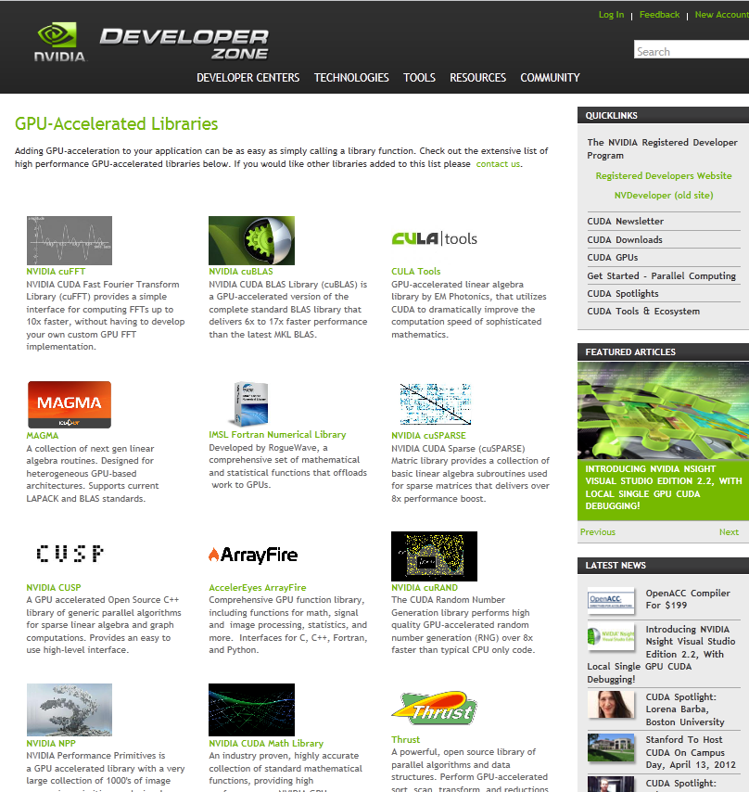
Explore the CUDA (Libraries) Ecosystem
CUDA Tools and Ecosystem described in detail on NVIDIA Developer Zone:
developer.nvidia.com/cuda-tools-ecosystem
Notes:
The next steps are now to explore the CUDA libraries ecosystem, accessible at
Developer.nvidia.com/cuda-tools-ecosystem. There you will find descriptions
and links of libraries you can start using today.

