Slide 1
An Introduction to the
Thrust Parallel Algorithms Library

Slide 2
What is Thrust?
High-Level Parallel Algorithms Library
Parallel Analog of the C++ Standard Template Library (STL)
Performance-Portable Abstraction Layer
Productive way to program CUDA

Slide 3
Example
#include <thrust/host_vector.h>
#include <thrust/device_vector.h>
#include <thrust/sort.h>
#include <cstdlib>
int main(void)
{
// generate 32M random numbers on the host
thrust::host_vector<int> h_vec(32 << 20);
thrust::generate(h_vec.begin(), h_vec.end(), rand);
// transfer data to the device
thrust::device_vector<int> d_vec = h_vec;
// sort data on the device
thrust::sort(d_vec.begin(), d_vec.end());
// transfer data back to host
thrust::copy(d_vec.begin(), d_vec.end(), h_vec.begin());
return 0;
}

Slide 4
Easy to Use
Distributed with CUDA Toolkit
Header-only library
Architecture agnostic
Just compile and run!
$ nvcc -O2 -arch=sm_20 program.cu -o program

Slide 5
Why should I use Thrust?

Slide 6
Productivity
Containers
host_vector
device_vector
Memory Mangement
Allocation
Transfers
Algorithm Selection
Location is implicit
// allocate host vector with two elements
thrust::host_vector<int> h_vec(2);
// copy host data to device memory
thrust::device_vector<int> d_vec = h_vec;
// write device values from the host
d_vec[0] = 27;
d_vec[1] = 13;
// read device values from the host
int sum = d_vec[0] + d_vec[1];
// invoke algorithm on device
thrust::sort(d_vec.begin(), d_vec.end());
// memory automatically released

Slide 7
Productivity
Large set of algorithms
~75 functions
~125 variations
Flexible
User-defined types
User-defined operators
Algorithm | Description
reduce | Sum of a sequence
find | First position of a value in a sequence
mismatch | First position where two sequences differ
inner_product | Dot product of two sequences
equal | Whether two sequences are equal
min_element | Position of the smallest value
count | Number of instances of a value
is_sorted | Whether sequence is in sorted order
transform_reduce | Sum of transformed sequence

Slide 8
Interoperability
Thrust
CUDA C/C++
CUBLAS, CUFFT, NPP
STL
CUDA Fortran
C/C++
OpenMP
TBB

Slide 9
Portability
Support for CUDA, TBB and OpenMP
Just recompile!
nvcc -DTHRUST_DEVICE_SYSTEM=THRUST_HOST_SYSTEM_OMP
GeForce GTX 280
$ time ./monte_carlo
pi is approximately 3.14159
real 0m6.190s
user 0m6.052s
sys 0m0.116s
NVIDA GeForce GTX 580
Core2 Quad Q6600
$ time ./monte_carlo
pi is approximately 3.14159
real 1m26.217s
user 11m28.383s
sys 0m0.020s
Intel Core i7 2600K

Slide 10
Backend System Options
Host Systems
THRUST_HOST_SYSTEM_CPP
THRUST_HOST_SYSTEM_OMP
THRUST_HOST_SYSTEM_TBB
Device Systems
THRUST_DEVICE_SYSTEM_CUDA
THRUST_DEVICE_SYSTEM_OMP
THRUST_DEVICE_SYSTEM_TBB

Slide 11
Multiple Backend Systems
Mix different backends freely within the same app
thrust::omp::vector<float> my_omp_vec(100);
thrust::cuda::vector<float> my_cuda_vec(100);
...
// reduce in parallel on the CPU
thrust::reduce(my_omp_vec.begin(), my_omp_vec.end());
// sort in parallel on the GPU
thrust::sort(my_cuda_vec.begin(), my_cuda_vec.end());

Slide 12
Potential Workflow
Implement Application with Thrust
Profile Application
Specialize Components as Necessary
Thrust Implementation
Profile Application
Specialize Components
Application
Bottleneck
Optimized Code

Slide 13
Performance Portability
Thrust
CUDA
OpenMP
Transform
Sort
Reduce
Transform
Sort
Reduce
Scan
Scan
Sort
Radix Sort
Merge Sort
G80
Fermi
G80
Fermi
GT200
GT200
Kepler
Kepler

Slide 14
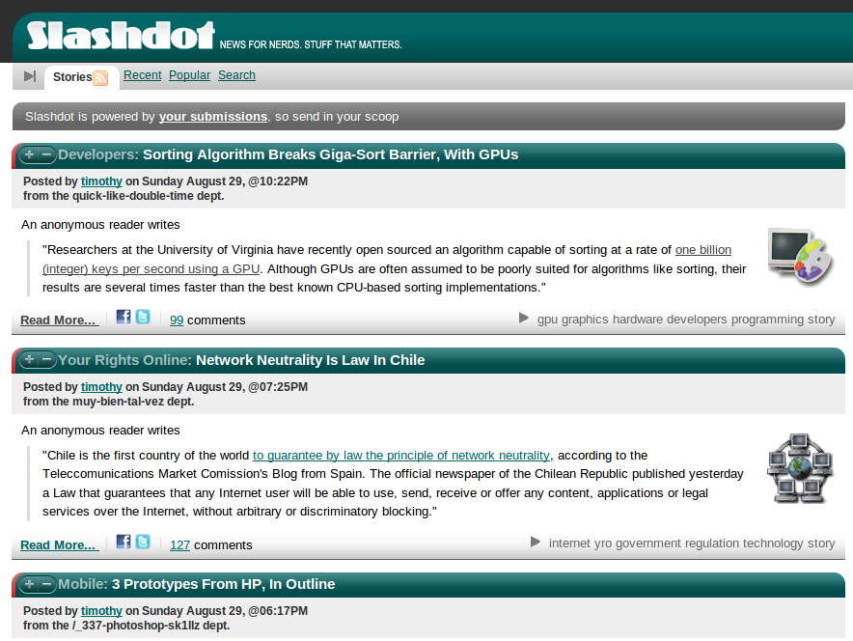
Performance Portability

Slide 15
Extensibility
Customize temporary allocation
Create new backend systems
Modify algorithm behavior
New in Thrust v1.6

Slide 16
Robustness
Reliable
Supports all CUDA-capable GPUs
Well-tested
~850 unit tests run daily
Robust
Handles many pathological use cases

Slide 17
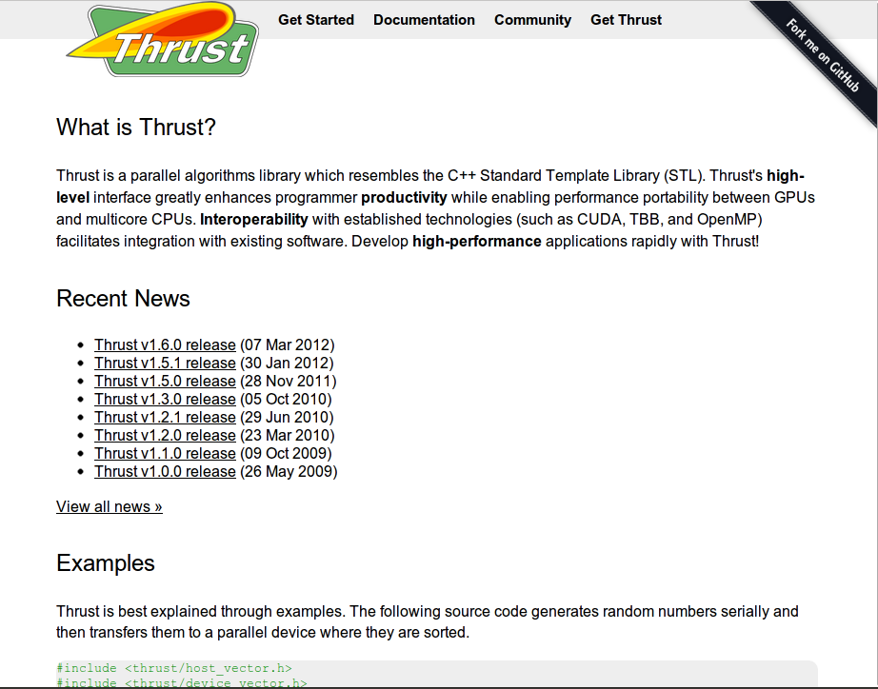
Openness
thrust.github.com
Open Source Software
Apache License
Hosted on GitHub
Welcome to
Suggestions
Criticism
Bug Reports
Contributions

Slide 18
Resources
thrust.github.com
Documentation
Examples
Mailing List
Webinars
Publications

