Slide 1
Why GPU Computing
Notes:
This presentation serves as an introduction to a series of more in-depth presentations on the three main approaches to GPU computing, which are GPU-accelerated libraries,
OpenACC compiler directives, and GPU programming languages. If you are interested in code examples, we also have a module called “Six ways to SAXPY” that demonstrates
the SAXPY computation implemented in multiple GPU computing languages.
To access the additional presentations in this series, click on the attachments tab of your viewing window.

Slide 2

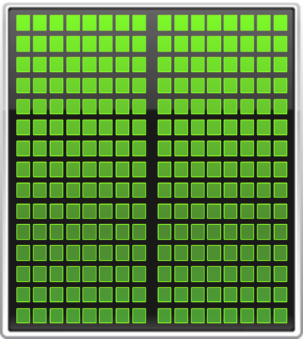

Add GPUs: Accelerate Science Applications
CPU
GPU
Notes:
GPU Computing is a type of heterogeneous computing – that is, parallel computing with multiple processor architectures. In GPU computing,
Many-core GPUs are combined with multicore CPUs to achieve higher performance.
Today’s CPUs have 4, 6, 8 or even 12 cores, while GPUs have up to 512 cores in a single chip.
Today’s computing applications typically have data intensive regions with a large amount of inherent parallelism. GPUs accelerate these parallel
Regions by spreading the computation over hundreds of cores. This can deliver significant acceleration for many applications.

Slide 3
Small Changes, Big Speed-up
Application Code
Rest of Sequential
CPU Code
GPU
Compute-Intensive Functions
CPU
Use GPU to Parallelize
+
Notes:
Your time is precious, which is why performance is critical. So you need to focus on what’s important.
To add GPU acceleration, simply identify and accelerate the *performance-critical areas* in your application.
The rest can run as-is on the CPU. There’s no need for an entire application to be ported to the GPU.
The key point here is that in a hybrid architecture where GPUs and CPUs are working together, developers only need to accelerate performance-critical functions on the GPUs in the system.

Slide 4
Fastest Performance on Scientific Applications
Tesla K20X Speed-Up over Sandy Bridge CPUs
Engineering
Physics
Earth
Science
Molecular
Dynamics
CPU results: Dual socket E5-2687w, 3.10 GHz, GPU results: Dual socket E5-2687w + 2 Tesla K20X GPUs
*MATLAB results comparing one i7-2600K CPU vs with Tesla K20 GPU
Disclaimer: Non-NVIDIA implementations may not have been fully optimized
Notes:
While benchmarks like DGEMM and SGEMM are important indicators for performance, eventually it’s about how well real world applications run on it. This chart compares the K20X vs the SandyBridge CPUs on some workloads that are relevant to HPC. The Speed up is anywhere between 8X to 18X. What does this speed really mean to a user? Well if a job took 2 months to run on a CPU, a 10X speedup means that the job can complete within a week.
-A developer gets the results sooner, check for correctness and can move on to the next step in process.
Therefore a speed of 10x can save a lot of time for a developer in the overall project.

Slide 5


Why Computing Perf/Watt Matters?
CPU
Optimized for
Serial Tasks
GPU Accelerator
Optimized for Many
Parallel Tasks
2.3 PFlops
7000 homes
10x performance/socket
7.0 Megawatts
7.0 Megawatts
> 5x energy efficiency
Traditional CPUs are
not economically feasible
Era of GPU-accelerated computing is here
Notes:
Why do HPC customers care about Perf/watt when upgrading their systems?
The reality of today is that computing performance cannot be considered by itself. The amount of power required to drive these systems is an important part of the overall cost of ownership.
For example, powering a 2.3 PFlops machine that is built with CPU requires upto ~7 megawatts. Assuming 1 megawatt can power 1000 homes for a year, it’s equal to the powering up 7000 homes for a year.
Clearly the CPU technology just cannot keep up with the explosive demand for computing. It’s too expensive and power-consuming. This has led the HPC customers to look for options. CPUs are optimized for sequential processing, but not very efficient for parallel computing. GPUs on the other hand are tailor-made for parallel computation. Combining a GPU with a CPU makes a winning combination with each doing what one does best. The result is 10x higher performance per socket and 5x the energy efficiency.
CPUs alone cannot keep up with the demand for computing performance, the era of GPU accelerated computing is here because the benefit it offers is meaningful in terms of perf/watt.

Slide 6
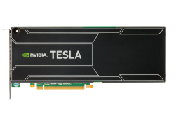

World’s Fastest, Most Energy Efficient Accelerator
Tesla K20X vs Xeon CPU
8x Faster SGEMM
6x Faster DGEMM
Tesla K20X vs Xeon Phi
90% Faster SGEMM
60% Faster DGEMM
Notes:
When compared to competition, Tesla K20 and K20X GPU really shines.
Sandy Bridge is the best CPU in market today. K20X is 8x faster on SGEMM and 6x faster on DGEMM.
Against Intel’s accelerator, Xeon Phi at 225W, our estimates indicate K20X is 90% faster on SGEMM and 60% faster on DGEMM.
We’re quite excited about the raw performance that this GPU is capable of. But we’re more excited about real application performance

