Slide 1



regression
View in Power BI
Last data refresh:
2022-04-08 1:19:30 PM UTC
Downloaded at:
2022-04-08 4:44:01 PM UTC

Slide 2
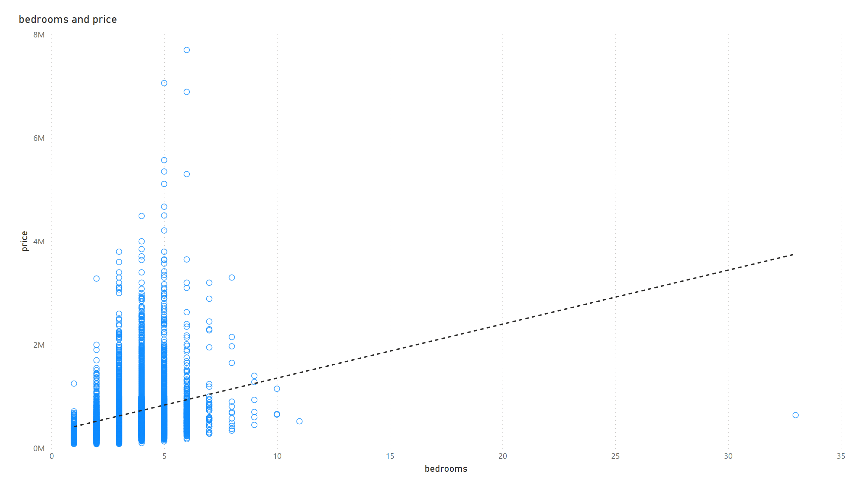
$ vs bedrooms
Notes:
scatterChart
No alt text provided

Slide 3
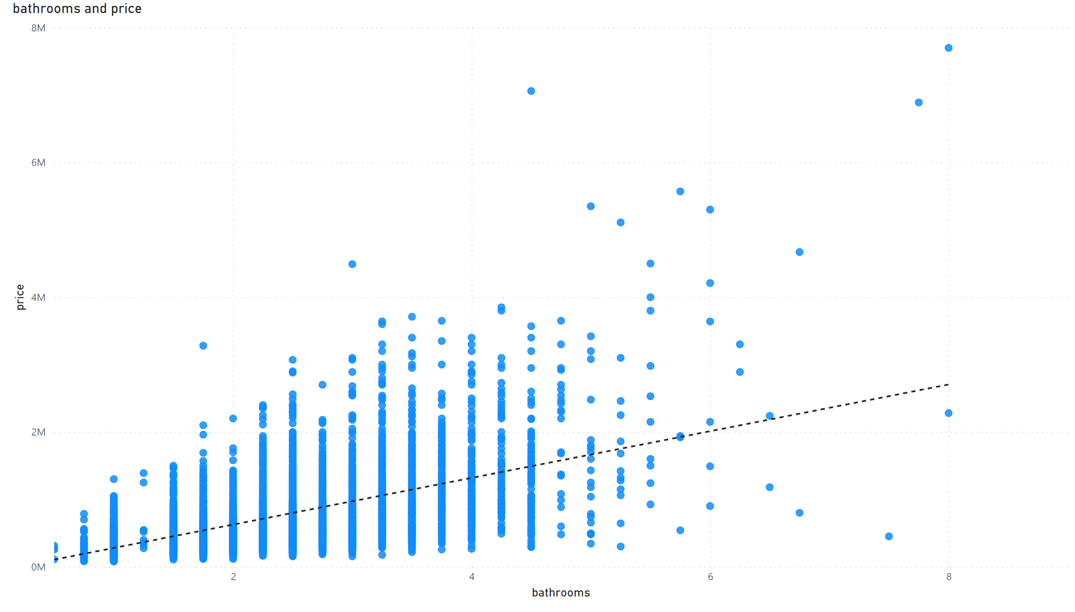
$ vs bathrooms
Notes:
scatterChart
No alt text provided

Slide 4
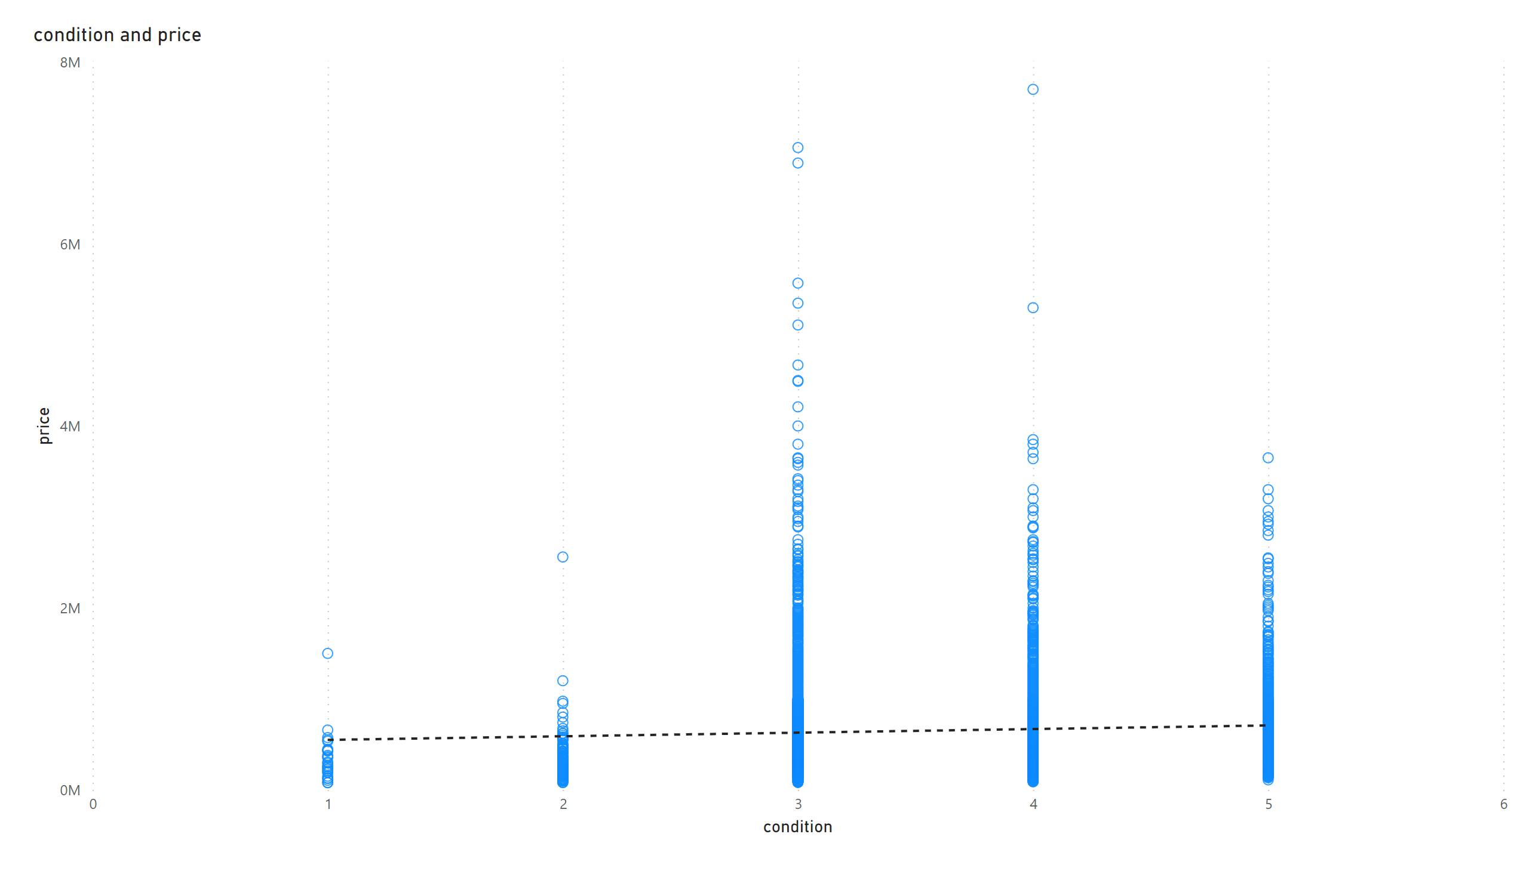
$ vs condition
Notes:
scatterChart
No alt text provided

Slide 5
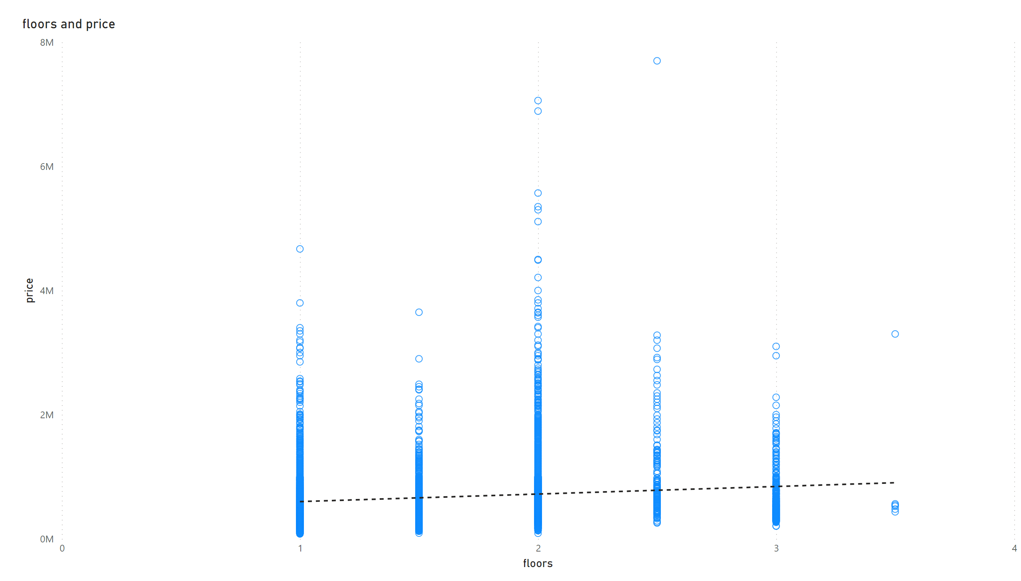
$ vs floors
Notes:
scatterChart
No alt text provided

Slide 6
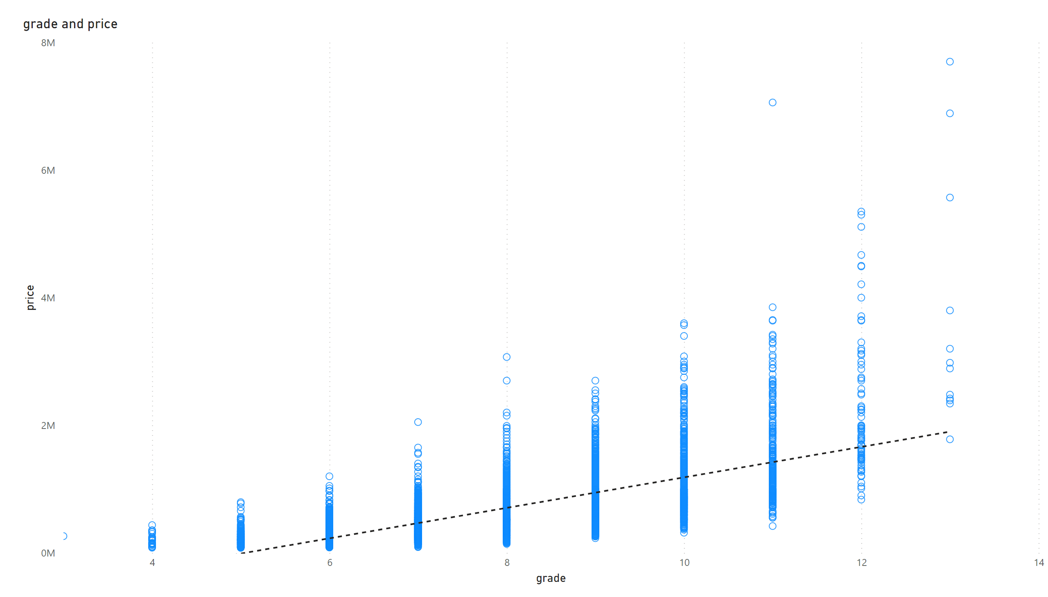
$ vs grade
Notes:
scatterChart
No alt text provided

Slide 7
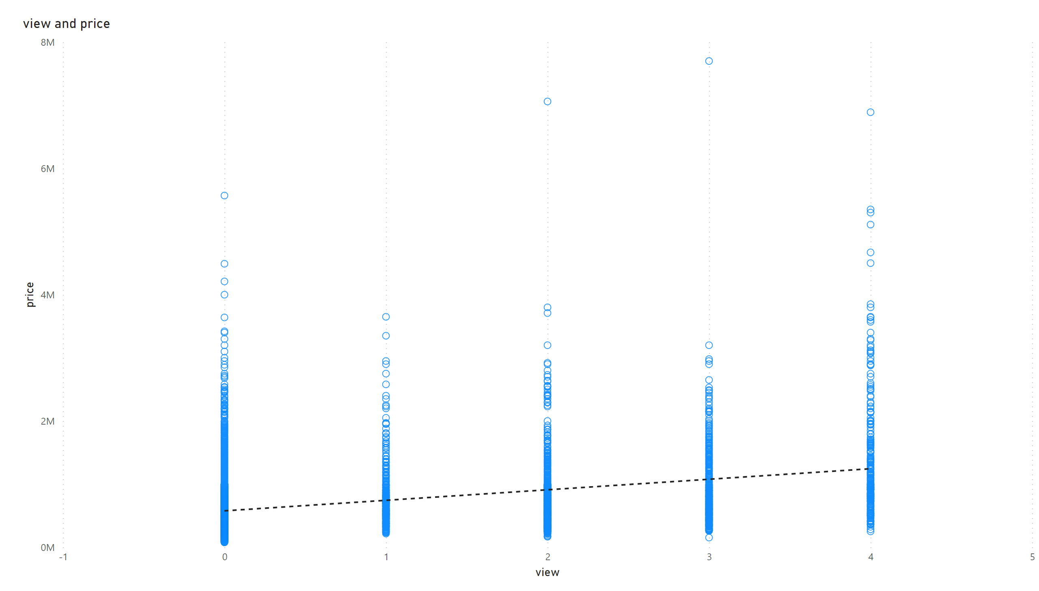
$ vs view
Notes:
scatterChart
No alt text provided

Slide 8
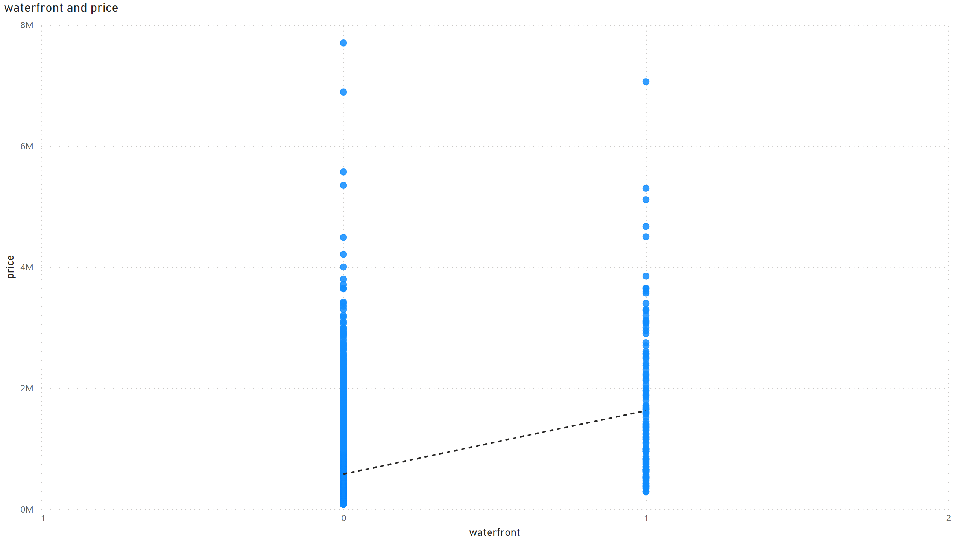
$ vs waterfront
Notes:
scatterChart
No alt text provided

Slide 9
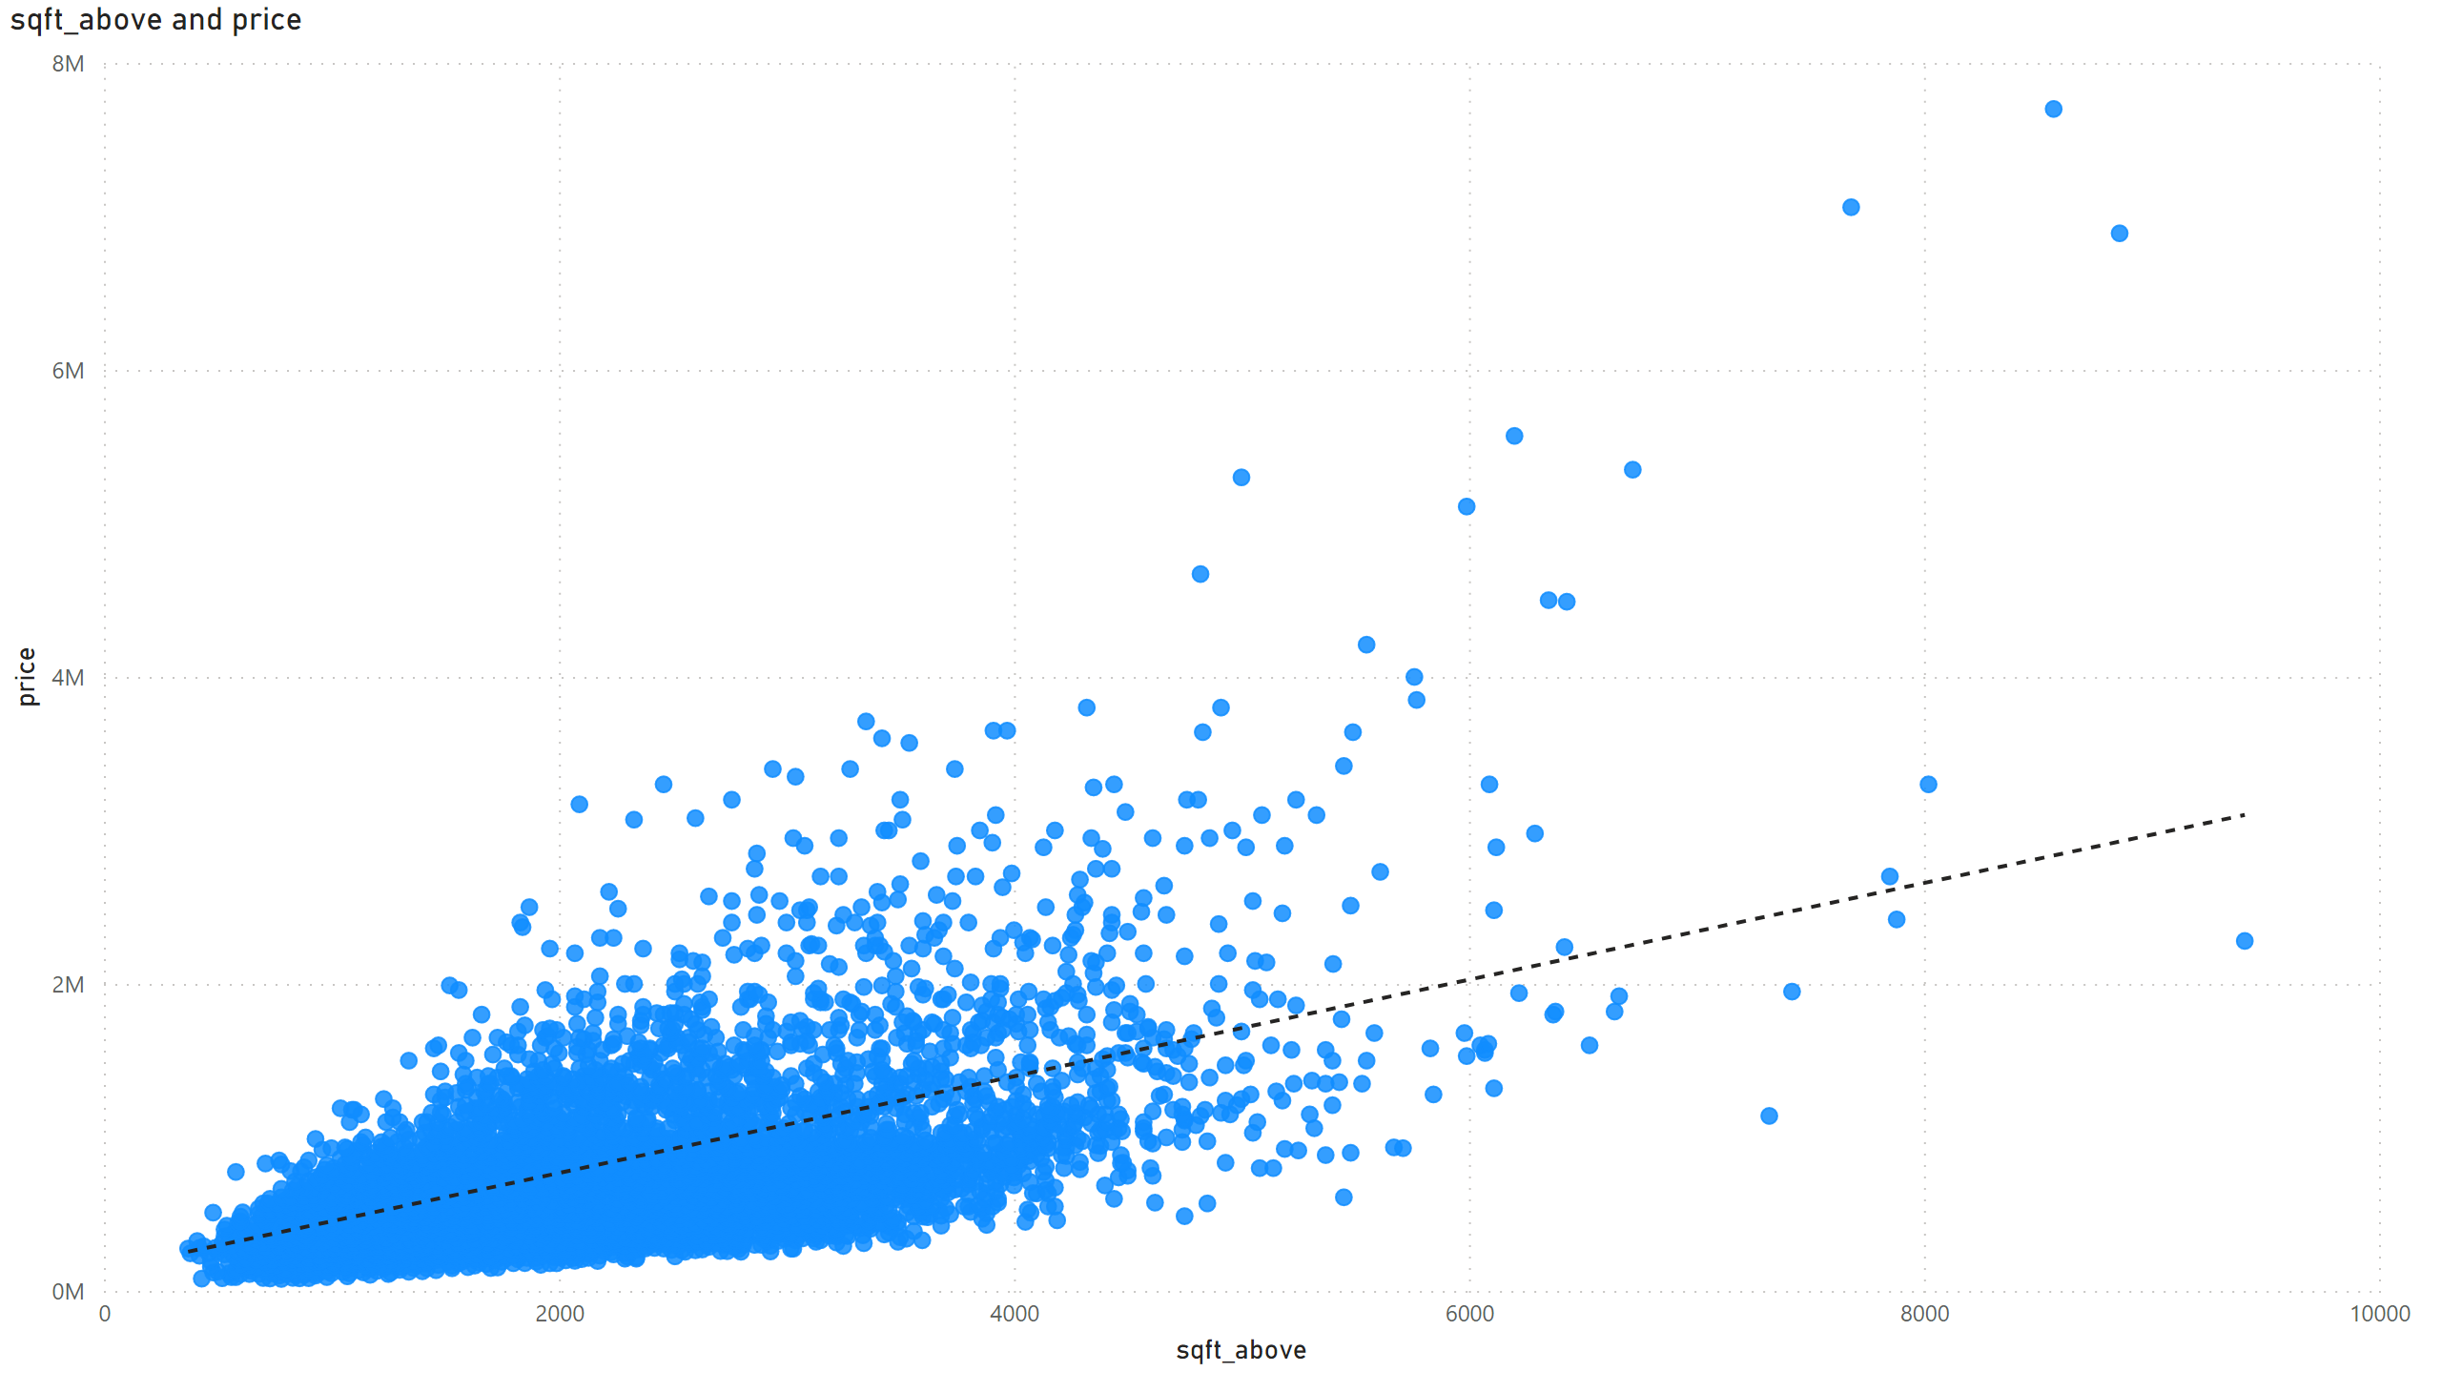
$ vs sqft_above
Notes:
scatterChart
No alt text provided

Slide 10
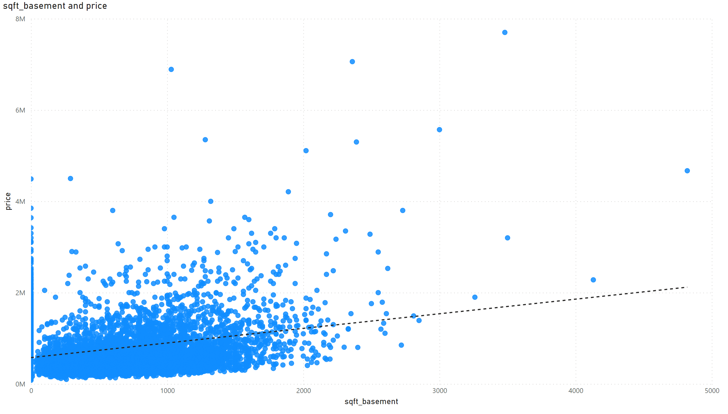
$ vs sqft_basement
Notes:
scatterChart
No alt text provided

Slide 11
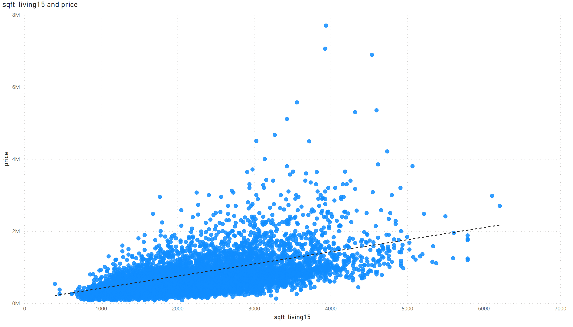
$ vs living15
Notes:
scatterChart
No alt text provided

Slide 12
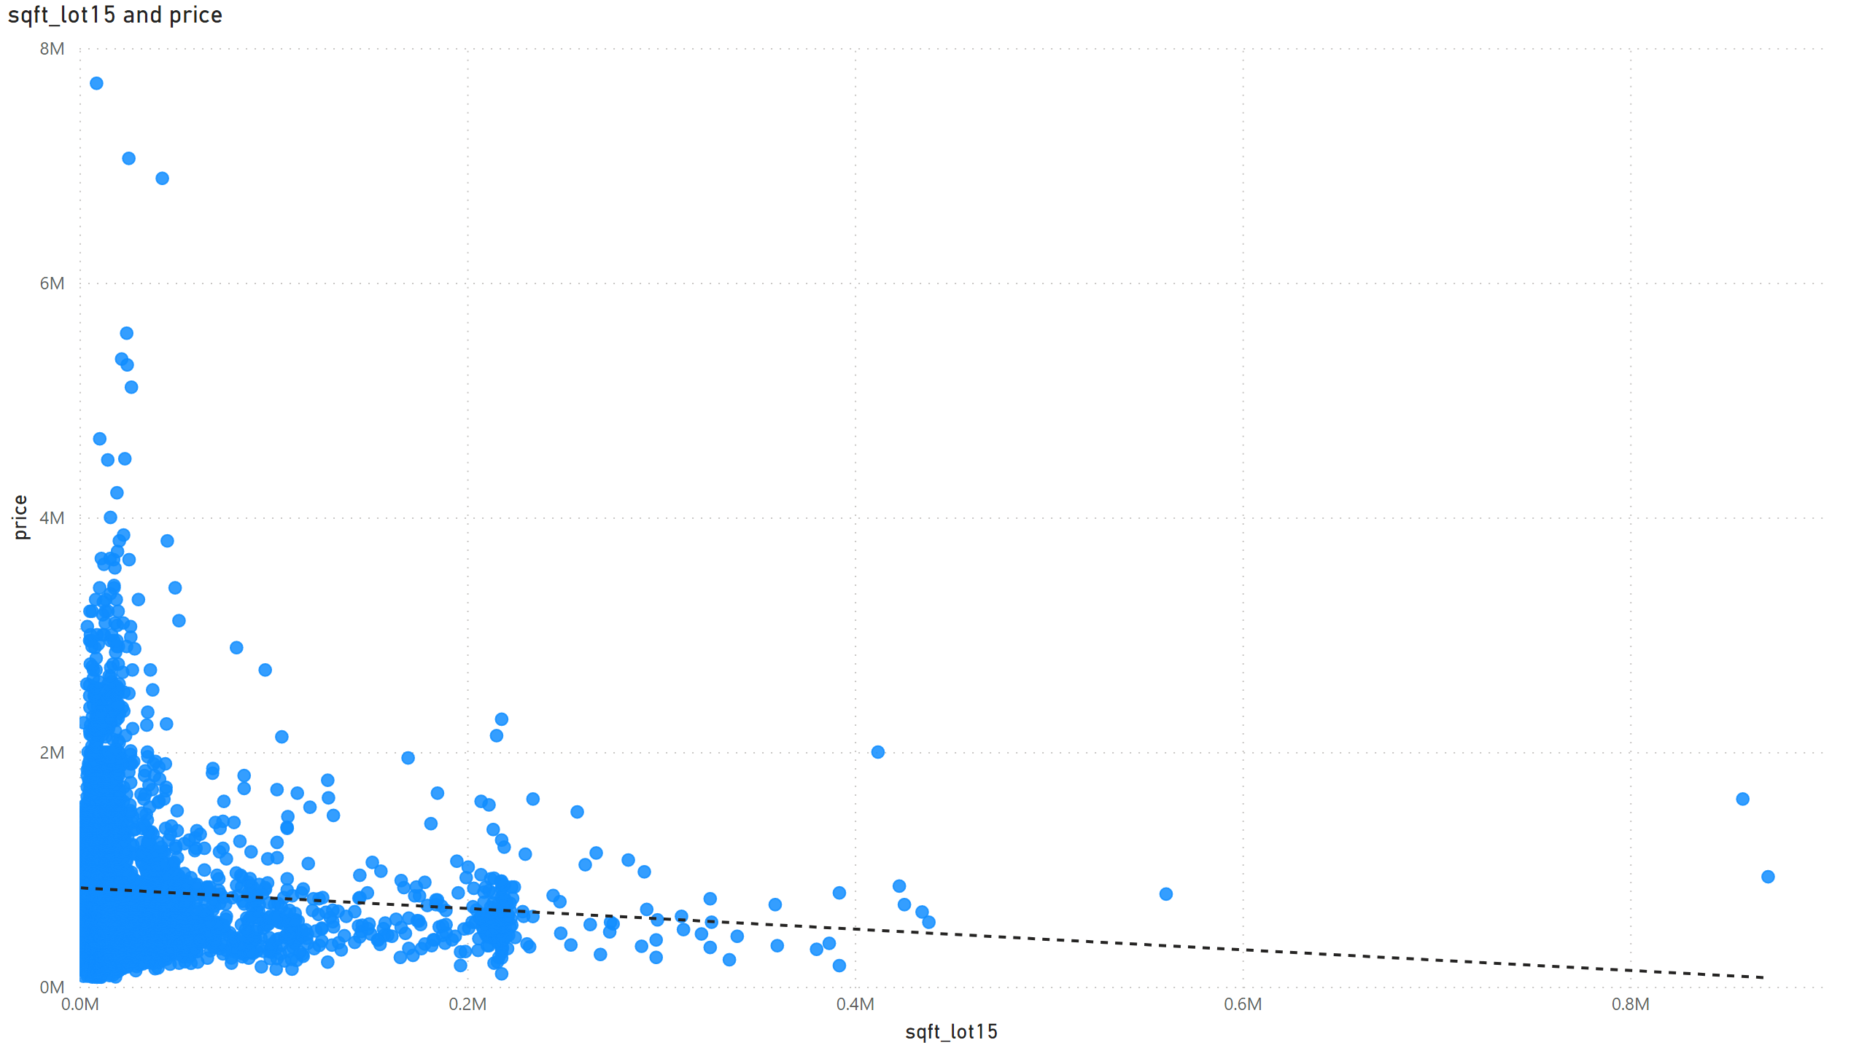
$ vs sqft_lot15
Notes:
scatterChart
No alt text provided

Slide 13
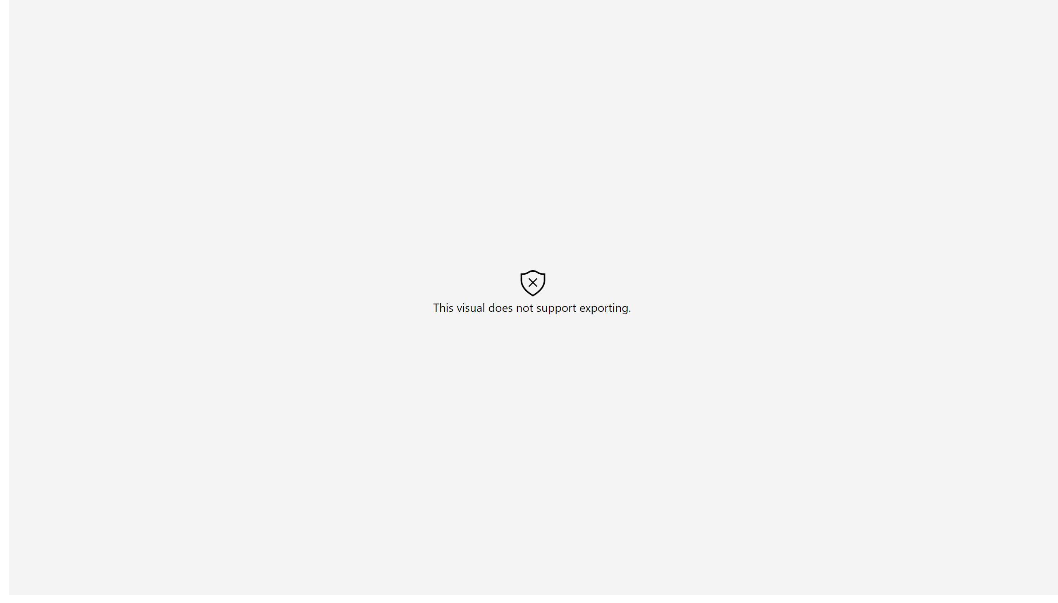
$ per zipcode
Notes:
esriVisual
No alt text provided

Slide 14
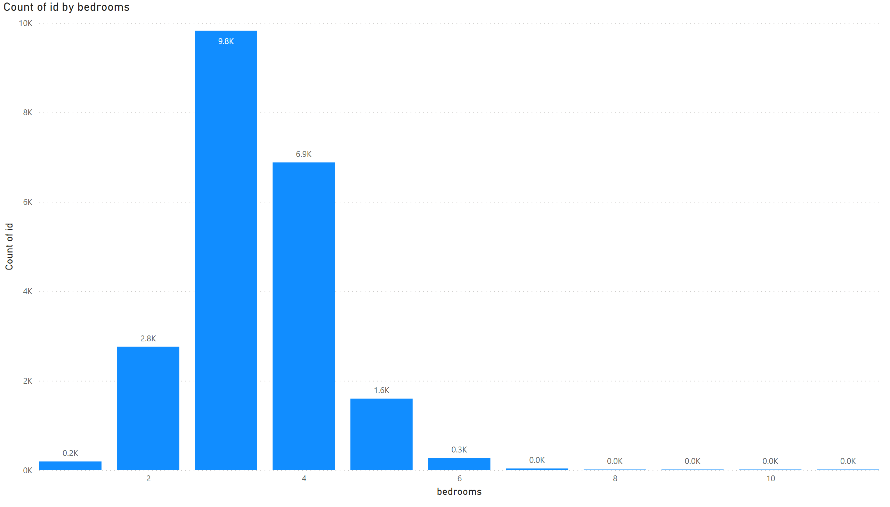
Most sold by Bedroom
Notes:
columnChart
No alt text provided

Slide 15
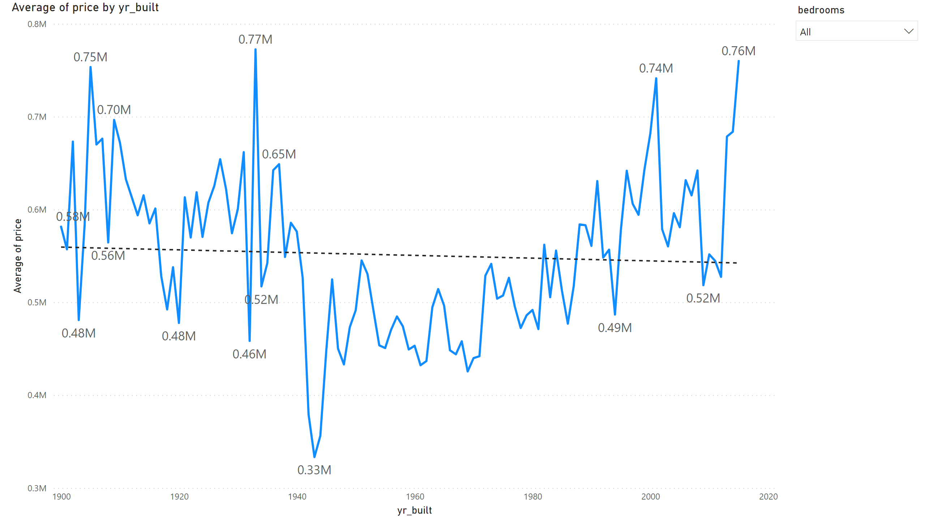
$ by year with bedroom filter
Notes:
lineChart
No alt text provided
slicer
No alt text provided

Slide 16
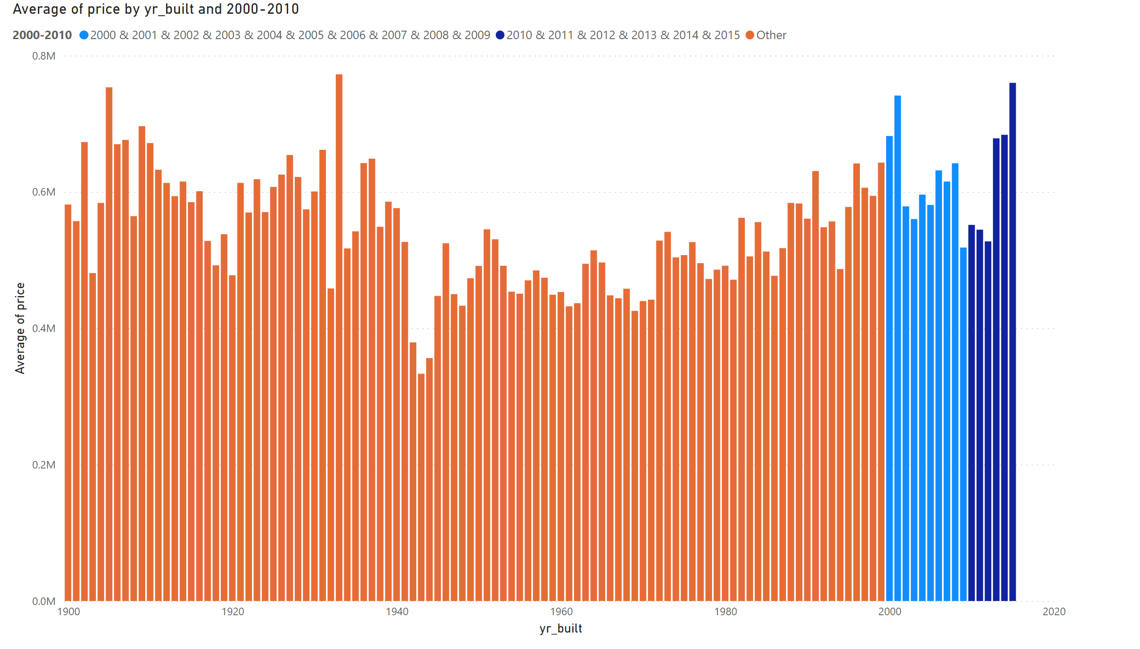
Distribution of Price over years
Notes:
columnChart
No alt text provided

Slide 17
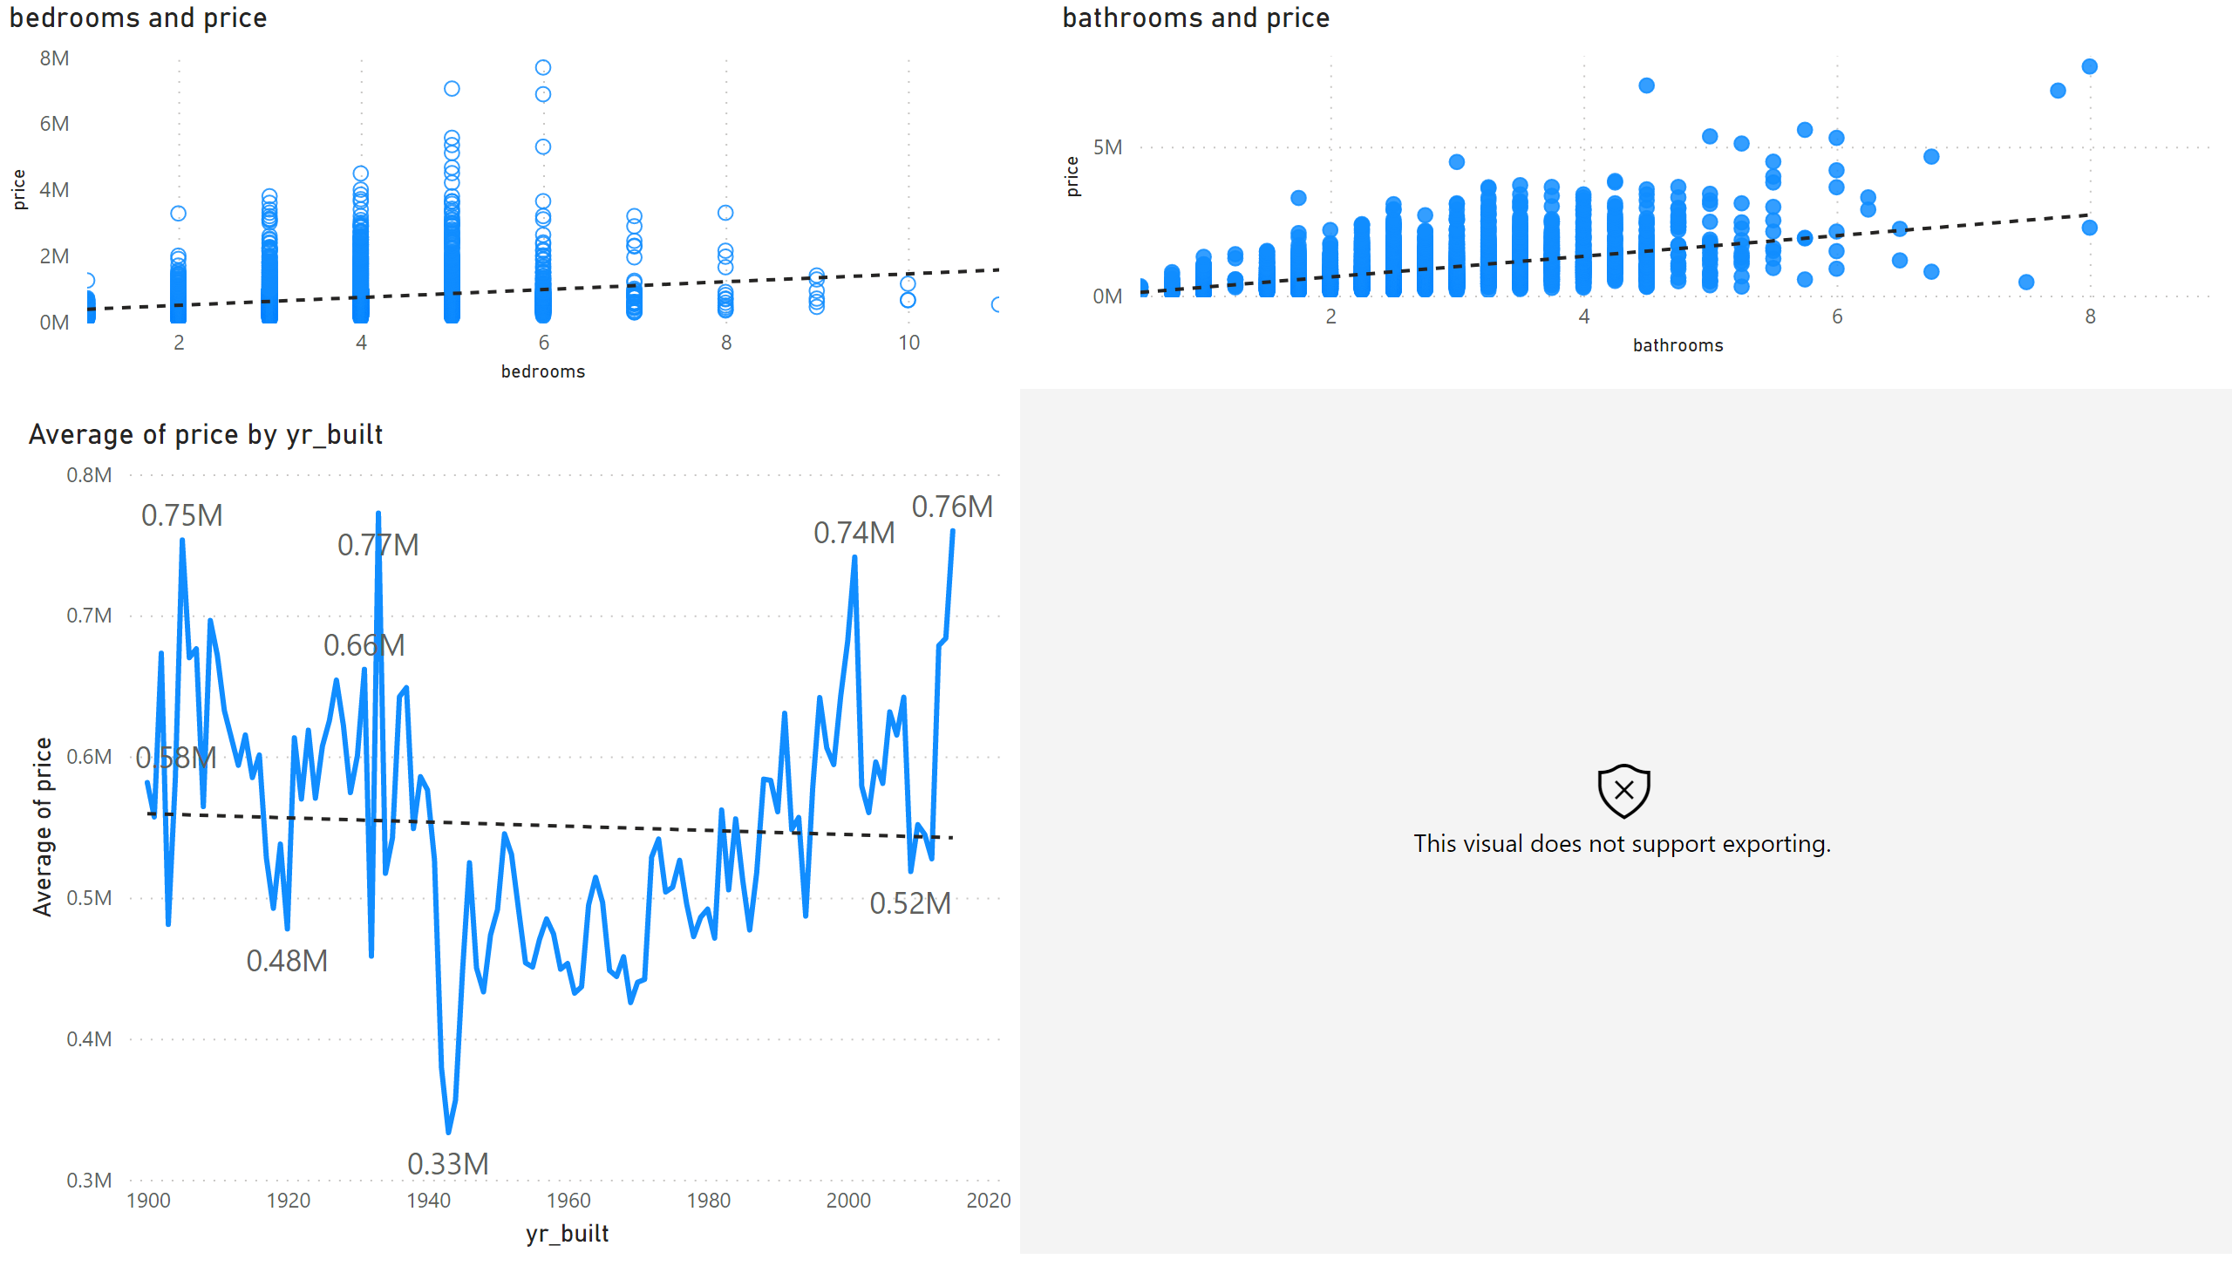
Dashboard
Notes:
esriVisual
No alt text provided
lineChart
No alt text provided
scatterChart
No alt text provided
scatterChart
No alt text provided

