Slide 1



Unit_4_lab_3
View in Power BI
Last data refresh:
2022-03-29 1:27:16 PM UTC
Downloaded at:
2022-03-29 4:58:22 PM UTC

Slide 2
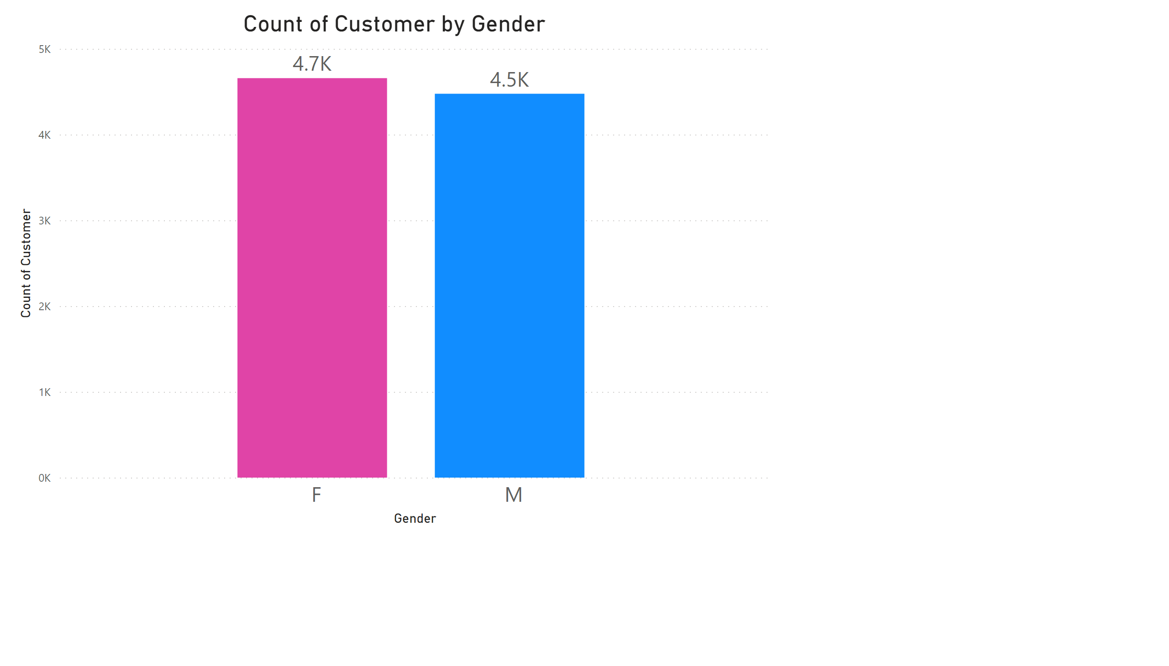
Page 1
Notes:
columnChart
No alt text provided

Slide 3
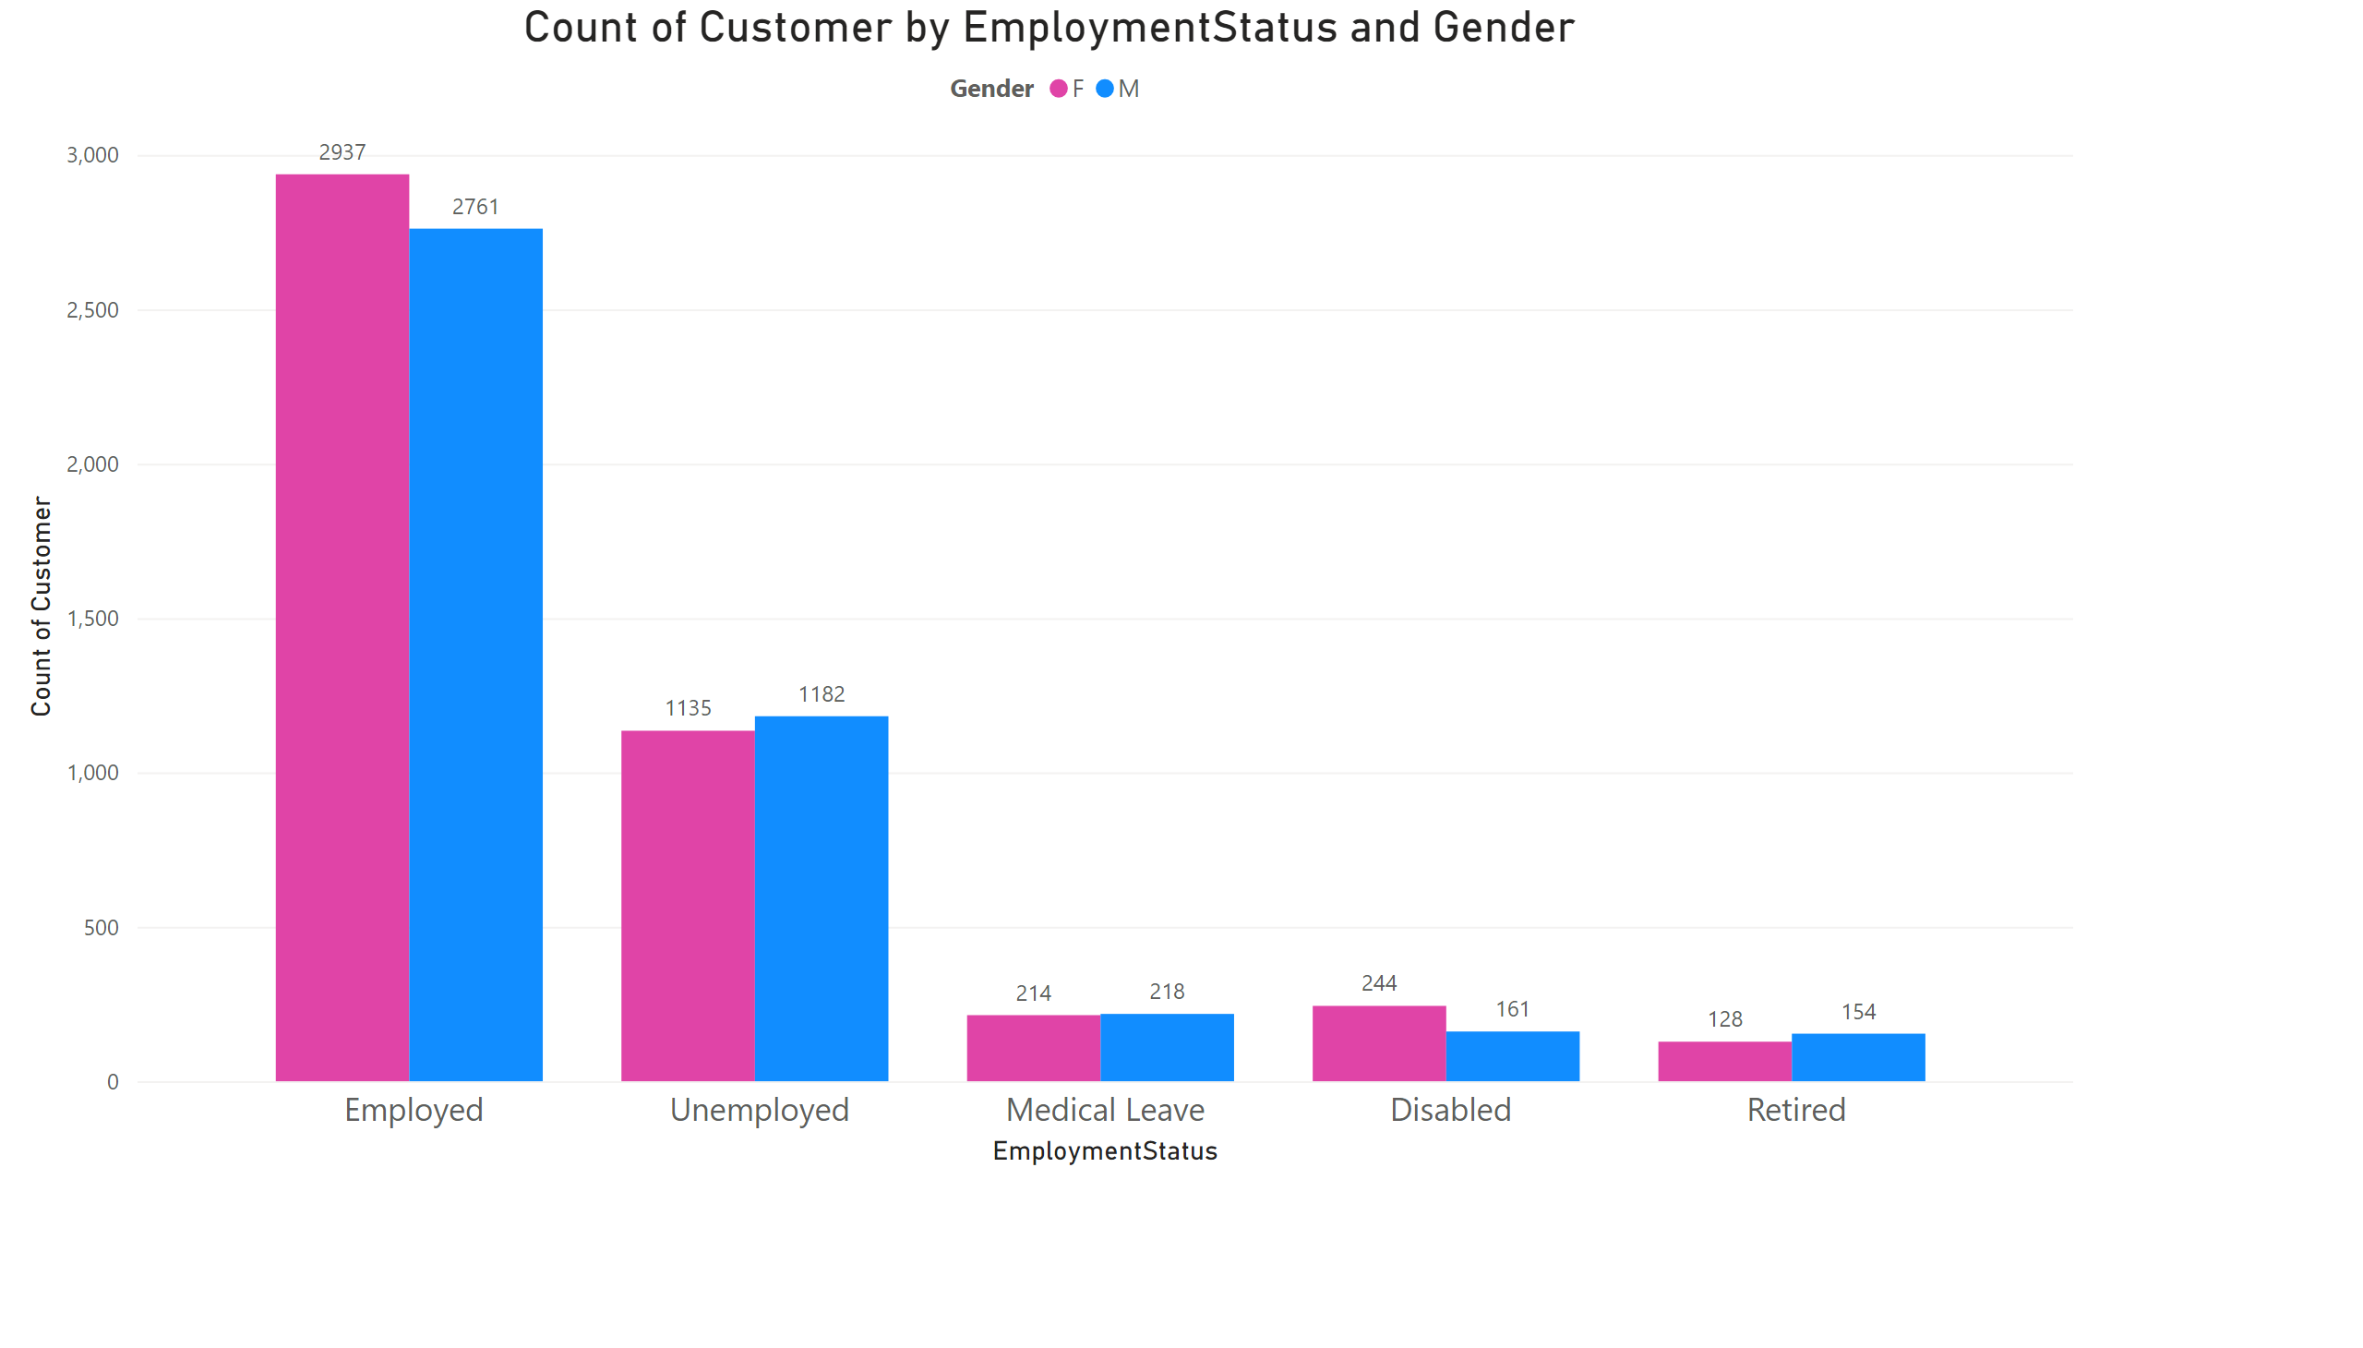
Page 2
Notes:
clusteredColumnChart
No alt text provided

Slide 4
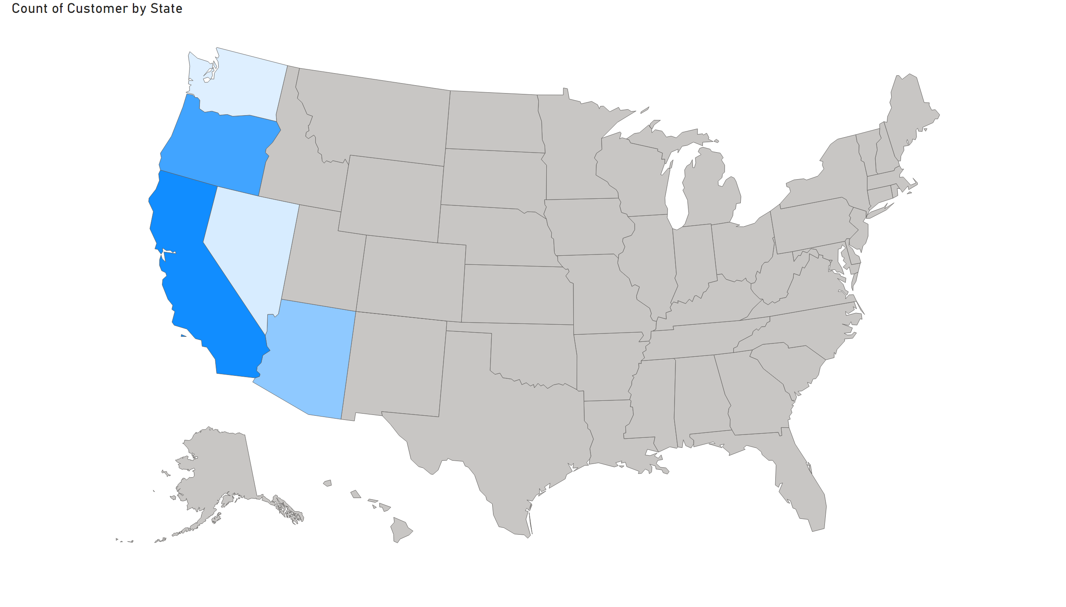
Page 3
Notes:
shapeMap
No alt text provided

Slide 5
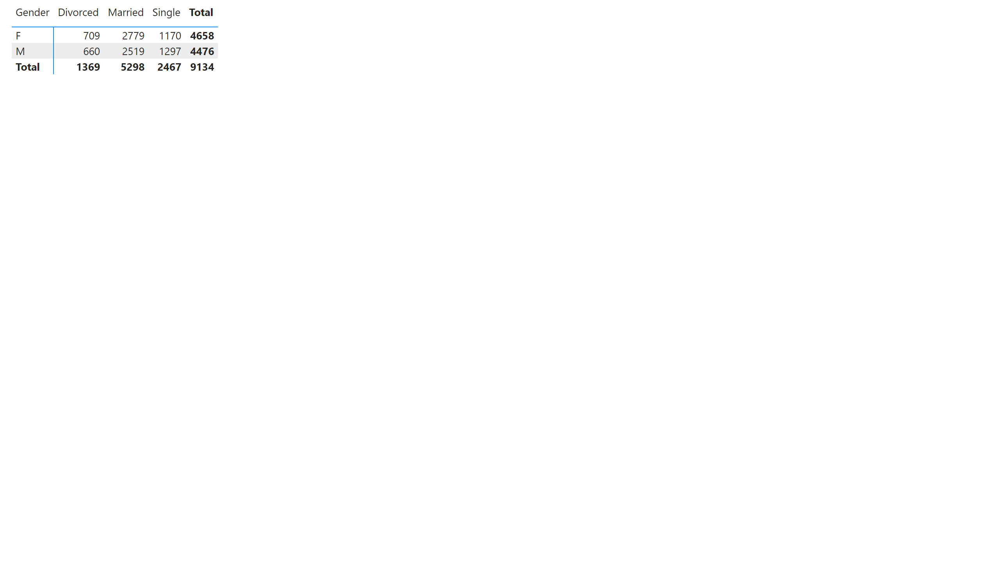
Page 4
Notes:
pivotTable
No alt text provided

Slide 6
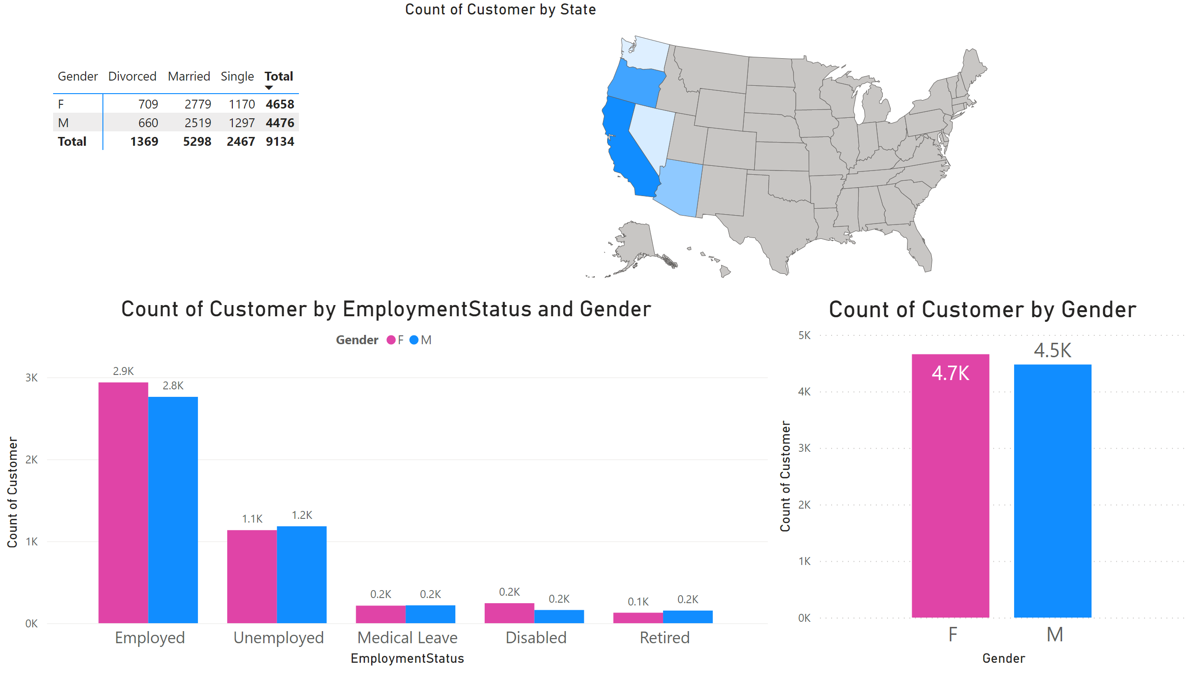
Page 6
Notes:
columnChart
No alt text provided
clusteredColumnChart
No alt text provided
pivotTable
No alt text provided
shapeMap
No alt text provided

Slide 7
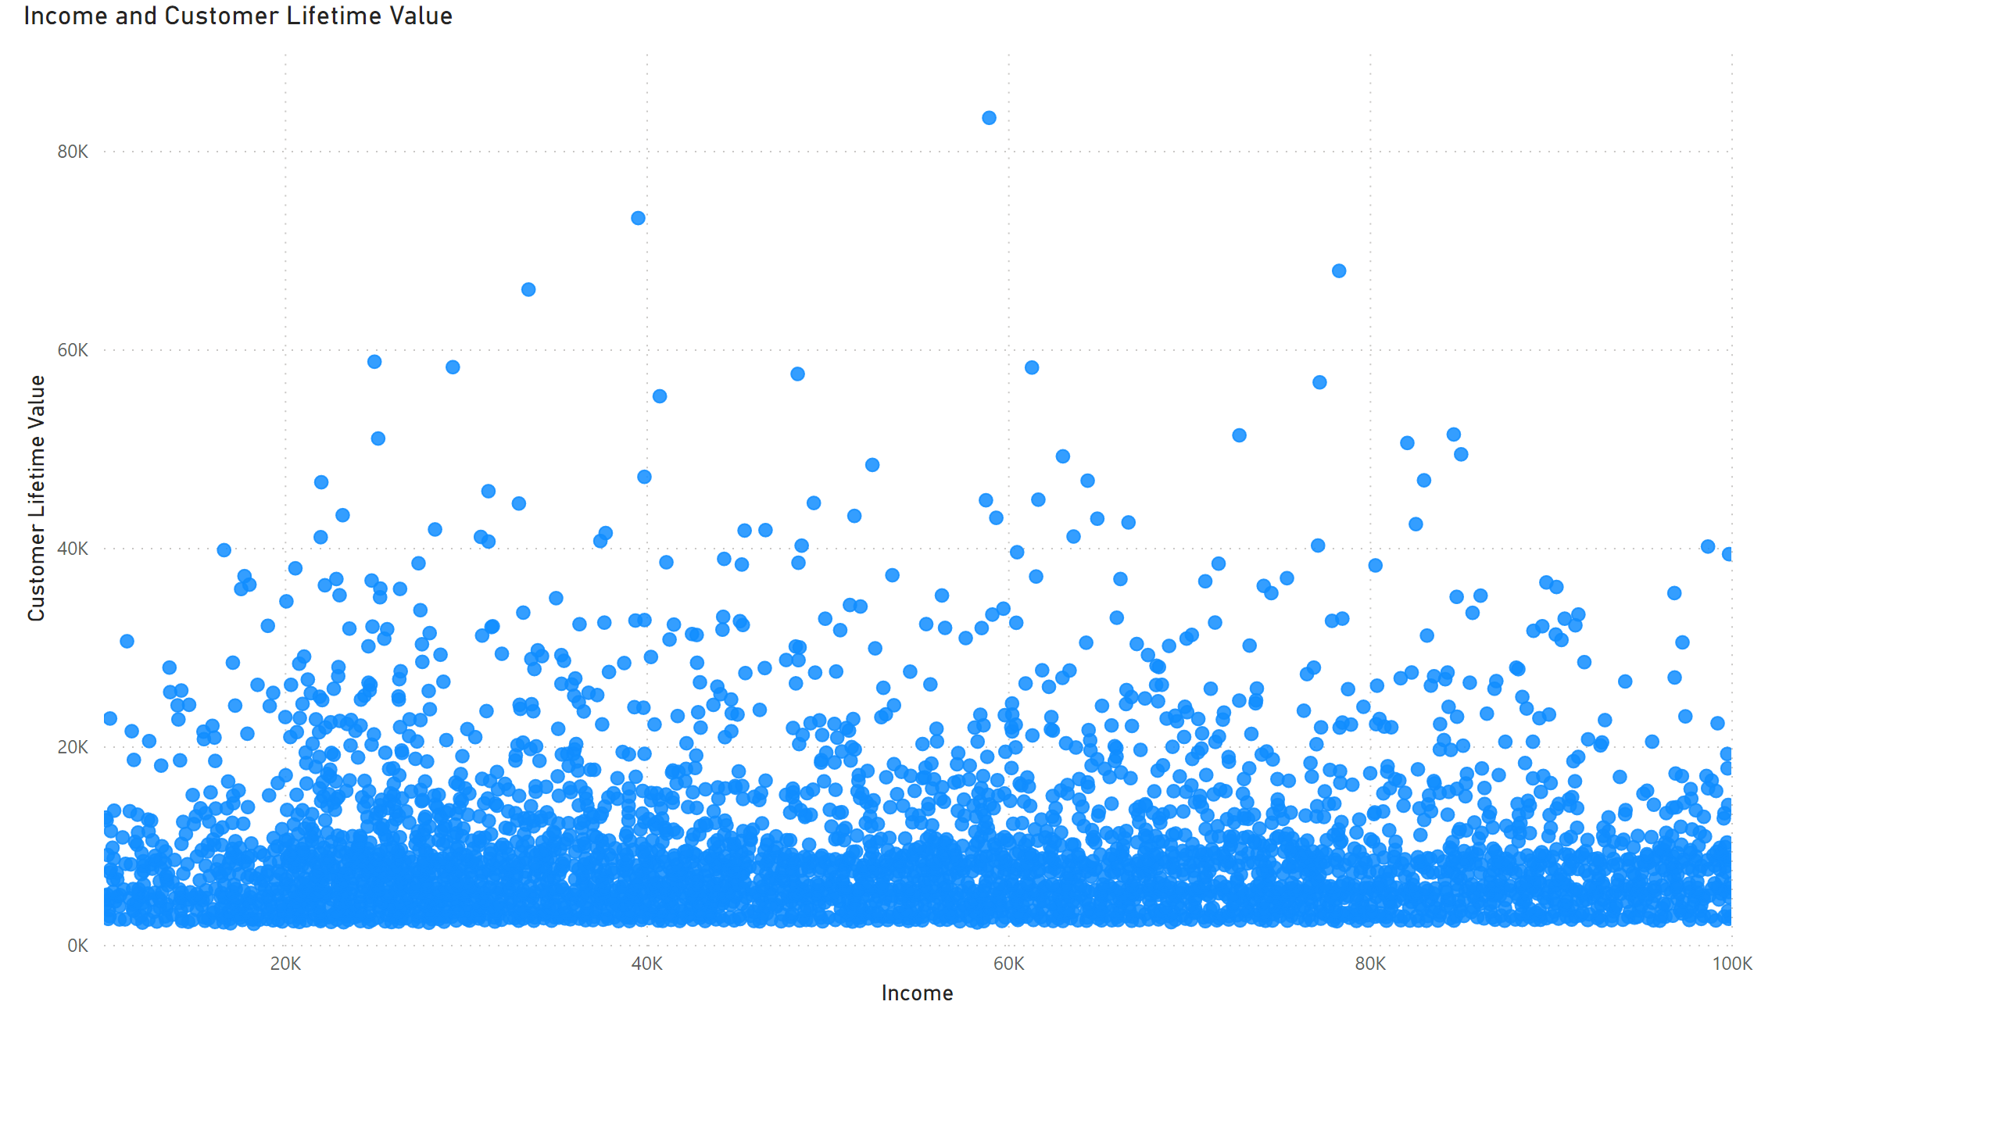
Page 5
Notes:
scatterChart
No alt text provided

Slide 8
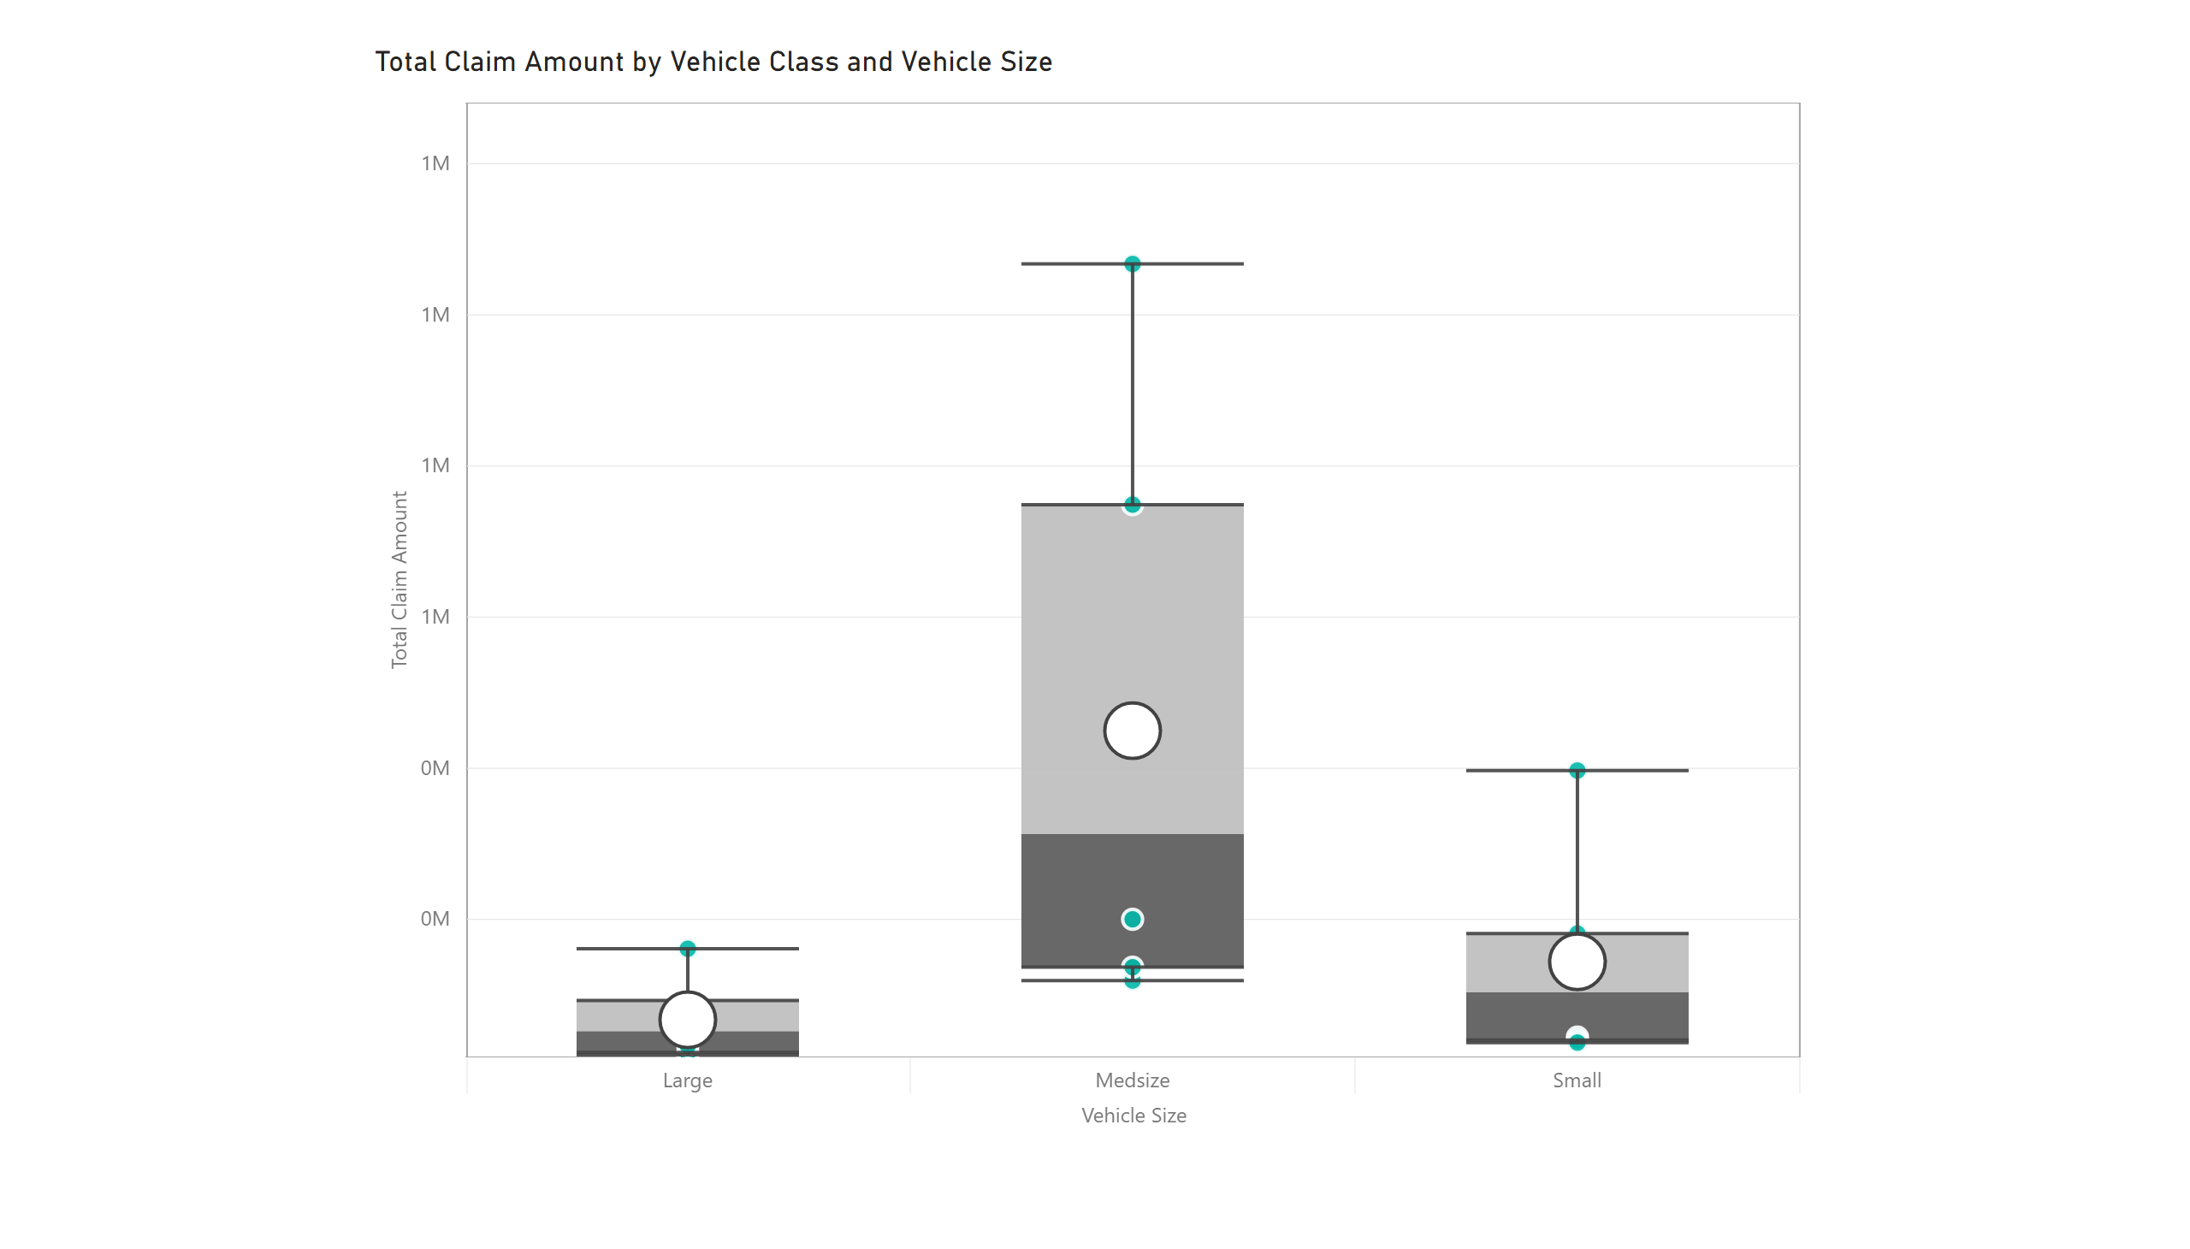
Page 7
Notes:
BoxandWhiskerByMAQ1823AD39DT234AB532063E128AX
No alt text provided

Slide 9
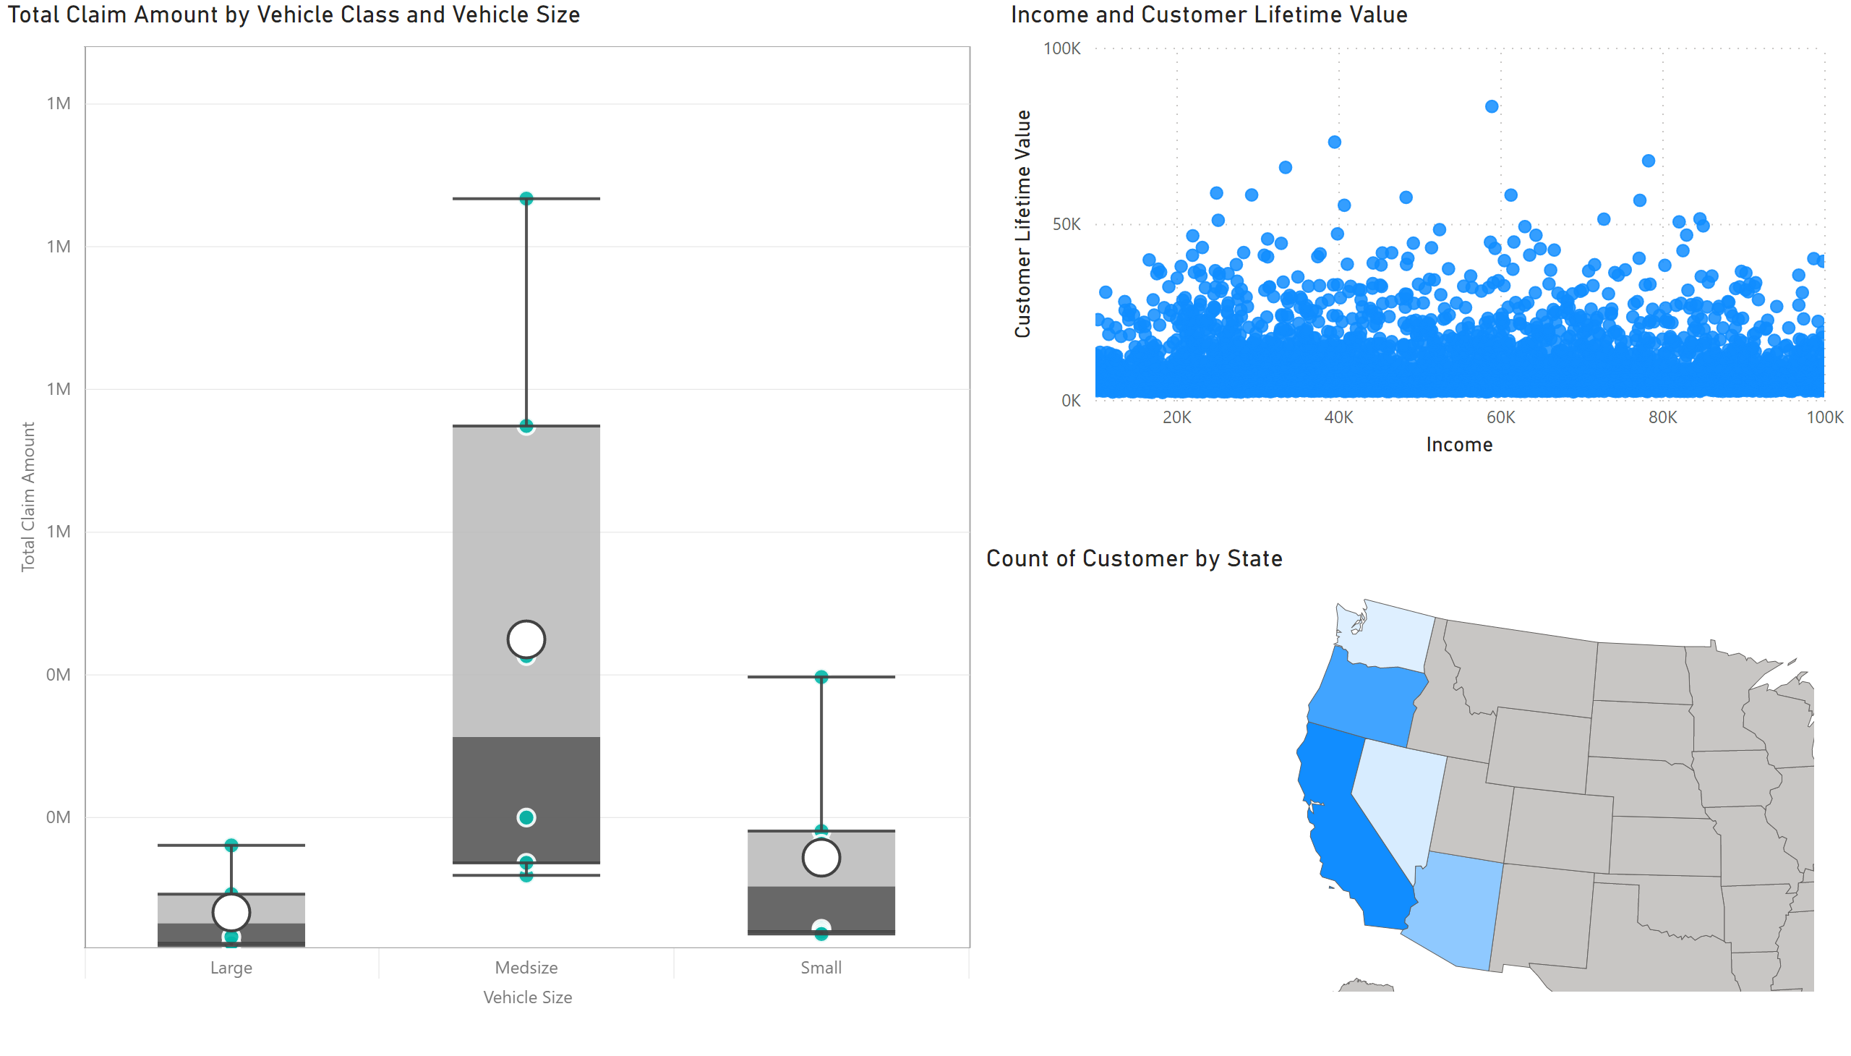
Page 8
Notes:
shapeMap
No alt text provided
scatterChart
No alt text provided
BoxandWhiskerByMAQ1823AD39DT234AB532063E128AX
No alt text provided

