Slide 1



Unit_4_lab
View in Power BI
Last data refresh:
2022-03-24 1:30:34 PM UTC
Downloaded at:
2022-03-25 2:00:22 PM UTC

Slide 2
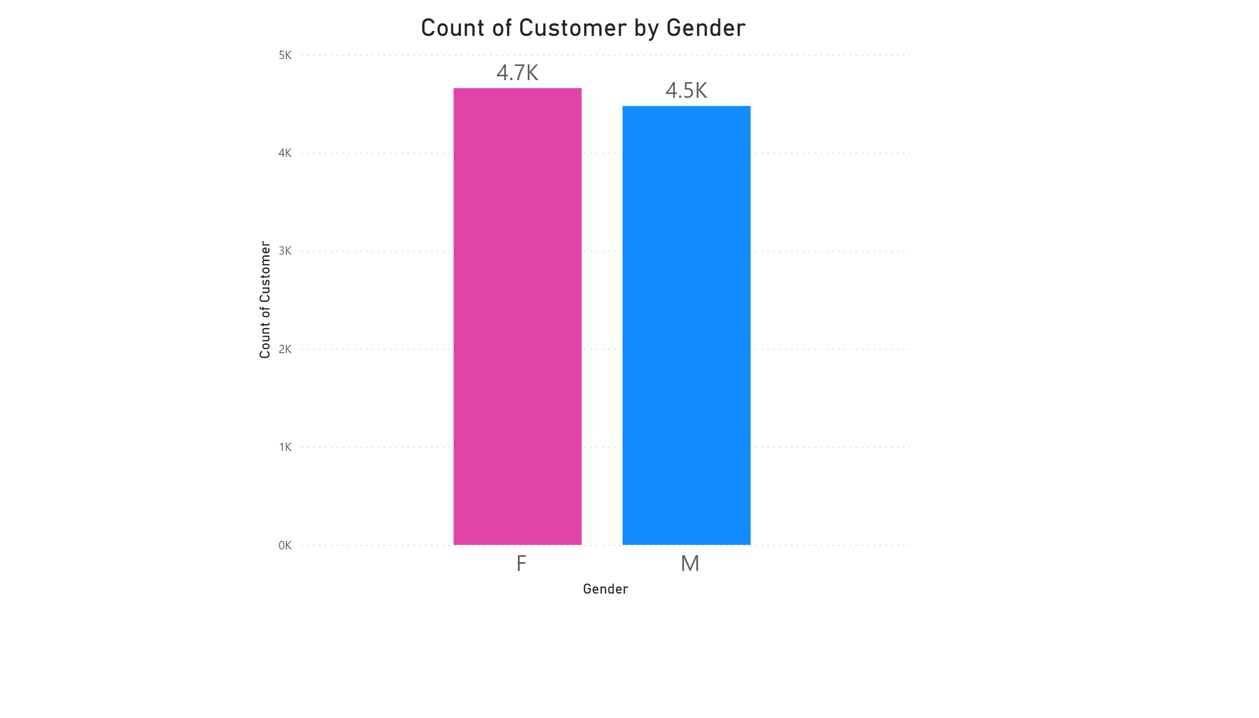
Page 1
Notes:
columnChart
No alt text provided

Slide 3
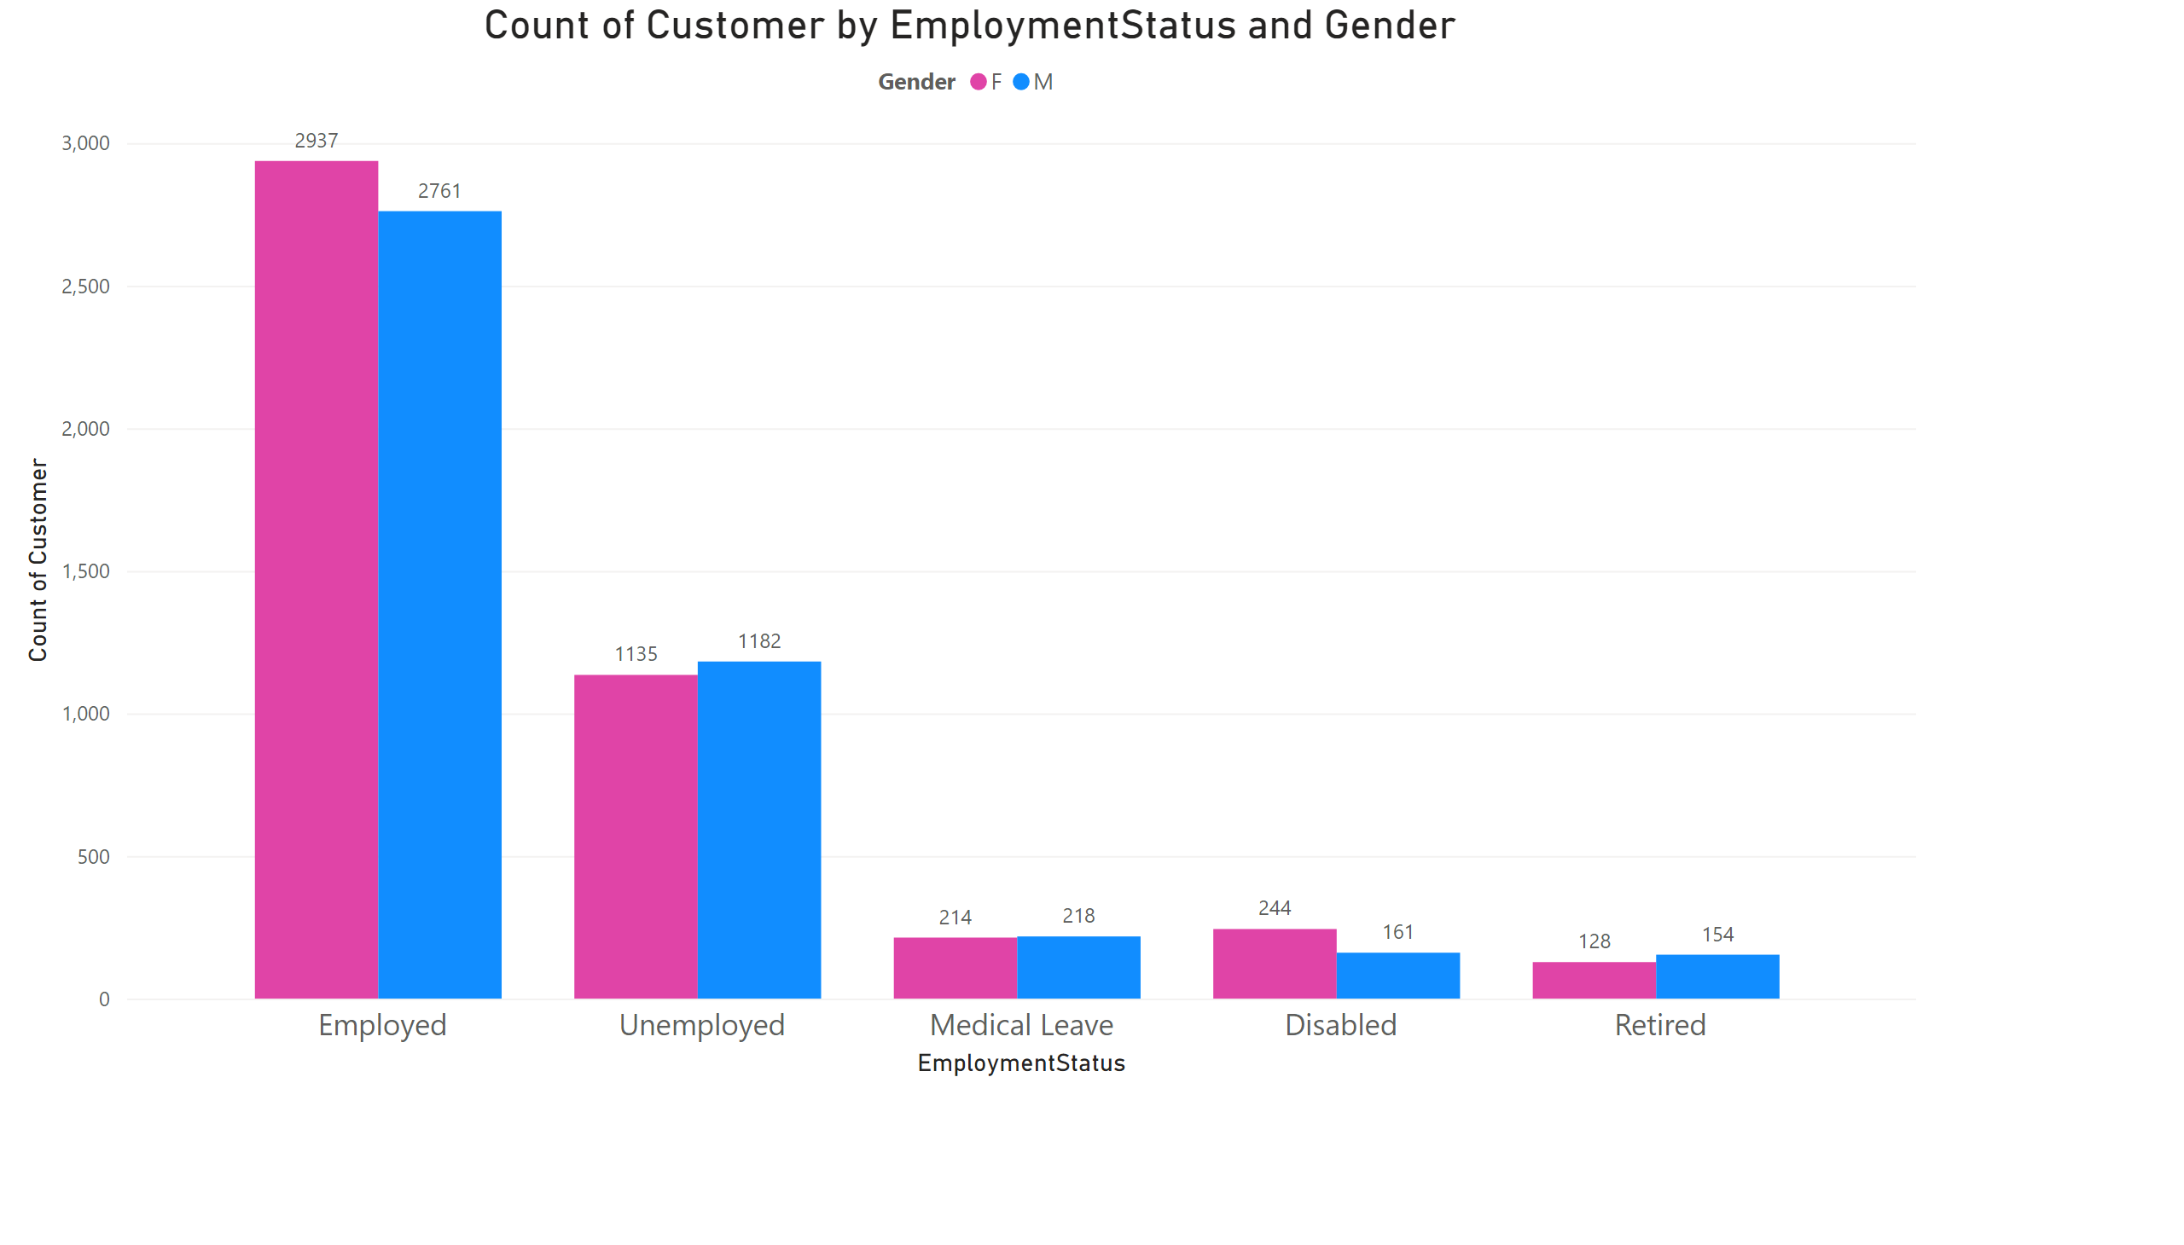
Page 2
Notes:
clusteredColumnChart
No alt text provided

