Slide 1
BALLANZA Andy Cante Clement

Slide 2
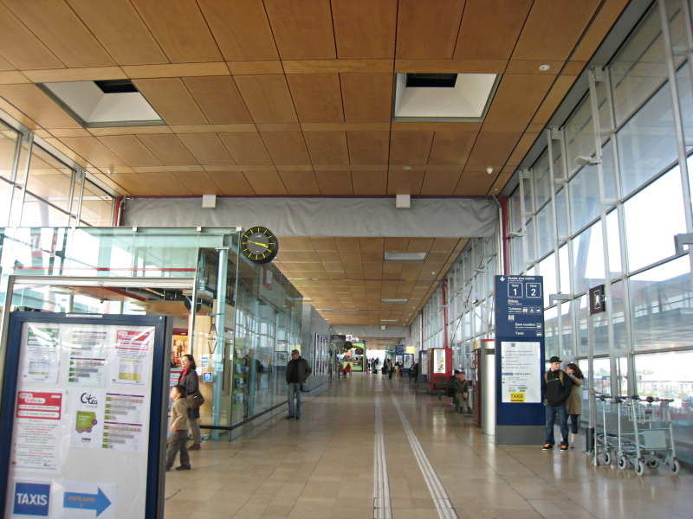
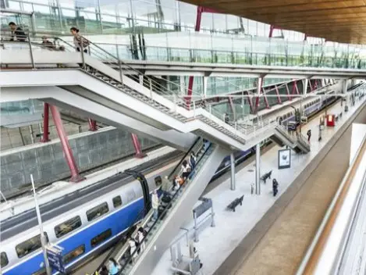
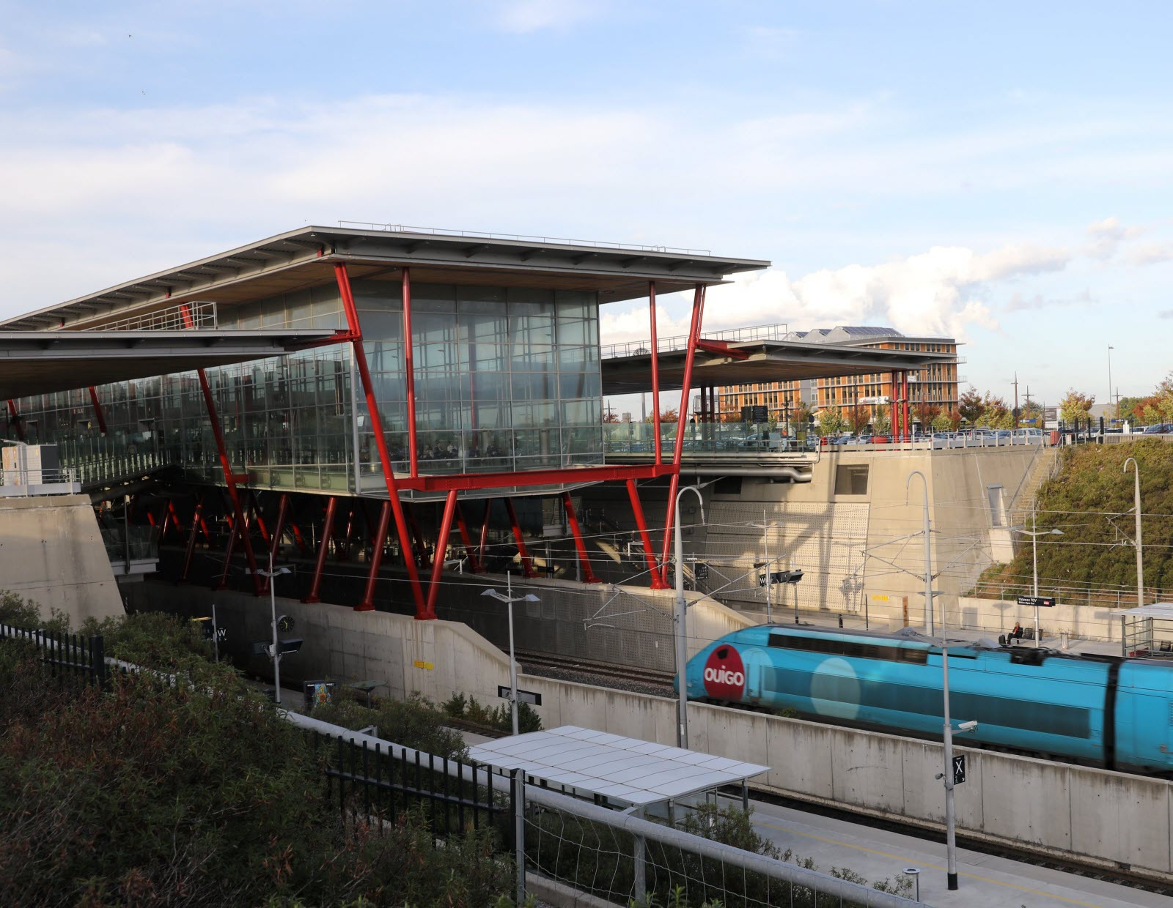
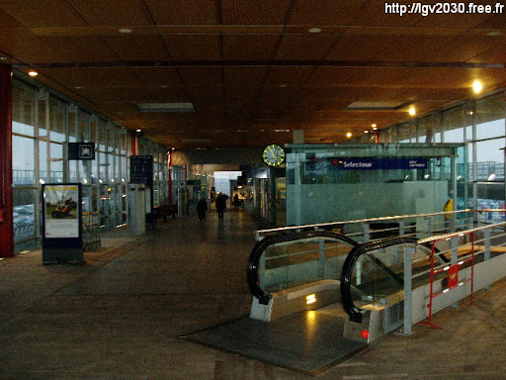
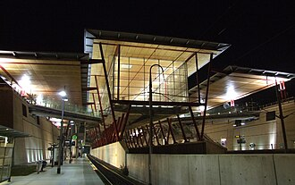

Moodboard

Slide 3
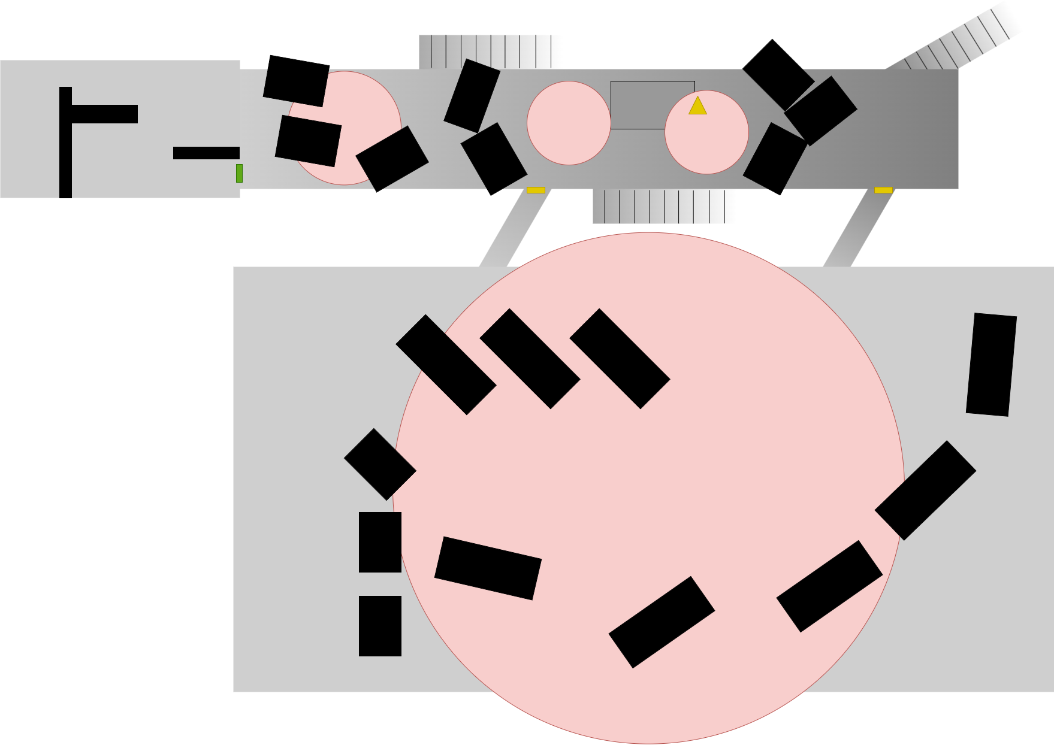
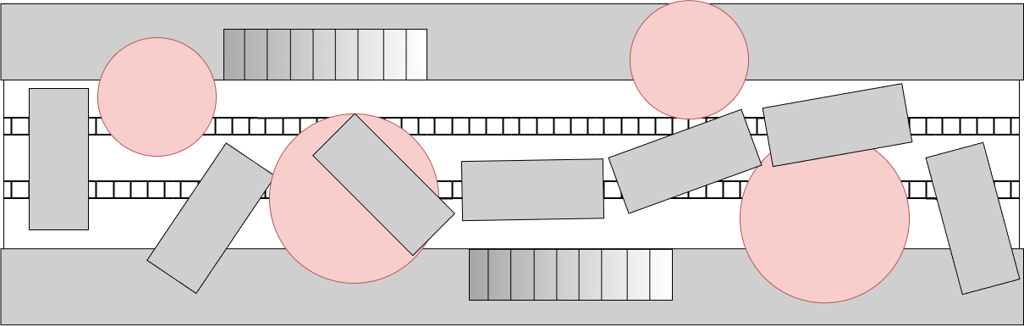
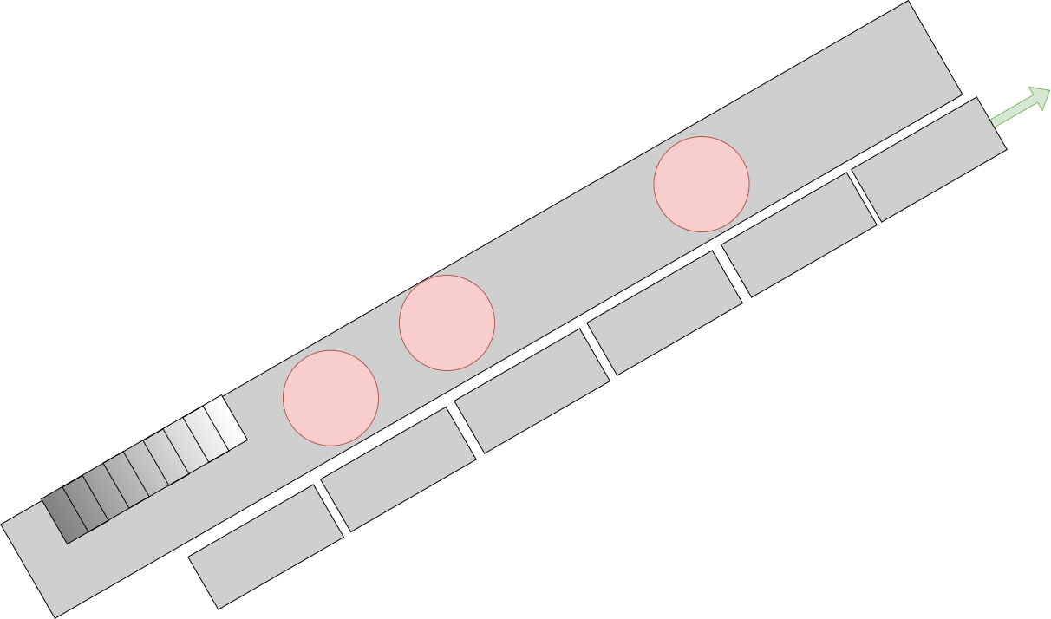
Layout : Global
Office
Shop
Dock
Hall
Parking
Dock

Slide 4
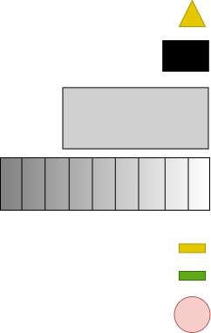
Layout : Ground Floor
To the floor -1
Office
Shop
X
Hall
To the floor -1
X
Spawn
Switch
Blocker
Car
Parking
Esclator
Locked Door (Unlockable)
Open Door
Zombie Zone

Slide 5
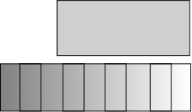
Layout : Floor -1
To the Hall
Dock
To the Hall
Zombie Zone
Car
Esclator

Slide 6
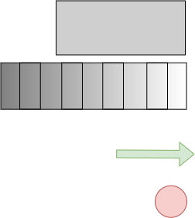
Layout : Floor -2
Dock
To the Hall
Car
Escalator
Exit
Zombie Zone

Slide 7
Step By Step
Step 1 : Start in break room
Step 2 : Enter in the train ttation’s hall
Step 3 : Bypass by the docks downstairs

Slide 8
Step By Step
Step 4 : Go to the other side of the dock
By jumping on crashed cars
By passing through cars riding on the docks
Step 5 : Go back up to the hall

Slide 9
Step By Step
Step 6 : Look for a switch to turn on the power in the station. This affects :
Lights
Doors
Escalators
Step 7 : Go through the parking to go to the floor -2

Slide 10
Step By Step
Step 8 : Look for a train entry
Step 9 : Start up the train and go away

