Slide 1
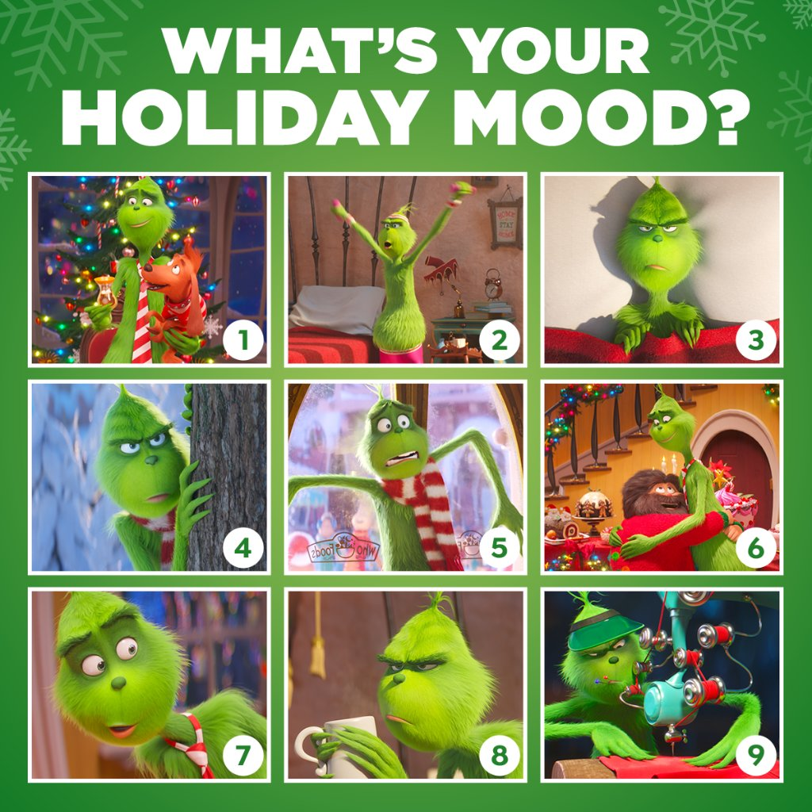

Slide 2
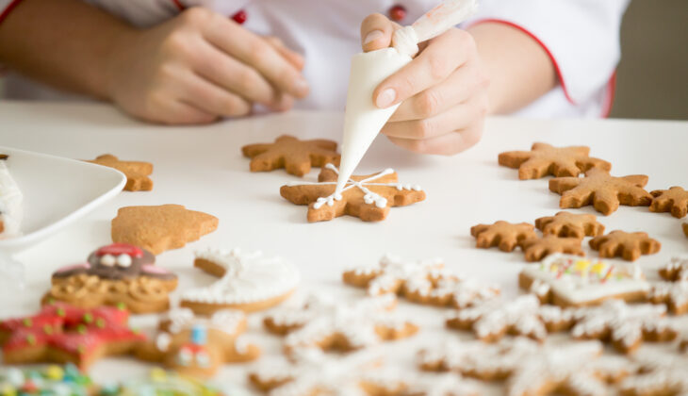
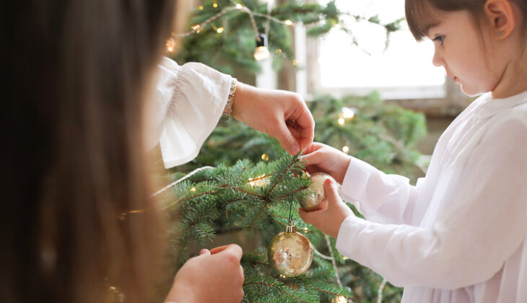
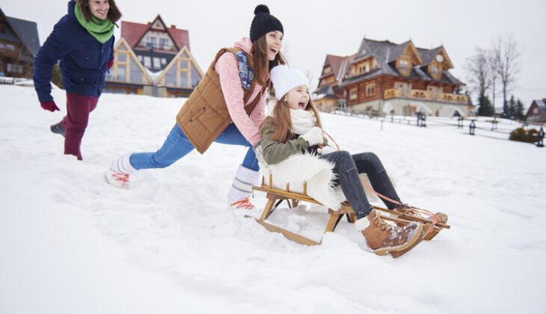
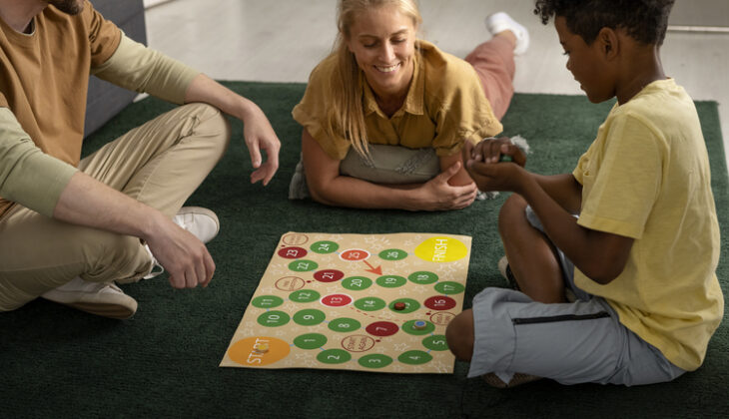
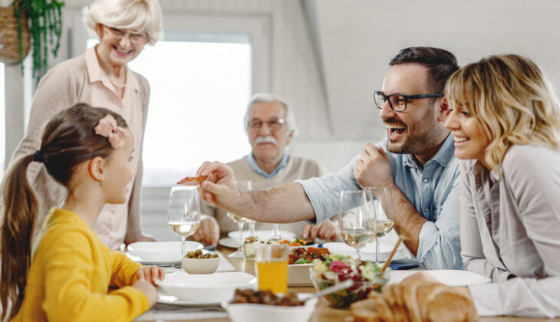

Look at the pictures.
What do you see?

Slide 3
decorate Christmas tree exchange presents bake cookies
play board games
go sledging
have a family dinner

Slide 4
Look and guess what period of time these traditions are from.
cut down the Christmas tree in the forest
play board games with a family
watch Christmas films
have VR activities with a family
decorate the Christmas tree in the forest
bake Christmas cookies for Santa
celebrate Christmas for 12 days
decorate the Christmas tree with candles and fruits
exchange virtual presents
decorate a digital Christmas tree online

