Slide 1


Slide 2


Current Process
Inefficient, Tedious, Vulnerable
Manual Data Input
From Various Sources
Centralized ABC Corp.
Database
Problem
Analysis
Recommendation
Proof of Concept
Pros & Cons
Predictions
Conclusion
Notes:
Quick overview of the problem (what it is)
Manual input of financial transactions from various sources (ABC corp & its subsidiaries) so that one database can contain all the transactions
That database must be stored in a single company’s database during audits etc, which is very space consuming & vulnerable to security risks
Key parts of the problem that needed to be solved
3 essential problems -> inefficient, cumbersome, vulnerable

Slide 3
Changing Perspectives
Interdependent Issues Arising
Performance
Market Share
Long-Term Strategy
Problem
Analysis
Recommendation
Proof of Concept
Pros & Cons
Predictions
Conclusion
Notes:
Forecast related issues & how it indirectly impacts market share & company output / performance
Affects Performance / Output: Consumes human labour & time, thus reduces company output and efficiency. Sacrificing innovation is an opportunity cost, as these resources can be reallocated to other projects that can push the company forward
Affects Market Share: majority of companies of this size have adapted blockchain & its benefits means ABC corp will fall behind the competition due to wasting resources
Affects Business Strategy: Cloud storage & IoT are predicted to be disrupted by blockchain which will directly affect ABC corp & its subsidiaries. Automation has been a long term trend & manual labour in technological industries does not align with company vision & strategy

Slide 4
Utilizing Available Data
One Platform, Different Sources
Transaction Sheet
Operating Structure
Problem
Analysis
Recommendation
Proof of Concept
Pros & Cons
Predictions
Conclusion
Notes:
Given data: previous financial transactions & operating structure of the company -> make use of both!
Linked data: extract previous data into the blockchain platform using excel, and allow for easy input of future data by taking into account the structure, and using language features to aggregate data

Slide 5
Data Preparation
Reaching a Solution Through Data Transformation
Append Previous
Data Using Excel
Leverage Framework
That Cleanses Data
Use Language Features
to Aggregate Data
Problem
Analysis
Recommendation
Proof of Concept
Pros & Cons
Predictions
Conclusion
Notes:
Data cleanup:
Aggregating: used Java features to structure the subsidiaries, employees, people etc. and use nodes that contain the information given
Appending: the extracted previous data is appended to future data within the blockchain
Filtering: when extracting data from transaction sheet, we will filter & add each transaction to its specific structure (eg. if it’s a payroll transaction, create an employee structure/add to it)
Deduping: duplicate IDs will not be included - this feature is implemented in the hyperledger framework
DQS Cleansing transformation uses Data Quality Services (DQS) to correct data from a connected data source, by applying approved rules that were created for the connected data source or a similar data source.
Future feature -> create a knowledge base, implement DQS to cleanse data

Slide 6
Recommendation
A Solution that Goes Beyond the Needed Criteria
Automation
Accuracy
Hyperledger
Composer
Platform
Problem
Analysis
Recommendation
Proof of Concept
Pros & Cons
Predictions
Conclusion

Slide 7
Systems of Trust
Explorers: 100% Expect Blockchain Supports Enterprise Strategy
63
61
57
56
56
51
51
Increase Transactional Transparency
Ensure Data Quality and Accuracy
Increase Trust
in Transaction Reliability
Improve
Security
Against Fraud
Increase Transaction Speed
Reduce Transaction Costs
Simplify
Business Processes
Problem
Analysis
Recommendation
Proof of Concept
Pros & Cons
Predictions
Conclusion
Notes:
At its core, blockchain is a shared ledger that allows participants in a business network to transact assets where everyone has control, but no one person is in control.” Leanne Kemp, Chief Executive Officer and Founder, Everledger, United Kingdom
Those who are currently implementing blockchain into their enterprise, i.e. explorers, find that Blockchain technology best supports their enterprise by creating more trust, transparency in both data and transactions Explorers: Those who are implementing blockchain Investigators: Those who are considering blockchain Passives: Not considering blockchain
Blockchains help build trust in several ways. The transparency of transactions establishes a traceable audit trail.
Smart contracts can encode the commitments between parties and help ensure they’re kept.

Slide 8
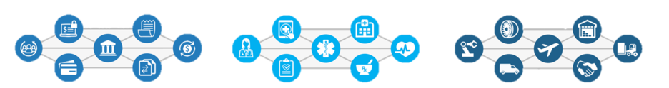
Shared Ledger Database
Secure Interaction Between Multiple Parties
Finance
Streamlined settlement,
improved liquidity, increased
transparency and new
products/markets
Healthcare
Unite disparate processes,
increase data flow and liquidity,
reduce costs and improve patient experience and outcomes
Supply Chain
Track parts and service
provenance, ensure authenticity
of goods, block counterfeits,
reduce conflicts
Problem
Analysis
Recommendation
Proof of Concept
Pros & Cons
Predictions
Conclusion

Slide 9
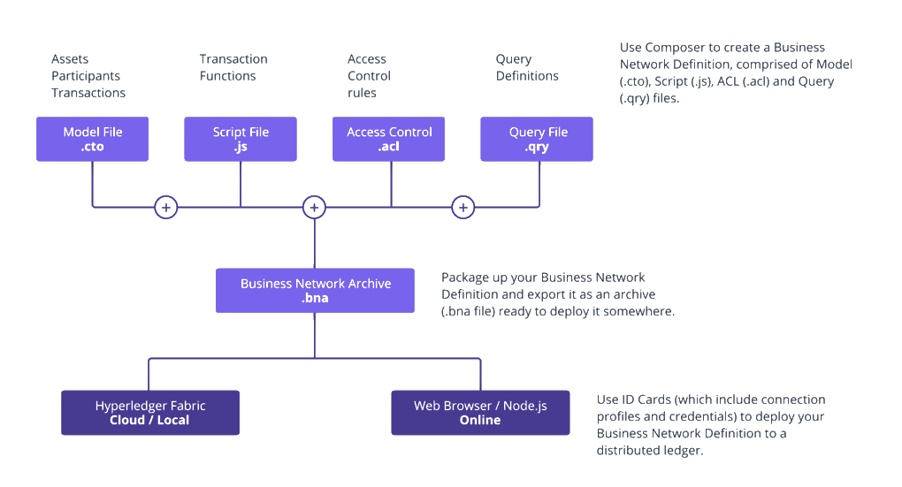
Hyperledger Composer Simplified
Data Integration and POC Platform
Problem
Analysis
Recommendation
Proof of Concept
Pros & Cons
Predictions
Conclusion
Notes:
The hyperledger composer is in essence a blockchain platform which allows for simpler and more cohesive programs. It allows for the quick creation of blockchain applications for a variety of industries, datasets and data types

Slide 10
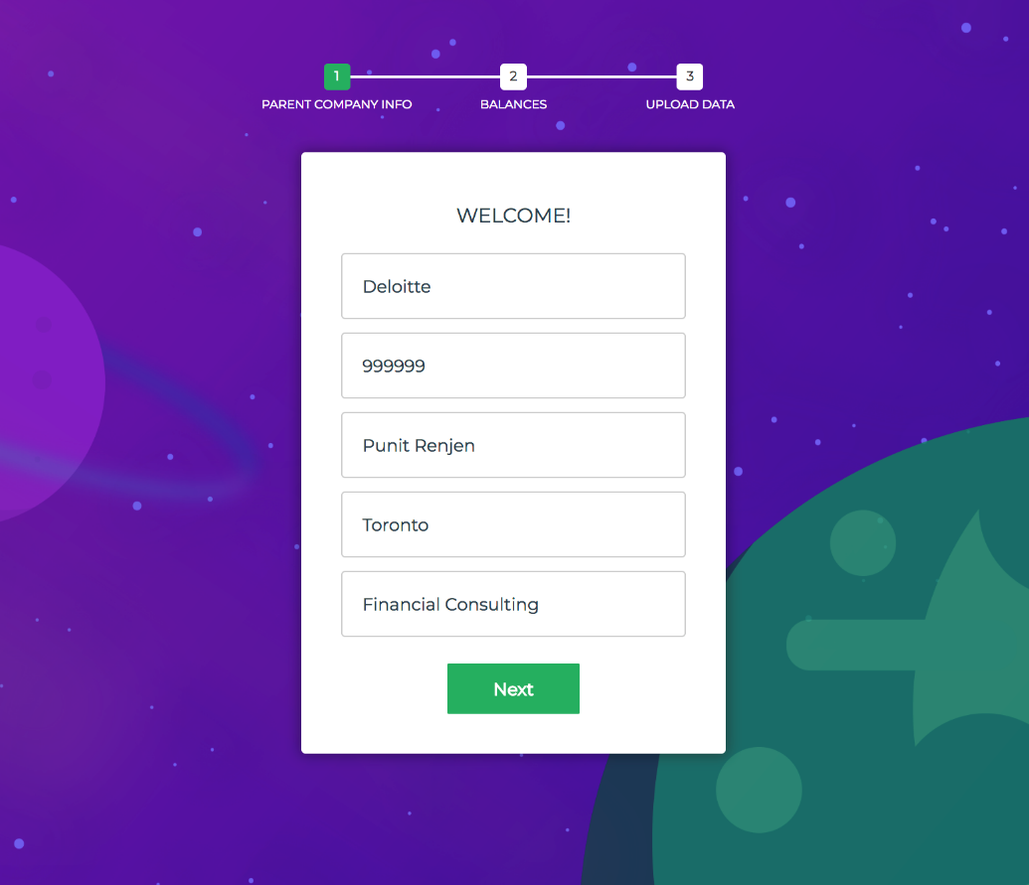
Proof Of Concept: Step 1
Summarizing the Approach
Setup Company Identity on the Blockchain
Problem
Analysis
Recommendation
Proof of Concept
Pros & Cons
Predictions
Conclusion
Notes:
Input company name, Company ID, CEO, Location, and Industry
This step adds all the employees, subsidiaries and their accounts and established them on the blockchain by uploading an excel file of the company’s information.
This is followed by uploading current balances which can be uploaded via an excel sheet

Slide 11
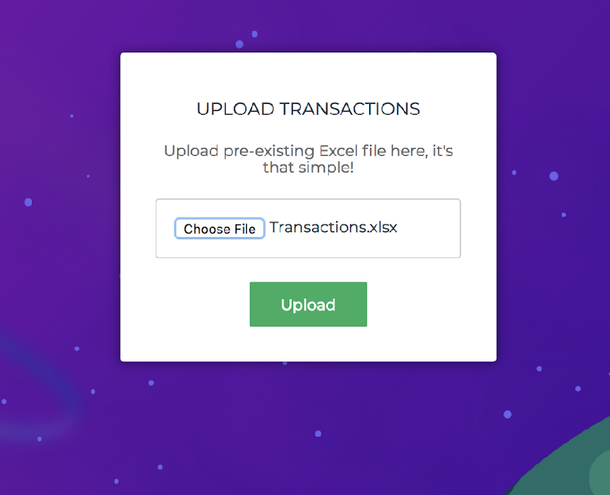
Proof Of Concept: Step 2
Summarizing the Approach
Upload Previous Transaction Records
Problem
Analysis
Recommendation
Proof of Concept
Pros & Cons
Predictions
Conclusion
Notes:
Upload an excel file of the transactions which will then get processed onto the blockchain.
This not only adds the transaction info but also accounts for the changes made in the balances of the employees and companies that are transacting amongst each other.

Slide 12
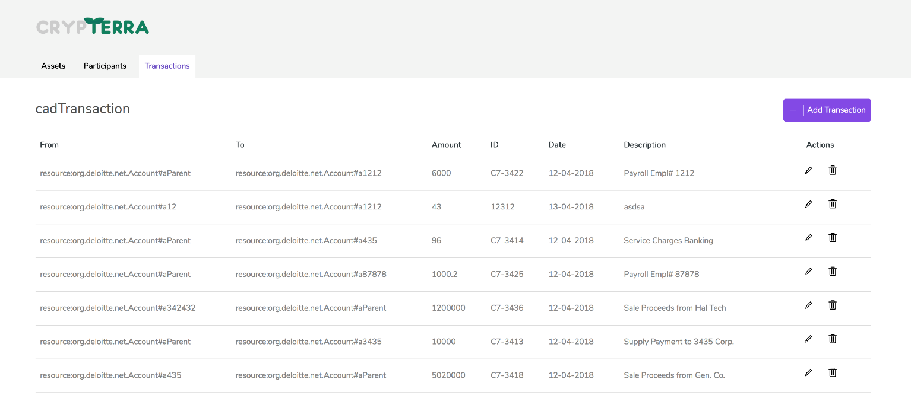
Proof Of Concept: Step 3
Summarizing the Approach
Visualize and Transact on the Blockchain
Problem
Analysis
Recommendation
Proof of Concept
Pros & Cons
Predictions
Conclusion
Notes:
Easily conduct transactions by:
Entering the account of the entity that is being sent from
Entering the account that is being sent to
a description of the transaction
Show live demo

Slide 13

Proof Of Concept
Demonstrating the Framework
Live Demo
Problem
Analysis
Recommendation
Proof of Concept
Pros & Cons
Predictions
Conclusion
Notes:
Demo:
Input the ABC company’s identification info
Upload their employee and subsidiary info in the form of an excel sheet.
Upload the transactions excel worksheet (2 minute delay to process all the transactions)
Show a visualization of the blockchain

Slide 14
Why Hyperledger Composer?
Pros & Cons
Enterprise
Based
Open Source
Enhanced Privacy
Problem
Analysis
Recommendation
Proof of Concept
Pros & Cons
Predictions
Conclusion

Slide 15
Forecasted Outcome
Consistent, Valuable and Positive Growth
Abstraction
Abstraction
200 Subsidiaries
Uniform Framework
Loss Aversion
Loss Aversion
Accountability
Duplicate Data
Security Breaches
Accountability
Transparency
Global Access
Problem
Analysis
Recommendation
Proof of Concept
Pros & Cons
Predictions
Conclusion

Slide 16
Streamlining Data Organization
Meet Present Needs, Innovate Future Solutions
Decentralized
Secure
Convenient
Problem
Analysis
Recommendation
Proof of Concept
Pros & Cons
Predictions
Conclusion
Notes:
Visualize and transact on the blockchain

Slide 17
“
Good to Great.
”
Problem
Analysis
Recommendation
Proof of Concept
Pros & Cons
Next Steps
Conclusion

