Slide 1
Peak Potential
CUSTOMER RESEARCH PRESENTATION

Slide 2
OVERVIEW OF THE PROBLEM
Many gym beginners struggle to maintain a consistent exercise routine due to challenges such as balancing study or work commitments, lacking confidence in their ability to exercise correctly, and not having access to tools that make fitness simple, efficient, and personally rewarding. Specific issues may include:
Difficulty in balancing fitness and life priorities results in inconsistent discipline
Hard to create simple and meaningful workout plans by themselves
Lack of means to see measurable progress or performance improvements
Fear of not knowing how to exercise correctly, or being judged for their ability or appearance

Slide 3
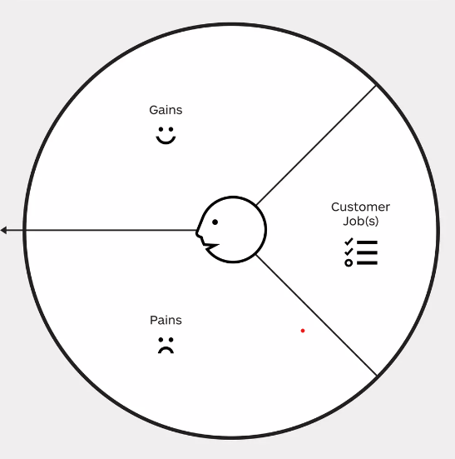
VALUE PROPOSITION CANVAS (JOBS, GAINS AND PAINS)
RANKING BY IMPORTANCE/ACUTENESS
Pains
Lack of discipline
It is difficult to log gym data and see results
Work/school gets in the way of the workout
Gains
Gamification interface to increase discipline
Visible progress and achievements
Community challenges to increase motivation
Jobs
Encourage and motivate the user to stay discipline in their gym journey
Track progress in the most simple way
Leverage on the community to avoid gaps in the workout
Create a simple gym routine

Slide 4
Peak Potential
Design and Copyright by: Strategyzer AG (https://www.strategyzer.com/). PowerPoint implementation by: Neos Chronos Limited (https://neoschronos.com). PowerPoint implementation License: CC BY-SA 3.0

Slide 5
UNIQUE INSIGHTS GAINED FROM INTERVIEWS
COMPLEMENTARY INSIGHTS OF THE INITIAL “JOBS, PAINS AND GAINS”
Early-stage users prefer guidance rather than total independence
“In the beginning, I like to exercise with someone more knowledgeable than me”
Users want fitness integrated seamlessly into their existing daily routine
“I wanna stay healthy, but I don’t want fitness to dominate my life”
Users value collaboration over solitary activities
“It’s easier to stay consistent with a friend”
Users are motivated by visible progress but dislike manual effort, i.e. convenience is key
“I wanna see my progress, but I’m lazy about logging my data”

Slide 6
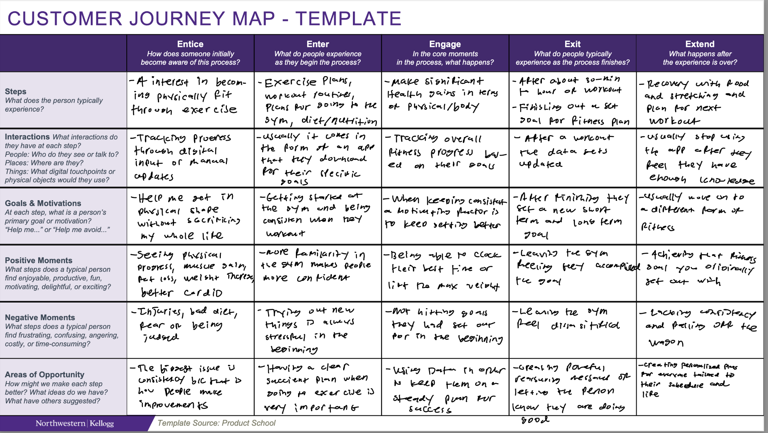

Slide 7
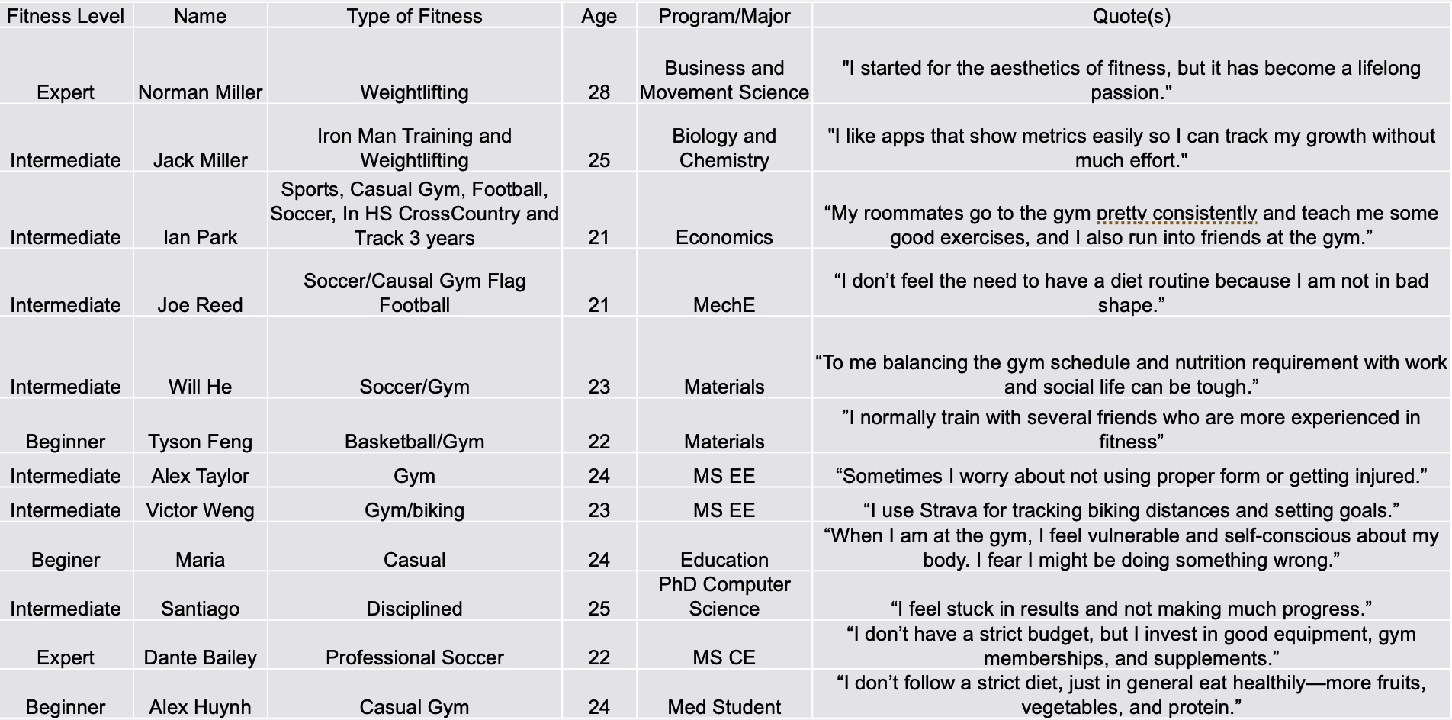
USER INTERVIEW PROFILES

Slide 8

USER PERSONA
IAN
Wants & Needs
He wants to stay consistent in going to the gym
He wants to track his progress
He doesn't want to get too big, he just wants to stay healthy
He wants friends who will hold him accountable for going to the gym
Frustrations
When he gets busy he stops going to the gym.
He has taken breaks from the gym that have lasted months
21
Economics in NU
Gym: 3 times per week
“I wanna stay healthy, but I don't want fitness to dominate my life"

Slide 9





Fitness Apps
Habit Trackers
Peak
Potential

Slide 10
Backup Slides

