Slide 1
Peak Potential
NORTH STAR METRIC

Slide 2
NORTH STAR METRIC
Our Top 5-6 Features | Things we can measure and at what frequency/unit | Our North Star Metric
Exercise (Dictionary) | Number of Searches | Number of Gym Entries Logged
Memories (Photo) | Number of Photos taken
Notifications | Number of Interactions with Notifications
Exercise Routine Creation | Number of Personalized Routines Created
Progress Tracking | Number of Entries
Daily Fitness Quotes | Engagement with Quotes (Likes, shares, etc)

Slide 3
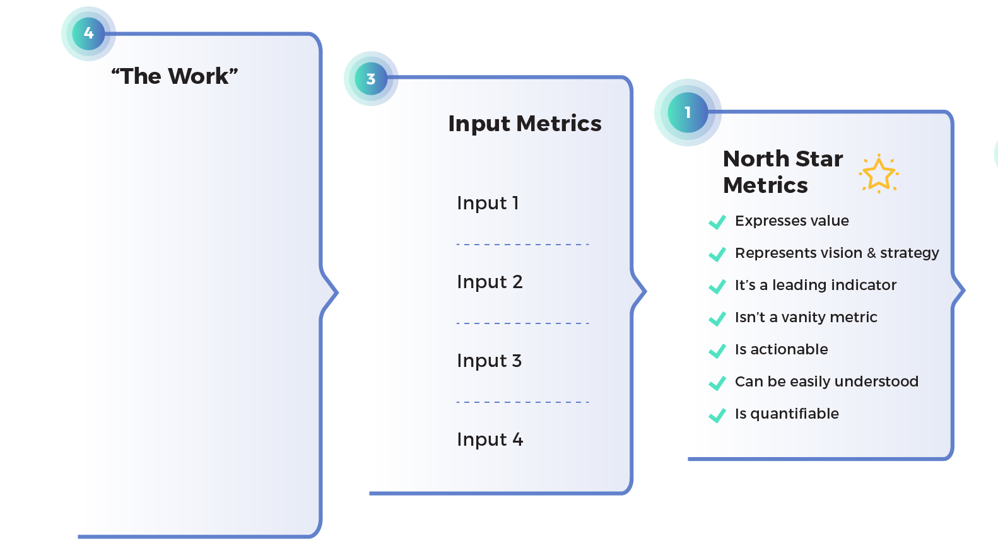
NORTH STAR METRIC – FOR REFERENCE
Product Initiatives / Features

Slide 4
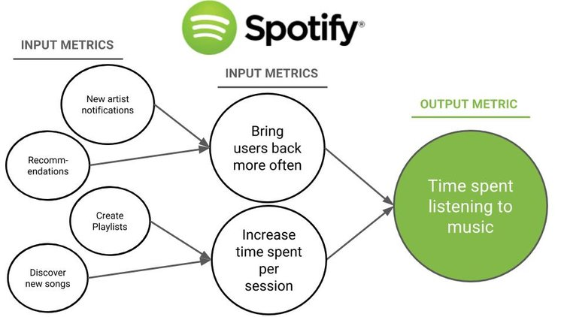
NORTH STAR METRIC – FOR REFERENCE

