Slide 1
Peak Potential
Wireframes/Prototypes and Feedbacks

Slide 2
Value Proposition and Competitive Advantage Tested
‘Community’ Prototype – Testing Social Accountability & Gamification
Are users willing to take a photo to keep track and share their gym visits?
Tests whether photo-based accountability increases engagement and consistency.
Assumes users find value in capturing proof of gym attendance (e.g., selfie logging or QR check-ins).
Explores whether users prefer a private-only log or social sharing with friends.
Do users feel motivated when grouped with strangers with similar interests? Or do they just want to log their own progress?
Tests whether leaderboards, friend rankings, and social challenges boost motivation.
Assumes that users prefer peer accountability over solo tracking.
Determines if users engage better with friends or if anonymous competition also works.
‘Exercises’ Prototype – Testing Exercise Guidance & User Preferences
Do users find value in having a list of exercises? Or do they prefer to have a program?
Tests whether users prefer structured workout plans or a searchable fitness dictionary.
Assumes that beginners need guided workouts, while experienced users prefer flexibility.
Explores whether users want AI-based workout suggestions for adaptability.

Slide 3
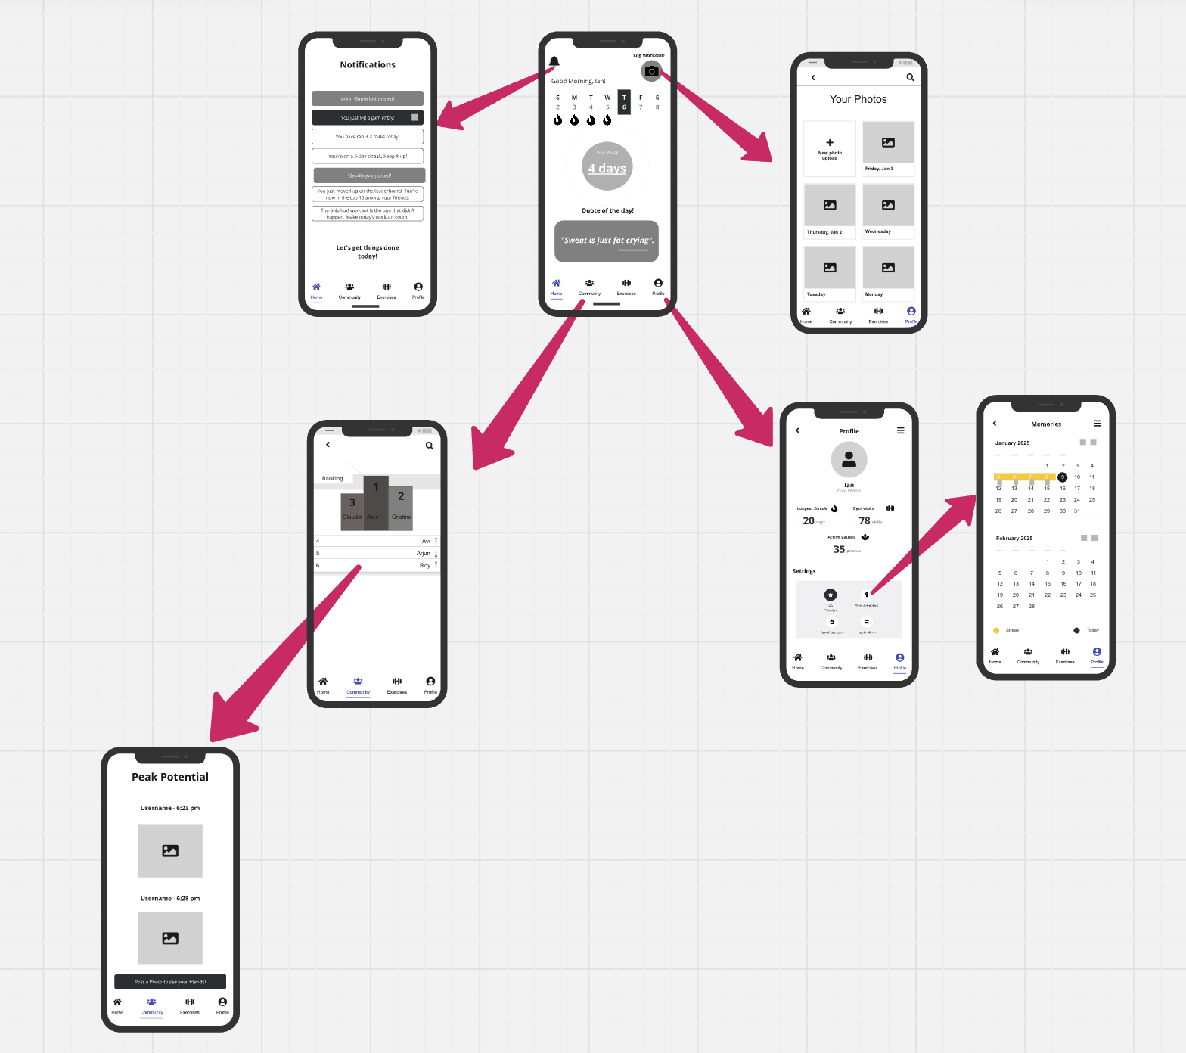
Prototypes/Frameworks – ‘Community’

Slide 4
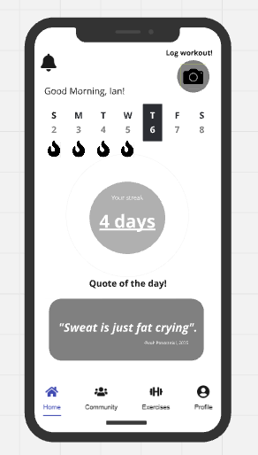
Home screen

Slide 5
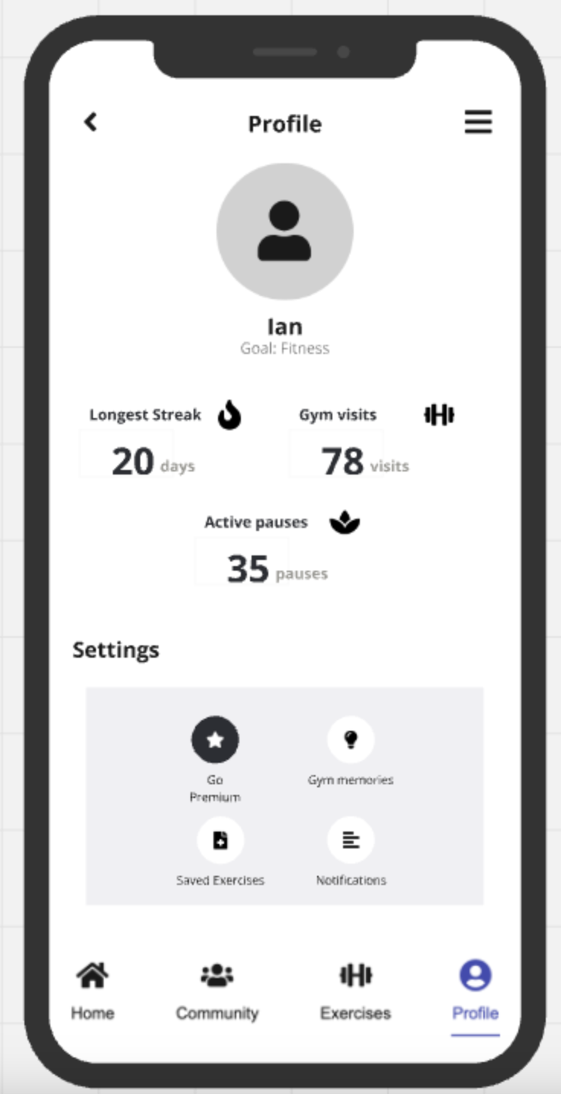
Profile

Slide 6
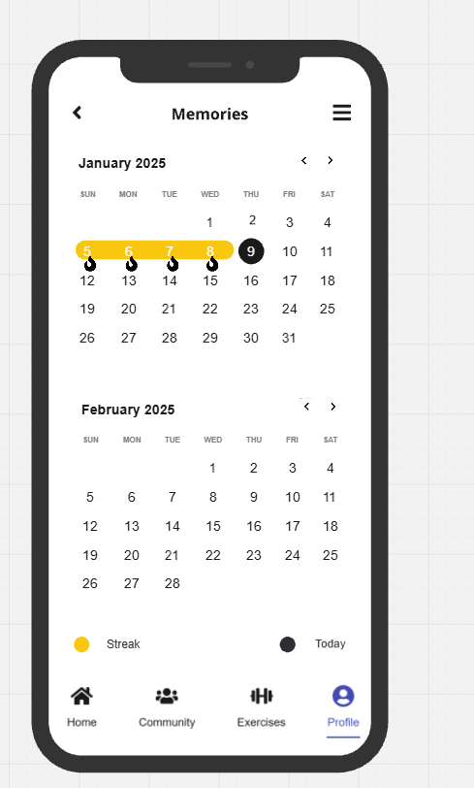
Memories

Slide 7
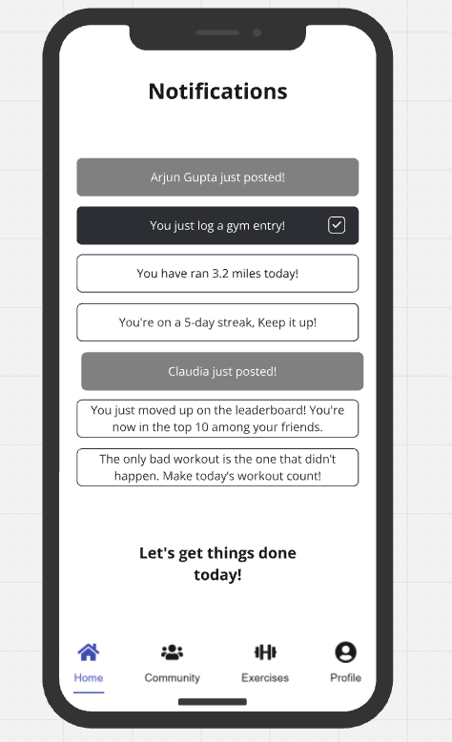
Notification

Slide 8
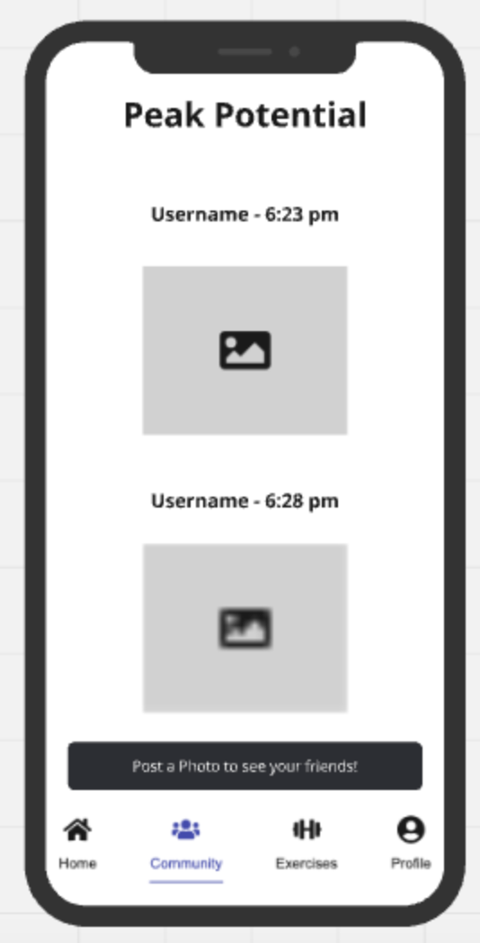
Friend Photos

Slide 9
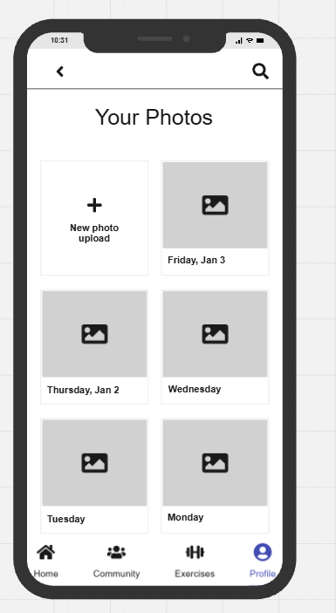
Your Own Photos

Slide 10
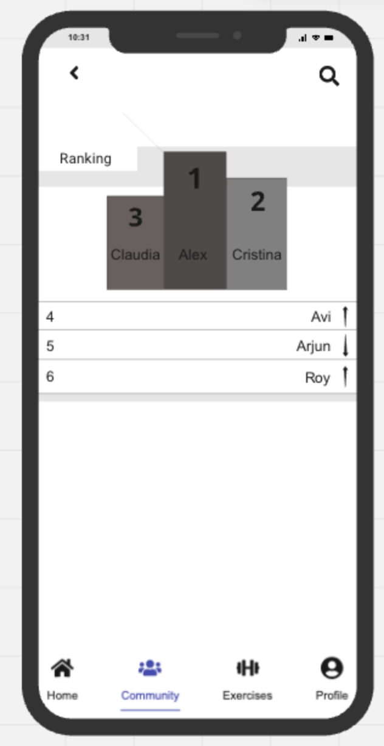
Friends List Ranking

Slide 11
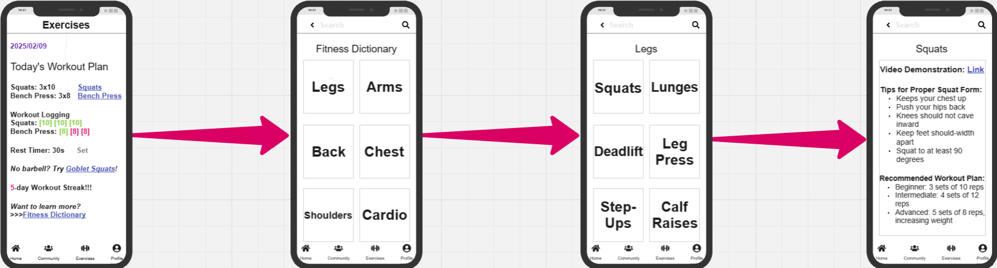
Prototypes/Frameworks – ‘Exercises’

Slide 12
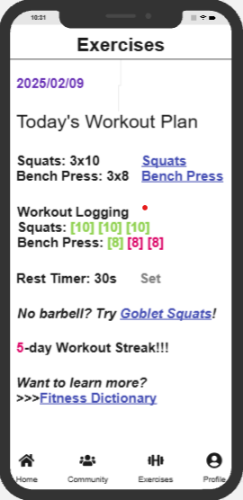
Workout Plan

Slide 13
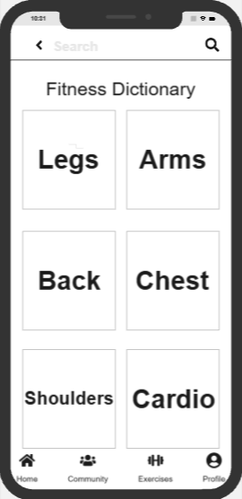
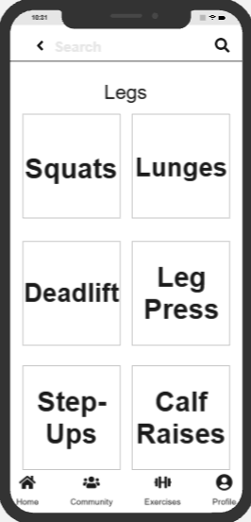
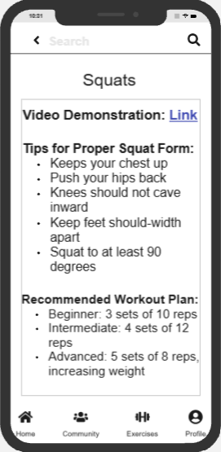
Fitness Dictionary

Slide 14
User Interview Profiles
Name | Fitness Level | Type of Fitness | Age | Program/Major
Chris Xia | Intermediate | Gym/Basketball | 24 | Masters in Materials Science
Allen Chen | Intermediate | Gym/Soccer | 23 | First year working in TSMC
Dhruv Patel | Intermediate | Gym | 22 | Biology Undergrad
Ian Park | Intermediate | Gym/Soccer | 21 | Economics Undergrad
Alex Trong | Beginner | Beginner Gym | 22 | PA School
Jake Mather | Intermediate | Gym/Basketball | 23 | Masters in Mechanical Engineering
Victor | intermediate | Gym/biking | 24 | Master in ECE
John | Beginners | Gym | 23 | Master in biomedical engineering
Eric Ou | Beginner | Gym | 23 | Masters in BioMed
Alekos Jackson | Intermediate | Gym/Soccer | 22 | Masters in Materials Science
Tanya | Begginer | Gym | 25 | MS Information Technology
Ian | Expert | Gym | 27 | -

Slide 15
Feedbacks & Insights
Name | Quote(s) | Unique Insights Gained
Chris Xia | "This is a clean and well-structured tool, but adding video demos, search, and filtering options would make finding exercises faster and more useful." | Implementing a search bar and filtering options (by experience level, equipment, and difficulty) will improve efficiency for regular gym-goers, while video demonstrations will enhance clarity and usability.
Allen Chen | “I I think it would be better to have workout suggestions”, “also a dictionary for home workout would be more helpful for those not going to gyms” | The app should include dictionary of exercises out of the gym and also curated workout suggestions to help casual users build consistency.
Dhruv Patel | "I love the BeReal-style concept, but I’d rather share with friends than random people." | Controlled sharing is key—users prefer social features but need privacy settings
Ian Park | "I like seeing what others post, but I wouldn’t personally take photos every time I go to the gym." | Users may enjoy passive engagement with social features but may not want to actively post.
Alex Trong | "If it felt like a personal trainer in my pocket and not just another random list of exercises." | A structured plan for beginners is needed to make the app more accessible and less overwhelming.
Jake Mather | "A mix of expert guidance and user customization. If it had a ‘coached’ feel, it’d be better than just another exercise list." | Users want quick, expert-backed exercise guides rather than generic fitness content.
Victor | "Tracking workouts is great, but I want more customization and faster loading times." | Personalization & speed are crucial—users value efficient progress tracking
John | "Competing with friends is fun, but the social features feel forced. I want an option to track without all the extras." | Social motivation isn’t universal—some users prefer simplicity over engagement-driven features.
Eric Ou | “Video guidance is great for someone like me who doesn’t always know what to do.” | The app should offer easy-to-follow recommendations based on fitness level.
Alekos Jackson | “Features like filtering by equipment and difficulty, plus tracking past exercises, would make it a real game-changer for planning workouts.” | Adding a workout history/logging feature will improve long-term engagement.
Tanya | "I feel self-conscious about my body, so I wouldn't like to post a photo with strangers" | People don't feel comfortable sharing their photo
Ian | "I like being group with people with similar interest but I wouldn't like to show my face in the photos" | Privacy is a key factor

Slide 16
Key Insights - ‘Exercises’
Exercise Search & Filtering Improves Usability
Users want a search bar and filters (by experience level, equipment, and difficulty) for faster access to exercises.
Video Demonstrations Enhance Clarity
Quick exercise demos help users understand movements better than text descriptions.
Workout Suggestions & Structure Are Important
Users prefer a mix of structured workout plans and flexible exercise lists, with beginner-friendly guidance to reduce intimidation.
Home & Gym Workouts Need to Be Included
A dictionary of home workouts and adaptive training suggestions can help casual users stay consistent.

Slide 17
Key Insights - ‘Community’
Customization & Speed Matter
Users value efficient progress tracking, fast loading times, and customized workout history/logging features.
Controlled Social Sharing is Key
Some enjoy leaderboards and friend challenges, but others prefer private tracking over forced social engagement.
Photos
Users don't like the idea of sharing selfies with strangers, especially if they don't feel comfortable with their body. Nevertheless, they would like to have the photos for themselves as an accountability measure.
Users would like to have Before and then after photos that are stored privately.

Slide 18
Evolvement of Prototype - ‘Exercises’
Features added based on the feedbacks:
Video Demonstrations
Users want video tutorials instead of just text-based exercise descriptions
Features to be added in the future based on the feedbacks:
Filtering & Search Improvements
Users want filters based on experience level, equipment, and difficulty
More Customization for Workout Plans
Users prefer personalized workout plans rather than just a list of exercises

Slide 19
Evolvement of Prototype - ‘Community’
Photos:
Photos should be taken but it should be optional to share them with the group
There should be a section about before and after so the user could feel more motivated to keep going to the gym
Community:
The user at the onboarding should have the following options:
Personal Tracking → no community aspect
Community challenges
With Friends
With Strangers with similar interest
Features to be added in the future based on the feedbacks:

Slide 20
How the Feedbacks Impact Assumptions about Value Proposition and Customer Segments
Users do understand the concept of fitness accountability app and find it valuable. Nevertheless, they want to have the flexibility regarding these factors:
Community motivation → Some users don't find this valuable and want to use only the tracking feature. Give them the possibility to opt-out.
Photo sharing → Most user don't feel comfortable sharing their photos with strangers.
Workout Guidance & Video Demonstrations → Users want quick, expert-backed exercise tutorials and would prefer short video demonstrations rather than just text-based instructions.
Customization & Filtering in Exercise List → Users need filtering options based on difficulty, equipment availability, and muscle group to quickly find relevant exercises.

Slide 21
Backup Slides

